Slide 1
Benefits of TIR for the New Silk Roads
Shanghai, 25 March 2015
Cédric Oelhafen
Head – Project Management Office

Slide 2



Meet the IRU
Mission
We uphold the interests of truck, bus, coach and taxi operators to ensure economic growth and prosperity via the sustainable mobility of people and goods by road worldwide.

Slide 3
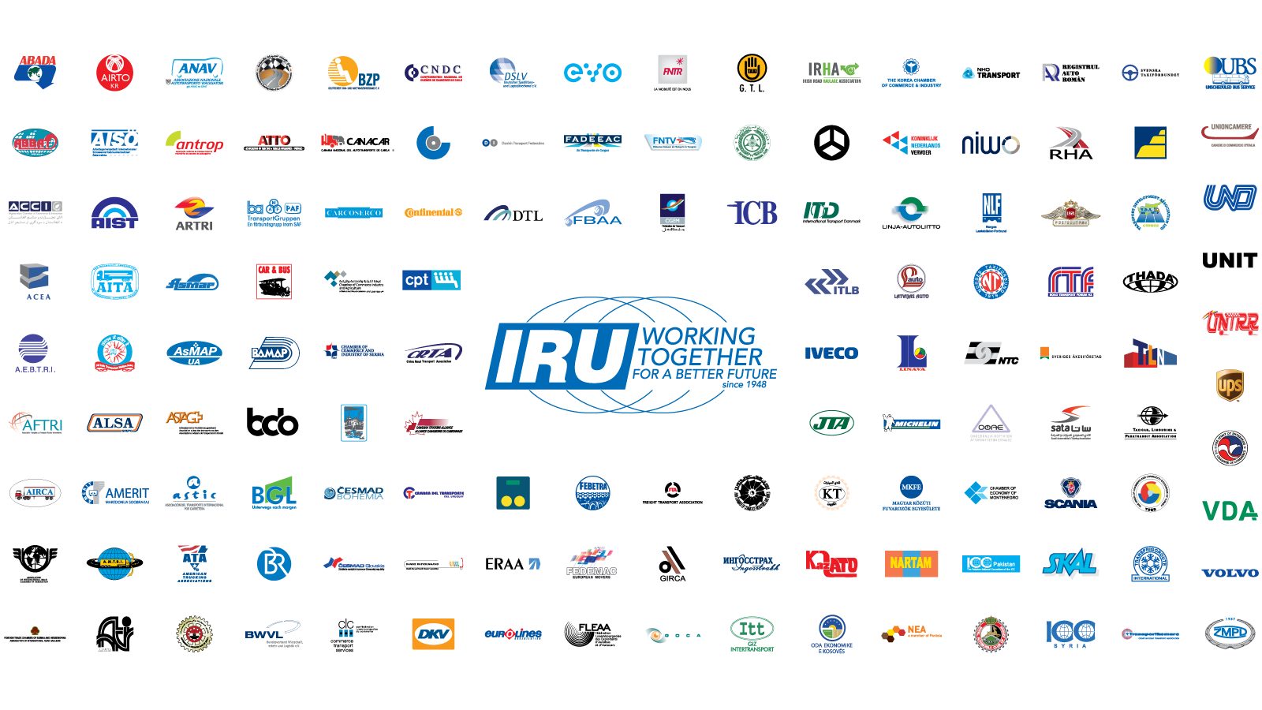
This is the IRU

Slide 4
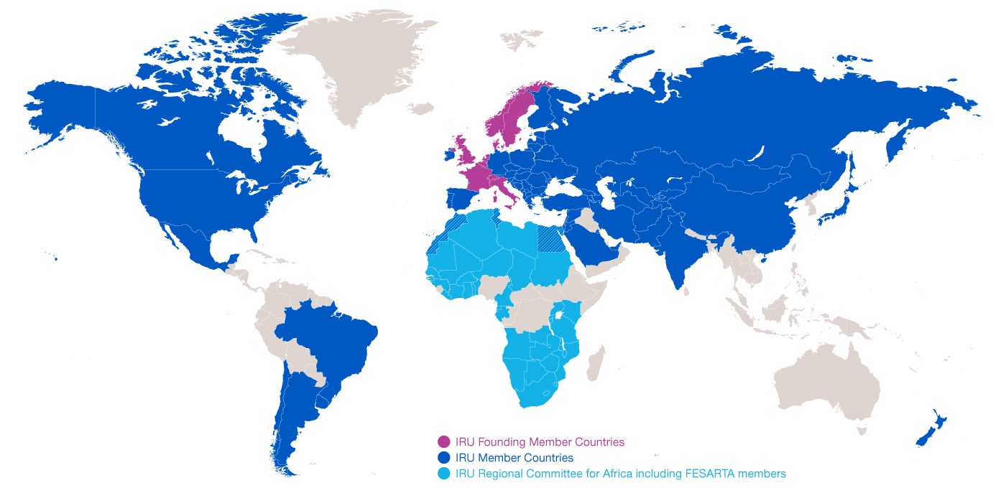
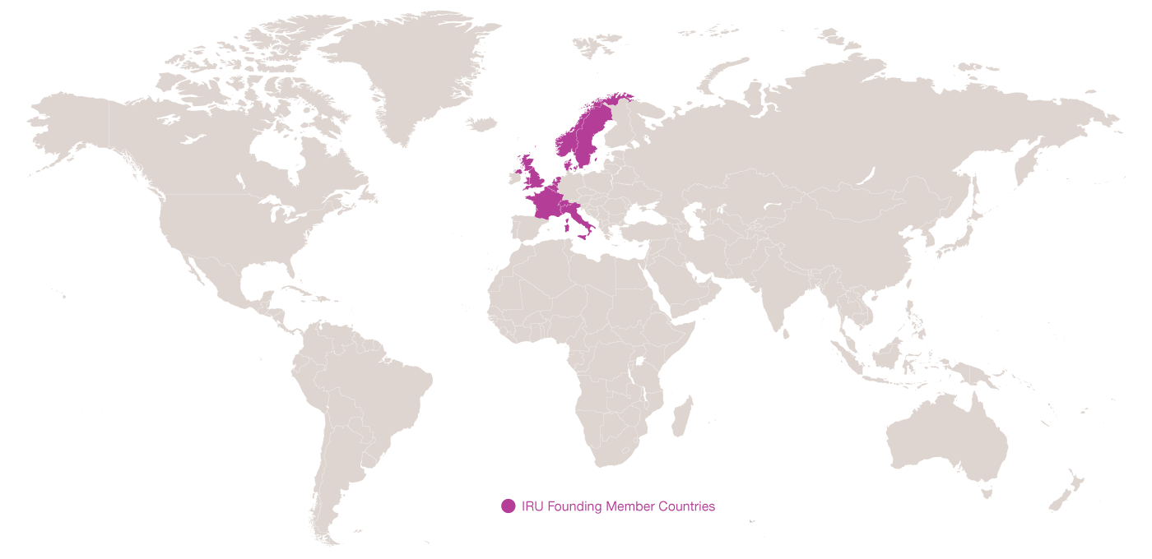
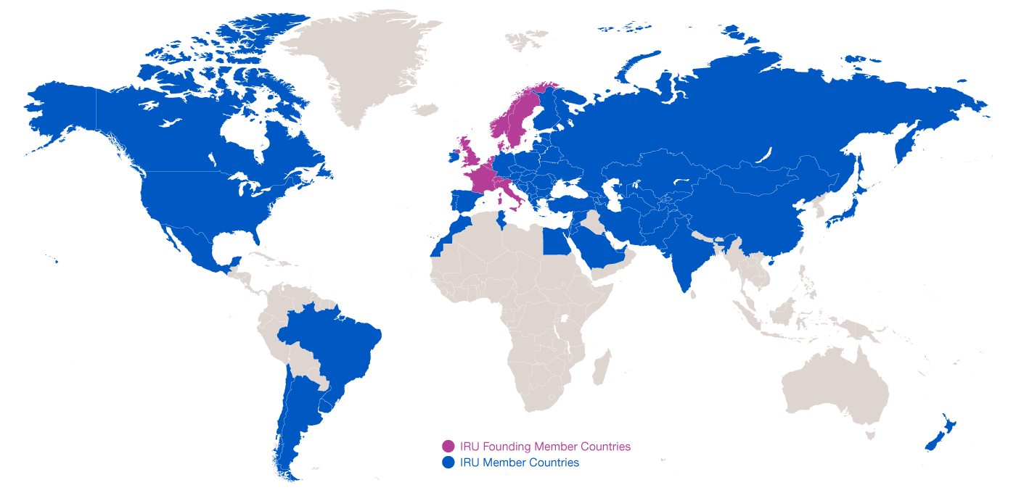
Evolution of IRU Membership
1948: 8 Founding Member Countries
2015: present in over 100 countries

Slide 5

Meet
Managed by the IRU under UN mandate since 1949

Slide 6
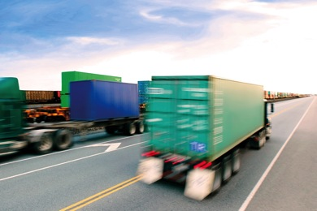
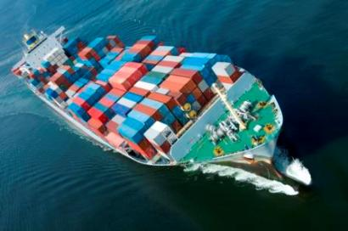
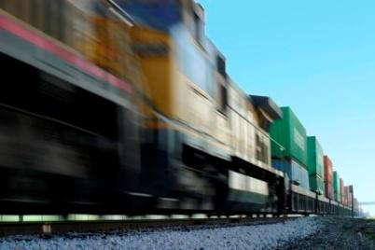
Meet TIR
A Customs transit system and guarantee that uses
one simple procedure, applied globally, for door-to-door transport by road, sea, rail and in the future by air.

Slide 7
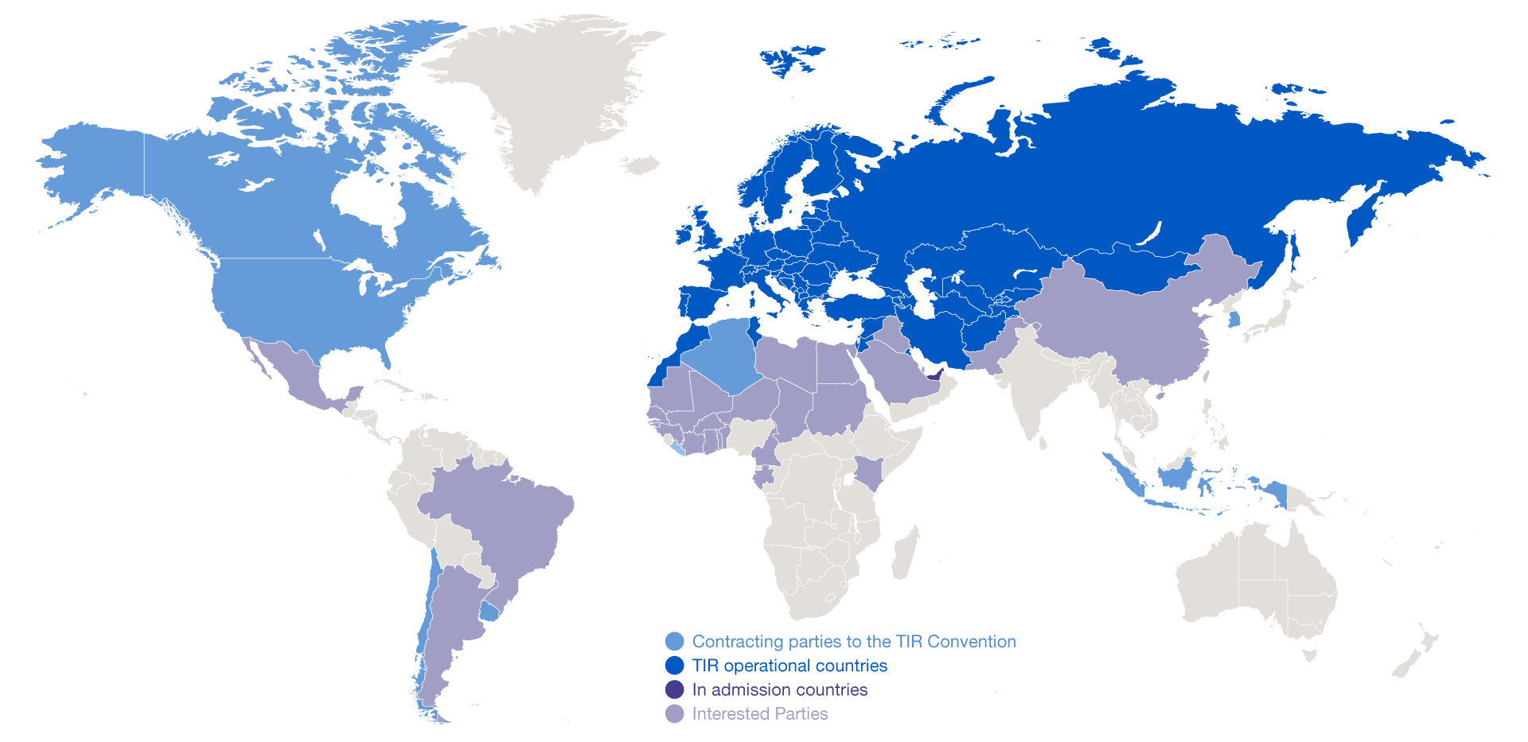
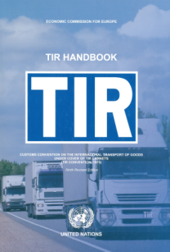
The TIR System
Based on TIR Convention of 1975
68 contracting parties
58 TIR operational countries

Slide 8

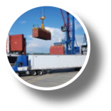

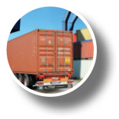
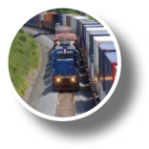
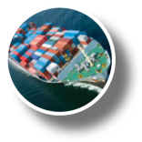
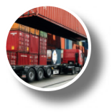
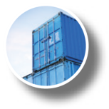
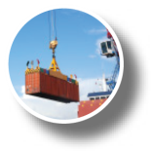
TIR gives your supply chain a competitive edge.
Saves time and money
Optimises intermodal transport
Connects continents
Uses real-time data exchange
Boost exports
Provides Customs guarantee

Slide 9
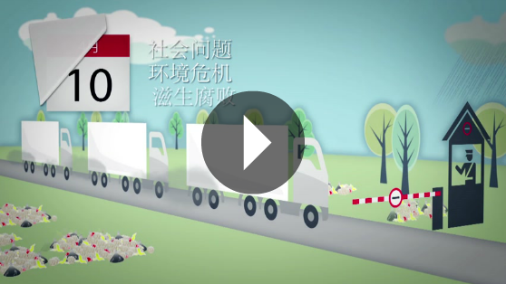
How TIR works

Slide 10
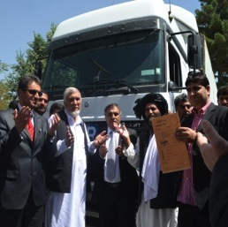
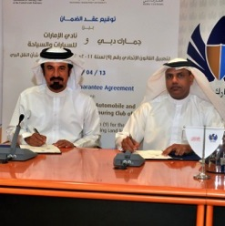


TIR Expansion
September 2013
Afghanistan opens for TIR
April 2014
UAE Customs sign guarantee agreement
April 2014
Pakistan officially confirms forthcoming accession to TIR
January 2015
China officially starts TIR accession process

Slide 11





TIR Expansion
Argentina
Brazil
Iraq
Kingdom of Saudi Arabia
Kenya and various African countries
Have expressed interest in TIR

Slide 12
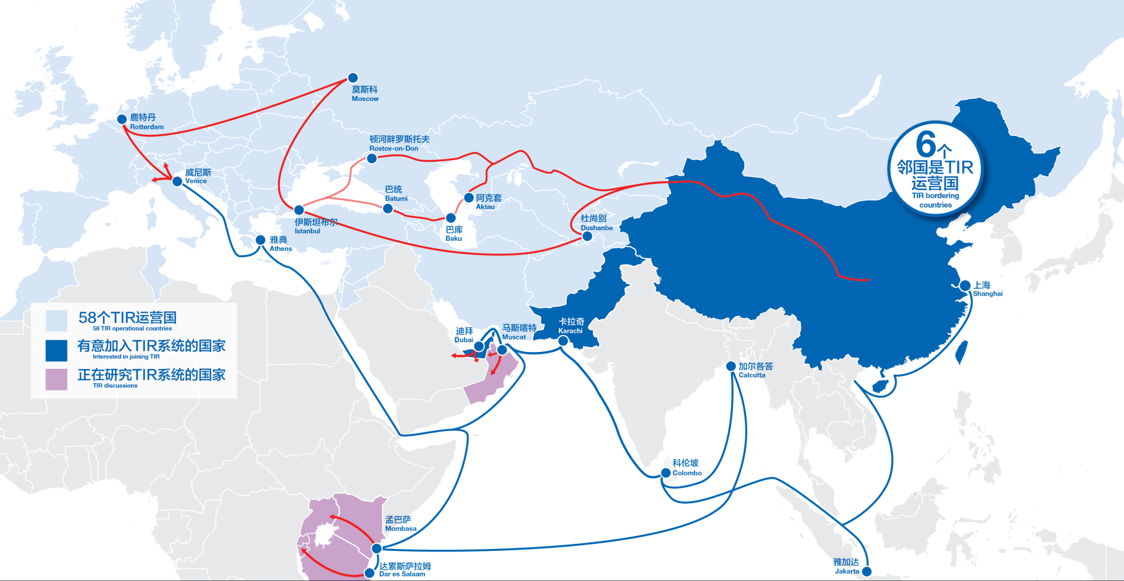
One Belt, One Road – with TIR
Notes:
Strong leadership by China (Silk Road, Go West)
Investments in infrastructure (highways and rail-road intermodal terminals)
Problems linked to maritime transport (overcapacity, increasing waiting times in ports, etc)
Development of trade between China and Central Asia
Opportunities for road transport between China and Europe for:
High value goods
Perishable goods
Refrigerated goods

Slide 13

Streamlined Customs Procedures at Borders
Customs formalities done at origin and destination rather than at borders
Advance cargo info and risk based Customs controls
Harmonisation and digitisation of transport and Customs documents
Modern solutions for real-time Business-to-Customs data exchanges

Slide 14
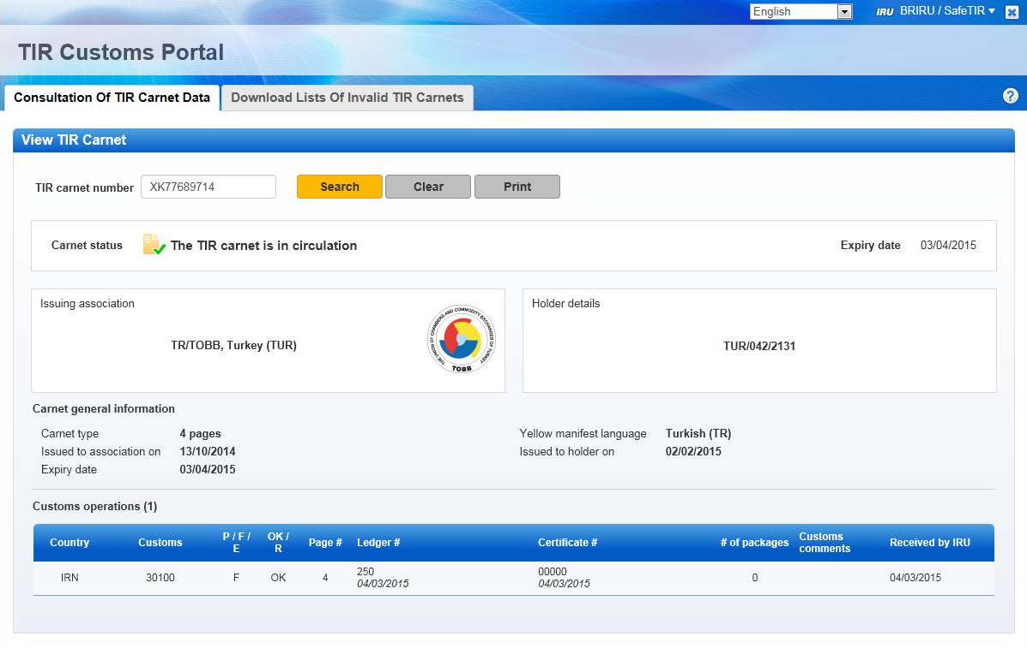
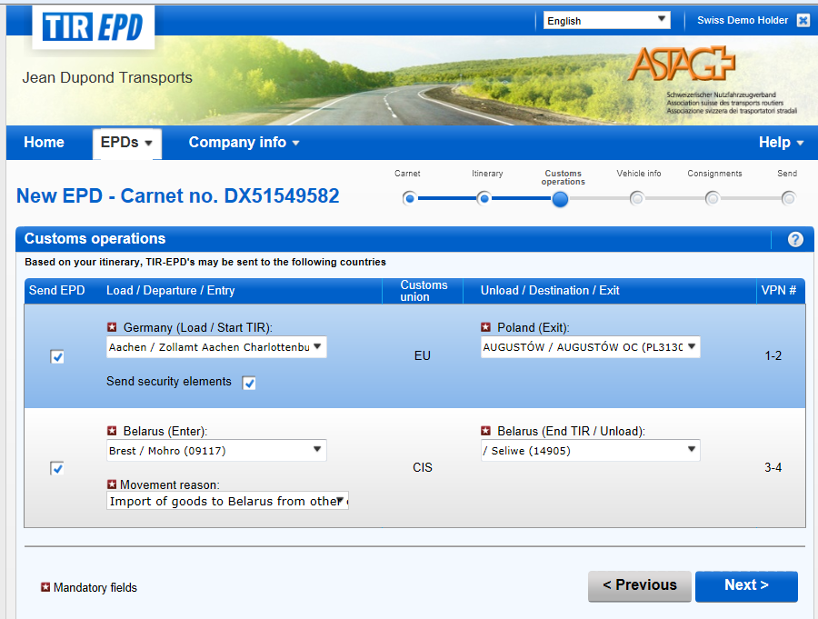
Electronic C2C and B2C data exchange
TIR Customs Portal
Real-time data exchange between IRU and 54 Customs systems
TIR EPD
Submission of electronic pre-declarations to Customs
  Integrated with 31 countries with more coming soon
  Available in 17 languages

Slide 15
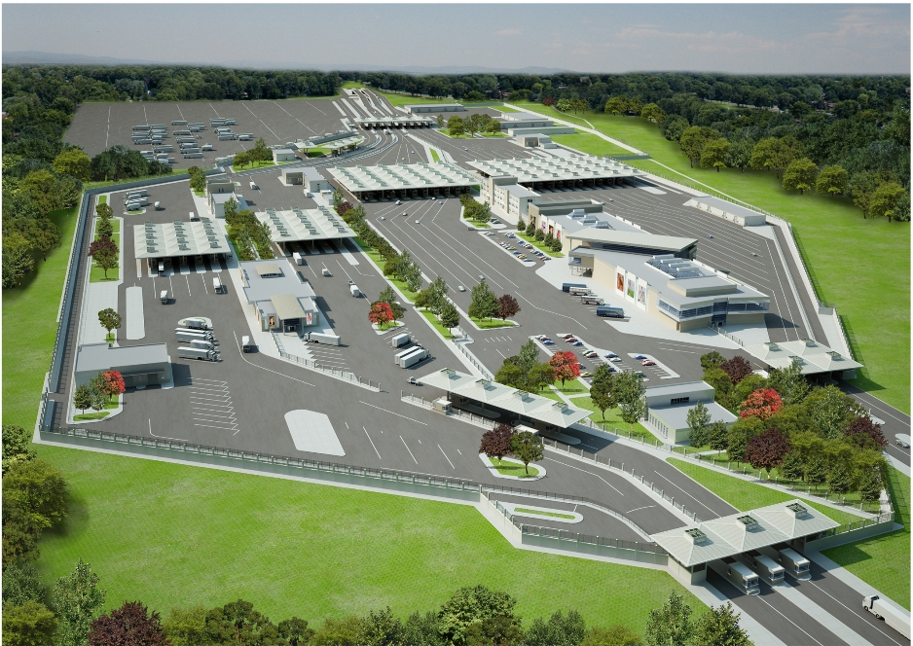
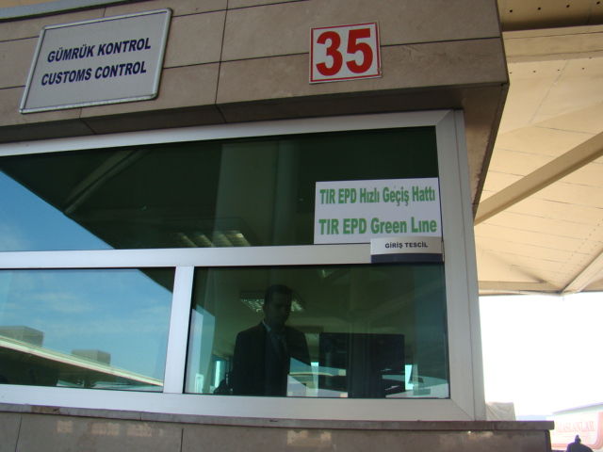
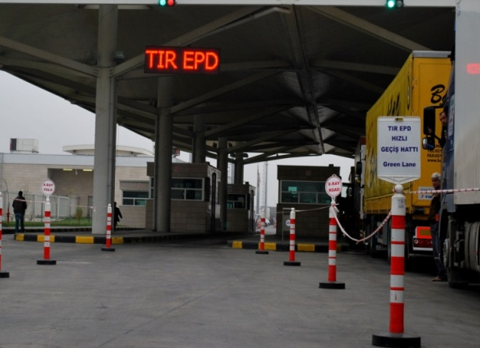

Green Lanes at Border Crossing Points
Notes:
As a result, we can implement green lanes that considerable speed-up border crossings as seen here (Turkey)
Where are the other places where we have green lanes (if they ask)?

Slide 16
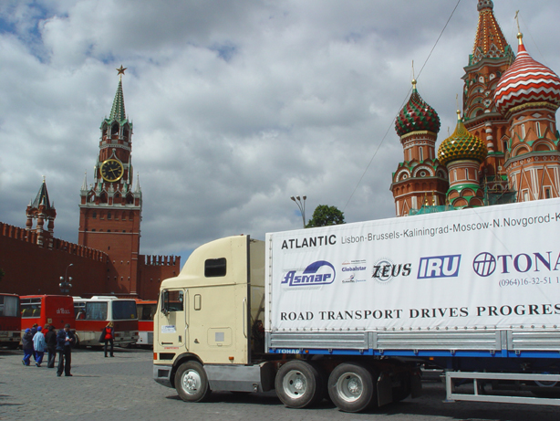
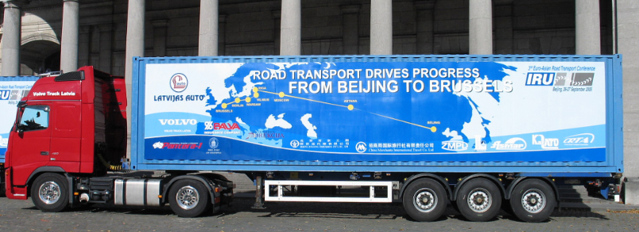
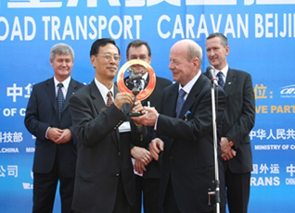

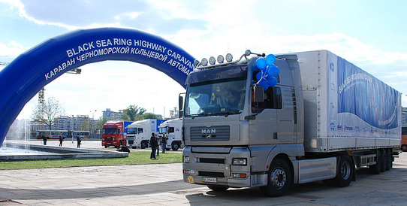
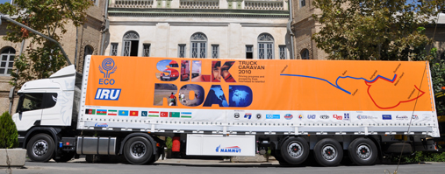
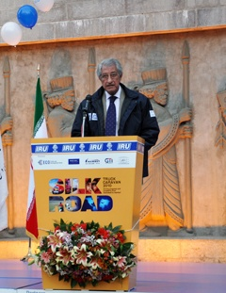
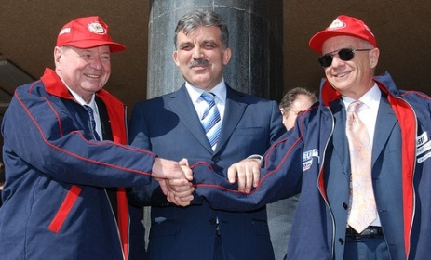
Results of IRU Caravans Clearly in Favour of TIR
Lisbon-Vladivostok
Beijing-Berlin-Brussels
Black Sea Highway
IRU-ECO Silk Road
Notes:
IRU has done several caravans in the past x years specifically focused on the Silk Road that show that …

Slide 17
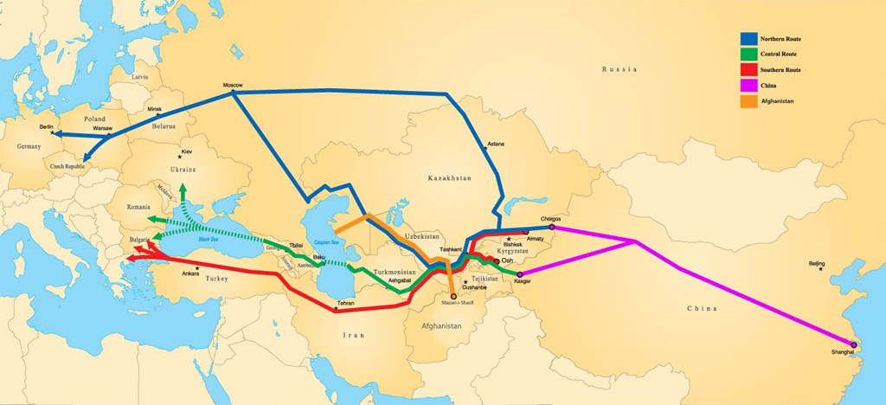

NELTI initiative
Northern Route: 10–16 days (between 6,000 – 7,700 km)
Central Route: 13–18 days (between 5,300 – 6,000 km)
Southern Route: 8–17 days (between 4,500 km – 6,200 km)
Notes:
Clear alternative for the western region
Questions on the figures:
Why 8 to 17 days?
Figures until where in Europe?
How does that compare with rail and sea?
8 days? So short? How does this happen?

Slide 18
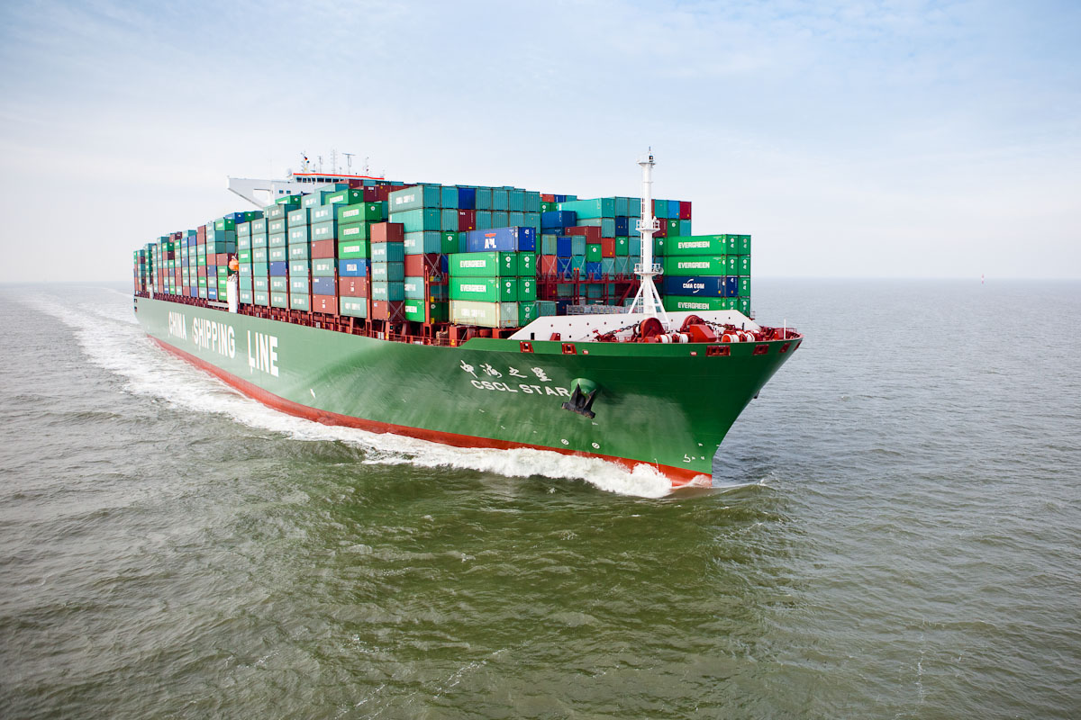
21st Century Maritime Silk Road with TIR

Slide 19
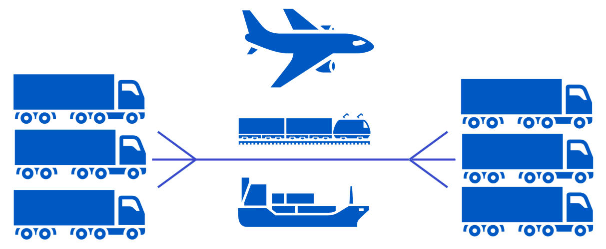
21st Century Maritime Silk Road with TIR
Door-to-door transport by road, sea, rail and in the future by air.

Slide 20

Streamlined Customs procedures at borders, ports and rail terminals
Door-to-door transport under a unique Customs guarantee
Customs formalities done at origin and destination rather than at borders, ports and railway terminals
Advance cargo info and mutual recognition of Customs controls to reduce number of inspections
Further dematerialisation of transport and Customs documents
Improved B2B and B2C sharing of transport and Customs data

Slide 21
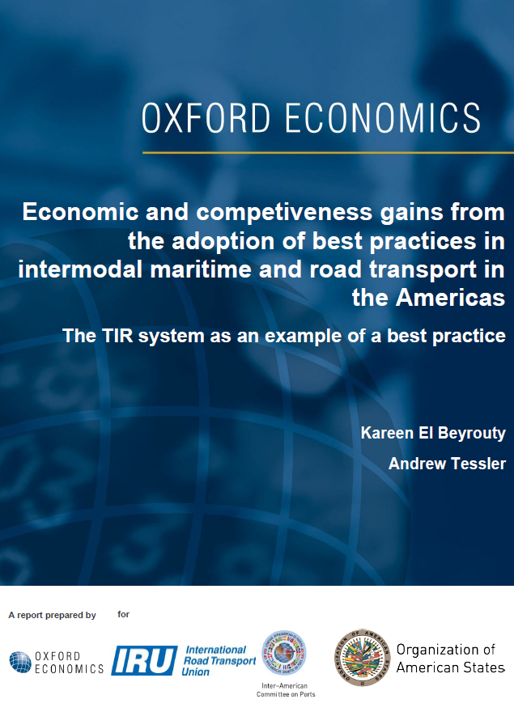
TIR Case study: Latin America
Boosts exports in Argentina, Brazil and Mexico,
by USD 9 billion/year
Cuts border waiting times by up to 50%
In Argentina and Brazil most of the boost comes from intermodal trade. In Mexico, by road transport
Average Port Customs clearance and technical controls Argentina/Mexico - 2 days
Brazil - 3 days
Major EU countries - only 1 day
Notes:
Specific studies are under way for China and Asia. Our latest study in LATAM showed that …

Slide 22
What’s next once China joins TIR?

