Slide 1
IRF 1st IRF Europe & Central Asia Regional Congress
Euro-Asian Transport Links:
An agenda for Regional Prosperity
Istanbul, 16 September 2015
Umberto de Pretto
Secretary General

Slide 2
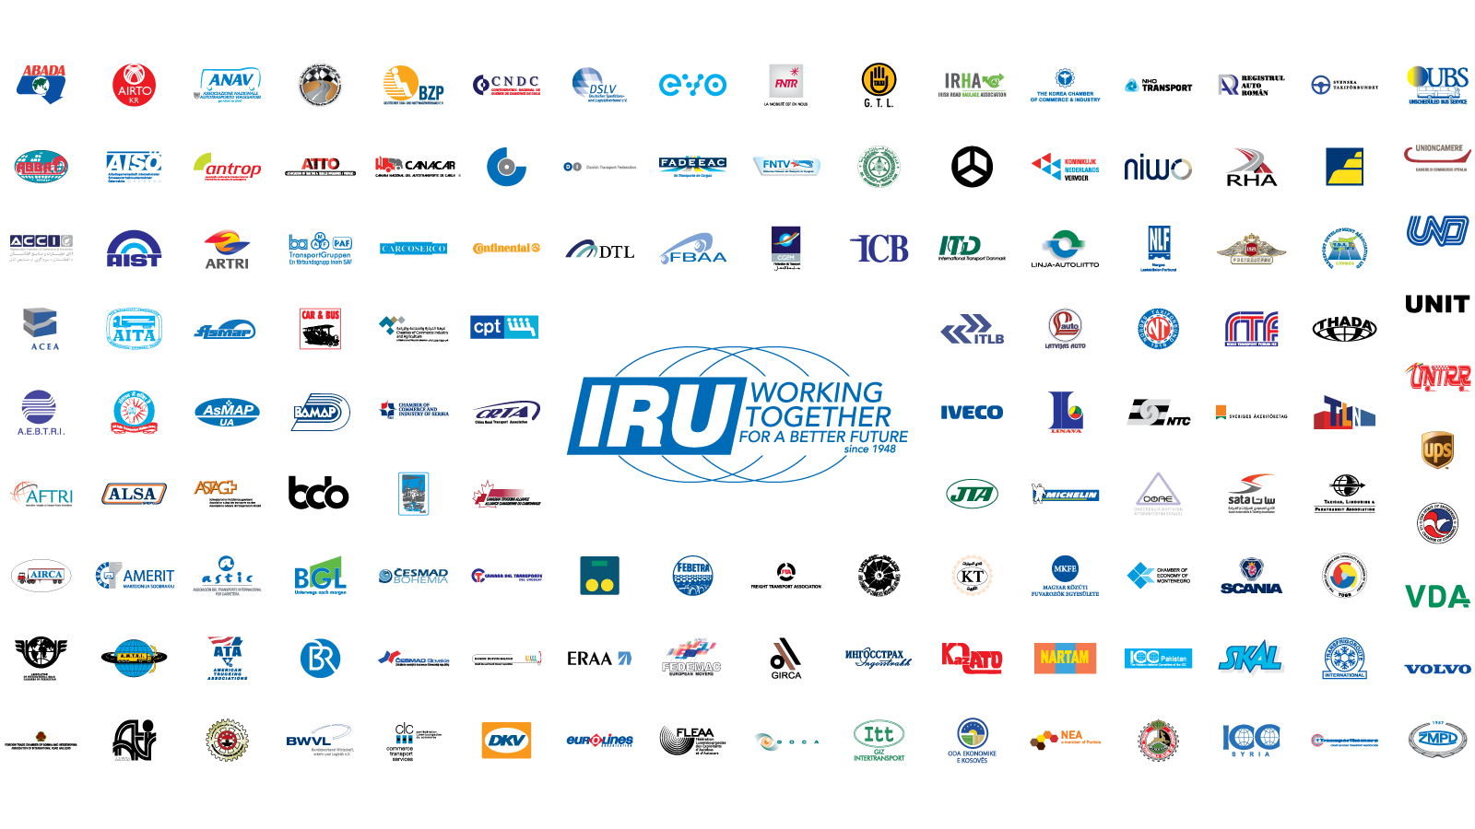
This is the IRU

Slide 3
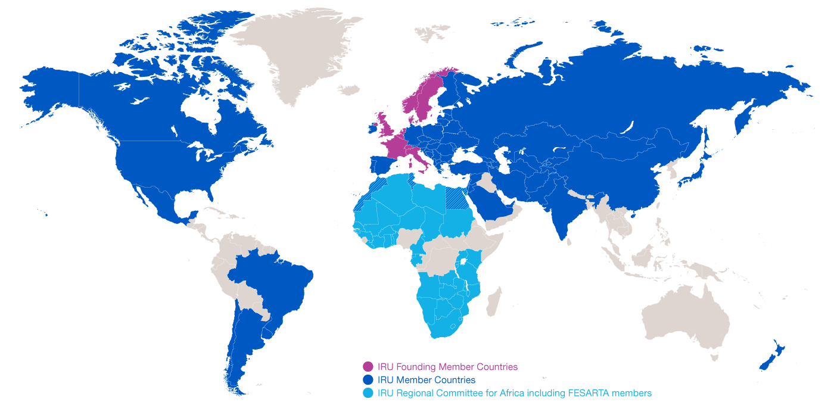
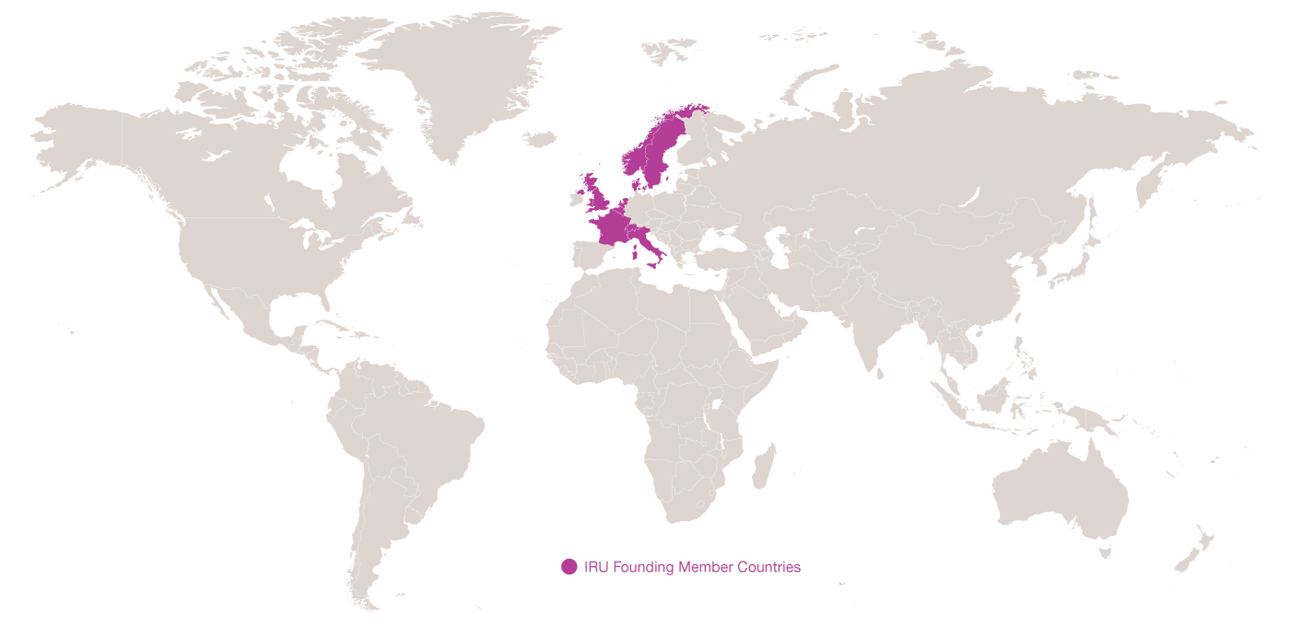
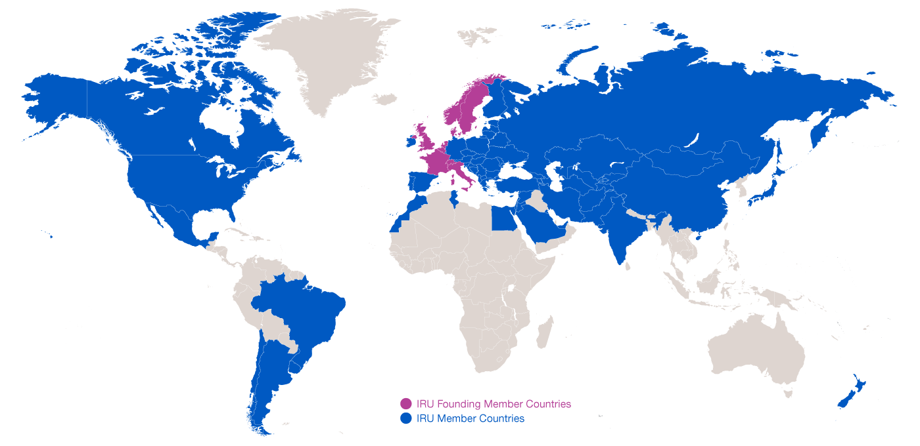
Evolution of IRU Membership
1948: 8 Founding Member Countries
2015: present in over 100 countries

Slide 4
What is Globalisation?
What does it take to have a cup of coffee in a café?
The combined efforts of 29 companies in
18 countries
Road Transport has become a vital production tool!
Source: IRU

Slide 5
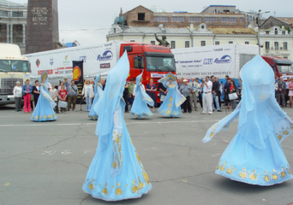
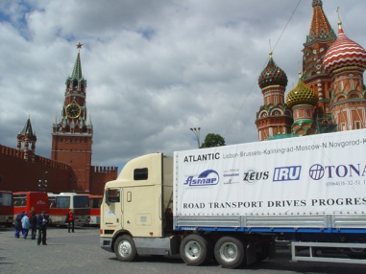
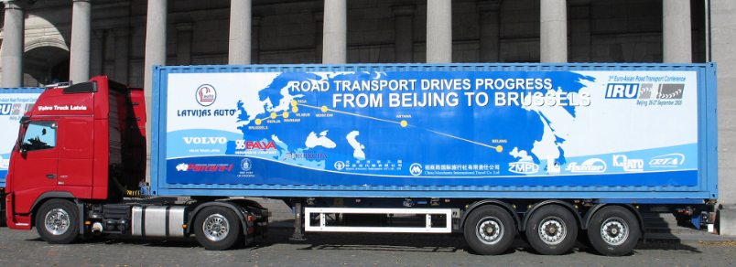
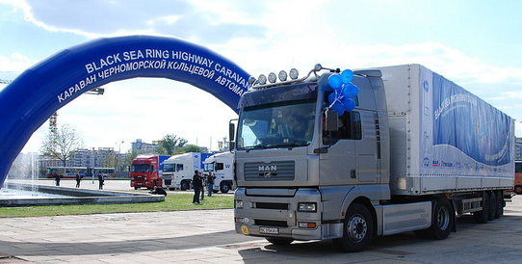
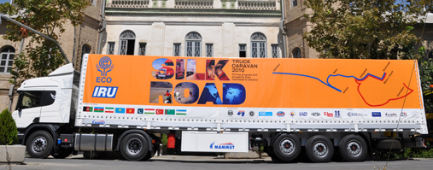




Pilot Caravans
Lisbon-Vladivostok
Beijing-Berlin-Brussels
Black Sea Highway
IRU-ECO Silk Road

Slide 6
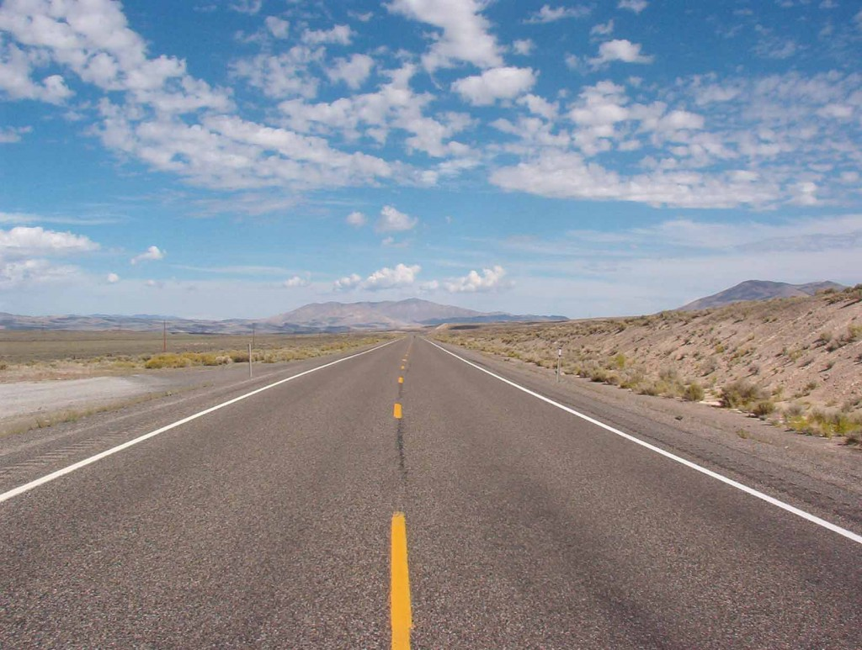
Drivers often see adequate roads…but little traffic!

Slide 7
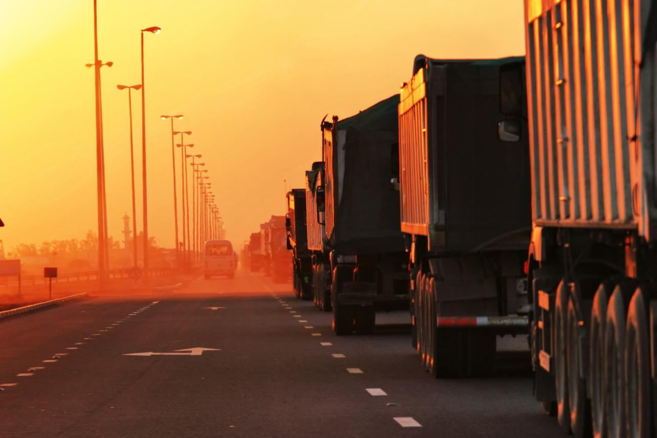
…until they reached border crossings!!

Slide 8




IRU New Eurasian Land Transport Initiative (NELTI)
From September 2008
Monitoring over 200,000 border crossings
57% of transport time lost at border crossings
38% of transport costs due to unofficial levies

Slide 9
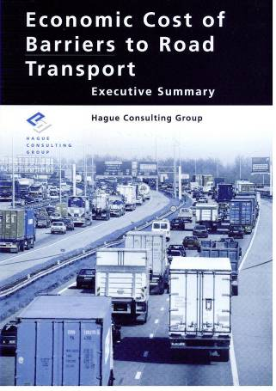
Any penalty on road transport is an even greater penalty on the economy as a whole!
* Includes lost opportunities
Source: Hague Consulting Group

Slide 10
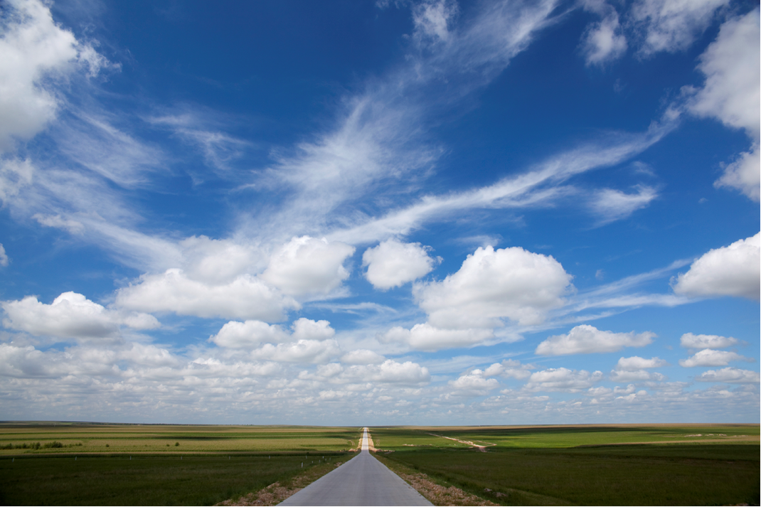
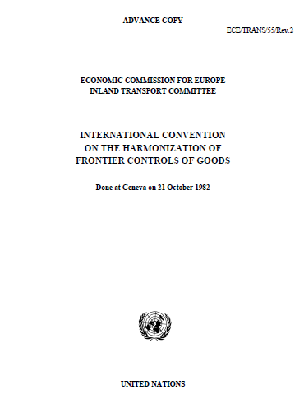
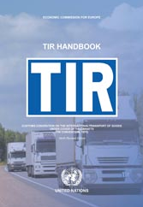
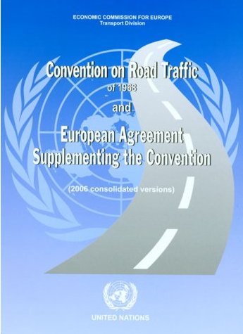
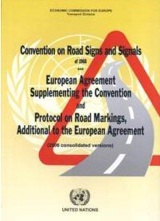
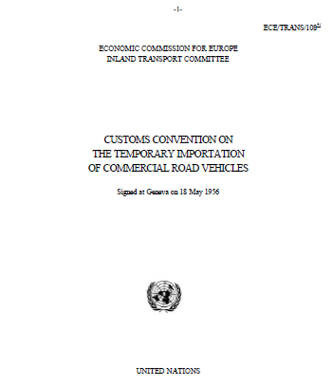
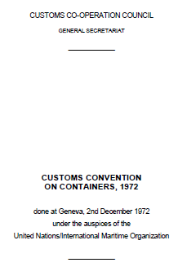
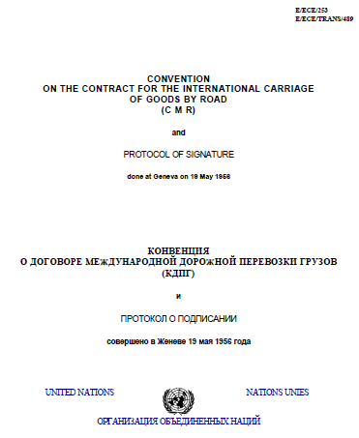
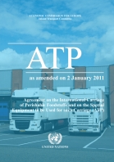
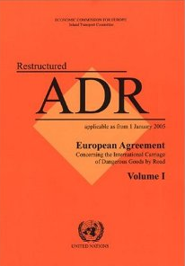
Implementation of key UN facilitation instruments
Allow the goods to cross the borders!

Slide 11
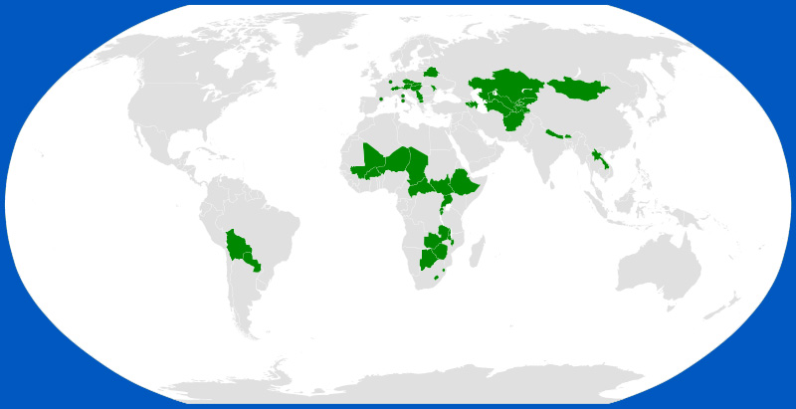
Land Locked Countries: Special needs in effective transport and transit systems

Slide 12
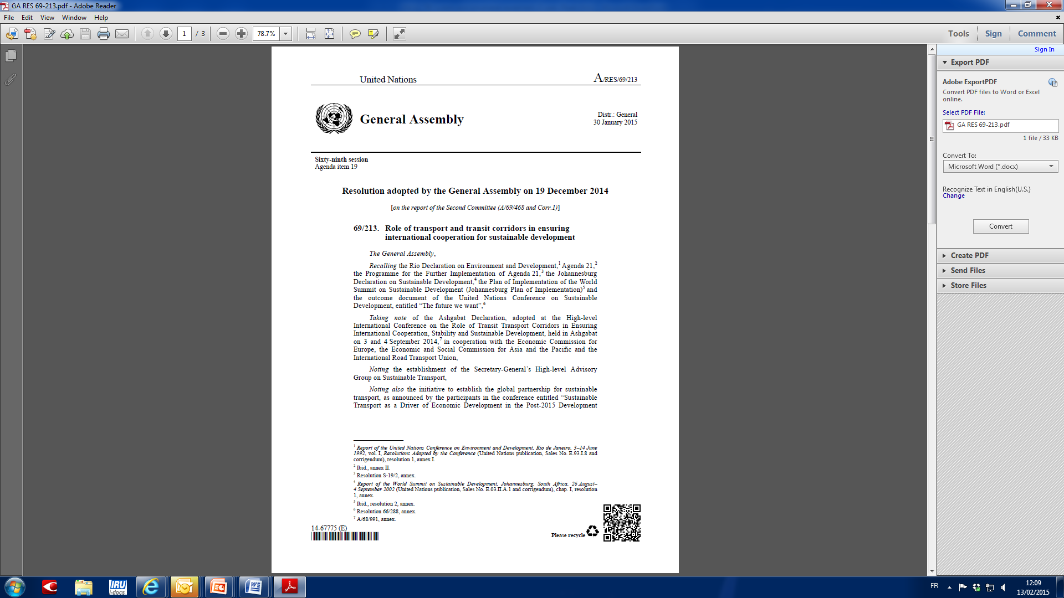
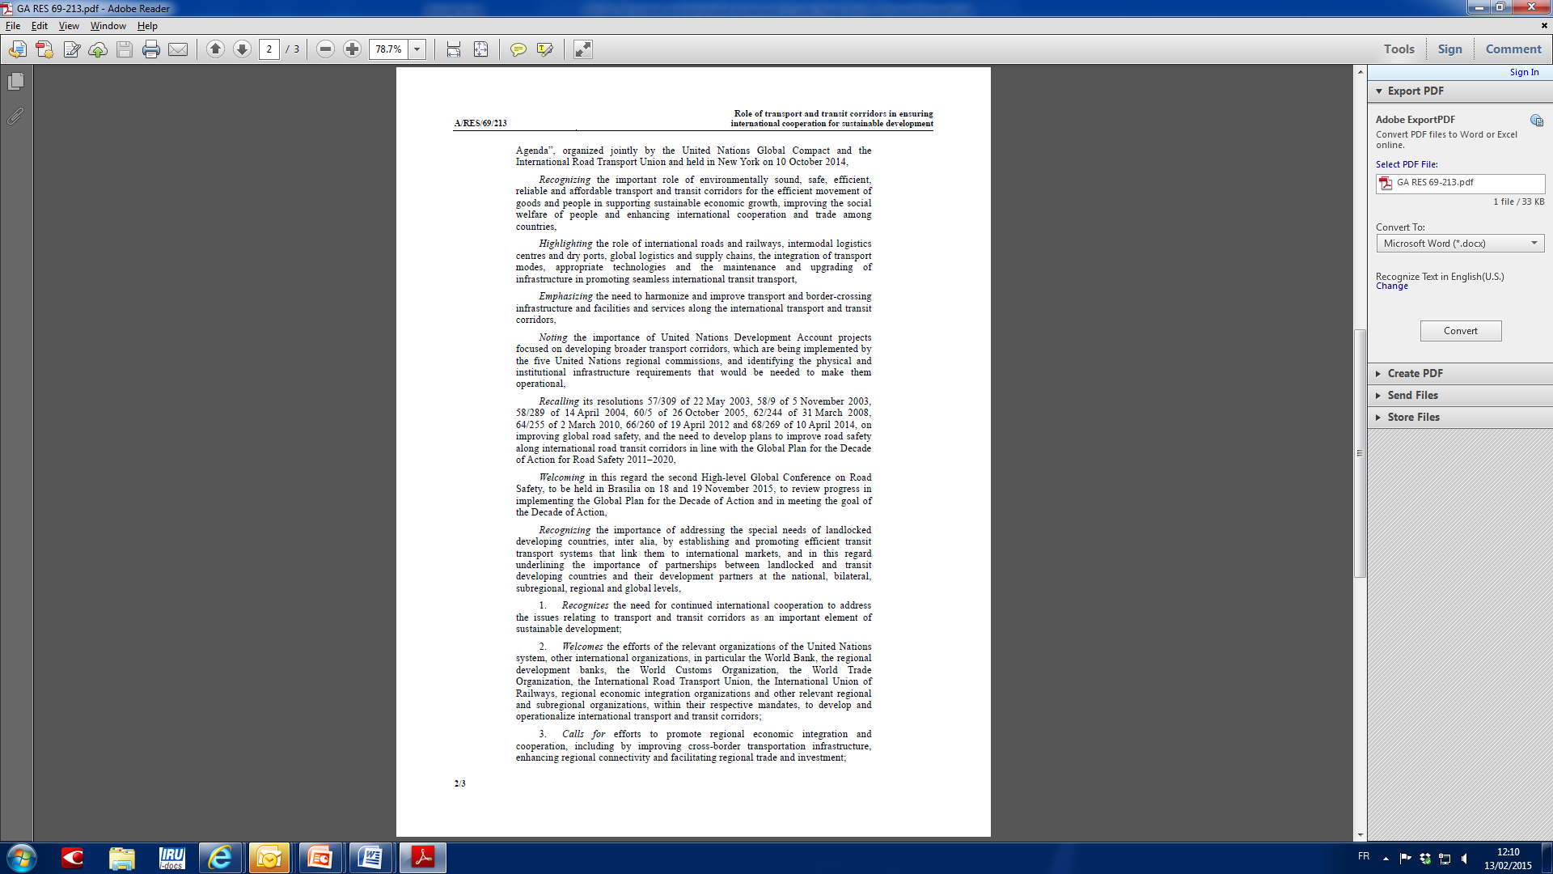
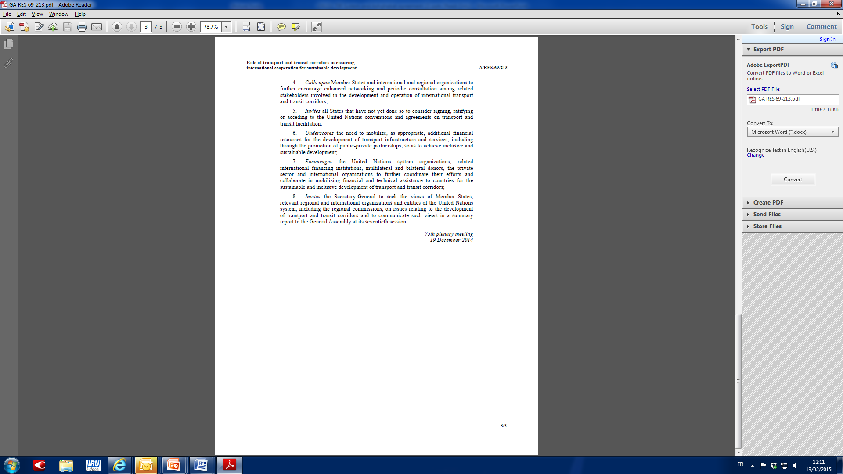
UN Resolution on Transport Corridors
Nr. 69/213 adopted on 19 Dec 2014

Slide 13
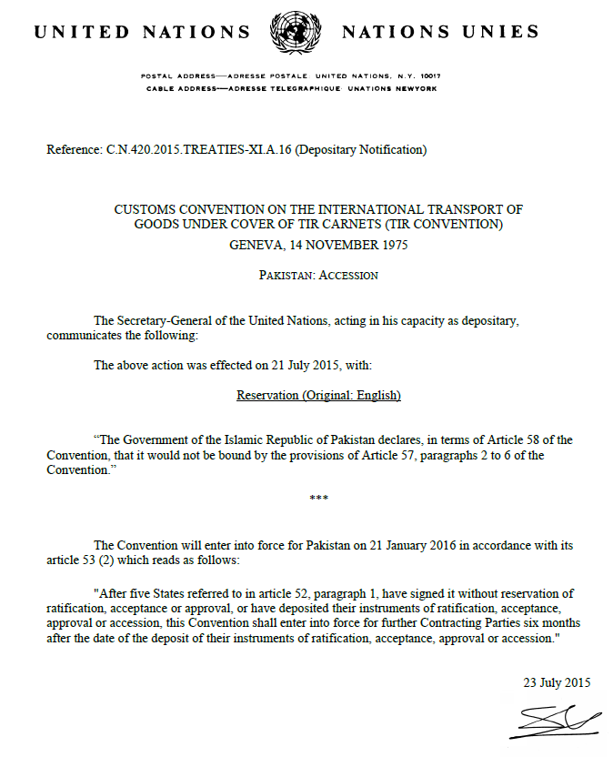

Pakistan acceded to the TIR Convention

Slide 14
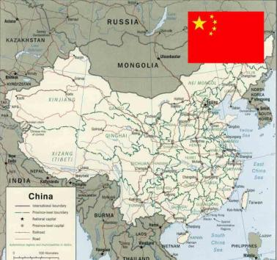
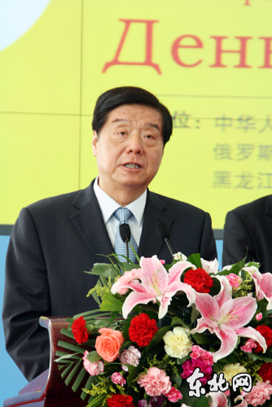
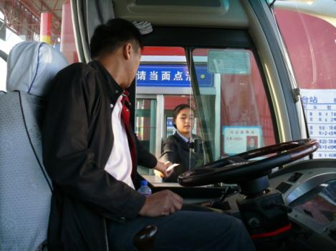
China speeds up the TIR accession process
Since early 2015, relevant Ministries have approved China’s accession to TIR. We are expecting the final approval from China’s State Council.

Slide 15
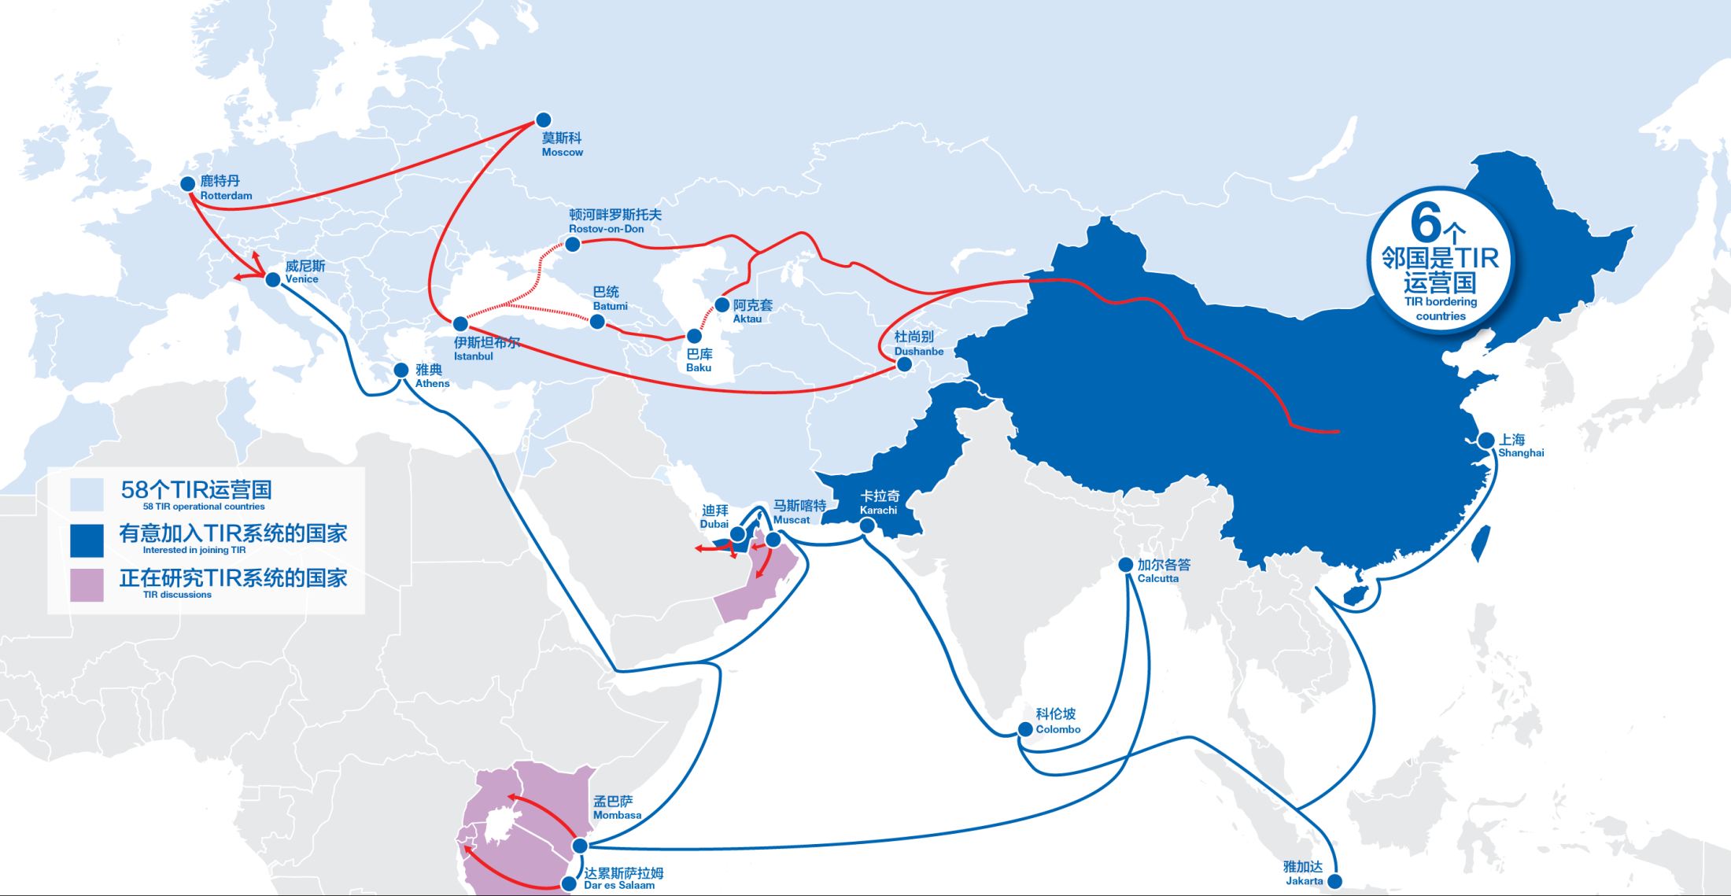
One Belt, One Road – TIR is the solution!
Notes:
What changes the dimension of TIR is the accession of China !
Calls for intermodality

Slide 16
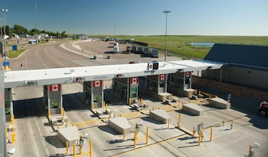
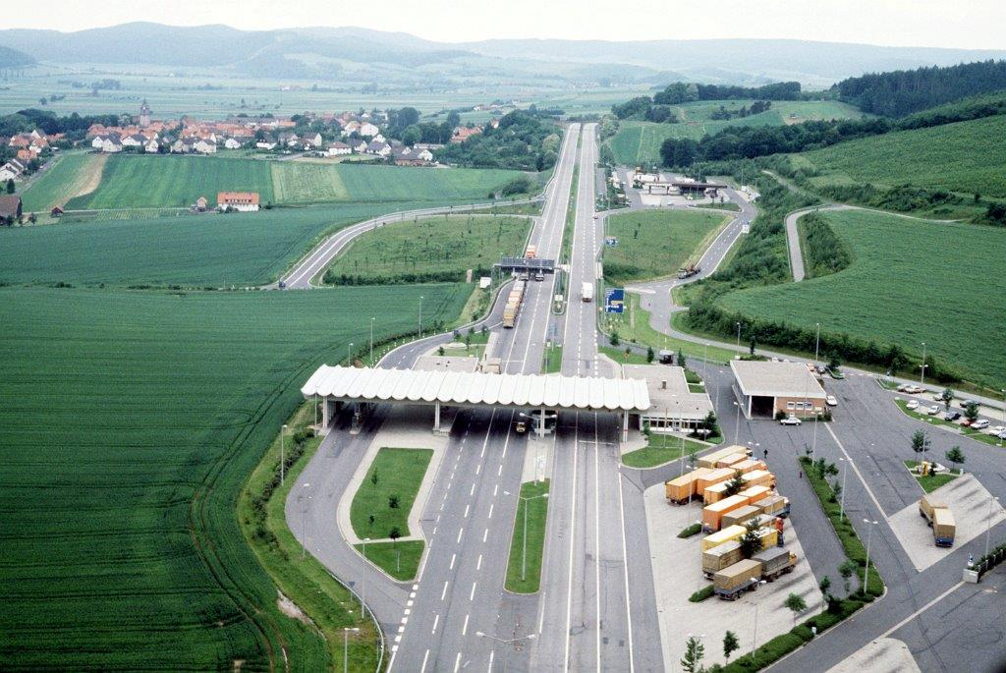
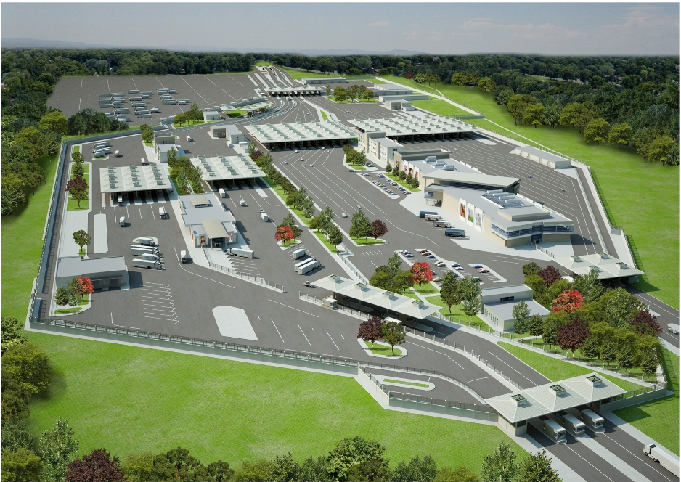
We want to see this…
Notes:
Hizli : fast in turkish

Slide 17
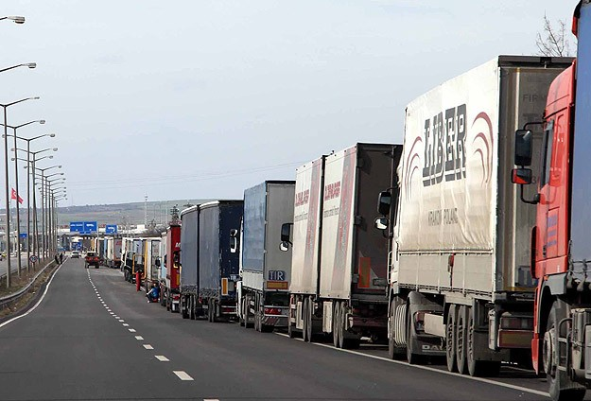
….instead of this...

Slide 18
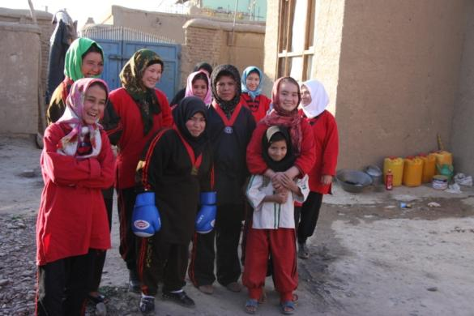
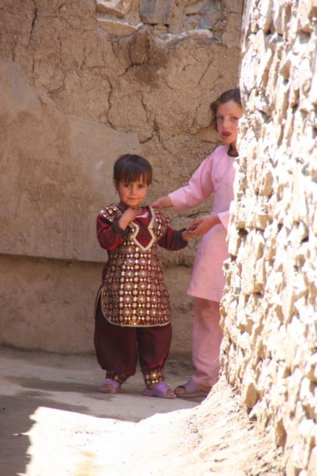
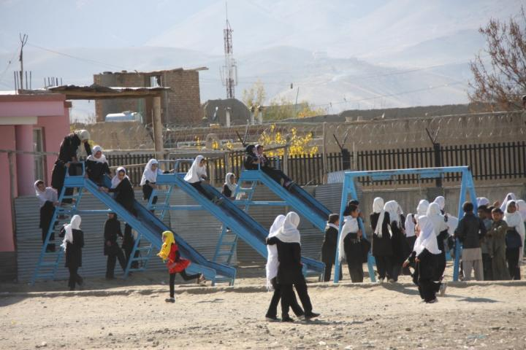
…in order to bring them hope!

