Slide 1
Middle East Commercial Centre
Leadership Forum
Washington DC, 9 December 2014
Umberto de Pretto, Secretary General

Slide 2
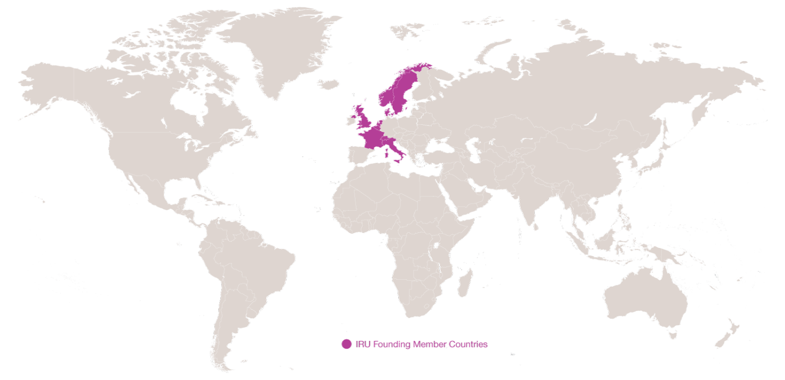
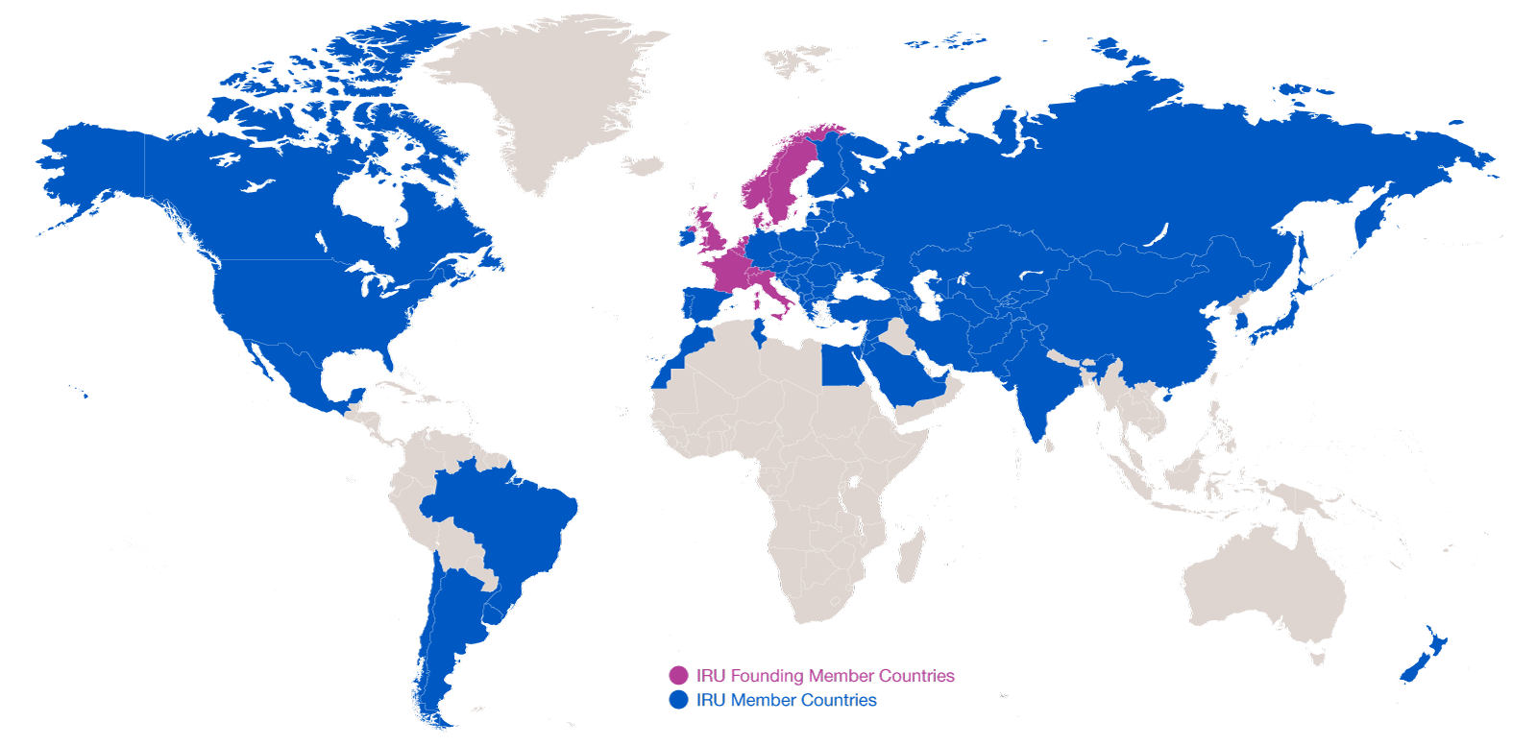
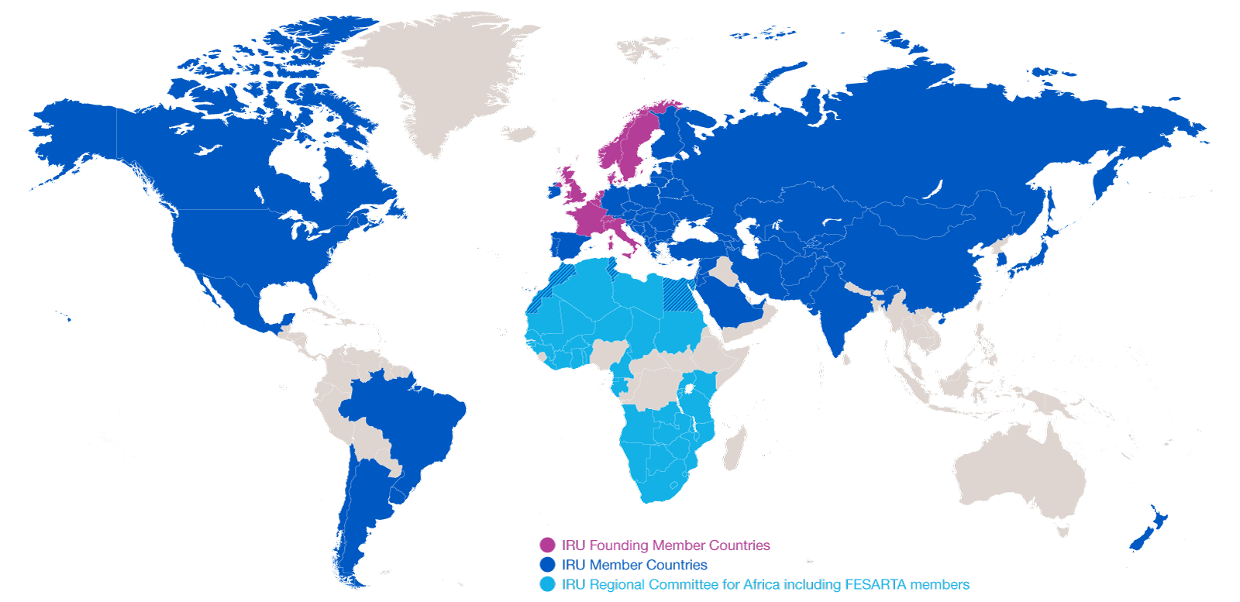
Evolution of IRU Membership
2014: 170 Members in 75 countries
2014: 170 Members in 75 countries
1948: eight founder countries
…and CRIPA: 27 Members + FESARTA in 38 countries

Slide 3
What is Globalisation?
What does it take to have a cup of coffee in a café?
The combined efforts of 29 companies in
18 countries
Road Transport has become a vital production tool!
Source: IRU

Slide 4






















IRU is pleased to work with MECC !
Alexandria Chamber of Commerce
Ready Made Garments Export Council

Slide 5
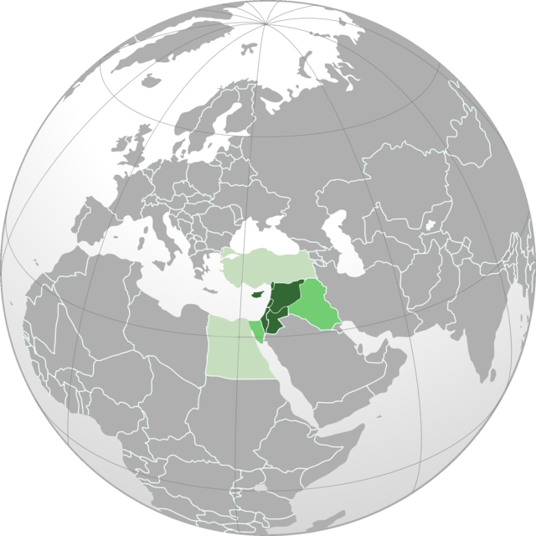
Core MECC Region
Heart of three continents!
MECC is composed mainly by the Levant region, which bridges Africa, Asia and Europe.
Jordan constitutes a hub point for interconnecting Arabian Gulf, Red Sea and Mediterranean.
Turkey represents a key producing economy and a gateway to Europe.
Egypt is another centre of gravity which opens to rest of Africa.
Israel is key for port facilities opening to Jordan and integrating Palestinian trade with the world.
Image by Wikipedia.

Slide 6
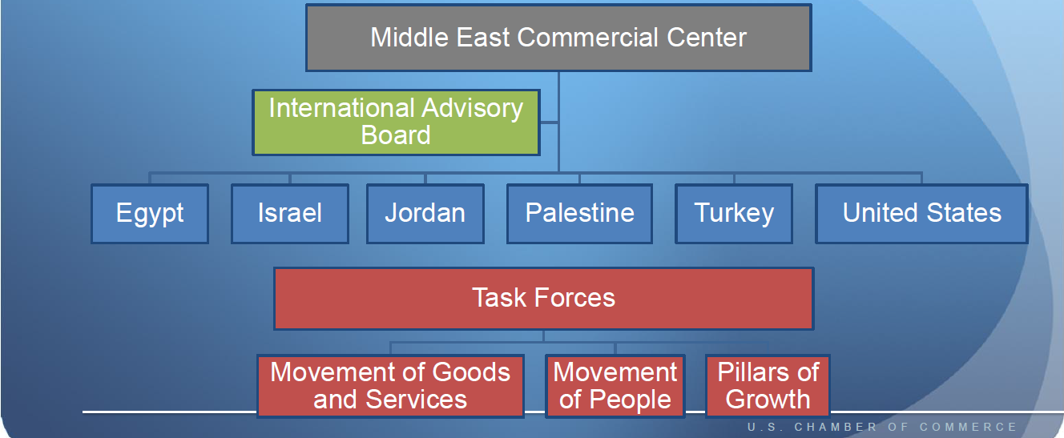
MECC Organisational Structure

Slide 7
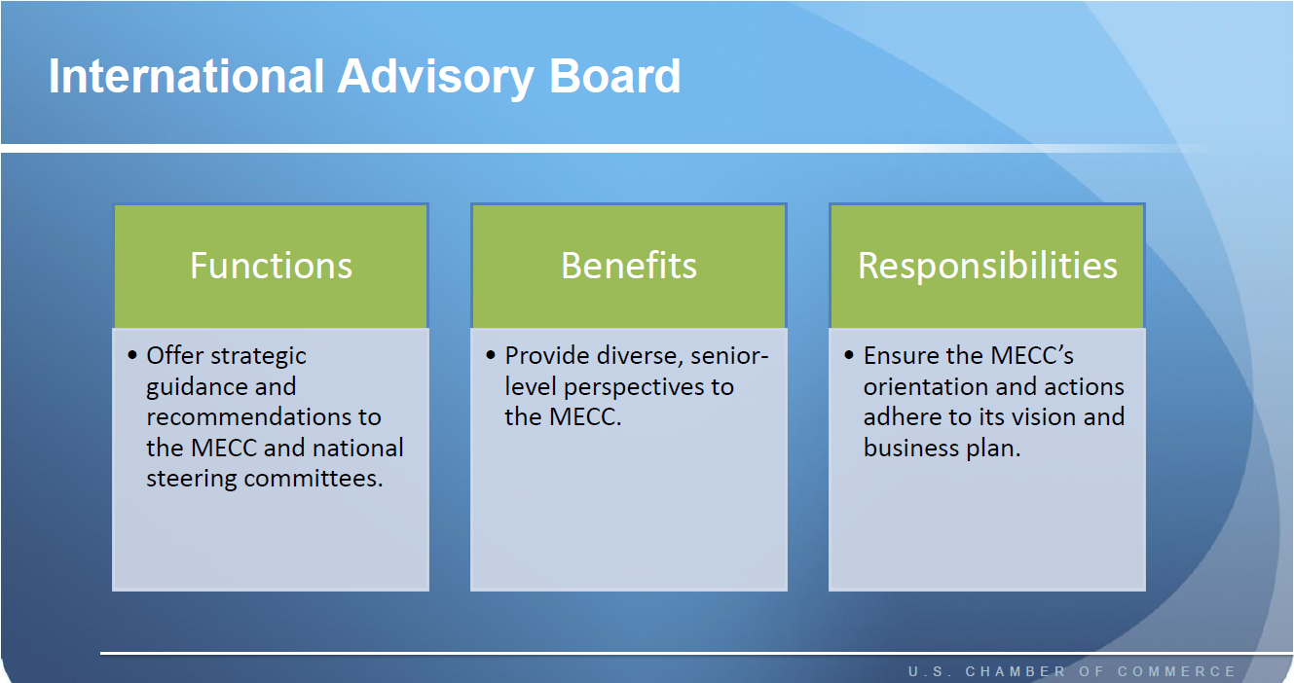
(1) IRU could join the Int`l Advisory Board!

Slide 8
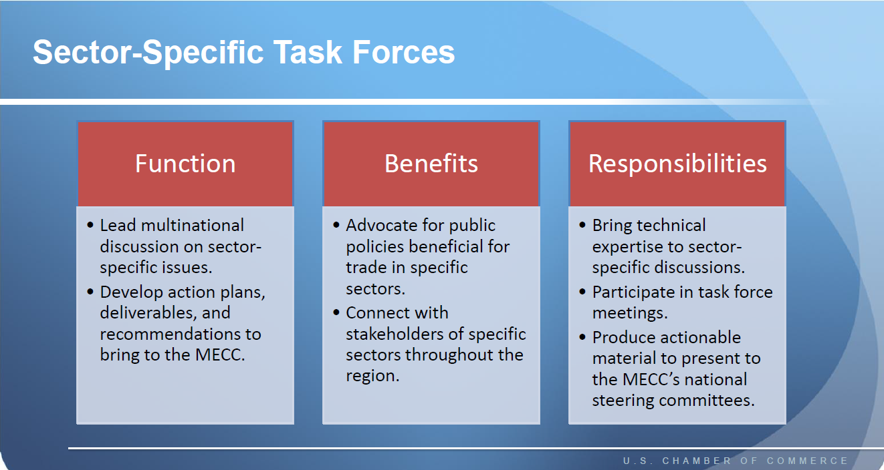
(2) IRU could lead Movement of Goods Task Force

Slide 9
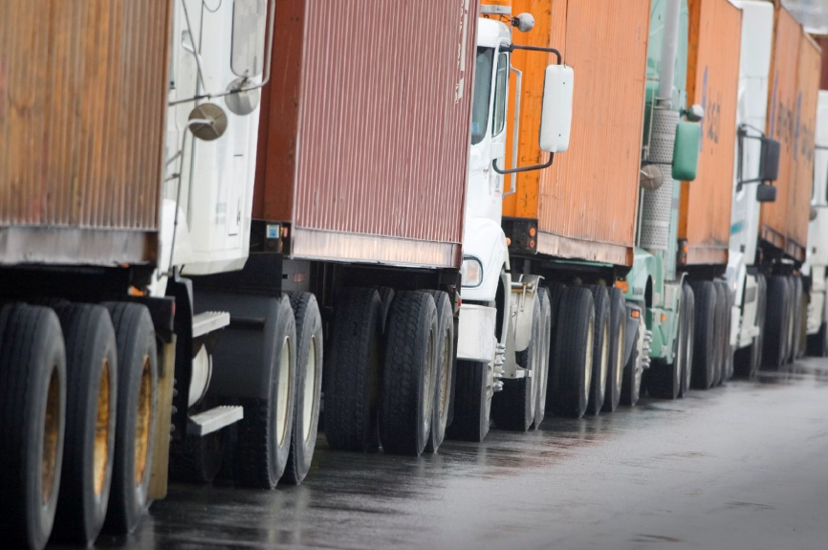
Our joint success depends on `moving them`!

Slide 10
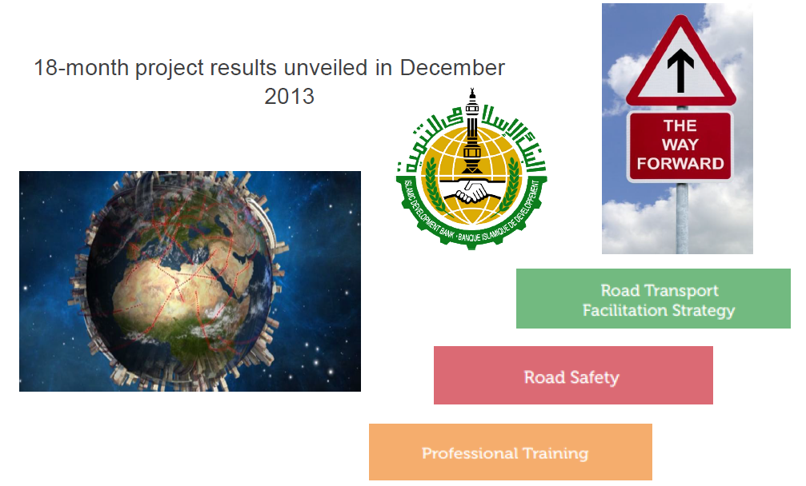
IRU/IsDB/AULT Study already tells a lot!

Slide 11

Trucks stop longer than they move en route!

Slide 12

Project results already show the way forward!

Slide 13
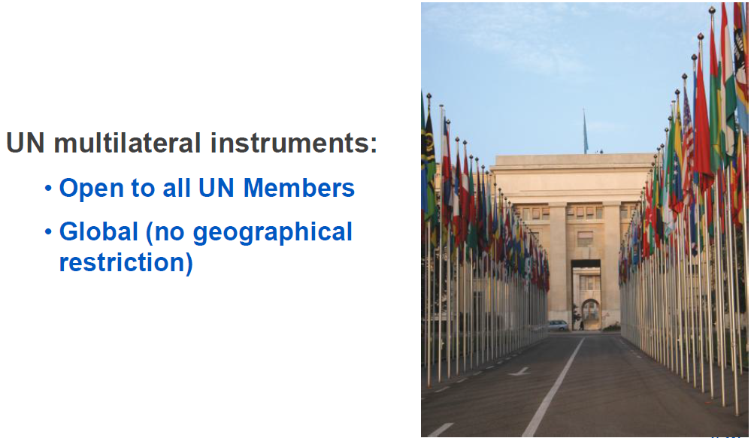
Use the UN multilateral instruments!

Slide 14
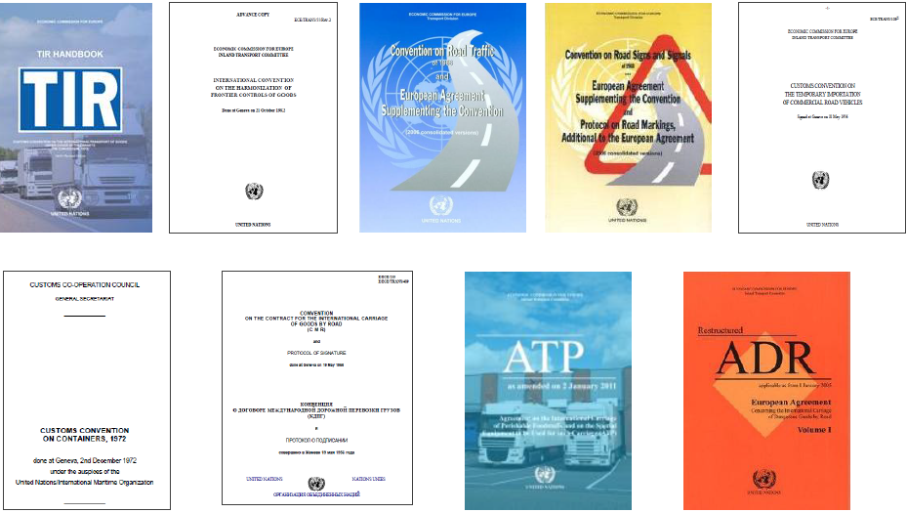
Don`t re-invent the wheel!

Slide 15
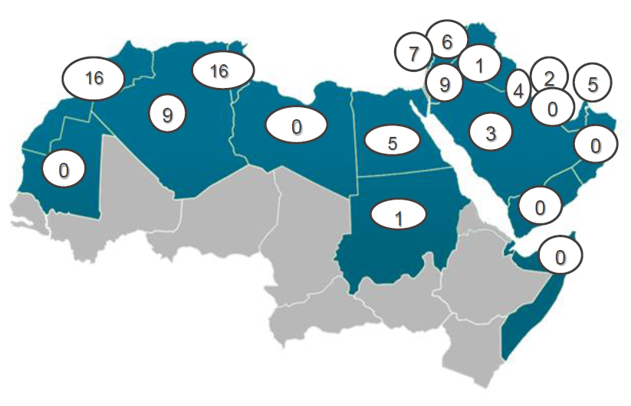
Status of 58 UN Conventions in the Arab world!
Status as of 13 October 2014.

Slide 16




IRU New Eurasian Land Transport Initiative (NELTI)
From September 2008
Monitoring over 200,000 border crossings
57% of transport time lost at border crossings
38% of transport costs due to unofficial levies

Slide 17
Securing and facilitating trade and international road transport
Transports
Internationaux Routiers
Managed by the IRU since 1949

Slide 18
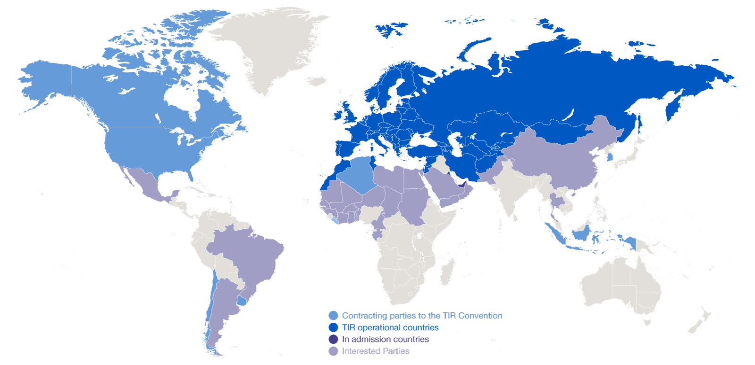
Geographical scope of the TIR Convention

Slide 19
TIR in the MECC region!
Egypt and Palestine missing!
All the MECC members are part of the global TIR Convention except Egypt and Palestine!
Use of key TIR IT risk management tools will ensure smooth and secure flow of goods across the borders thanks to TIR Electronic Pre-declaration, Real Time SafeTIR, TIR-EPD Green Lane, CUTE-Wise, AskTIR, etc.

Slide 20
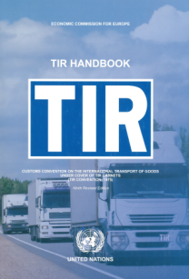


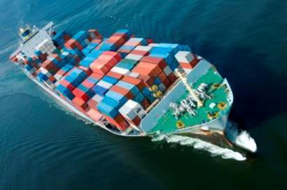
What is the TIR System?
A tried and tested, affordable facilitation instrument for international transport and trade
  Multilateral
  Intermodal (road-rail, road-maritime, road-air)
  Global
Based on TIR Convention of 1975, signed by 68 contracting parties

Slide 21
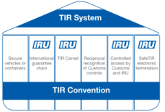
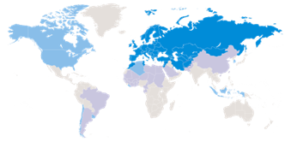
Benefits of the TIR System
Secures and facilitates trade through the implementation of harmonised controls & documents
Ensure the secure and sustainable development of international trade and road transport (controlled access, traceability)
Through mutual recognition of Customs Controls and the guarantee, transport costs, formalities and delays are reduced
Gives access to 58 TIR operational countries

Slide 22
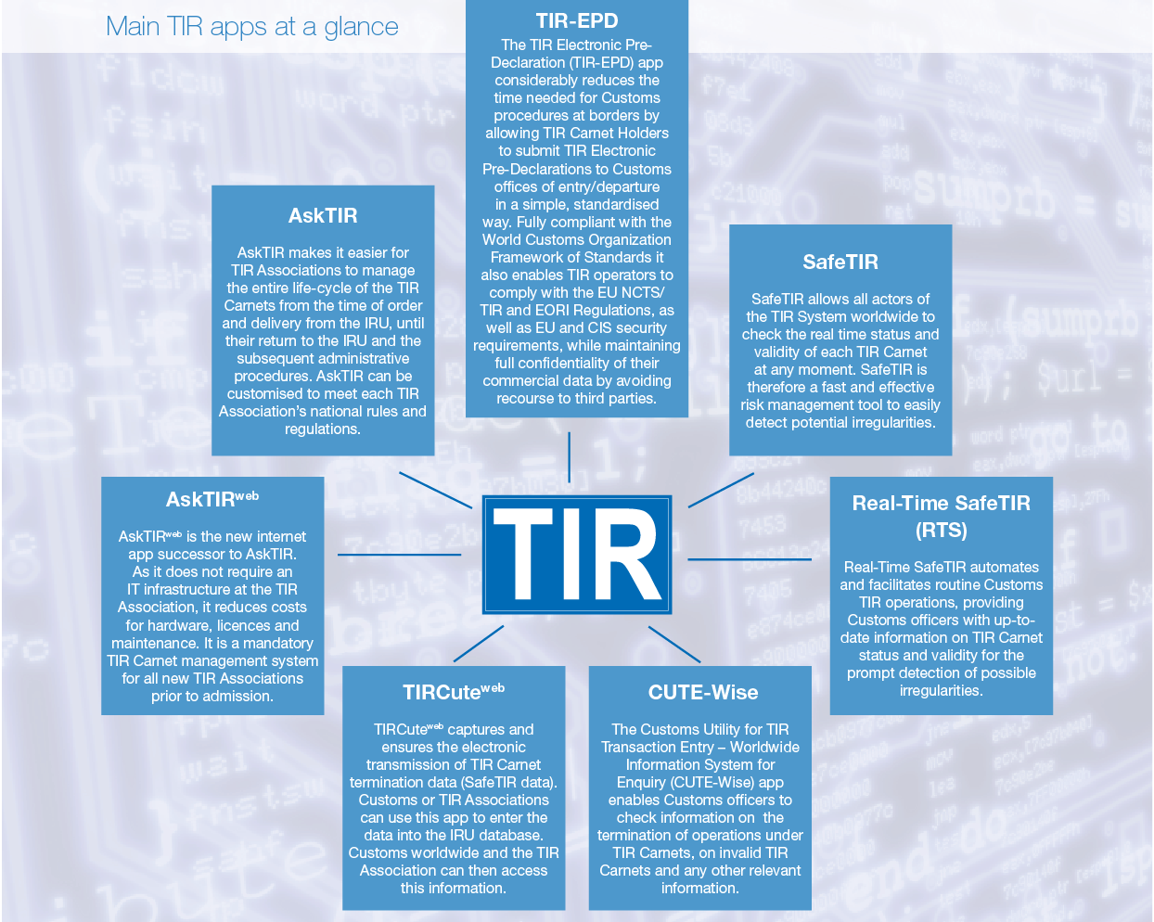
Computerised TIR procedures

Slide 23
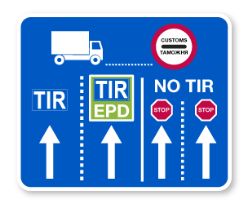
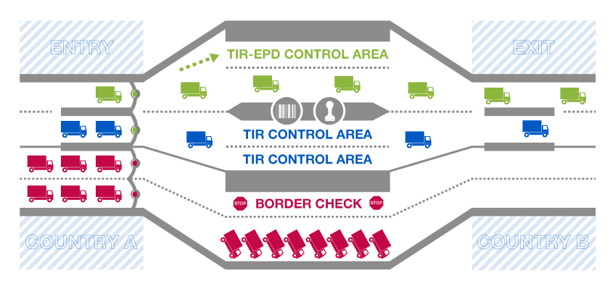
TIR-EPD Green Lanes blueprint
Reduce border waiting times, facilitate trade, increase risk management efficiency, improve customs controls, secure trade and transport!

Slide 24


WCO SAFE Framework
Requirement
fulfilled by
✪
✪

Slide 25
IRU`s Recommended Next Steps!
IRU/US Chamber of Commerce update NELTI-4 to contain port connections as well as Israel and Palestine!
IRU/Customs Administrations to develop an Intermodal TIR Pilot Project in order to put in place key TIR risk management tools and ensure smooth flow of goods across the MECC Region.
IRU assists Customs Administrations of Egypt and Palestine to join and implement TIR System.
IRU/MECC and National Authorities conduct Model Highway Pre-feasibility Studies along intermodal itineraries across the MECC region.

Slide 26
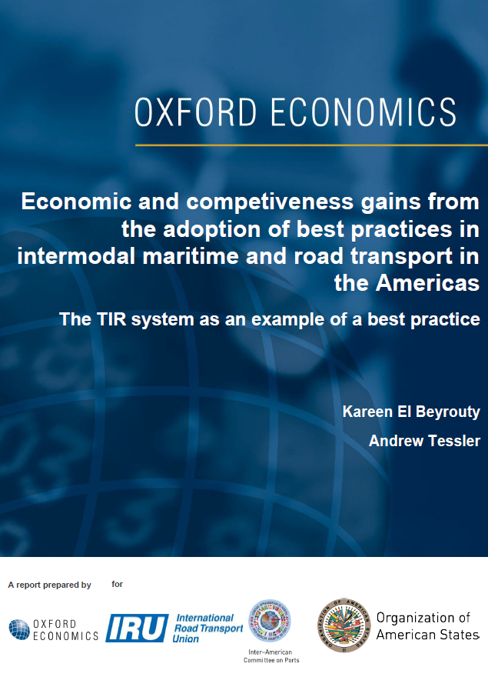
Oxford Economics and Organisation of American States (OAS) Report on TIR
TIR as a best practice for intermodal transport facilitation in Latin American Countries
Results of the report have shown significant benefits in TIR implementation for LAC countries

Slide 27
Oxford Economics and Organisation of American States (OAS) Report on TIR
TIR as a best practice for intermodal transport facilitation in Latin American Countries
Argentina, Brazil, Mexico: exports boost by up to
USD 9 billion total
Border waiting times cut by 50% between Latin American countries

Slide 28
Findings of Oxford Economics and OAS report on TIR potential for trade facilitation in LAC
Implementation of TIR could boost exports in Argentina, Brazil and Mexico for a total of $9 billion per annum
In Argentina and Brazil most of the boost occurs through intermodal trade, while in Mexico’s case - road transportation
TIR system simplifying and harmonizing formalities would
cut border waiting times between LAC by 50%
Port Customs clearance and technical control takes on average
2 days in Argentina, 3 days in Brazil and 2 days in Mexico compared to
only 1 day in major European countries utilizing the TIR system

Slide 29

Facilitate Road Transport for their future!

