Slide 1

New TIR – EPD submission process

Slide 2
Contents
New TIR-EPD Submission
TIR-EPD status check
TIR-EPD printable documents
Using previously submitted TIR-EPD as a template for creating a new one

Slide 3
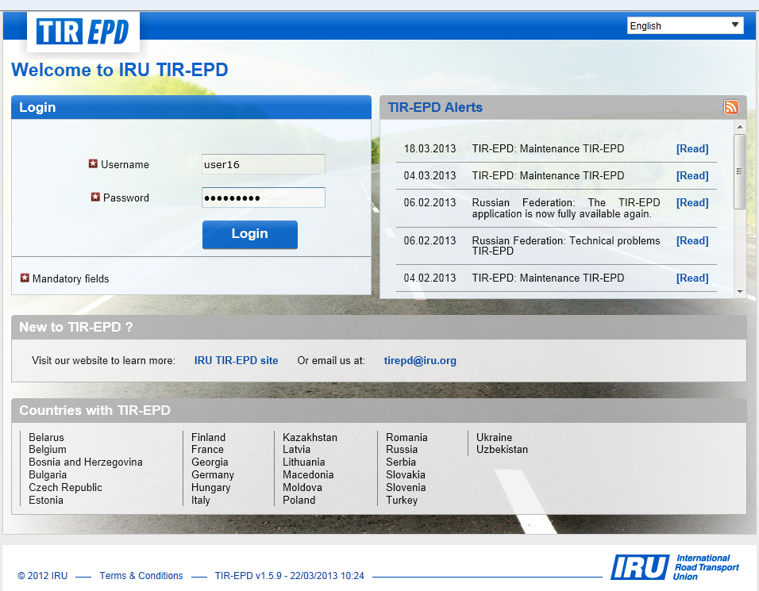
TIR-EPD Demo Login page: https://demo-tirepd.iru.org/

Slide 4
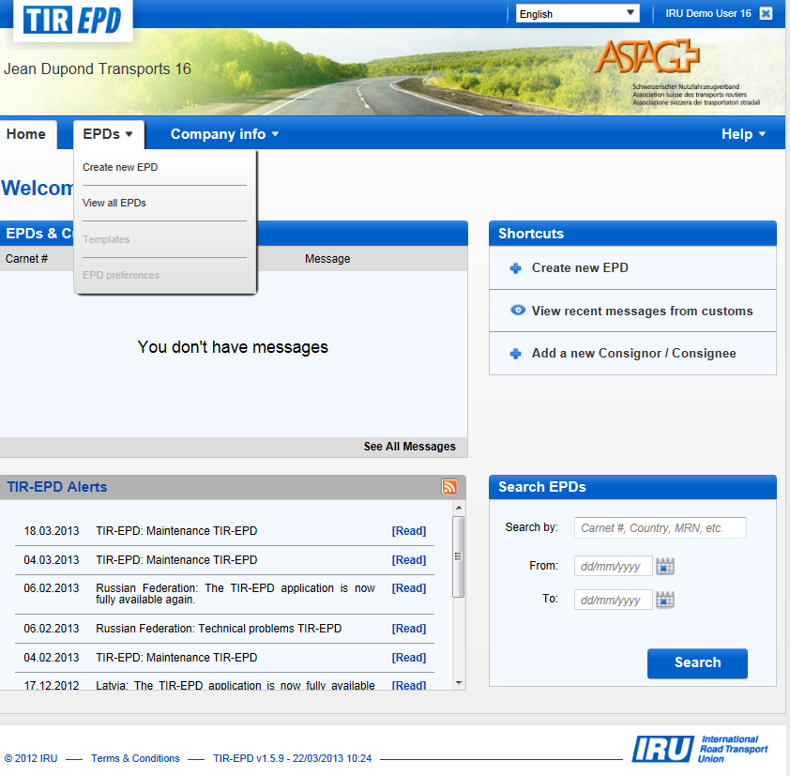
Create New TIR-EPD

Slide 5
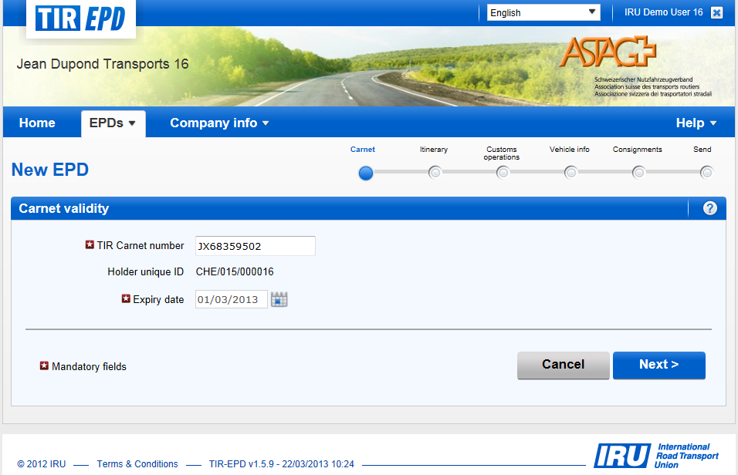
Step 1: TIR Carnet Information

Slide 6
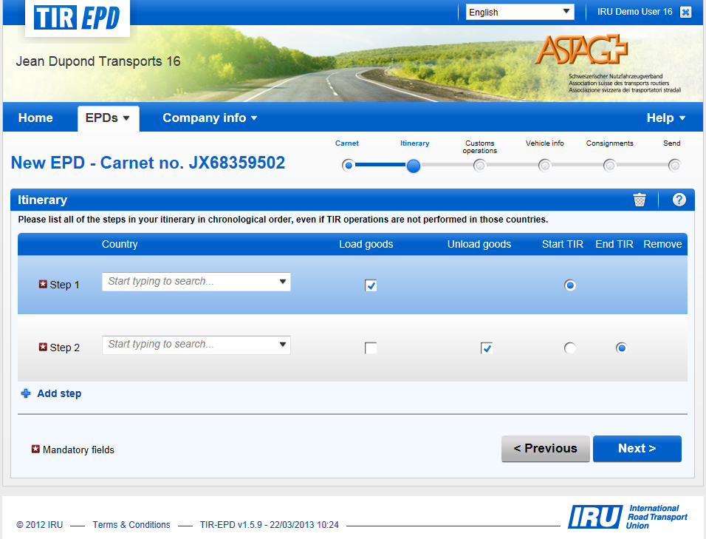
Step 2: Itinerary

Slide 7
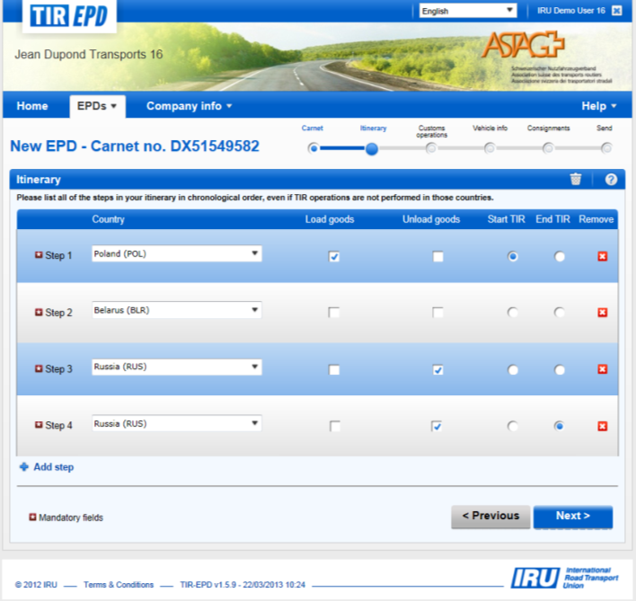
Itinerary page- completed
List all the steps in your itinerary in chronological order, from first Load to last Unload (even if they were not under TIR)
Include all the countries of your itinerary, including transit countries.
Indicate Start and End of TIR operation, all places of Loading and Unloading.
If you have more than one Load or Unload in the same country, please list the country as many times as necessary

Slide 8
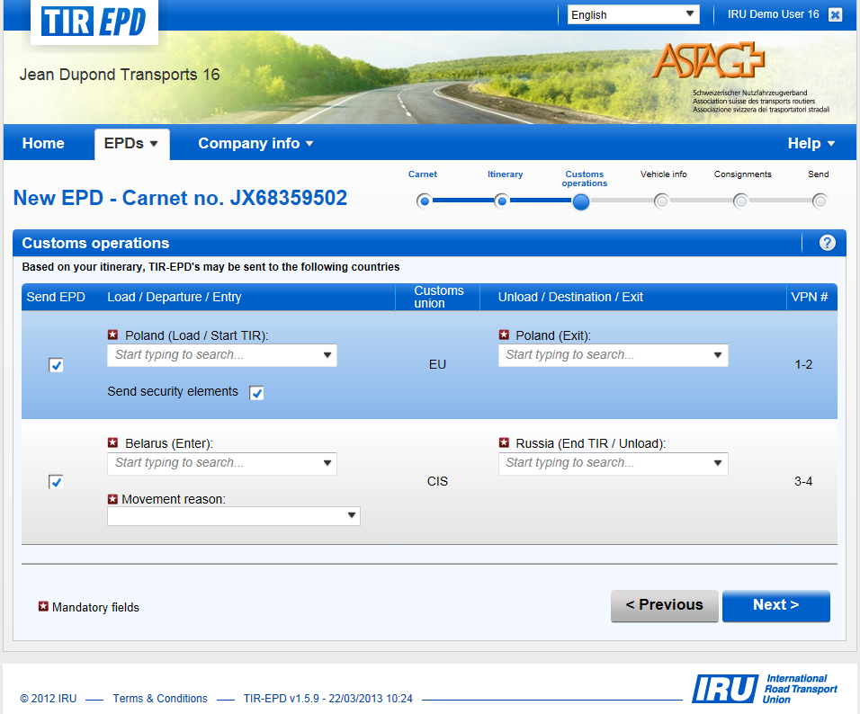
Step 3: Customs Operations

Slide 9
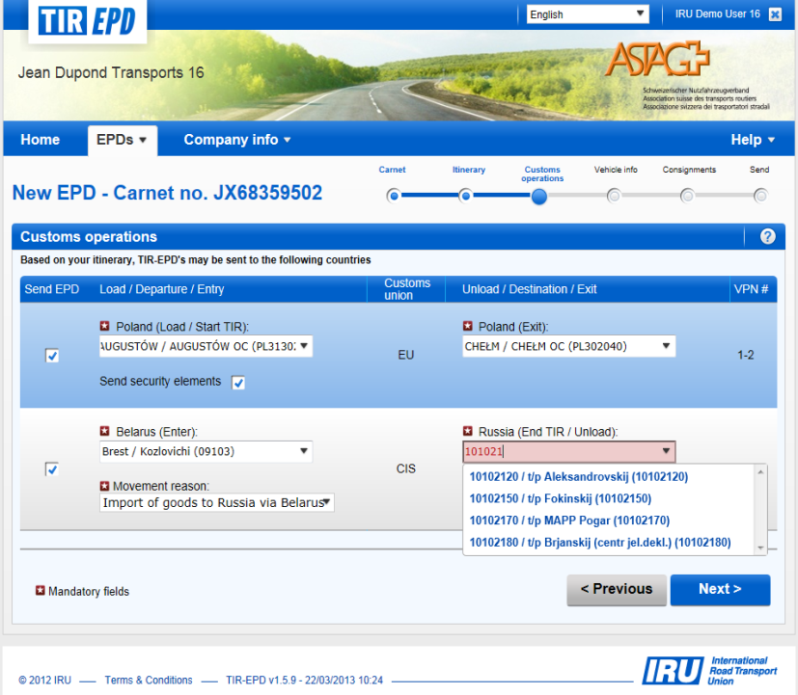
Customs operations page- completed
A customs operation in countries within a same customs union is represented as a single line.
The operations for which it is possible to create EPD have "Send EPD" check box. You may uncheck the box to not submit the EPD.
VPNs are calculated automatically. In case of any discrepancies, please verify your itinerary on the previous page.
Please select the Customs Offices where it is mandatory.
To select the Customs Office, start typing its name or its code (min 2 characters). The application will display the search results for you.
If the line with the place of Loading or Unloading does not have the "Send EPD" check box, you may put the free text as a value of such place

Slide 10
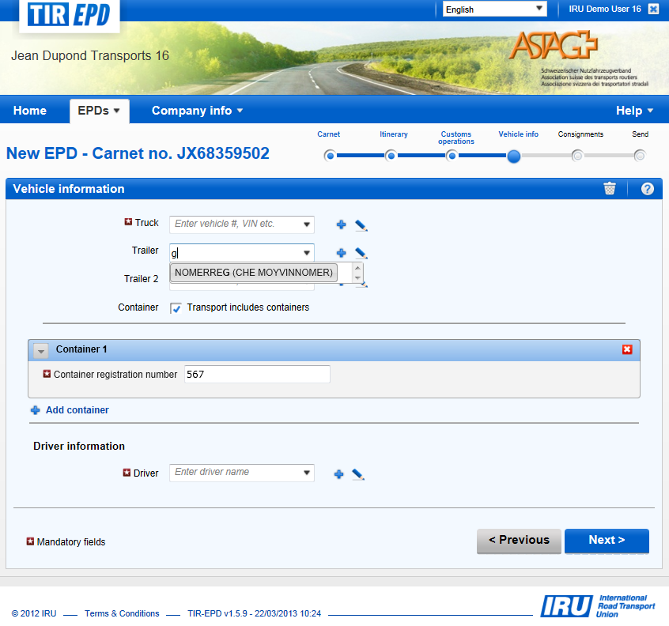
Step 4: Vehicle Information
If you have saved vehicles, please start typing the plate number or VIN. The application will display the search results for you.
To add new vehicle, please use the appropriate icons next to the field.
Indicate all your containers by checking the container box.
If you have saved driver, please start typing his last, first or middle name. The application will display the search results for you.
The driver field appears only if you send the EPD to a country, which requires this element.
New driver or vehicle added will be saved for future use.

Slide 11
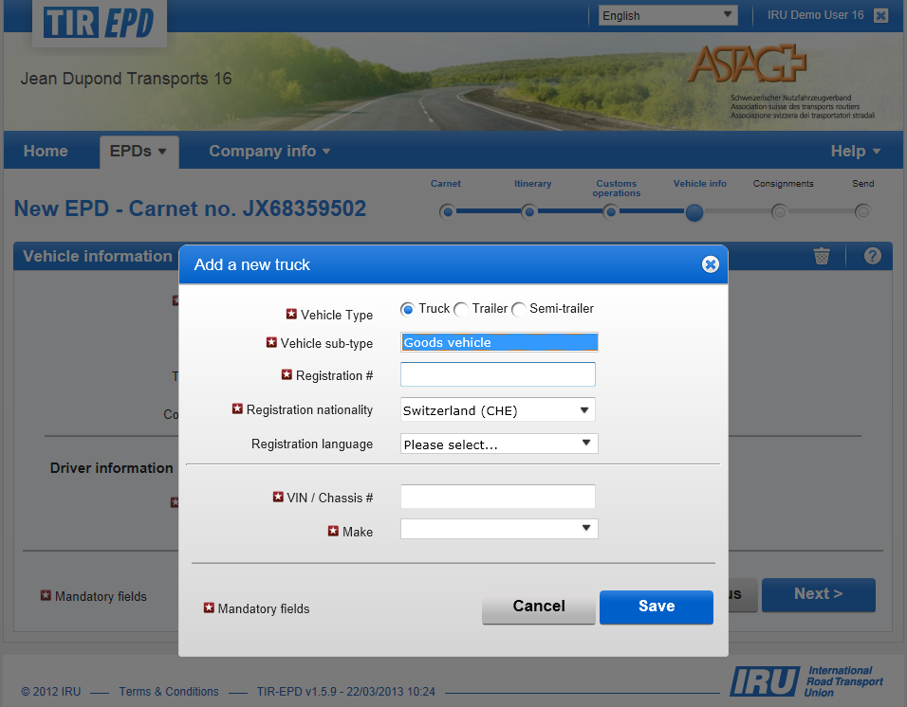
Vehicle Information-adding new
Complete all the mandatory fields marked marked with a star
Follow the same logics completing “Trailer” and “Semi-trailer” information as well as Driver Information

Slide 12
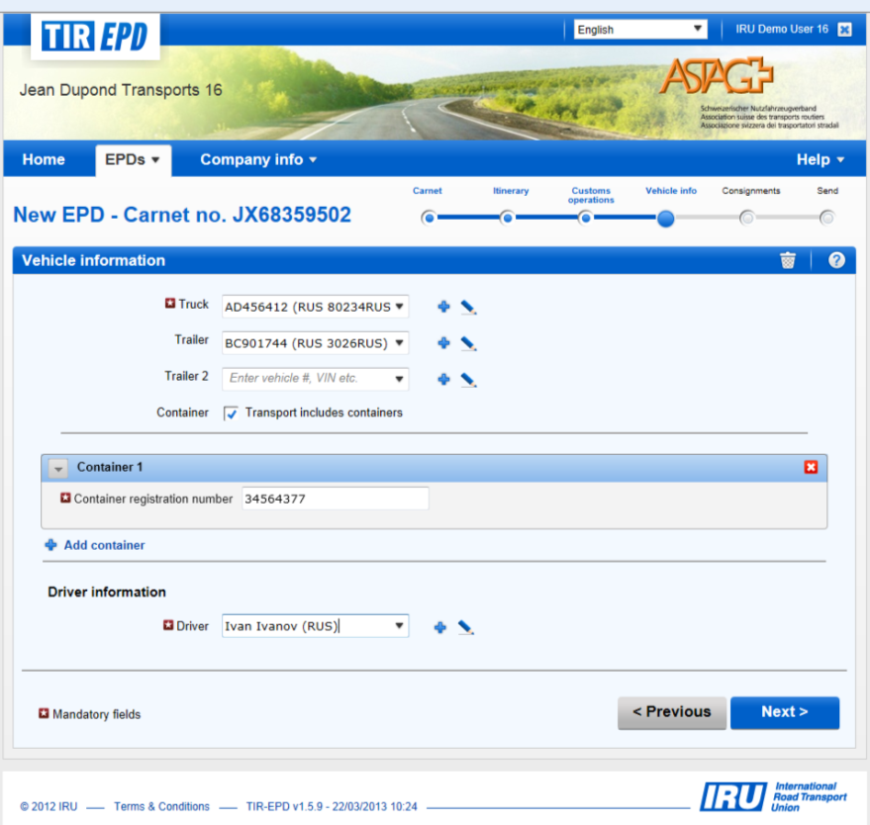
Vehicle Information-completed

Slide 13
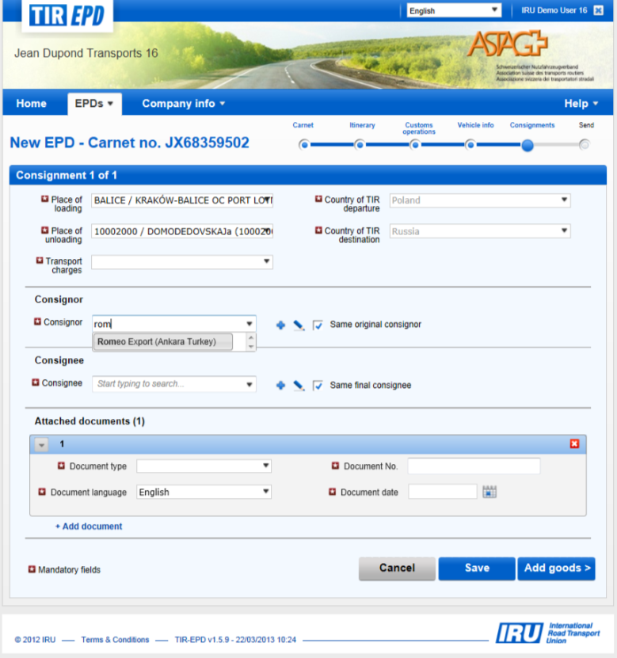
Step 5: Consignments
Chose relevant “Place of loading” and “Unloading” from the drop down list, that appears based on the info entered at “Customs Operations” Section”. If there was only one place of Loading / Unloading, it will be displayed automatically.
Complete all the mandatory fields marked by star.
If you have previously saved information on “Consignee” and “Consignor”, please start typing their names. The application will display the search results for you
To add new “Consignee” and “Consignor”, please use the appropriate icons next to the field.
New “Consignee” and “Consignor”,, added will be saved for future use.
To include information on attached documents use “Add Document” Icon.
Note! At this level indicate all the documents related to the entire consignment.
7. To include information on Goods item, use “Add Goods” Icon.

Slide 14
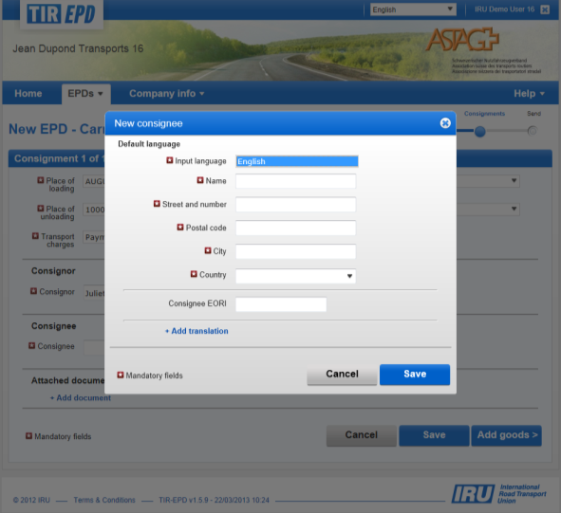
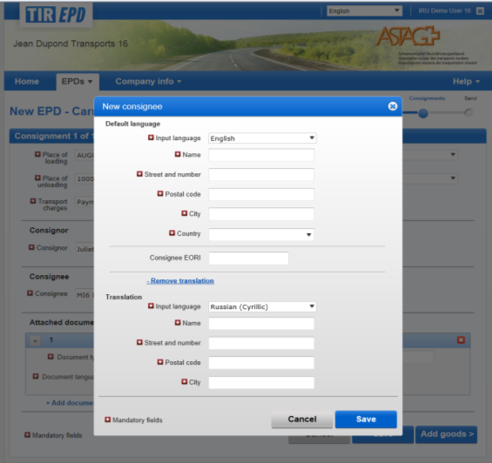
Entering information on a new Consignee/Consignor in 2 languages
Complete all the mandatory fields marked marked with a star
If you are submitting TIR-EPD to Customs Union and wish to include information on “Consignee” and “Consignor” using Cyrillic characters, please use “Add Translation” Icon and complete all the mandatory fields using Cyrillic characters

Slide 15
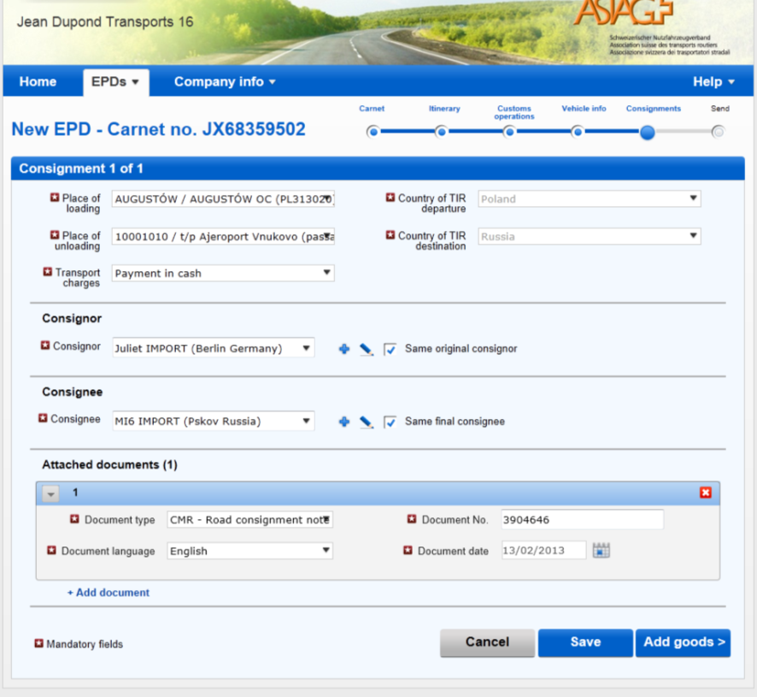
Consignments-completed

Slide 16
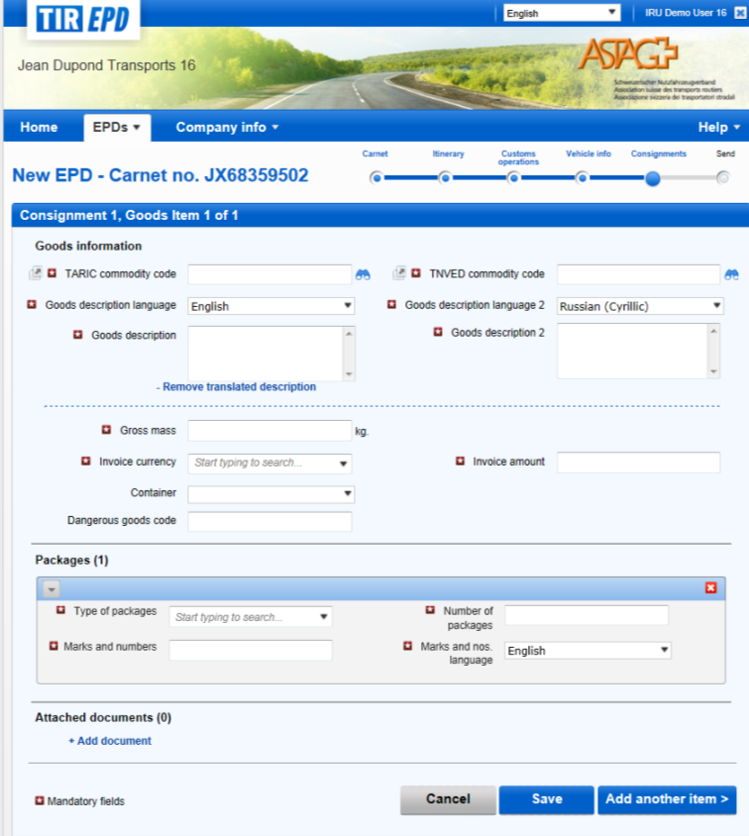
Step 6: Goods Item Information
Complete all the mandatory fields marked by star.
Do not forget to chose the container info from a drop down menu under the field “Container”
In the fields “Invoice Currency” and “Type of packages” start typing at least first 2 letters and the application will display the search results for you.
For more details on completion of ‘Goods description” field, please, refer to the next slide.
When all the information on Goods Item is completed, press the icon “Save” or “Add another Goods Item”
To include information on attached documents use “Add Document” Icon.
Note! At this level indicate all the documents related only to this particular Goods Item

Slide 17
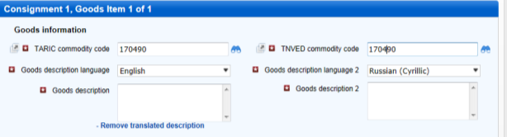
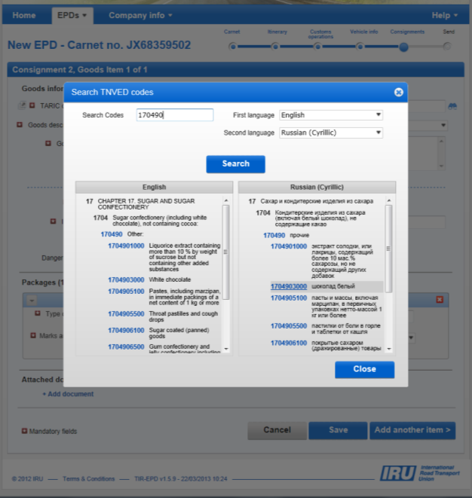
Goods Item-Goods Description
Enter TARIC (or TNVED) code in the appropriate field
You can enter the goods code manually in the “Goods description” field or click on binocular icon, following which Search TARIC (or TNVED) code window will open.
Only the codes in blue (with hyperlinks) satisfy the customs criteria for the respective country(-ies).
Click on the required code in blue and it will be inserted in the TARIC (or TNVED) commodity code field on the Goods information page. “Goods description” field will be filled automatically with the description corresponding to this code you have selected. Automatically selected text can be edited manually

Slide 18
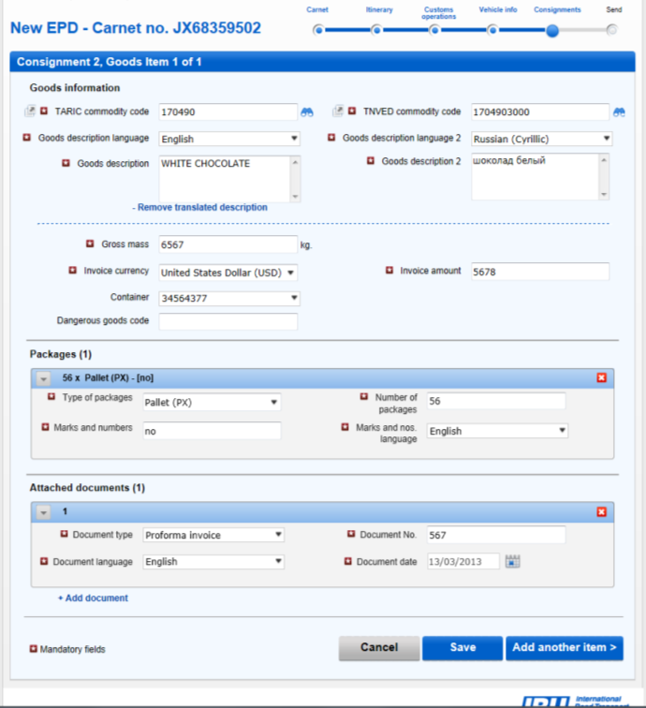
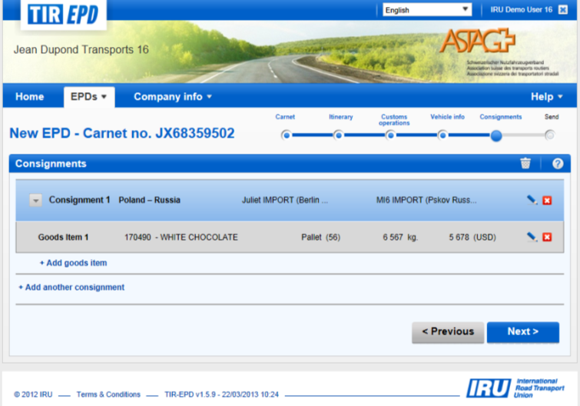
Goods Item-Goods Description-Completed
Make sure all the information on Goods items and Consignments is completed Correctly and press the button “Next”
If there are any changes to be done, you can always press on “Edit”
or “Delete” buttons.
3. You can add as many Consignments and Goods Items as required.

Slide 19
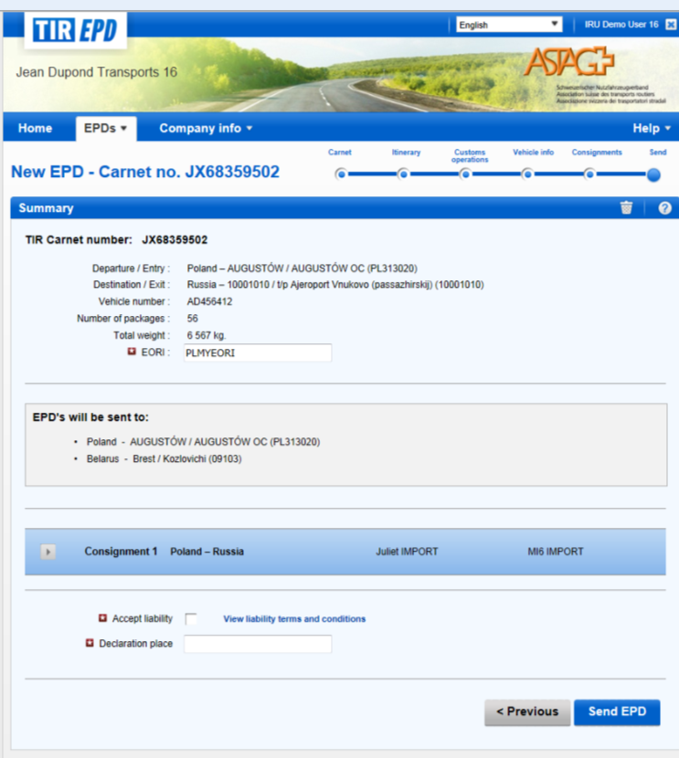
Step 7: Summary page
Complete your EORI number
View where your EPD will be sent
Check the box ”Accept liability”
Complete the field “Declaration place”
Press on “Send EPD” button

Slide 20
Checking TIR-EPD Status

Slide 21
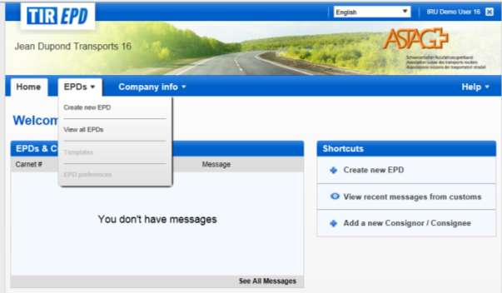
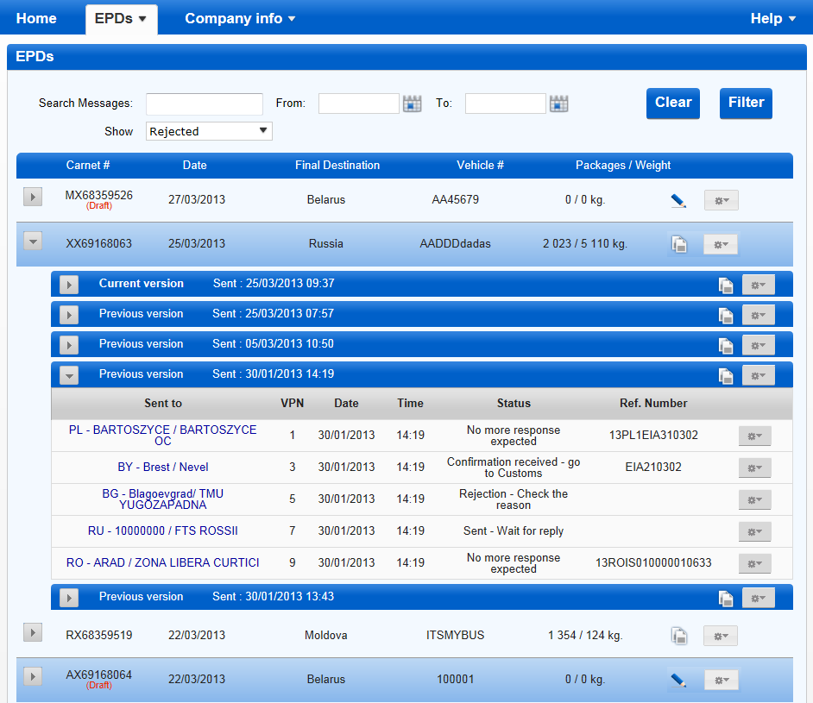

Checking TIR-EPD Status
After sending your TIR-EPD, you will be automatically redirected to Home page
To view the status of the TIR-EPD just sent, chose the icon “View recent messages from Customs”
alternatively
chose “View all EPDs” and apply search filters accordingly
By clicking on the Actions button in each line of the TIR-EPDs table you can view and print out the printable version of TIR-EPD

Slide 22
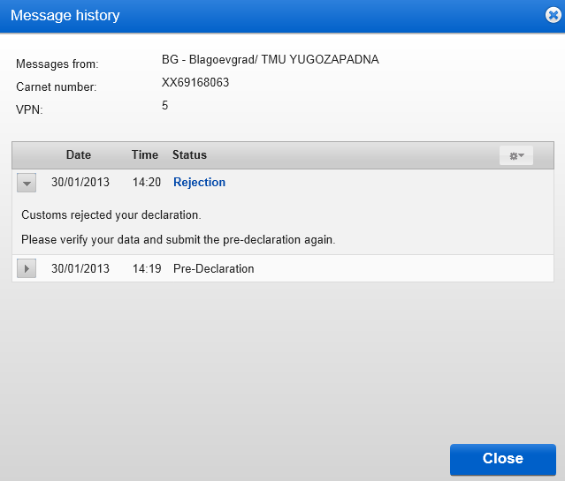
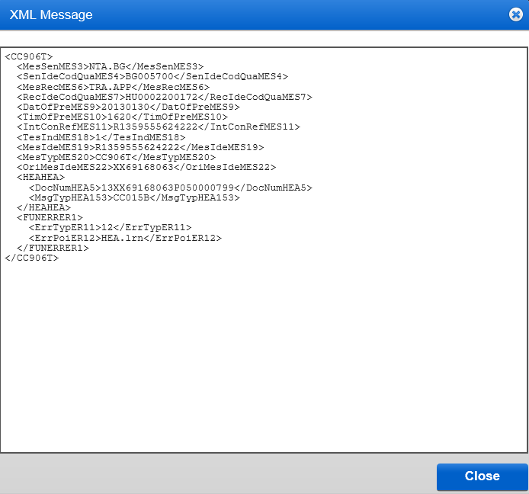
Checking TIR-EPD rejections reasons
Click on the customs office, where TIR-EPD was submitted, in the first column in order to see the history of the message exchange
If the message was rejected for some reason, you can click on the hyperlink of Rejection status to view the XML message, containing the rejection reason

Slide 23
TIR-EPD Printable Documents

Slide 24
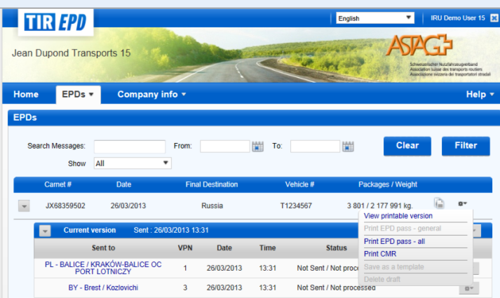
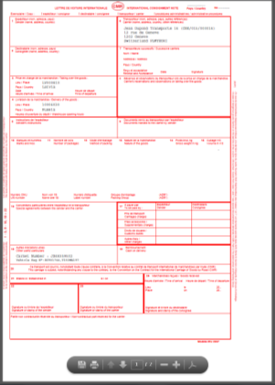
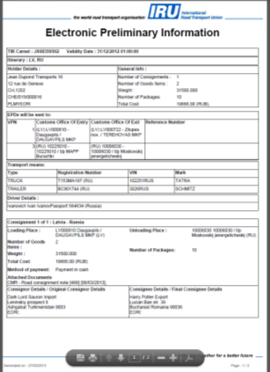
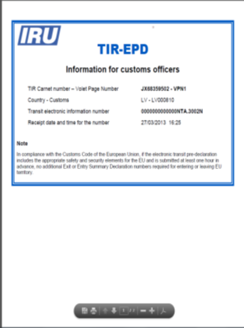
TIR-EPD printable documents
By clicking on the Actions button in each line of the TIR-EPDs table you can view and print out the printable version of the corresponding TIR-EPD with complete summary of the information sent., CMR and TIR-EPD pass.
CMR
Printable version
TIR-EPD Pass
Samples of printable documents

Slide 25
Using previously submitted
TIR-EPD as a template for
creating a new one

Slide 26
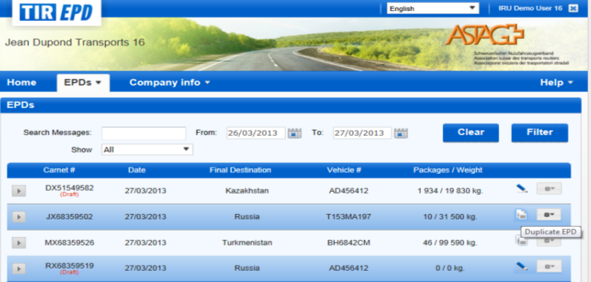
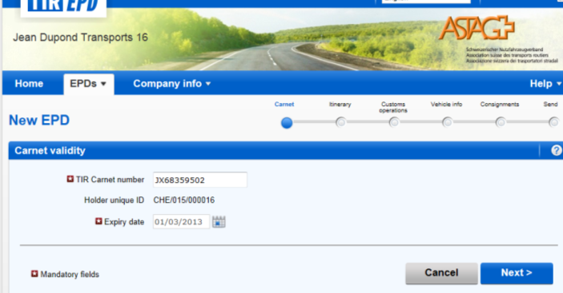
Create TIR-EPD from already existing
In case if you want to create a New TIR-EPD from already existing one, you can use the Icon Duplicate EPD button.
The application will automatically send you to Carnet Validity Section which is the first step in the new TIR-EPD completion.
You can edit the information on any page, as required.

Slide 27

www.iru.org

