Slide 1

Smart Enforcement – View from the industry
Michael Nielsen, General Delegate to the EU
IRU

Slide 2
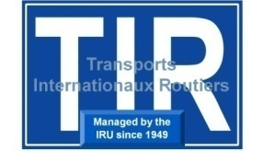
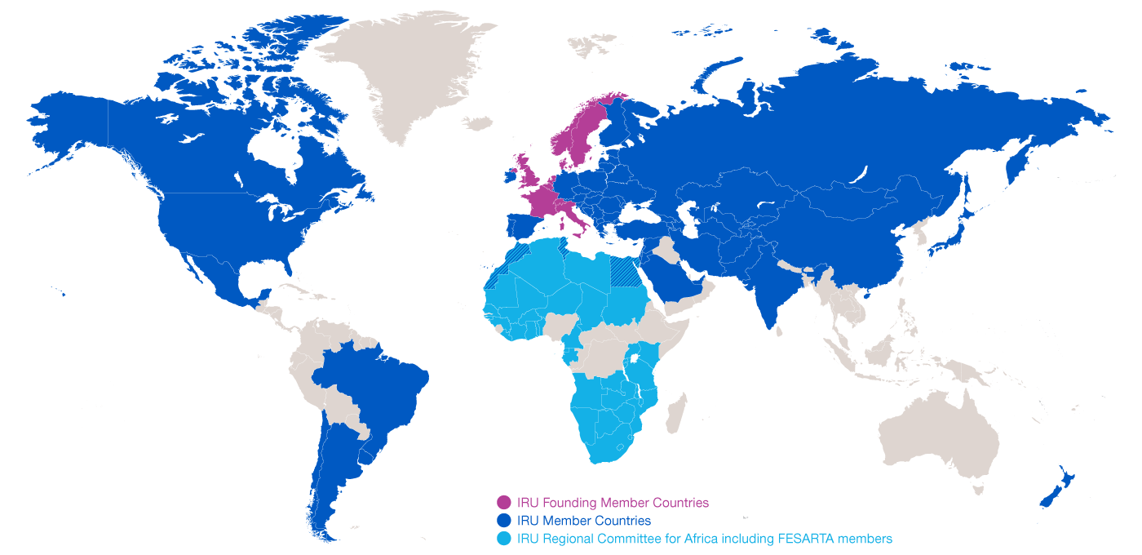


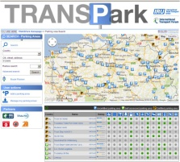


This is the IRU
Represent and deliver services to truck, bus, coach and taxi operators in more than 100 countries worldwide

Slide 3

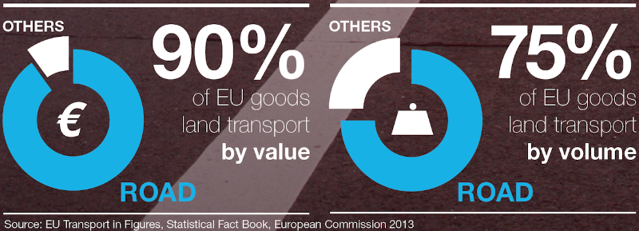
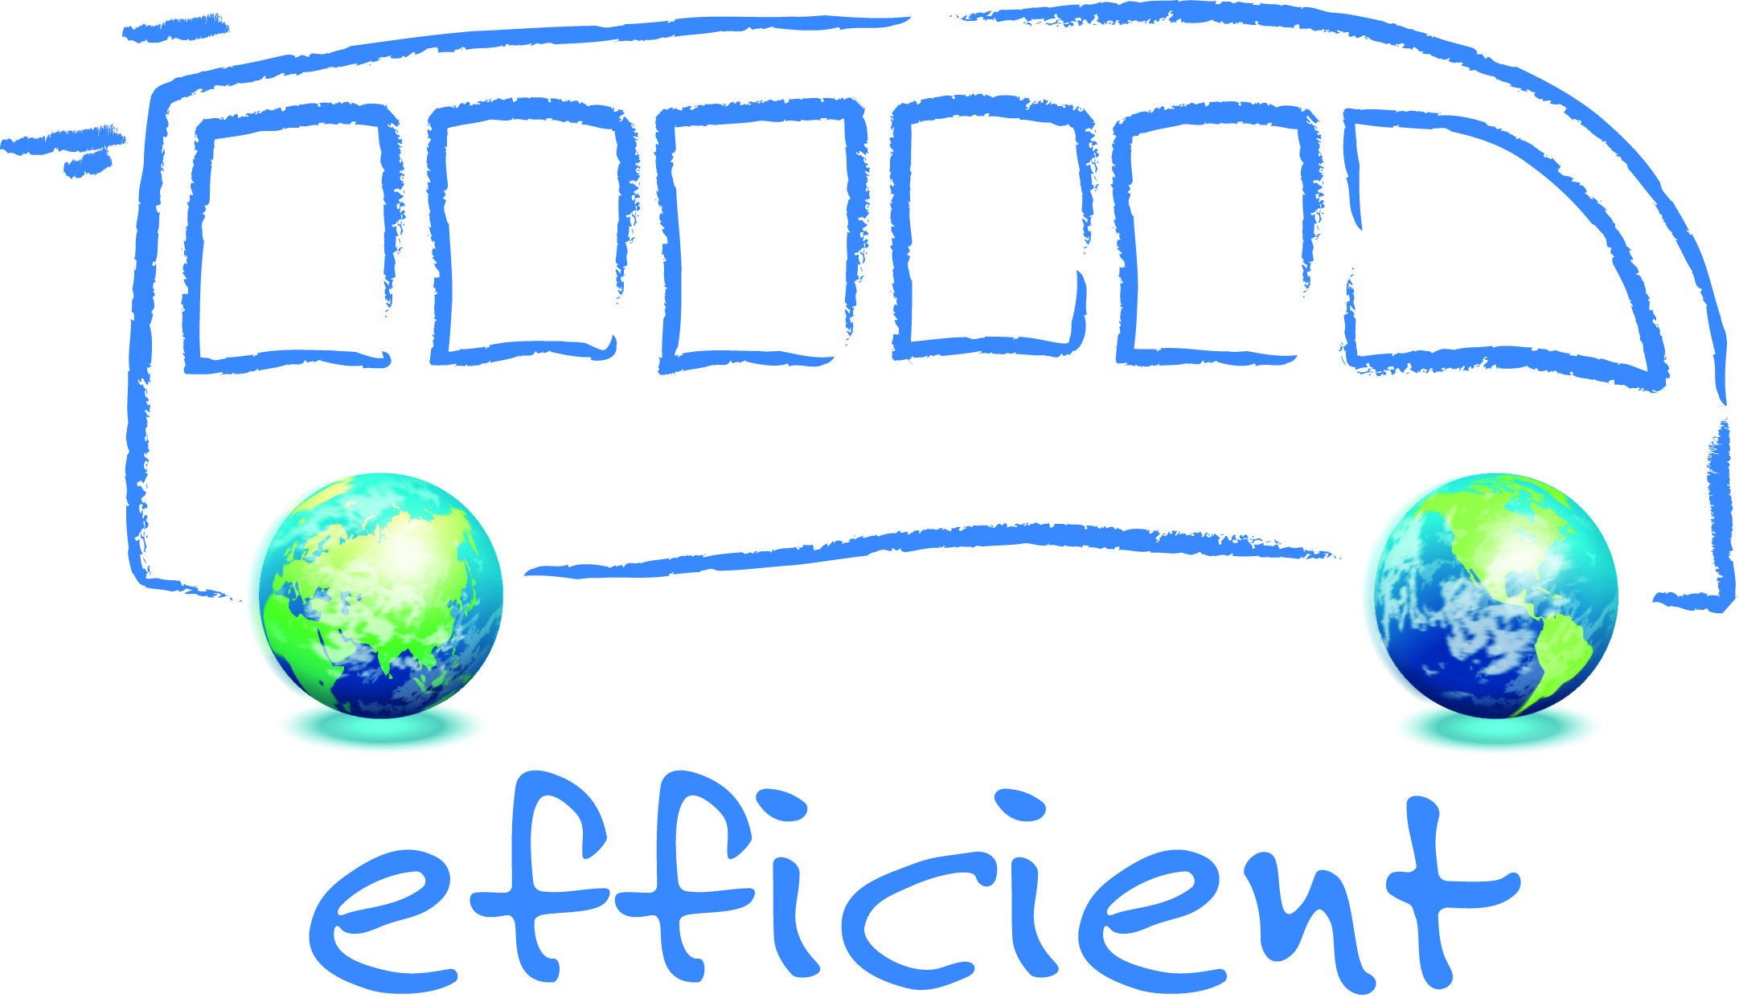

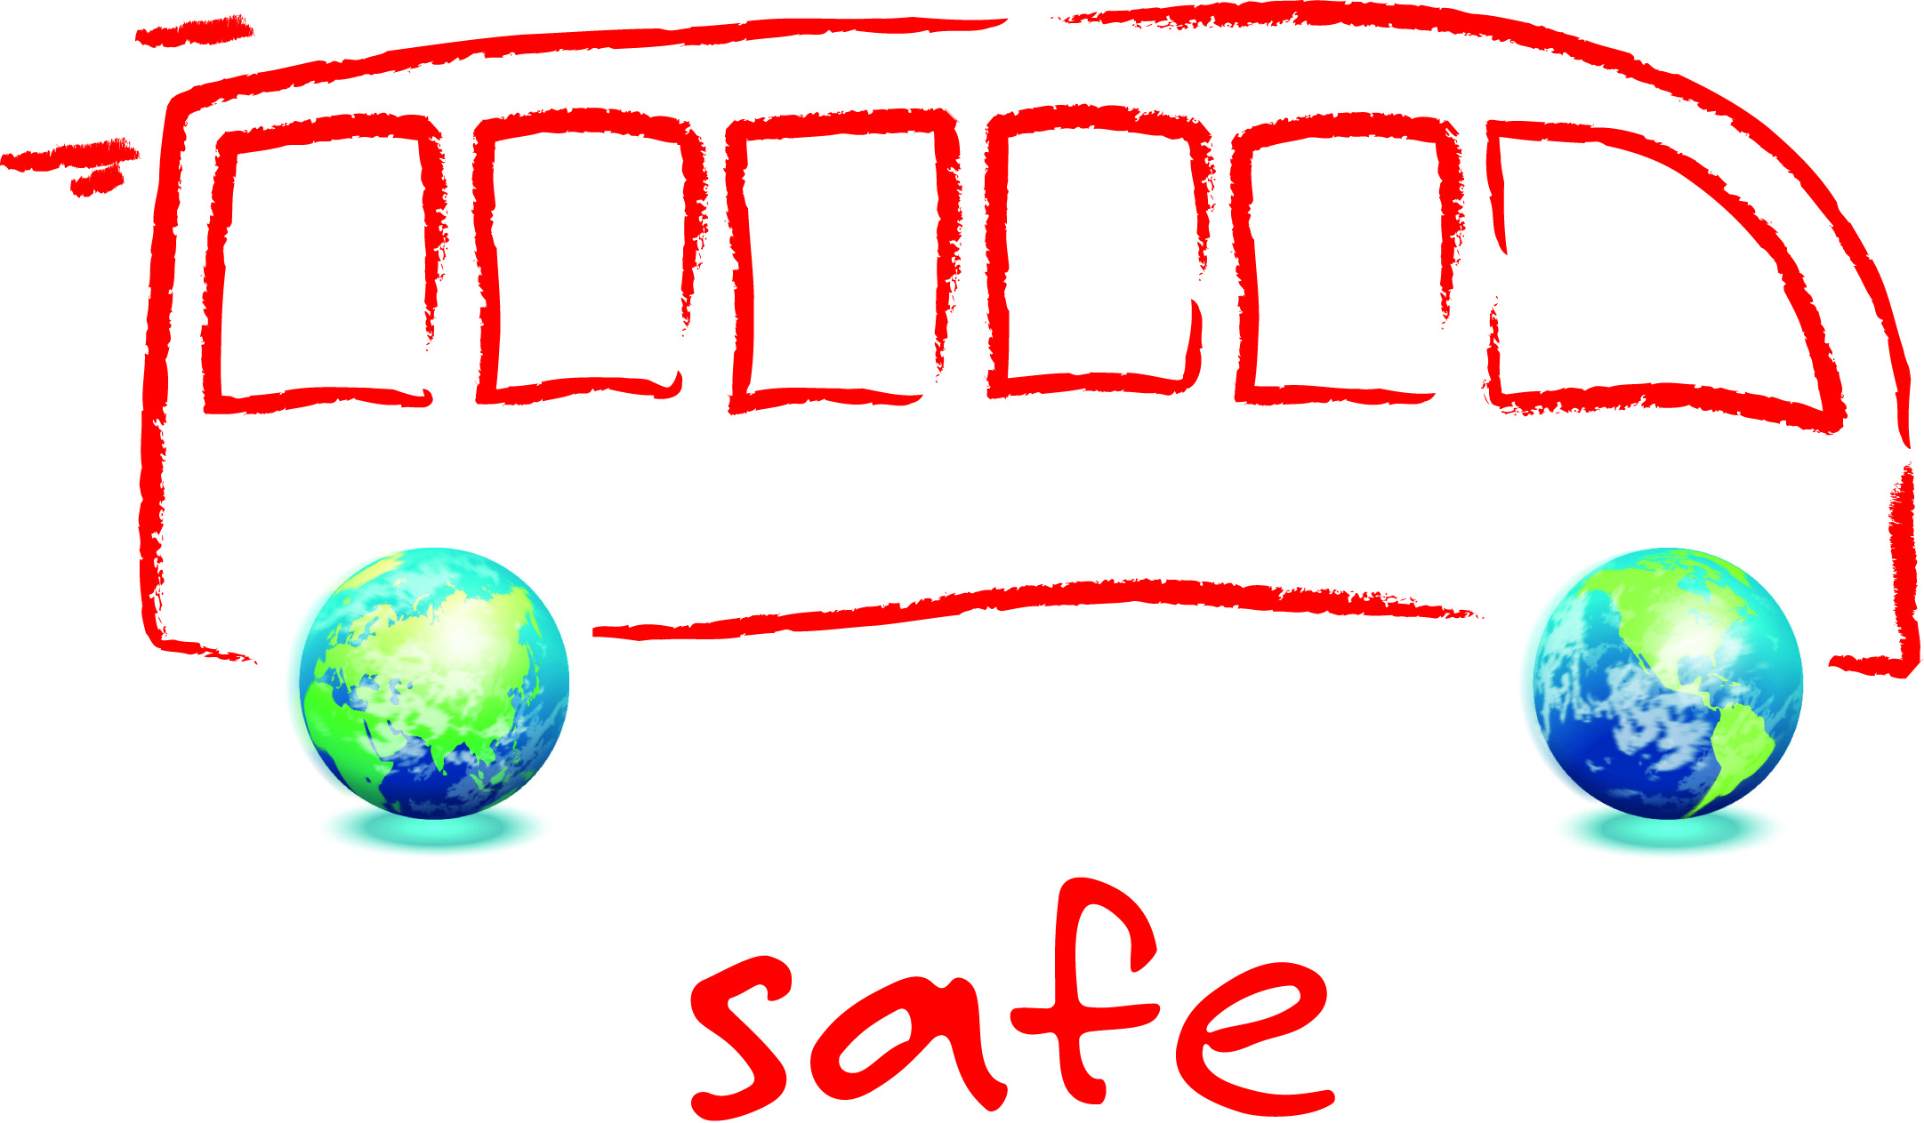

Importance of road transport in EU Economic growth and job creation
buses & coaches carry more people
than rail, tram & metro combined

Slide 4
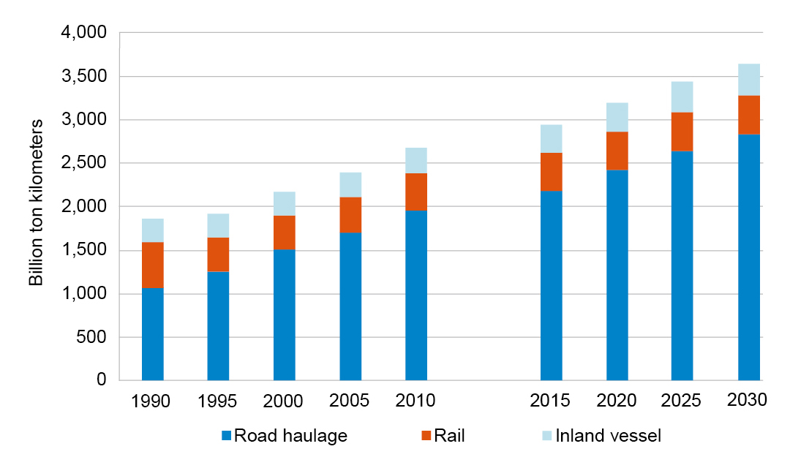
Forecast of transport activity in the EU until 2030
Road haulage
Expected growth of transport activity from 2010 to 2030:
44 % in the EU
Source: 2014 Dekra and ZF Study on the future – Fernfahrer 2.0

Slide 5

Complex EU market situation
Market
Crisis
State-owned integrators
Unclear Rules
Prices
Unfair competiton
New entrants not respecting existing law
Intermediaries

Slide 6
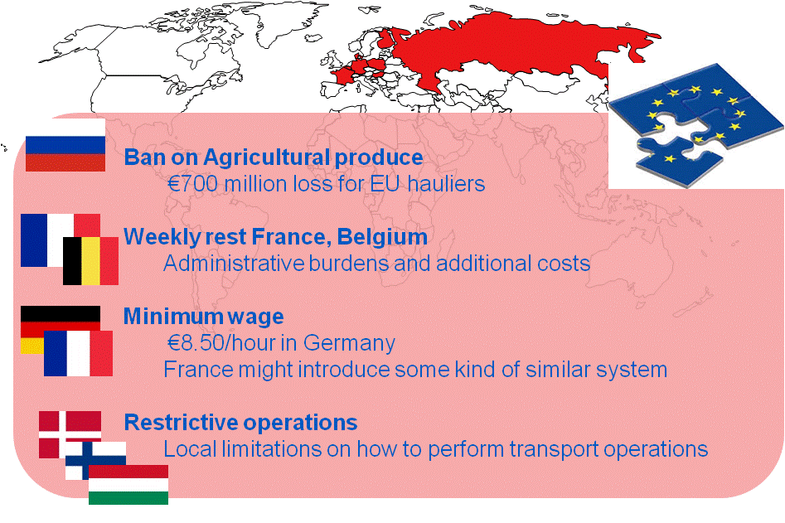
Market functioning

Slide 7

Where are we today?
COMPETITION
RULES
PRICE PRESSURE
Increased pressure from e. g. state owned integrators on prices without consequences for shippers and/or freight forwarders IRU wants access to profession and joint liability across the supply and mobility chain
Unfair competition by exploiting loopholes in the system IRU wants competitive environment with level playing field
Different interpretations and practises, misleading statistics IRU wants simple rules, uniform interpretations and adequate enforcement
SOLUTION
Single Enforcement Area

Slide 8

Enforcement challenges
EU MARKET SITUATION
OPERATORS ADAPT TO NEW REALITIES + USE NEW BUSINESS MODELS
MOST OF THEM PERFECTLY LEGAL
ENFORCEMENT AIM – REPEATED/STRUCTURAL INFRINGEMENTS
NOT A CASH COW
FOCUS ON ROAD SAFETY NOT ADMIN OMISSIONS
ENFORCEMENT COMPLICATED
EU WIDE OPERATIONS
COMPLEX STRUCTURES and UNCLEAR RULES
Minimum standards for checks needed

Slide 9

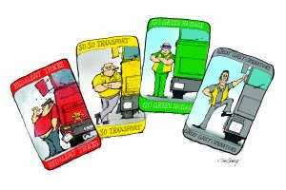

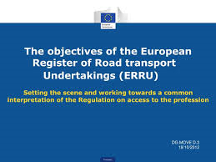

Smart Enforcement
UK Operator Compliance Risk Score
(OCRS)
NL Covenant System
Use risk rating
Use ERRU
Cooperate
cross border

Slide 10
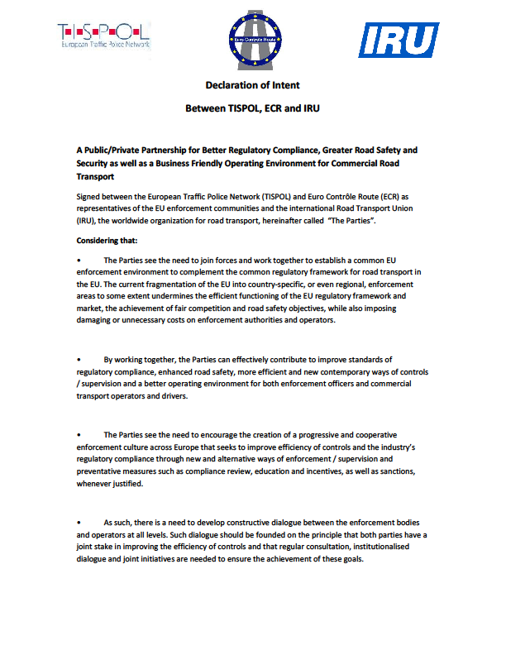
Working together
2011 IRU/ECR/TISPOL Declaration of Intent
Annual Joint Work Programmes
Harmonised interpretations and enforcement requirements
- Improving the quality of enforcement via common standards of training especially through the TRACE and CLOSER projects!
- Intensified cooperation in the field of safe and secure parking especially through the TRANSPark project
- Work towards fair, dissuasive, proportionate and better aligned penalties
Euro Contrôle Route/TISPOL/IRU
Memorandum of Understanding on passenger transport enforcement

Slide 11

Working together
THE BEST FUTURE IS ONE
WE MAKE TOGETHER
Let’s jointly create the most efficient and professional transport system for the future

