Slide 1
IRU TIR-EPD

Slide 2

IRU TIR-EPD - a tool for submitting advance information on goods
Advance information on goods as one of central elements of WCO SAFE
Electronic pre-declaration mandatory in EU + Safety and Security elements
Electronic preliminary information mandatory in Customs Union
TIR- EPD satisfies all national laws requirements of all countries connected to TIR-EPD.

Slide 3
IRU TIR-EPD: Concept
Authorised holder sends preliminary information on goods to customs of all countries of his itinerary via IRU TIR-EPD free-of-charge
IRU TIR-EPD ensures handling and transmission of this information to all customs authorities
Customs receive information on goods for preliminary risk analysis and send confirmation to holder.

Slide 4
Advantages for Holders
Free of charge - no need for broker assistance
No access to the confidential commercial data by any third party
Exclusively with TIR-EPD: EPD sent simultaneously to all countries
Exclusively with TIR-EPD: User interface in national languages
Accessible via Internet from anywhere
Simpler and faster border crossing procedures, money economy,
and increased competitiveness
© International Road Transport Union (IRU) 2012

Slide 5
Value for Customs
Advance information advance risk analysis in line with WCO SAFE
No need for manual data entry
Security check against the TIR central database (CUTE-Wise)
Only valid TIR carnets can be submitted with TIR-EPD and only by authorised holders
Identical information goes to all customs
Possibility to adjust TIR-EPD to national customs requirements
NCTS and ASYCUDA compatible

Slide 6
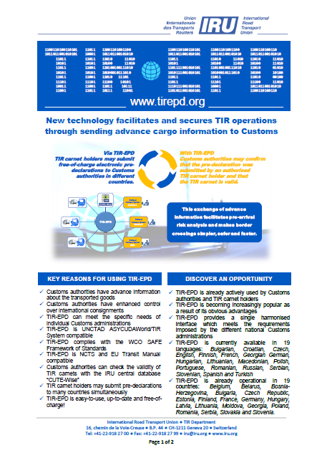
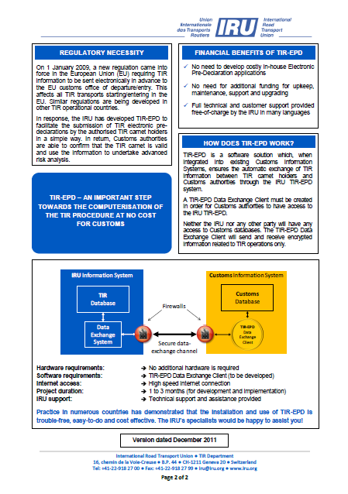
TIR-EPD Brochure for Customs
Explaining advantages and benefits for Customs
Page 1
Page 2

Slide 7
I
TIR-EPD Geographic extension
27 countries
IRU TIR-EPD Operational
Finalisation stage
Development and
Testing stage
N O R W A Y
F I N L A N D
S W E D E N
Discussion and
Preparation stage
E S T O N I A
D E N M A R K
L A T V I A
R U S S I A N F E D E R A T I O N
Russian Fed.
L I T H U A N I A
I R E L A N D
U N I T E D
B E L A R U S
K I N G D O M
NETHERLANDS
G E R M A N Y
P O L A N D
B E L G I U M
L
U
X
.
C Z E C H R E P U B L I C
U K R A I N E
F R A N C E
S L O V A K I A
K A Z A K H S T A N
S W I T Z E R L A N D
A U S T R I A
H U N G A R Y
R O M A N I A
M O L D O V A
SLOVENIA
C R O A T I A
SERBIA
BOSNIA-
HERZEGOVINA
B U L G A R I A
I T A L Y
MONTENEGRO
MKD
G E O R G I A
K I R G I S T A N
S P A I N
ALBANIA
ARMENIA
A Z E R B A I J A N
T U R K M E N I S T A N
U Z B E K I S T A N
P E O P L E ‘ S
R E P U B L I C
O F
C H I N A
PORTUGAL
G R E E C E
T U R K E Y
A Z E R B.
T A J I K I S T A N
S Y R I A N
I R A N
A F G H A N I S T A N
CYPRUS
A R A B
T U N I S I A
L E B A N O N
R E P U B L I C
M O R O C C O
I S R A E L
J O R D A N

Slide 8
Growth of TIR-EPD submission
Average monthly grown: 7%
Weekly submission: > 13’000

Slide 9
TIR-EPD vs TIR Carnet
TIR-EPD = TIR Carnet + additional information
(in compliance with all national requirements)

Slide 10
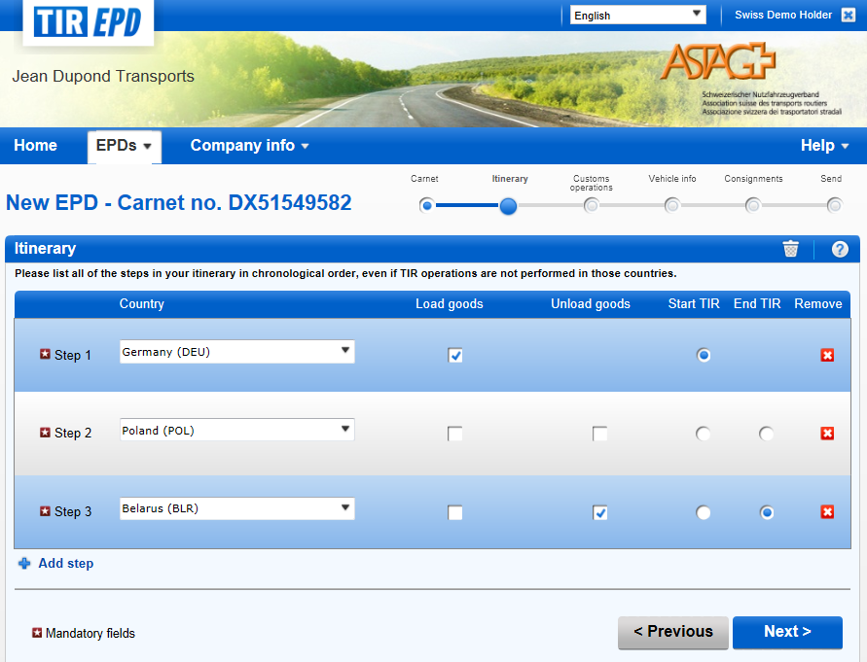
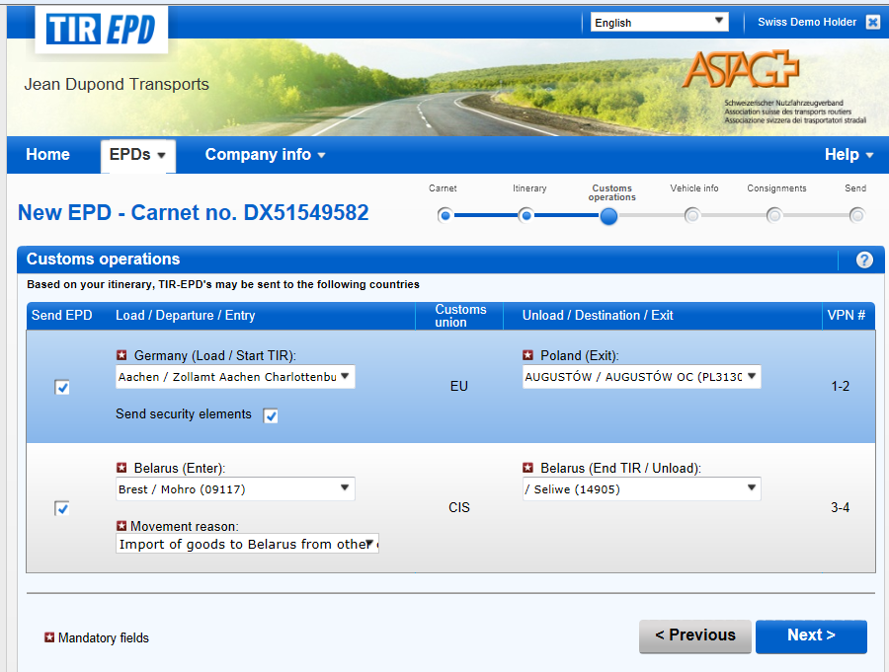
New version of IRU TIR-EPD: from 15 April 2013
https://tirepd.iru.org

Slide 11

Main advantages of new TIR-EPD interface
Modern easy to use interface
6 easy steps:
One TIR-EPD is sent to EU and Customs Union (no need to create a separate TIR-EPD)
Based on itinerary automatic calculation of required fields
Automatic search of countries and customs
Possibility of forming consignments
No need to attach accompanying documents for each goods position (only at consignment level)

Slide 12
Recommendations for Holders
Register for TIR-EPD: ask your Association to create an account for you
Submit your pre-declarations via TIR-EPD
Ask for the Association/IRU support in case if you have questions
Use your reference number to cross the border faster and easier without sharing your confidential information with 3rd parties

Slide 13
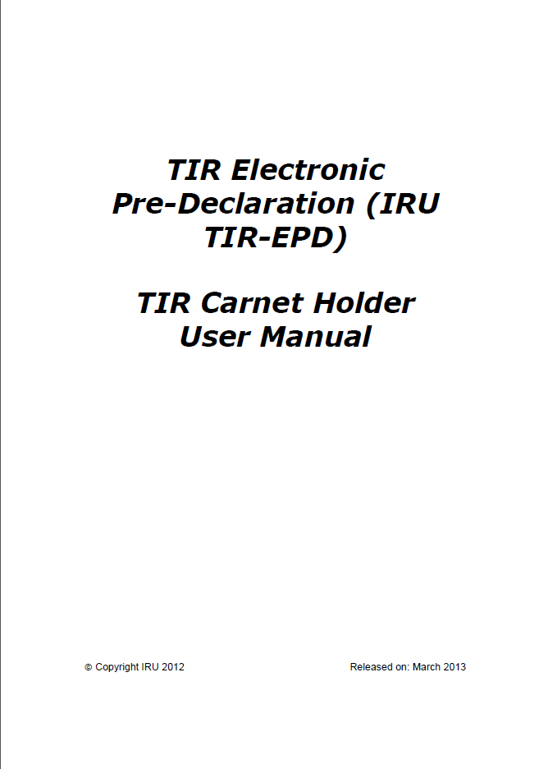
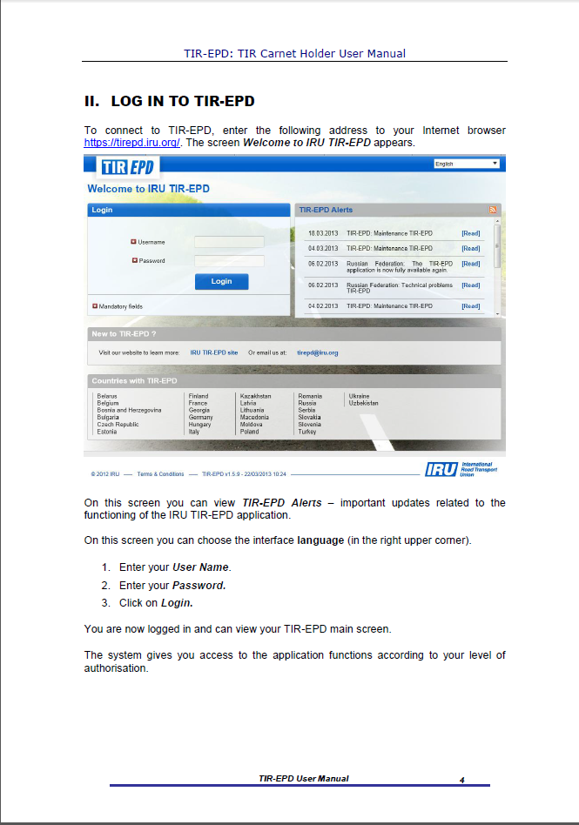

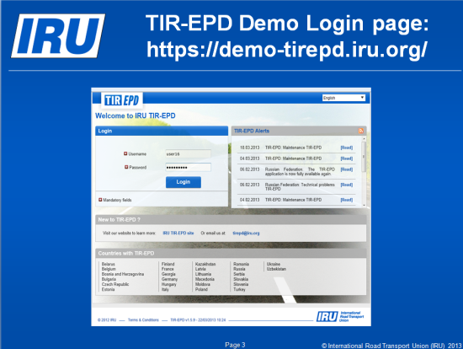
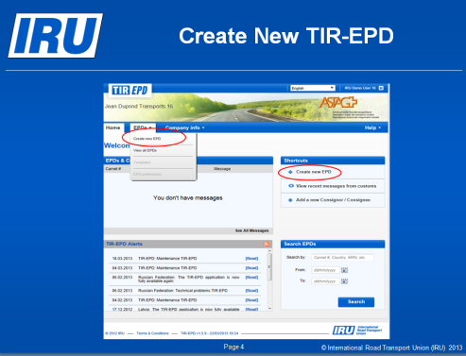
TIR-EPD Support Materials
Available on the IRU site: http://www.iru.org/en_tirepd_information
Holder User Manual
Presentation with step-by-step submission process

Slide 14
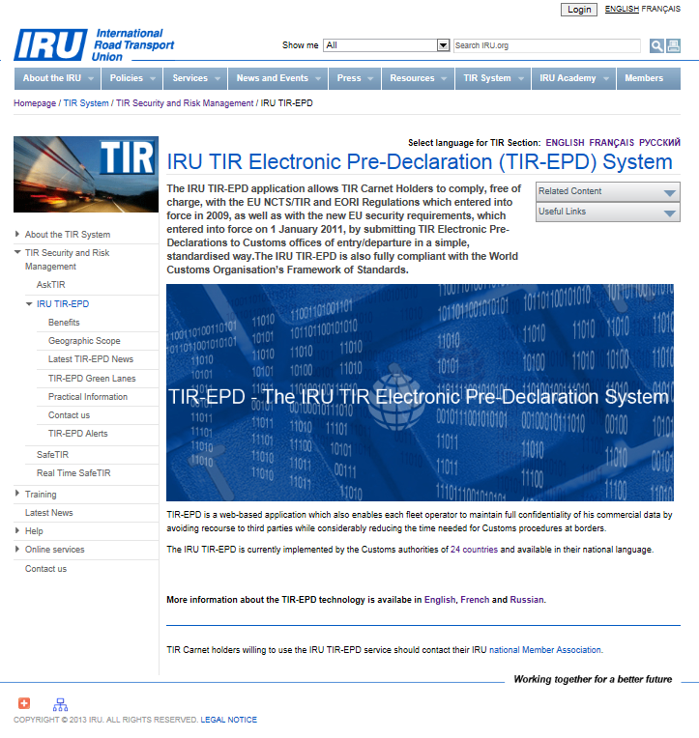
TIR-EPD information web page
http://www.iru.org/en_iru_tir_epd
Structured menu:
Benefits
Geo-scope
News
TIR-EPD Green Lanes
Practical info
Contacts
Alerts
Available in EN, FR, and RU

Slide 15
Address your association or
iru tir-epd hotline at: tirepd@iru.org
for any further information

