Slide 1


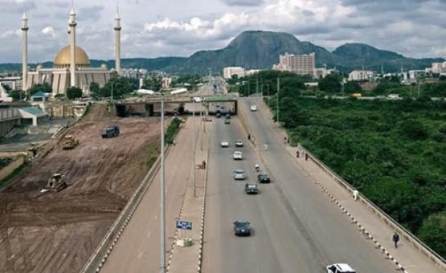
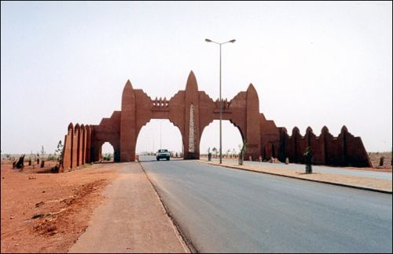
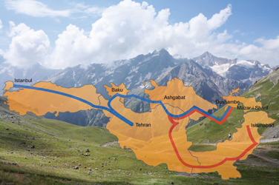
IDB Initiatives for Developing Trade and Transport across Europe, Asia and the Arab region
Dr. Walid Abdelwahab, Director
Infrastructure Department

Slide 2
Snapshot of IDB Group Trade and Transport across IDB regions Initiatives of the IDB Group for developing trade and transport across Africa, Asia and the Middle East
Outline

Slide 3





Snapshot of IDB Group - Overview
1975
1981
1994
1999
2008
US$ 84.9 billion total approvals since inception
Transport is a priority for IDB
Sector distribution of IDB project financing

Slide 4
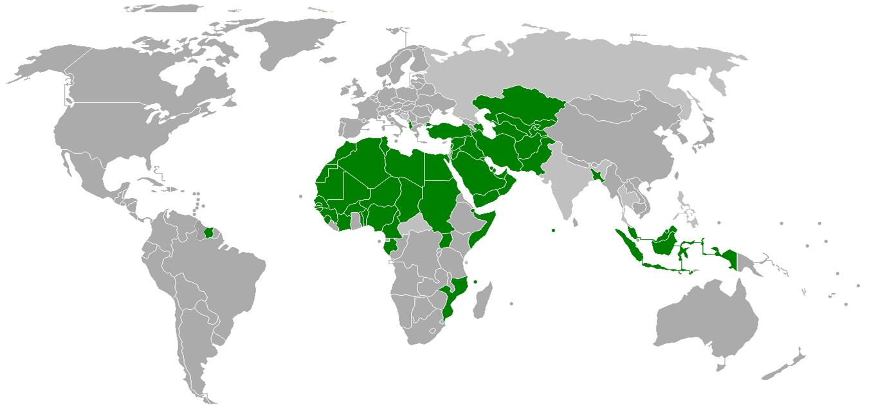
Snapshot of IDB Group – The only South-South MDB present across Africa Asia and the Arab regions
AAA rating (S&P, Moody’s)
Zero Risk (Basel Committee on Banking supervision)
Capital increases (May 2013)
Authorized capital tripled to US$150 billion
Subscribed capital tripled to US$ 75 billion

Slide 5

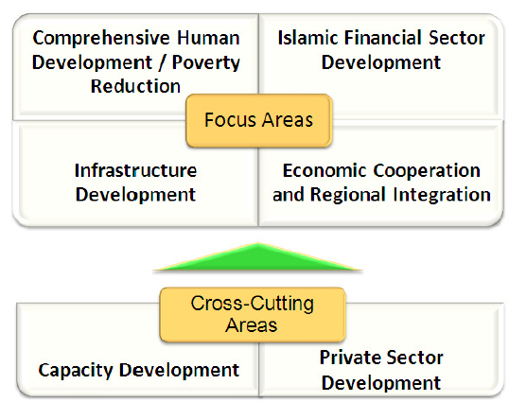
Snapshot of IDB Group – Strategic focus on regional integration
The strategic thrust of the IDB Vision 2020 is to support
and promote greater economic cooperation and
integration at regional level.
Reform IDB
Alleviate Poverty
Promote Health
Universalize Education
Prosper the people
Empower the Sisters of Islam without breaching the tenets of Islam
Expand the Islamic Financial Industry
Improve the Image of the Muslim World
Facilitate Integration of IDB Member Country Economies Among Themselves and with the World
Mid-term business strategy

Slide 6
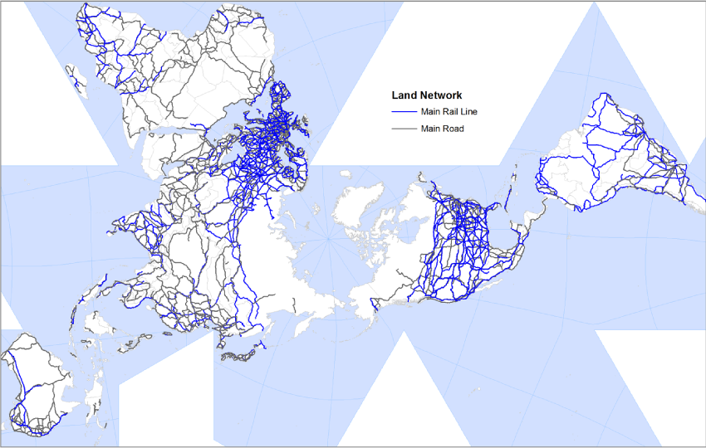
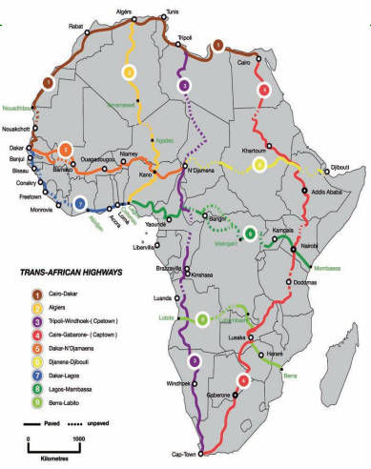
Developing Trade and Transport across IDB regions 1) Integration and interconnection of transport networks
Missing links along African Hihways
Source: AfDB
Flat view of main global land transport networks
Source: J-P. Rodrigue, the Geography of transport systems
“While the global road and rail networks appear to be integrated and interconnected, this is far from being the case. ” J-P. Rodrigue, the Geography of transport systems

Slide 7
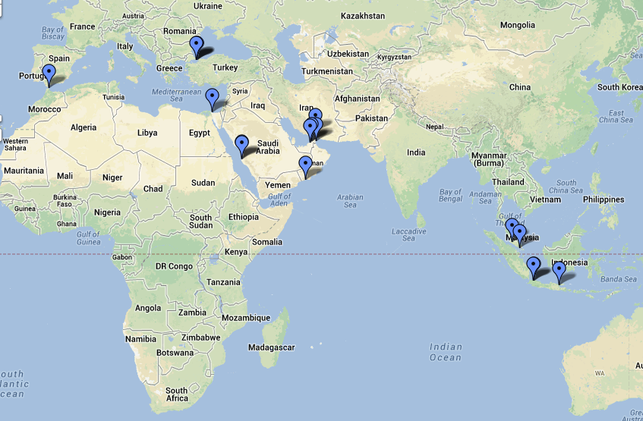
Developing Trade and Transport across IDB regions 1) Integration and interconnection of transport networks
Airports with annual traffic of more than 20 million PAX
Soekarno-Hatta IA, Indonesia
Dubai IA, UAE
Ataturk IA, Turkey
Kuala Lumpur IA, Malaysia
King Abdelaziz IA, KSA
Development of Mega-hubs across IDB member countries has triggered integration and interconnection of maritime and air transport networks
Ports with annual traffic of more than 2 million TEUs
Dubai, UAE
Port Klang, Malaysia
Tanjung Pelepas, Malaysia
Jakarta, Indonesia
Jeddah, KSA
Port Said, Egypt
Khor Fakkan, UAE
Salalah, Oman
Bandar Abbas, Iran
Istanbul, Turkey
Surabay, Indonesia
Tangier Med, Morocco
Map of the main air and maritime mega-hubs across IDB countries Source: IDB

Slide 8
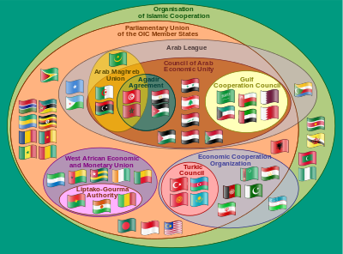
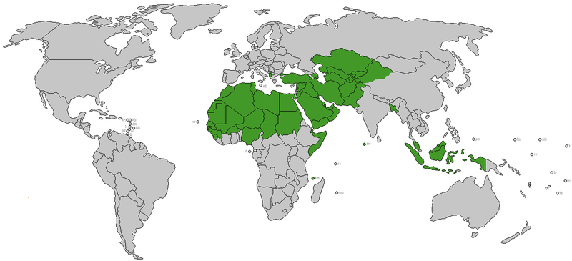
Developing Trade and Transport across IDB regions 2) Regional Economic Cooperation
GCC Gulf Cooperation Council
ECO Economic Cooperation Organization
LAS
League of Arab States
AMU
Arab Maghreb Union
ECOWAS
Economic Community of West African States
UEMOA
West African Economic and Monetary Union
ASEAN Association of Southeast Asian Nations
COMESA Common Market for Eastern and Southern Africa
+Others e.g. SAARC, IGAD, etc.
IDB Supports regional economic cooperation across sub-regions and partners with the Regional Economic Communities for the integration of member countries
Main Regional Economic Communities that IDB partners with

Slide 9
Developing Trade and Transport across IDB regions 3) Trade integration
Intra and inter-regional merchandise trade statistics by region as a percentage of total 2010 exports
Origin/Destination | North America | Latin America | Europe | CIS | Africa | Middle East | Asia
North America | 48.7 | 8.4 | 16.8 | 0.6 | 1.7 | 2.7 | 21.0
Latin America | 23.9 | 25.6 | 18.7 | 1.3 | 2.6 | 2.6 | 23.2
Europe | 7.4 | 1.7 | 71.0 | 3.2 | 3.1 | 3.0 | 9.3
Commonwealth of Independent States (CIS) | 5.6 | 1.1 | 52.4 | 18.6 | 1.5 | 3.3 | 14.9
Africa | 16.8 | 2.7 | 36.2 | 0.4 | 12.3 | 3.7 | 24.1
Middle East | 8.8 | 0.8 | 12.1 | 0.5 | 3.2 | 10.0 | 52.6
Asia | 17.1 | 3.2 | 17.2 | 1.8 | 2.7 | 4.2 | 52.6
Source: WTO
IDB Regions are among the least integrated in terms of intra and inter-regional trade…

Slide 10
Developing Trade and Transport across IDB regions 3) Trade integration
But the entry into force of the TPS-OIC System and the initiatives under way to develop intra-OIC trade demonstrate promising results: intra-OIC set to reach 20% by 2015
Trade Preferential System (TPS-OIC)
Framework agreement - 2002
PRETAS (Tariffs) - 2010
Rules of Origin – 2011

Slide 11
IDBG Initiatives for developing trade and transport across regions
1) Financing of critical transport infrastructure
Transport Scorecard
Total Financing : ID 4.42 Bn
Total Operations : 393
Total 1429-34H: ID 2.27 Bn
Total Operations : 57
51% of total in last 5 years

Slide 12
Our focus on international corridors
Prioritization criteria for international transport corridors
Involvement of OIC Member States
Intra Regional Trade Potential
Inter Regional Trade Potential
Presence of Missing Links
Importance of Non-Physical Barriers
Distance from Ports
Connections with Capital Cities
Connection Between Locations of Economic Importance
Transport costs along the corridor
Source: A study of international transport corridors in OIC member countries, IDB, 2011
Some Ongoing Projects across IDB constituency
SEETO Corridor
CAREC Corridors
Silk Road
Trans-Saharan Highway
Machreq Corridors

Slide 13
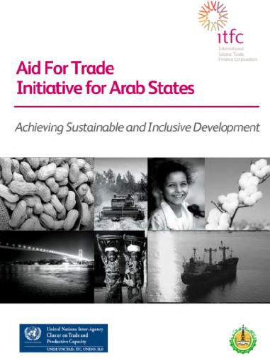


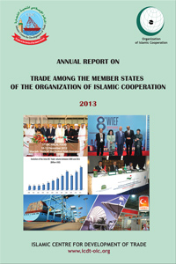

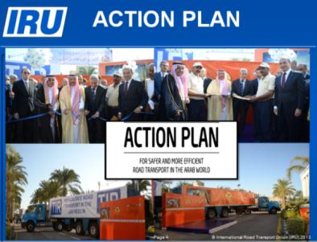

IDBG Initiatives for developing trade and transport across regions
2) Strategic initiatives with global and regional institutions
Global and regional Institutions
OIC Institutions

Slide 14
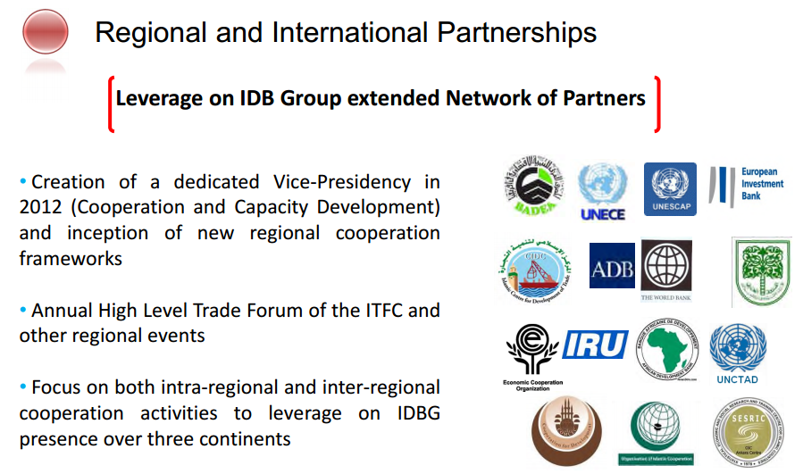
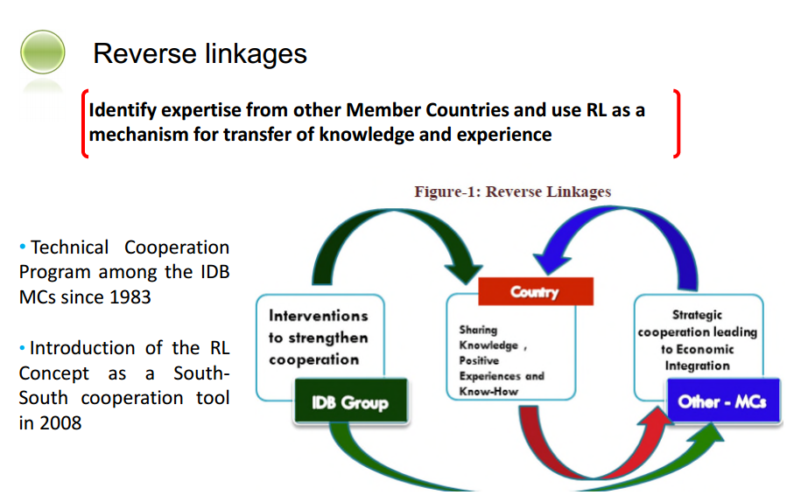
IDBG Initiatives for developing trade and transport across regions
3) Cooperation and capacity development

Slide 15

IDBG Initiatives for developing trade and transport across regions
4) The way forward
Strategic alignment
Scale-up
Effective delivery
Knowledge generation and Innovation
Connectivity
Sustainability

Slide 16
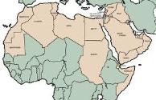
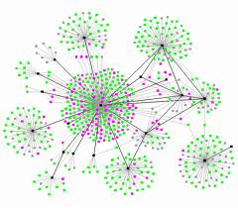
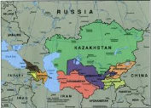
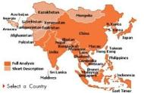
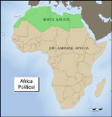
IDBG Initiatives for developing trade and transport across regions
4) The way forward
Regional Partnership Strategies
Employment Generation
Arab countries
CIS & Albania
Sustainability & Inclusiveness
Asia+Surinam
Connectivity: Physical & Knowledge
Enhancing “Software” for Economic Growth
Value-Adding Productivity
SSA Countries

Slide 17

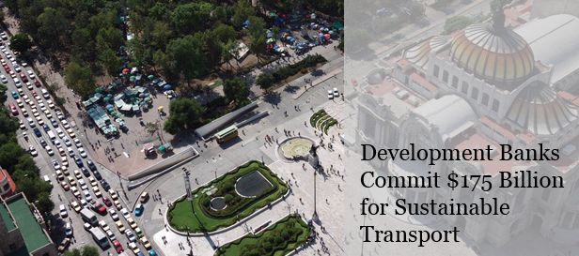
IDBG Initiatives for developing trade and transport across regions
4) The way forward
Landmark initiatives

Slide 18























IDBG Initiatives for developing trade and transport across regions
4) The way forward
Partnerships

Slide 19
شكرا لكم Thank you Walid Abdelwahab wabdelwahab@isdb.org

