Slide 1
Temperature controled road transport in the EU
Marc Billiet, IRU

Slide 2
Content
This is the IRU
EU rules & what is playing today
The market
Free movement of goods
Emissions
Innovation
Conclusion

Slide 3
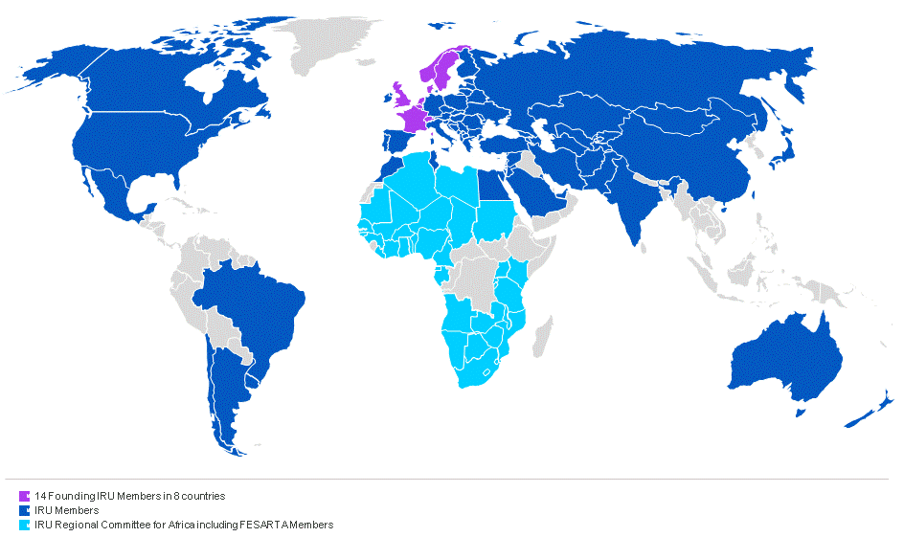
IRU Membership
170+ members in more than 100 countries, including every EU Member State
Representing bus, coach, taxi and truck operators to ensure economic growth and prosperity via the sustainable mobility of people and goods by road worldwide

Slide 4






IRU Secretariat General
1948 – IRU founded in Geneva
1973 – IRU Permanent Delegation to the European Union in Brussels
1998 – IRU Permanent Delegation to Eurasia in Moscow
2005 – IRU Permanent Delegation to the Middle East and Region in Istanbul
2012 – IRU Secretariat for Africa in Geneva
2013 – IRU Permanent Delegation to the United Nations in New-York

Slide 5
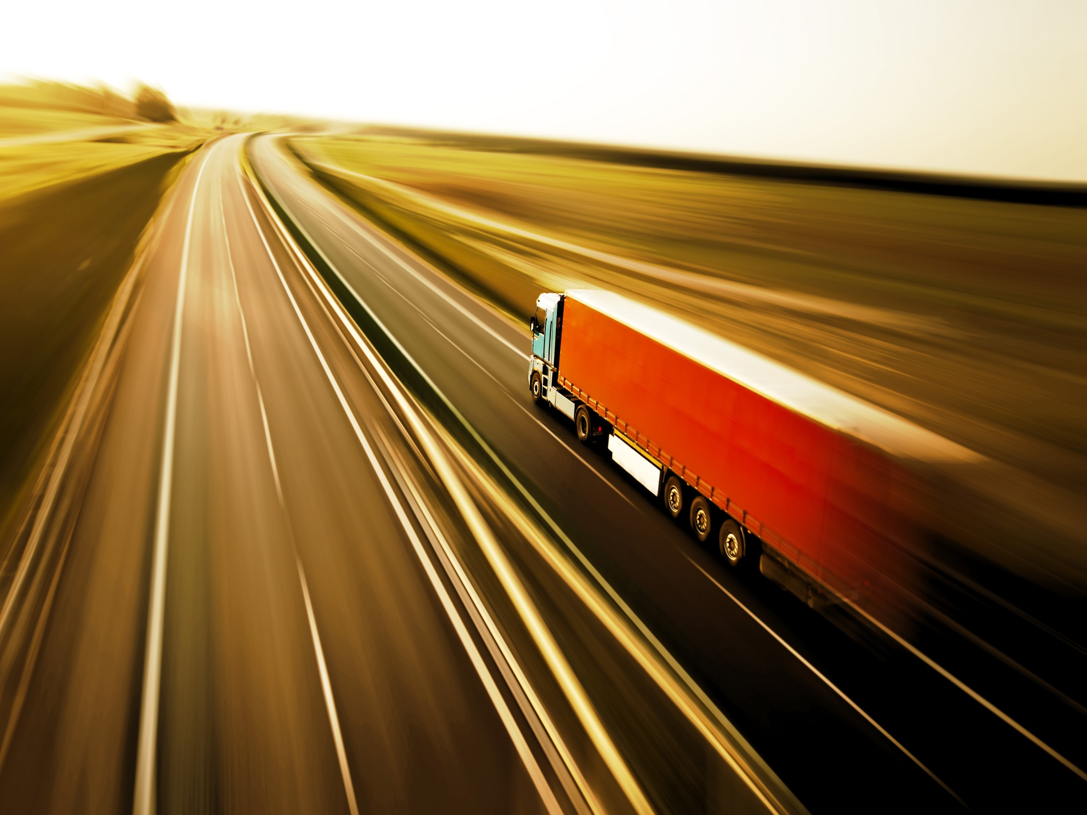
IRU Priority Issues
Sustainable Development
  Innovation
  Incentives
  Infrastructure
Facilitation
  Trade
  Tourism
  Road Transport
These are also the priorities of the IRU Academy

Slide 6

Heavy EU Regulation on road transport
Legislation
+ 70% of all laws in an EU Member State are defined and agreed at EU level…
Rules for everything!
More than 150 directives and regulations for road transport that you need to comply with every day…

Slide 7
What plays today?
Greening
Free Movement
Market functioning
Innovation
Enforcement
Security

Slide 8
Complex EU market situation
Market
Crisis
Competition
State-owned integrators
Prices
Working conditions
Shippers
forwarders
Food & Safety rules

Slide 9
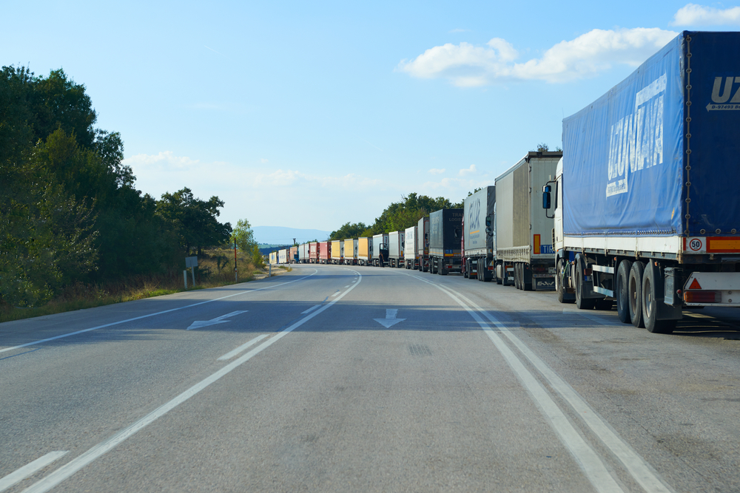
Free Movement
Goods
Migration
Stowaways
Border controls
Strikes
Waiting times
Traffic bans
Security

Slide 10
Global Evolution of Commercial Vehicle Toxic Emissions
Source: IRU based on EU Commission 2008, US Environmental Protection Agency 2010, Japan Ministry of the Environment 2005

Slide 11
Carbon emissions
Source: EEA 2012 + TLN 2010 (HDV part of total road transport)

Slide 12
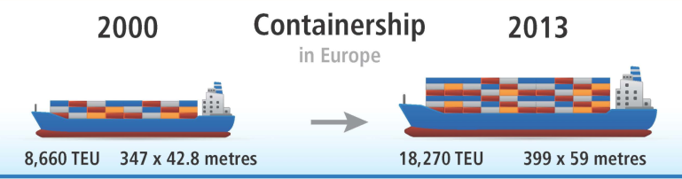
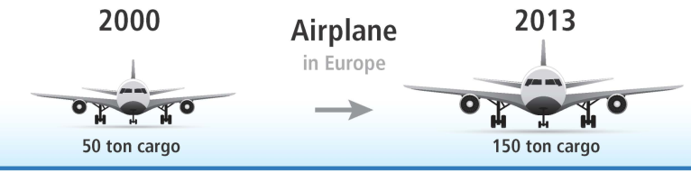
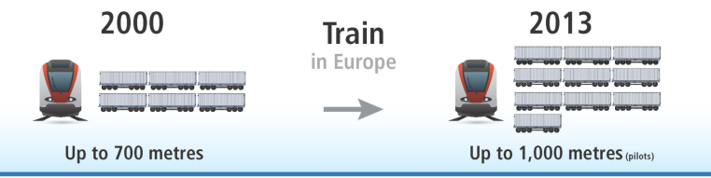
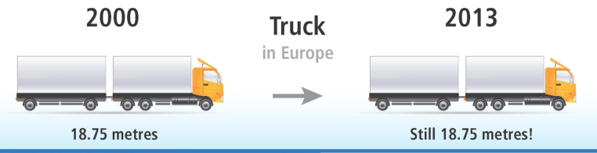
Freedom to innovate!
Why?
Reduce costs
Increase profits
Improve efficiency
Improve environmental performance
How?
Break out from political dependence/restrictions designed to protect other modes’ transport share
Move from changing slightly e.g. Weights & Dimensions to DEFINING THE Commercial Vehicle of the Future driving on the infrastructure of the future
Notes:
Creating equal opportunities also includes giving the opportunity to our industry to innovate. “Innovation” is one of the pillars of our 3 “I” strategy and is also a key element in our 30-by-30 Resolution.
In the EU, the weights and dimensions dossier has entered in its final decision-making phase . I think that you are all aware that over the last 10 years, the capacity of the other modes has been increasing.

Slide 13
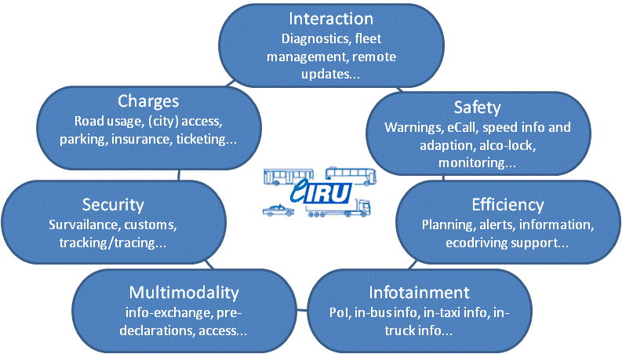

The future will be ”Connected”...but how

Slide 14
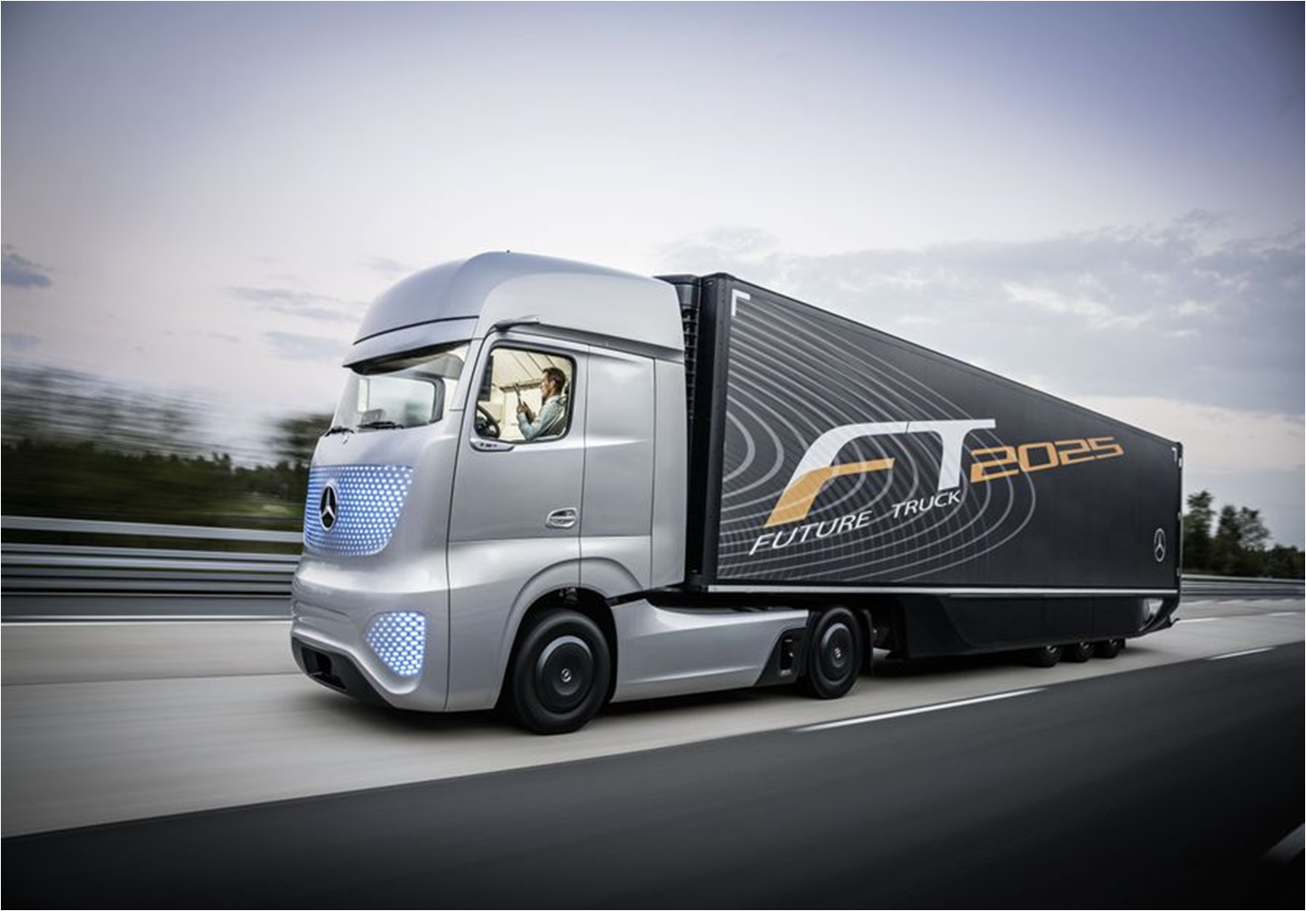
The Commercial Vehicle of the Future
public-private reflection group run by IRU
30% reductions of CO₂ emissions by 2030
60% reductions of CO₂ emissions by 2050
increase the safety and efficiency of commercial vehicles, operations and infrastructure
business and policy recommendations and proposals + roadmap

Slide 15

THE FUTURE SHOULD BE DEFINED BY THE INDUSTRY

Slide 16
THE BEST ROAD IS
THE ONE WE MAKE TOGETHER

