Slide 1

MINISTERIAL MEETING
“Road Transport – Driving Regional and Intercontinental Trade”
Amman, 12 June 2013
Umberto de Pretto
Secretary General

Slide 2
Road Transport –
It’s your business, too!
In today’s globalised economy, professional international road transport is no longer merely a mode of transport, but has become a vital production tool, driving economic, social and environmental progress throughout
the world

Slide 3




Recognise and address the
real challenges blocking trade
57% of transport time = border crossings
38% of transport costs = unofficial levies

Slide 4
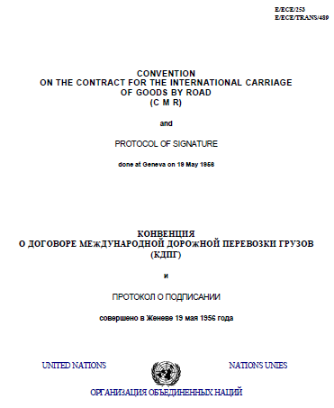
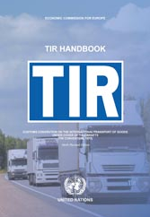
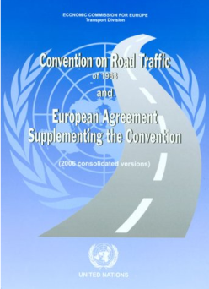
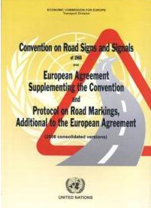
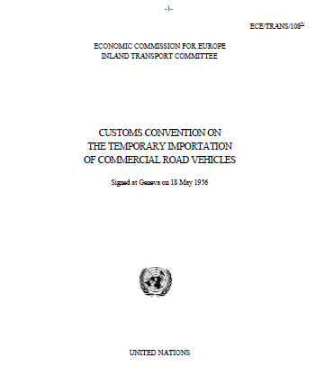
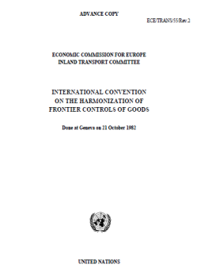
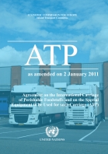
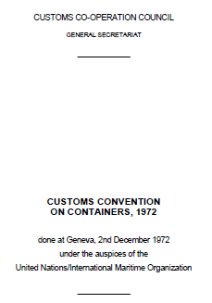
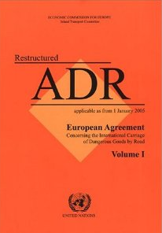
Tried and tested solutions exist!
Implement key UN facilitation and security instruments
to allow road transport to drive trade!

Slide 5
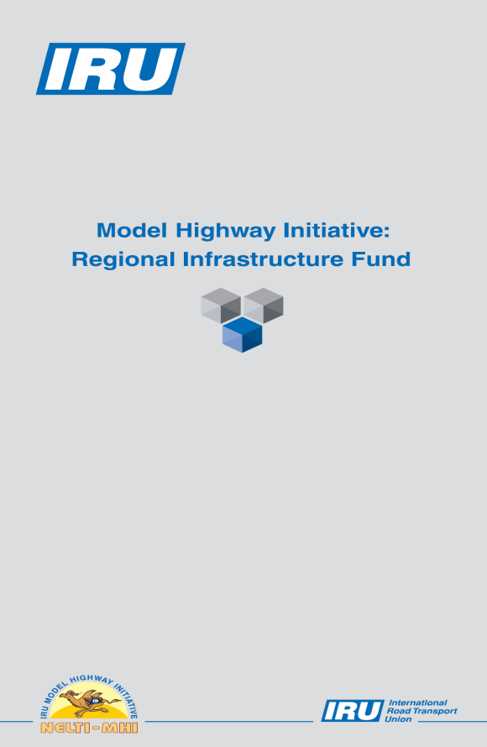
Partner to drive trade
Develop, in PPP,ancillary infrastructure as per the IRU's Model Highway Initiative (MHI)

Slide 6
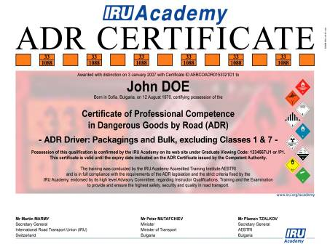
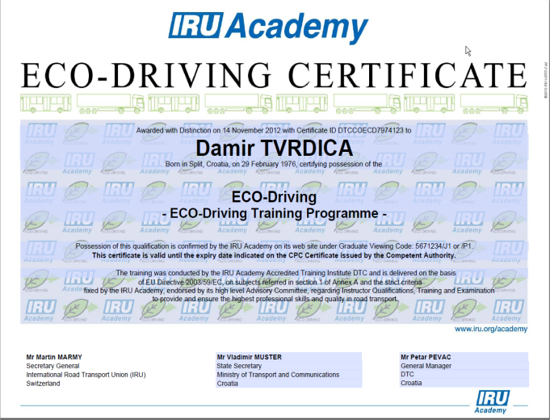

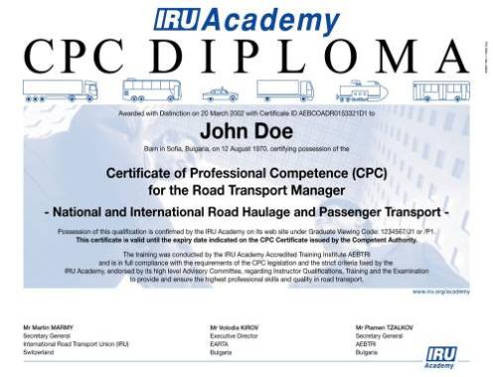
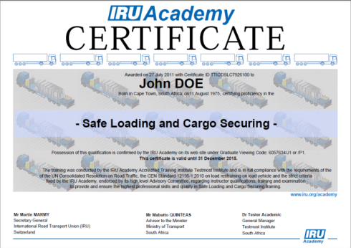
Partner to increase professionalism, safety and competitiveness
Promote and support vocational training

Slide 7
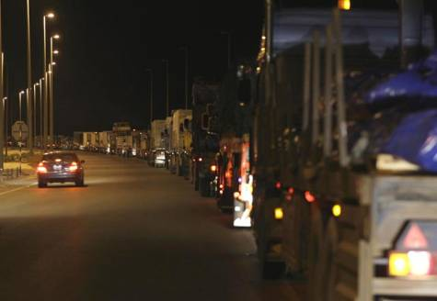
So instead of this….

Slide 8
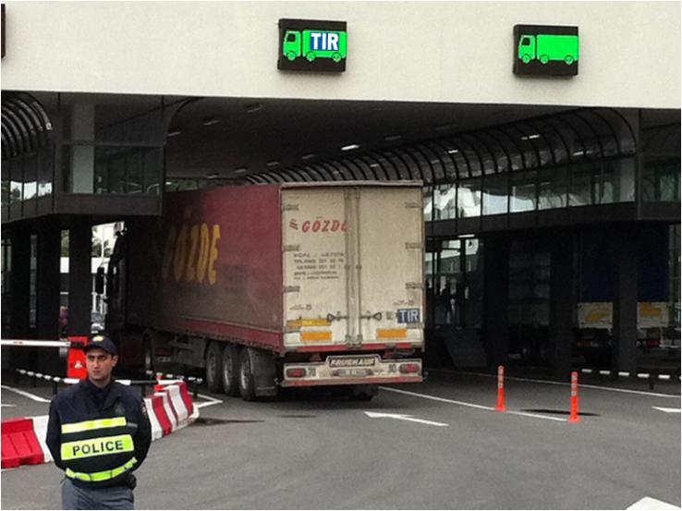

…we see this…

Slide 9
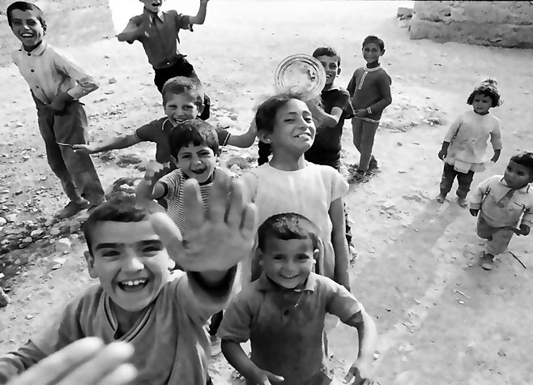
…to bring them progress, prosperity and ultimately peace!

Slide 10

www.iru.org

