Slide 1
Language challenges of enforcement in a globalising transport industry
- The view of the IRU -
Oleg Kamberski, Head Passenger Transport
Euro Contrôle Route Conference
Sofia, 18 June 2014

Slide 2

This is the IRU

Slide 3
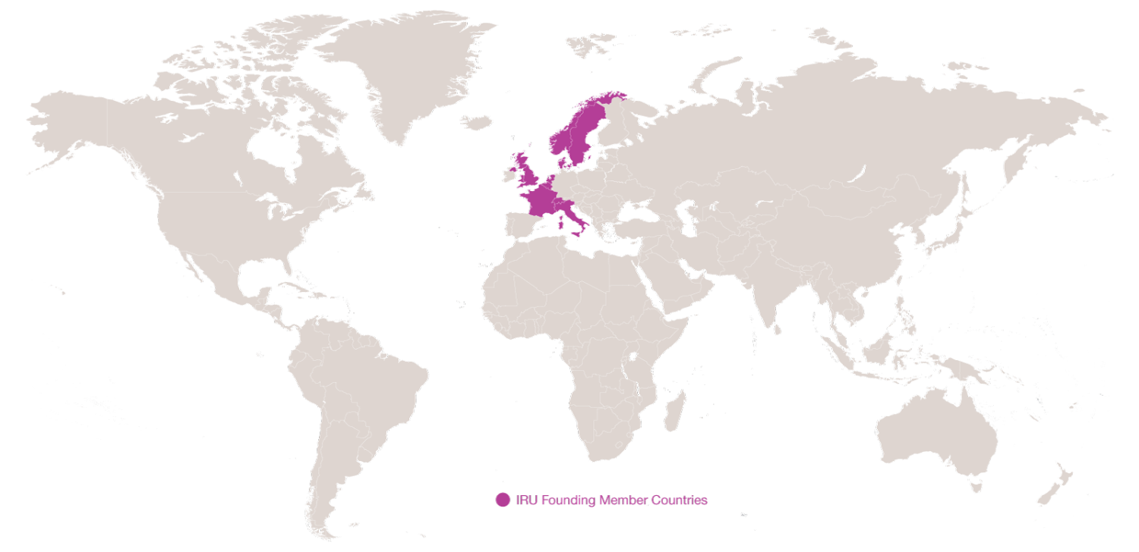
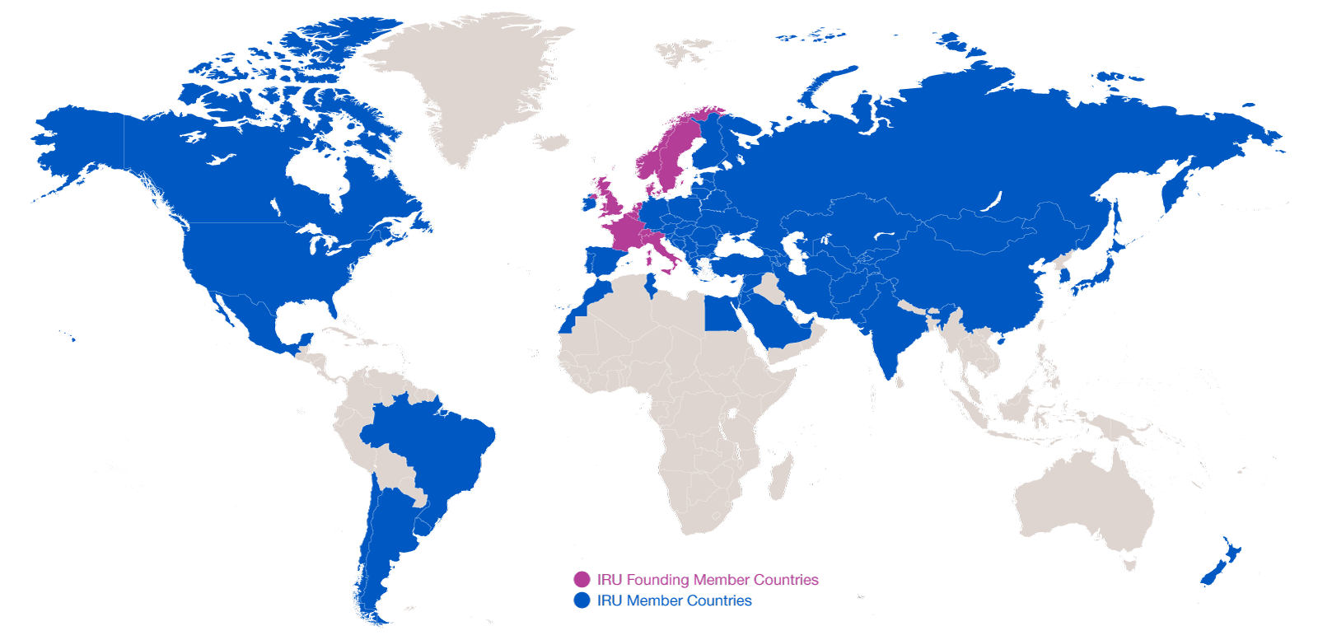
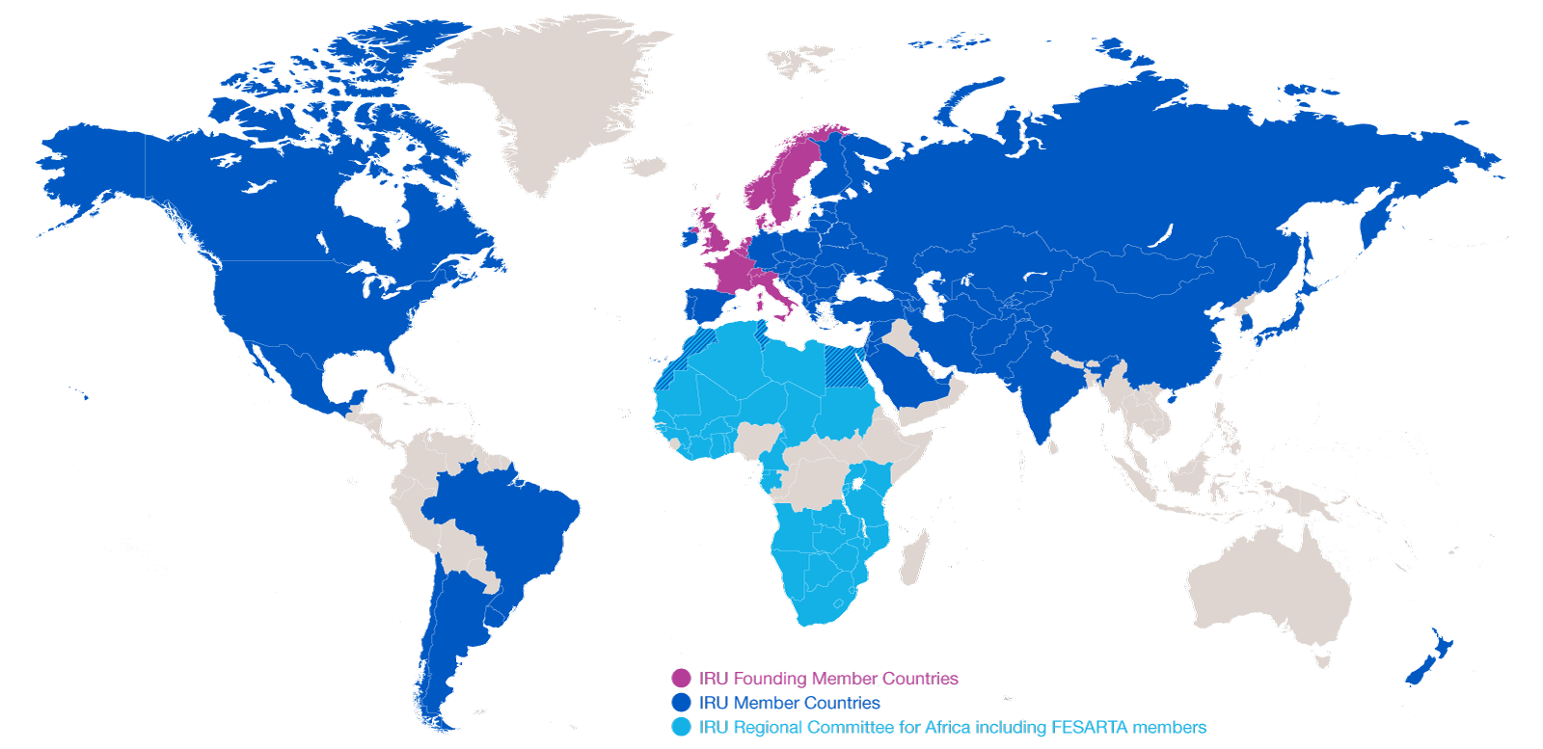
Evolution of IRU Membership
2014: 170 Members in 75 countries
2014: 170 Members in 75 countries
1948: eight founder countries
…and CRIPA: 27 Members + FESARTA in 38 countries

Slide 4


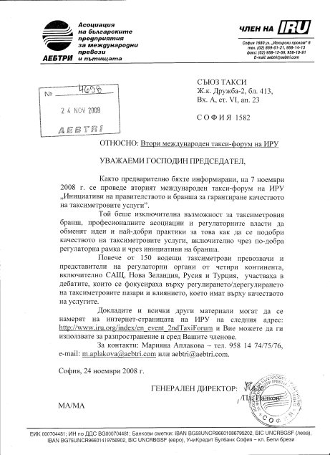
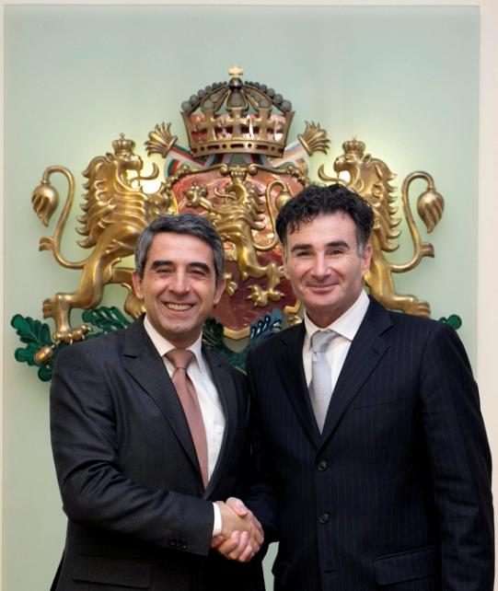
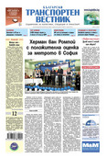
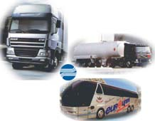
This is the IRU

Slide 5






IRU Secretariat General
1948 – IRU founded in Geneva
1973 – IRU Permanent Delegation to the European Union in Brussels
1998 – IRU Permanent Delegation to Eurasia in Moscow
2005 – IRU Permanent Delegation to the Middle East and Region in Istanbul
2012 – IRU Secretariat for Africa in Geneva
2013 – IRU Permanent Delegation to the United Nations in New-York

Slide 6










IRU International Commissions & Working Parties
Commissions
Social Affairs
Economic Affairs
Customs Affairs
Legal Affairs
Technical Affairs
Road Safety
Services to
Transport Operators
Working Parties
Dangerous Goods
Intermodal Transport & Logistics
Taxis and hire cars with driver

Slide 7
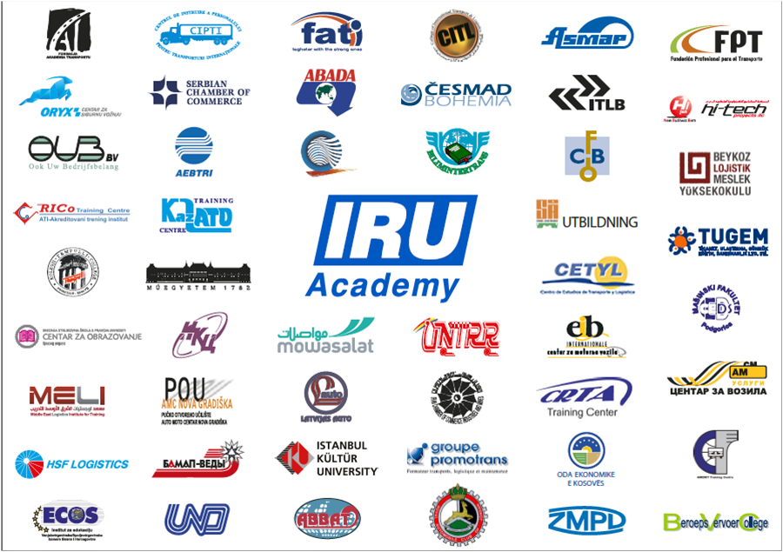




Worldwide Excellence in Road Transport Training
International Network of IRU Academy Accredited Training Institutes (ATIs)
IRU Academy Advisory Committee
World Bank
United Nations Economic Commission for Europe

Slide 8
Facilitation of road transport
General
  Trade, Tourism and Road Transport
  Security: a balanced approach
  Harmonised legislation and procedures
  Waiting times at borders: facilitation of border crossing through efficient customs transit systems & modern control tools

Slide 9
Enforcement today
Where are we today?
Unclear rules with different interpretations and practices, misleading statistics
Law abiding hauliers face unfair competition from black sheep exploiting loopholes in the system
State-owned multimodal integrators increase pressure on prices – sometimes using illegal practices without consequences for shippers and/or freight forwarders
Adequate enforcement is essential to contribute to fairer competition
Need to preserve competitive environment with level playing field

Slide 10
Enforcement today
Enforcement target repeated/structural infringements
Infringements not cash source
Economic downturn new realities and explore all business models
New legal models (subsidiaries, hiring third country drivers) - enforcement has to adapt to check e. g. establishment conditions
Enforcement complicated – EU wide business operations
Cooperation of all enforcement branches and between all Member States

Slide 11
Enforcement – a joint effort
TISPOL, ECR, IRU ‘Declaration of Intent’ (March 2011)
Work Programme 2013
  Harmonised interpretations and enforcement requirements
  Improving the quality of enforcement via common standards of training especially through the TRACE project
  Intensified cooperation in the field of safe and secure parking especially through the TRANSPark project
  Common efforts to counter vehicle crime and adoption of an EU incident report form
  Legislative observatory and enforcement impact assessment

Slide 12
Enforcement – a joint effort
Joint ECR-IRU information leaflet on how to fill in, use and control the journey form for international occasional coach transport
Joint ECR-IRU Service Level agreement on passenger transport
(future) joint internet-based electronic lexicon and …

Slide 13
Language challenges of enforcement - general
Important issue …
… less important within a country or a region…
… but increasing with the market enlargement
Bigger at EU level…
… and even bigger at pan-European level
Problems exist at all levels – first contacts at road side, borders, documents, appeal

Slide 14
Language challenges of enforcement – road-side
Most frequent and most difficult to handle in particular when additional information is required
Interpretation services over the phone (in serious cases)
Most frustration, time- and resource-consuming for both controllers and controlled
Training (language)
Multilingual lexicon
Standardisation of controls and procedures
Best practices (ECR-IRU service level agreement)

Slide 15
Language challenges of enforcement - documents
Equally important, since most often control documents, road side control protocols and evidence documents (sanctions) in the country language
Standardisation of documents
Multilingual documents – i.e. at least in the country language & English
CMR good practice example

Slide 16
Language challenges of enforcement - appeals
Underutilised, since not known, difficult to proceed without local lawyers, costly
IRU network of lawyers
Information made available in foreign languages (English), including on payment procedures
ECR-IRU control practices feedback desk (contact point)

Slide 17
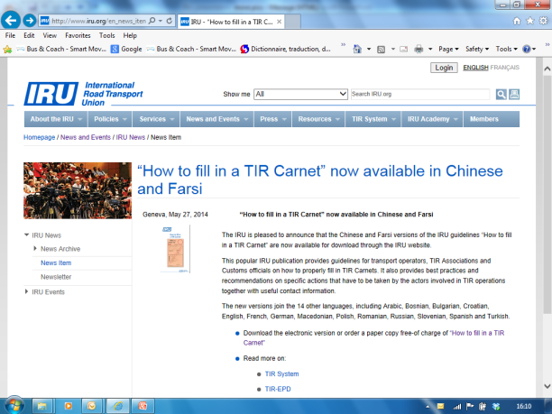
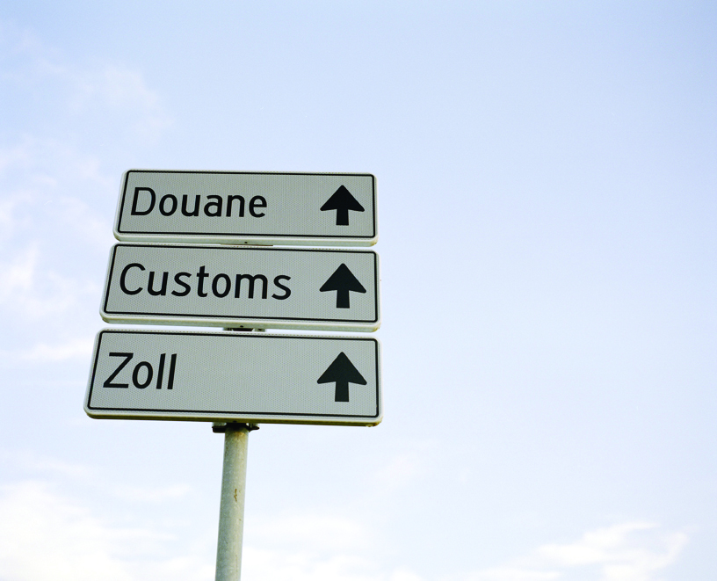
Language challenges of enforcement - borders
All of the above are to be found at borders, multiplied by the transition from one legal, control and language environment to the other
UN acquis
Industry know-how: IRU border waiting time observatory
ITF/ECMT acquis

Slide 18

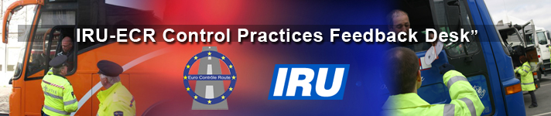
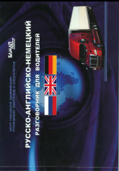

Добро утро! Моля да представите документите на превозното средство – best practices

Slide 19
Language challenges of enforcement - conclusions
Key and yet underestimated issue
Could improve quality of controls and reduce costs
Public-private lobbying and partnership

