Slide 1
Management & Prevention of Traffic Accident Risks in Road Passenger and Goods Transport Undertakings
Cairo, 16 March 2014
Jean Acri, Head - IRU Regional Committee for Africa Secretariat

Slide 3
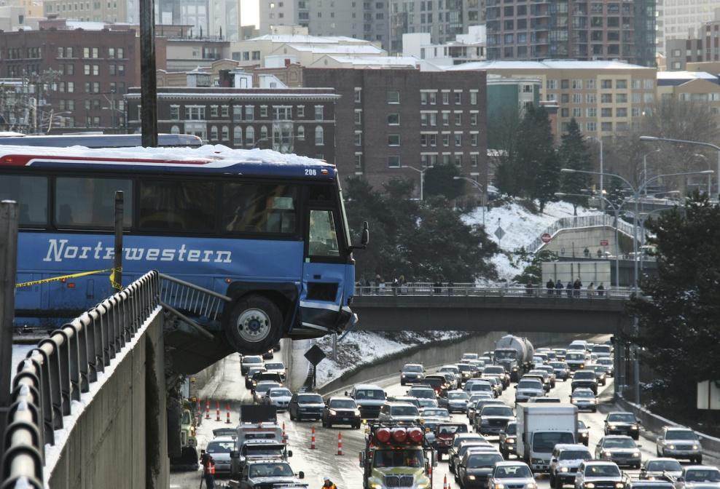
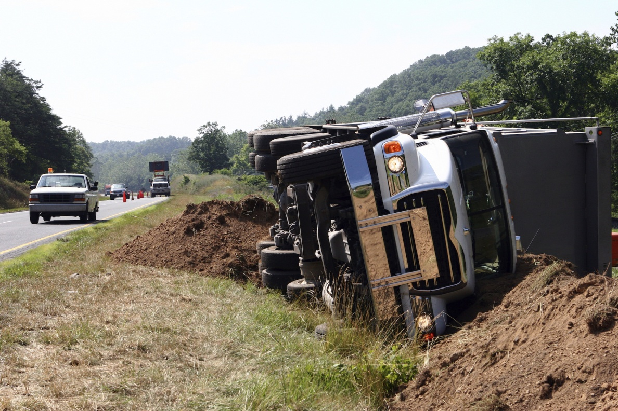
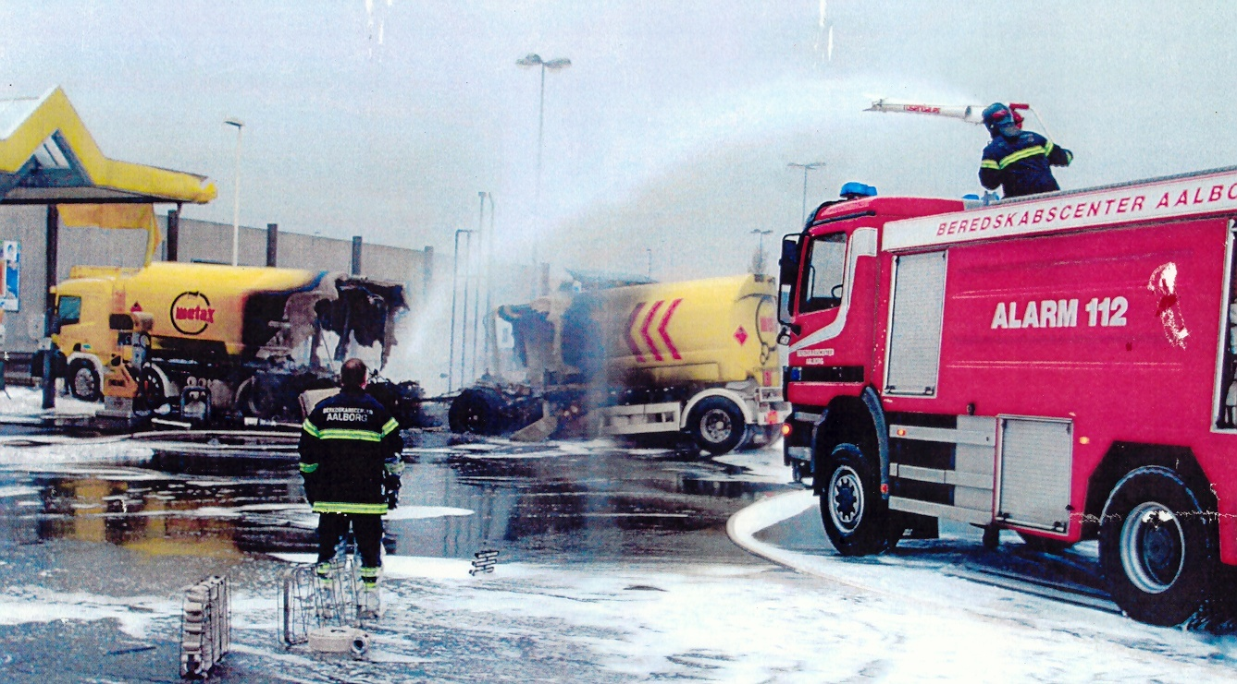
Never again...

Slide 4



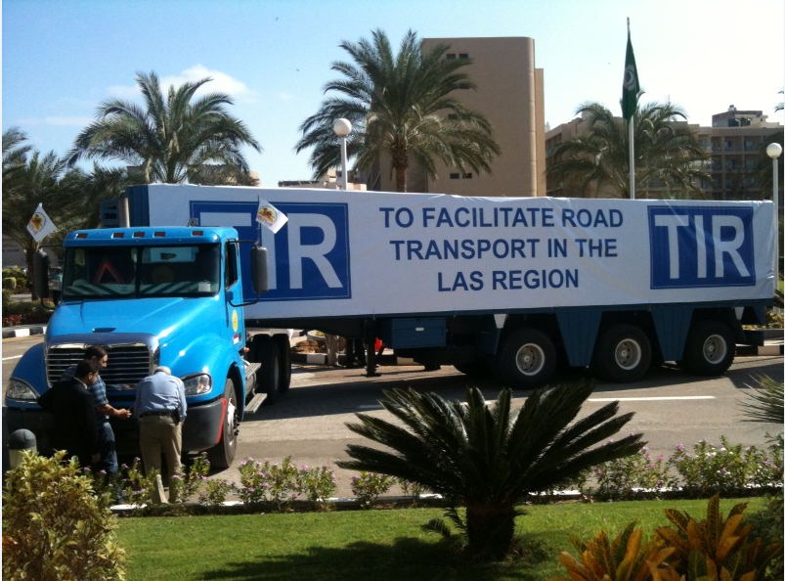

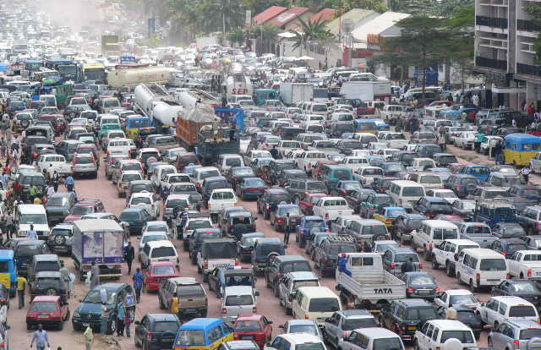
Road Safety & Accident Prevention in Road Transport Undertakings
Consignee
Public authorities
It’s everybody’s business
Consignor / transport organiser
Road transport operator
Other road users

Slide 5

Road Safety & Accident Prevention in Road Transport Undertakings
Road safety and accident prevention at the heart of corporate culture
Organisation
Human Resources
Commercial
Technical
Drivers
Management & finances
Procedures
Rolling stock
Customer relations
Insurers’ role
Key role of public authorities

Slide 6

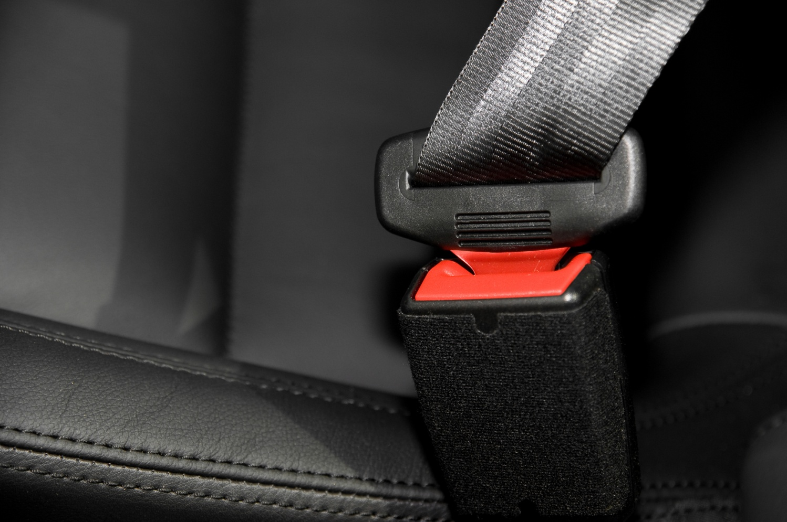
Road Safety & Accident Prevention in Road Transport Undertakings
Company organisation:
Key role of company manager
Personal involvement
Relayed to all company levels

Slide 7

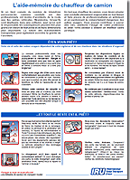
Road Safety & Accident Prevention in Road Transport Undertakings
Human Resources:
Hiring: Check references, including road safety record
Continuing education
Prevention of risk behaviours:
Speeding
Alcohol / hygiene
Excess load
Driving & rest times
Training / information
Checklists / first aid
Incident identification
Incident analysis and management

Slide 8


Road Safety & Accident Prevention in Road Transport Undertakings
Business & operating procedures:
Management
Commercial staff
Technical staff
Administrative & financial staff
Drivers & helpers

Slide 9
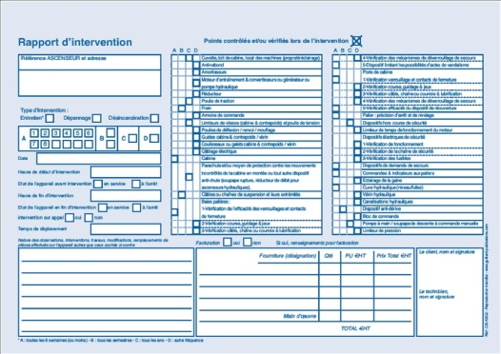
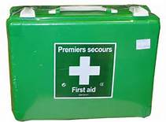

Road Safety & Accident Prevention in Road Transport Undertakings
Rolling stock:
Regular maintenance of vehicle fleet
Identification of each vehicle
Maintenance logbook
Incident logbook (on board)
Periodic servicing schedule
Random checks
Visual and sound checks on each return
Foremen entitled to prevent non-compliant vehicles leaving base
Fleet renewal schedule & budget
Protection and first aid equipment on board and regularly checked

Slide 10
Road Safety & Accident Prevention in Road Transport Undertakings
Customer relations:
Reducing accident risks is also in the customer’s interest:
IRU General Conditions for the International Carriage of Goods by Road (3 November 2011)
and
IRU General Conditions for the International Carriage of Goods by Road and Logistic Services (3 November 2011)
- Make clients accountable
Refuse excess loads
Refuse instructions jeopardising safety (leading to excessive driving times and/or speeding), ......... .

Slide 11
Road Safety & Accident Prevention in Road Transport Undertakings
The Insurers’ role:
Insurers should acknowledge the company’s efforts towards accident prevention by:
Extending profit-sharing
Supporting assistance networks
Reducing or raising deductibles
……………………………
Please refer to the IRU Guidelines for transport operators on insurance matters
(http://www.iru.org/cms-filesystem-action/2009_InsuranceContracts/Guidelines-insurance.E.pdf )

Slide 12

Road Safety & Accident Prevention in Road Transport Undertakings
The key role of public authorities:
Make principals accountable for:
Excess loads
Breach of safety rules due to instructions leading to:
Speeding
Non-compliance with driving or rest times
Monitor subcontracting
Banning cut prices which do not cover basic costs
Enforce and sanction in an efficient and resolute manner

Slide 13
Road Safety & Accident Prevention in Road Transport Undertakings
The key role of public authorities (cont’d):
Financial incentives to allow fleet renewal
Incentives to finance driver training and offset company losses during training periods

Slide 14


Road Safety – An IRU TOP Priority
Notes:
The IRU has recently issued several resolution to contribute to the development of a sustainable future:
Let me highlight a few:
Resolution on Road Safety which is a key instrument to contribute in the success of the UN Decade of Actions on Road Safety
30 by 30 resolution on the decrease of Co2 emission by 30 percent by 2030
Resolution on Driver Shortage

Slide 15

Road Safety – Specific Strategy
The IRU supports all measures that improve road safety
if
they effectively target the main causes of accidents involving professional vehicles

Slide 16

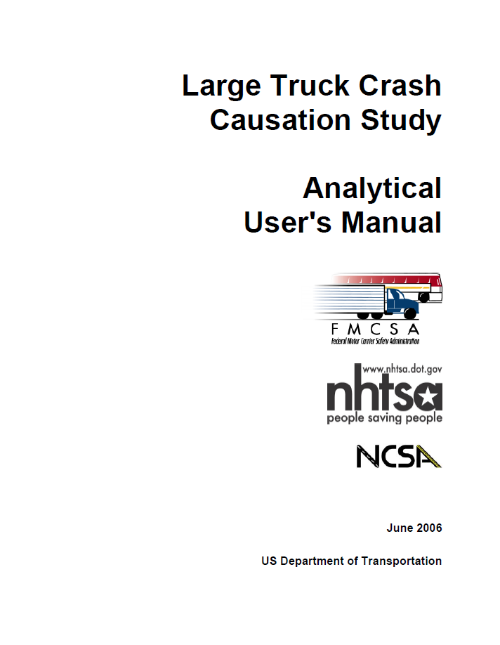

Accident Analysis ETAC – A Scientific Study
Results confirmed by other studies
Notes:
ETAC is a study that analysed more than 3000 variables on 624 accidents involving trucks and for which there has been a severe casualty.
European Truck Accident Causation Study (ETAC) - http://www.iru.org/en_bookshop_item?id=171
http://ai.fmcsa.dot.gov/ltccs/data/documents/LTCCS_Manual_Public.pdf
http://www.volvotrucks.com/SiteCollectionDocuments/VTC/Corporate/Values/ART%20Report%202013.pdf
Study is available from: http://www.iru.org/en_bookshop_item?id=169

Slide 17
Focus on Priorities – Road Safety – Main Cause: The Human Factor
Investigation of 624 accidents showed the main cause of the accident is the human error
However, from the 85.2% linked to human error, 75% were caused by other road users!
Source: EU, IRU
Notes:
Result – Human factor is the central element we have to act upon in order to increase road safety effectively. But prof. driver only the main reason in 25% of the accidents!

Slide 18
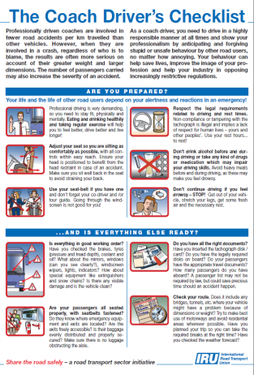
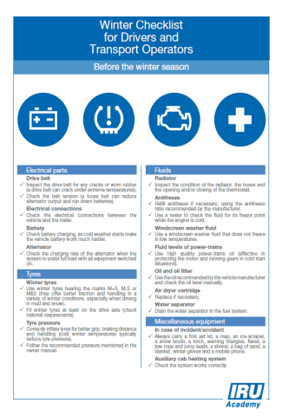
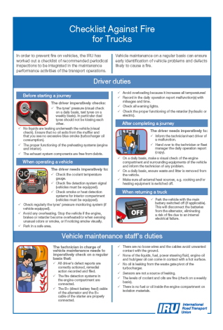
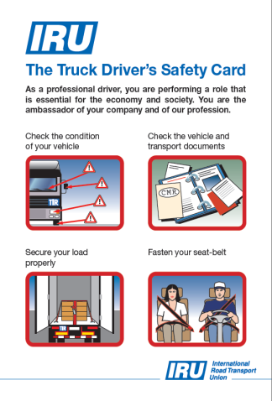
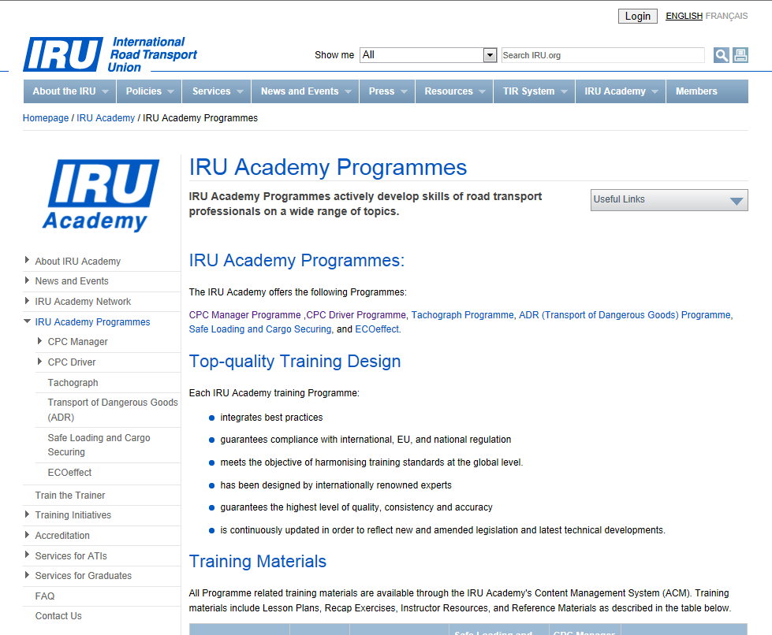
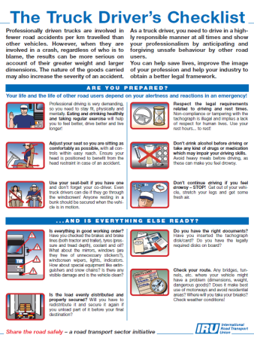
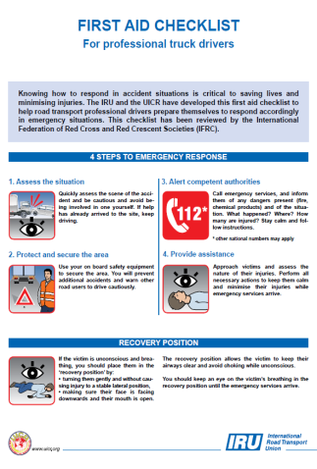
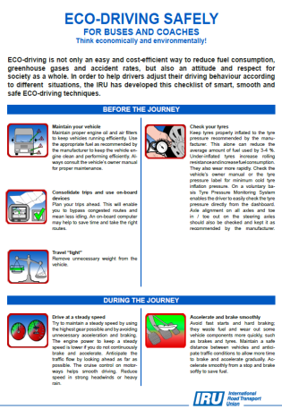
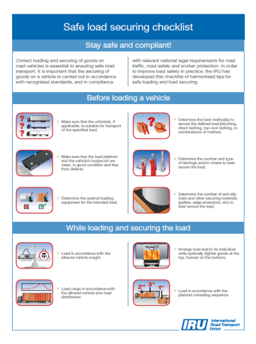
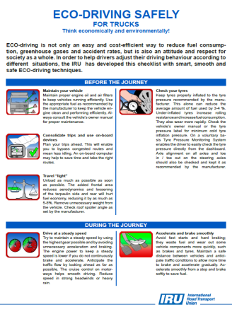
Contribution to Road Safety – IRU Academy
21 Professional Training Programmes
17 Drivers’ Checklists

Slide 19
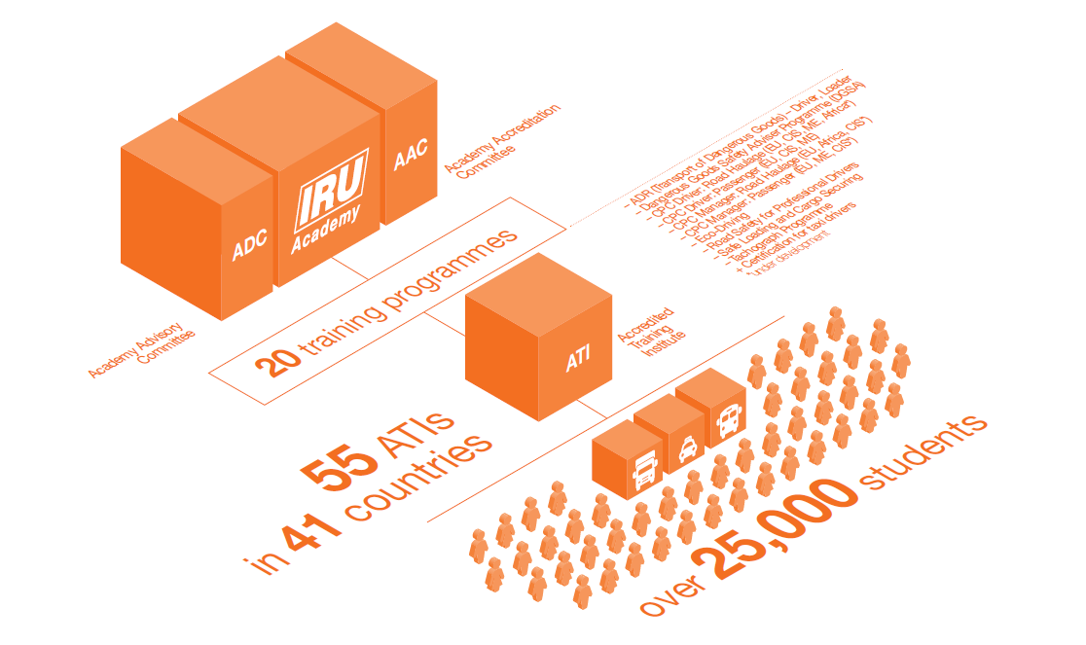
The IRU Academy at a glance

Slide 20

Focus on Priorities – Defensive/ECO-Driving ?
A Defensive driving module combining technology and the latest training techniques that will improve efficiency and safety for the commercial sector;
Train-the-Trainer & Driver training that have been specifically designed for the road transport sector and contribute to:
important financial savings in fuel and fleet costs,
significant reduction of CO₂ emissions and improve fuel-efficiency,
impact on the reduction of the road risks, accidents and casualties.

Slide 21
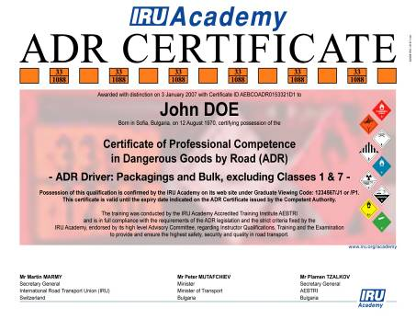
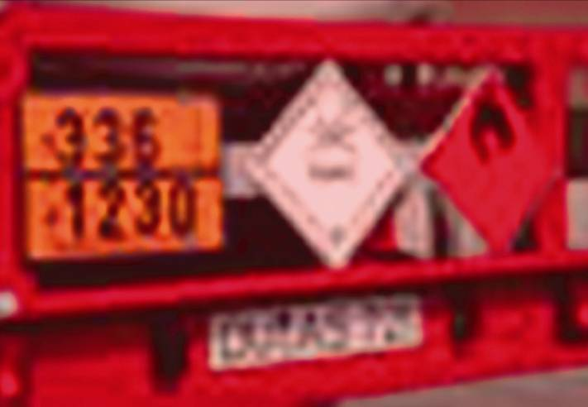
IRU Academy Dangerous Goods
(ADR) Programme
Full compliance with the ADR 2013 Agreement
Safety
Notes:
21

Slide 22


Crash Prevention Programme
1-day classroom-based programme on crash prevention, compatible with EC periodical training format
Highly visual combines simulation playbacks, on-board camera footage, and various videos
Highly practical Evocative real-life crash cases illustrate the theory
Highly engaging Focus on group discussions and crash case analysis
Story-based The course is introduced by the story of a fatal crash, told by the truck driver
Includes next generation truck simulator software license

Slide 23
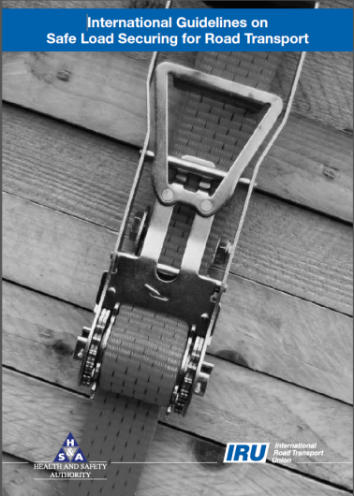
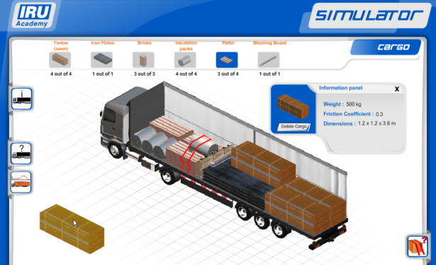
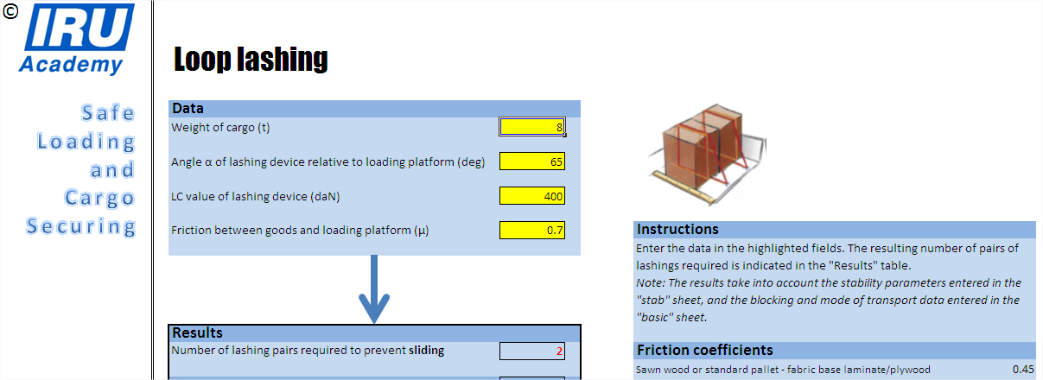
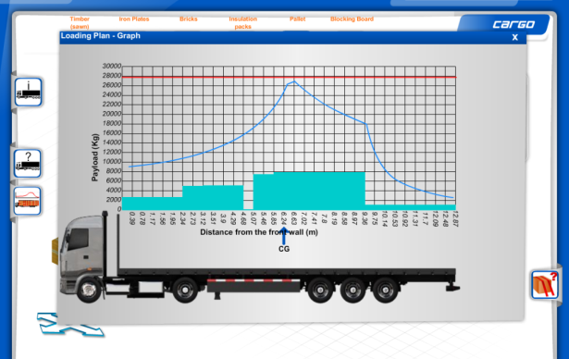
IRU Academy Interactive Programme on Safe Loading and Cargo Securing
Industry reference
guidelines
Interactive simulation environment
Calculator: Specific and practical advices
Latest International Reference Standard
EN 12195-1:2010
Notes:
23
Latest IRU Academy programmes developed to address key Industry concerns of road safety and professionalism

Slide 24
International Guidelines on Safe Load Securing for Road Transport
The aim of these guidelines is to provide basic practical information and instruction to all key stakeholders involved in the international road transport industry to correctly load and secure goods on vehicles, from the outset, improving global road traffic safety.
The guidelines should serve as a common basis for practical application and enforcement of load securing!
Notes:
The guidelines on safe load securing for road transport aim to provide a guide for safe and effective load securing for all situations that may occur in normal traffic conditions. The guidelines should also serve as a common basis for both practical application and enforcement of load securing.

Slide 25
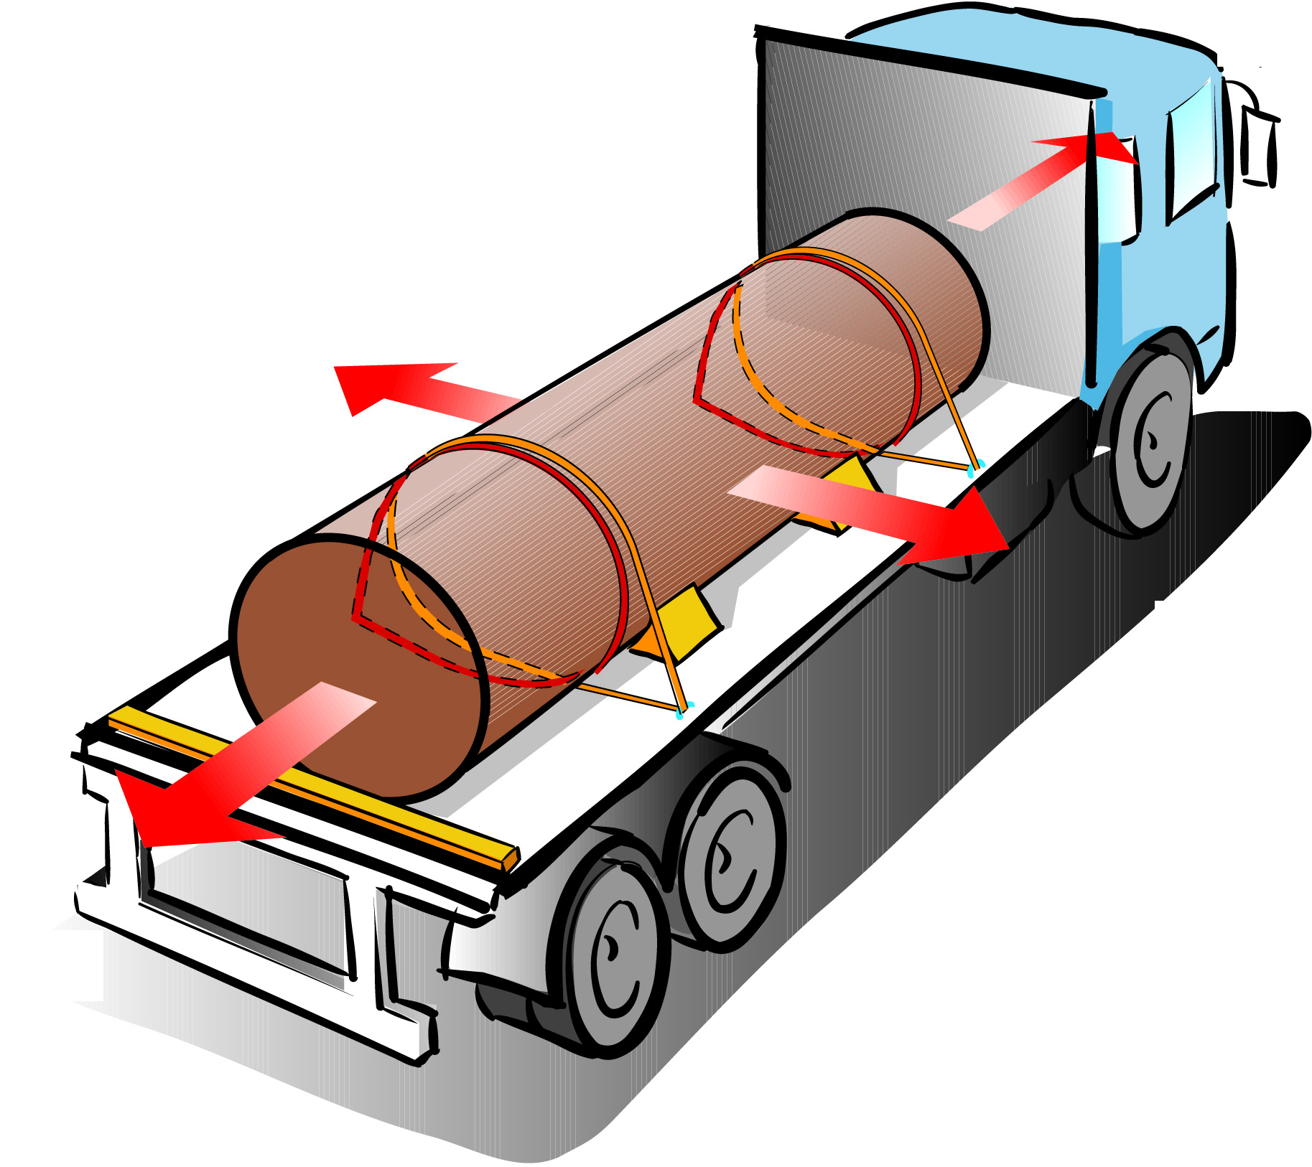
Physical background
The load securing arrangements has to be based on:
Accelerations
Friction factors
Safety factors
Test methods
….these parameters are described in the standard EN 12195-1:2010
Notes:
The design of load securing arrangements has to be based on:
Acceleration
Friction factors
Safety factors
Test methods
The sum of effects of locking, blocking, direct and frictional lashing are allowed to be used to prevent the load from moving including sliding, tilting, rolling, wandering, substantial deformation and rotation.

Slide 26
Following principles
To avoid loads from sliding, tilting and rolling the following principles shall be considered:
Securing direction
Securing method and equipments
Friction
Dimensions / center of gravity
Mass of the load
Notes:
Load securing arrangements to prevent load from sliding, tilting and rolling should be designed in accordance with the instructions in the quick lashing guide.
If there is no risk of the goods sliding, tipping or rolling - then the goods can be transported without the use of lashing straps. However, there is a risk that unlashed goods will move in transit because of vibration. To prevent unlashed / unblocked load from being significantly displaced due to vibration, it is recommended to use one top over lashing with standard tension force for instance S_{TF} 400 daN per four tons of load.

Slide 27
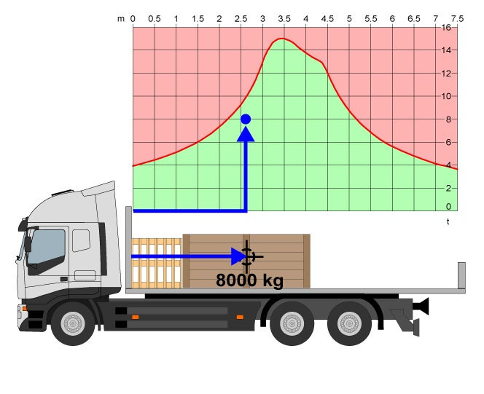
Load distribution
Road transport vehicles are in particular sensitive regarding the position of the centre of gravity of the loads loaded onto vehicles, due to specified axle loads.
Notes:
Transport units are particularly sensitive to the position of the centre of gravity of the load, due to specified axle loads. Such vehicles may be equipped with specific diagrams, which show the permissible pay load as a function of the longitudinal position of its centre of gravity.

Slide 28
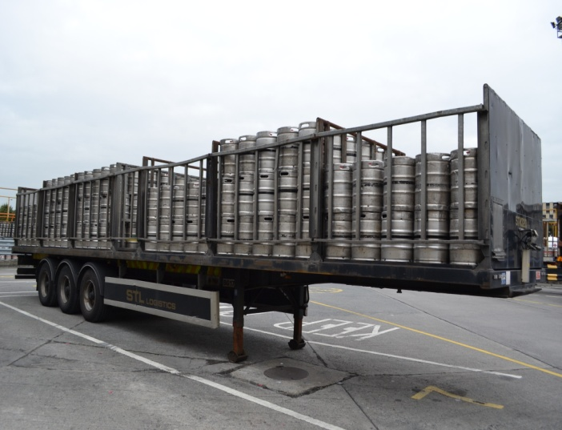
Restraining methods
Restraining methods are principally
locking
blocking
direct lashing
top-over lashing
combinations of methods in conjunction with friction
Notes:
The restraining method(s) used should be able to withstand the varying climatic conditions (temperature, humidity etc) likely to be encountered during the journey.
The IRU Guidelines demonstrates several illustrations of securing methods and equipements, such as:
locking
blocking
direct lashing
top-over lashing
combinations of methods in conjunction with friction
Combination two or more restraining methods is the most practical and cost efficient; i.e. top over lashing can be combined with base blocking, etc.

Slide 29
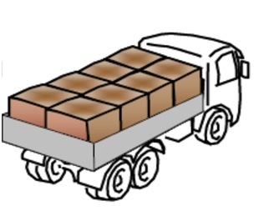
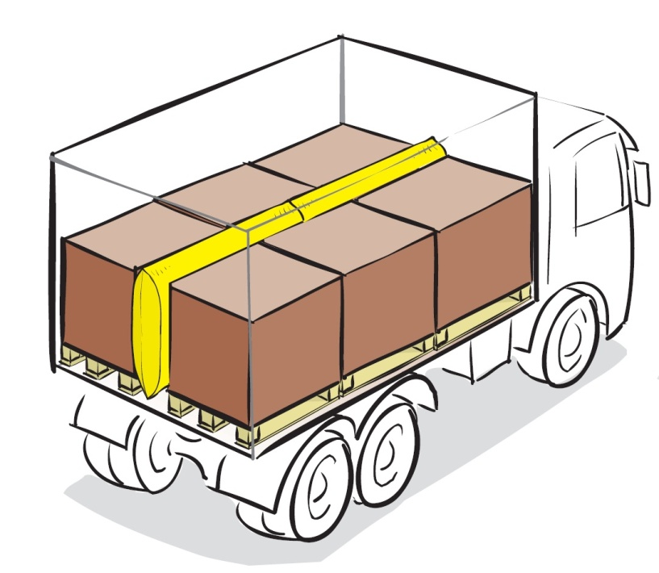
Blocking
Blocking by headboard and sides
Blocking with filler between the rows of load
Notes:
By blocking, gaps must be filled with a filler material to create compressive forces that ensure a satisfactory blocking of the load!
Gaps must be kept to a minimum, especially those to the headboard. The load should be blocked against the head board either directly or by the use of filler material in between, such as a pallet.

Slide 30
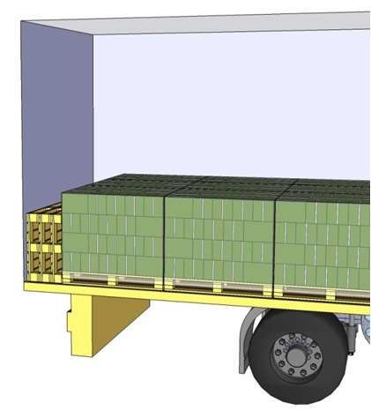
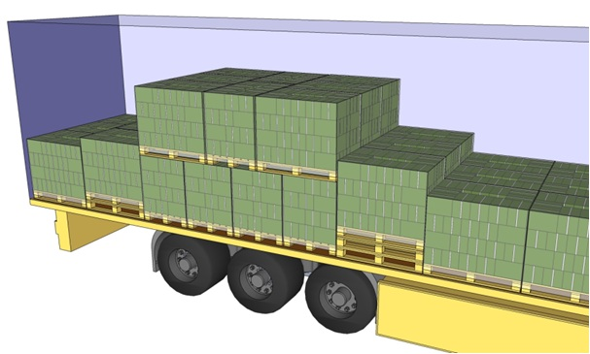
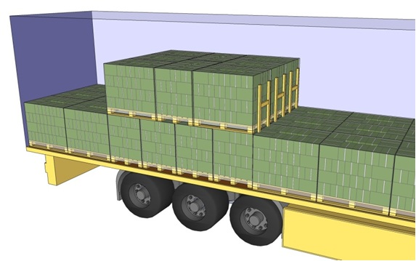
Blocking
Blocking with pallets in rear direction
Threshold blocking or panel blocking
Notes:
Large empty spaces can alternatively be filled with empty pallets!
When there is a height difference between various layers, threshold blocking or panel blocking can be used for base blocking of the upper layer against the lower layer.

Slide 31
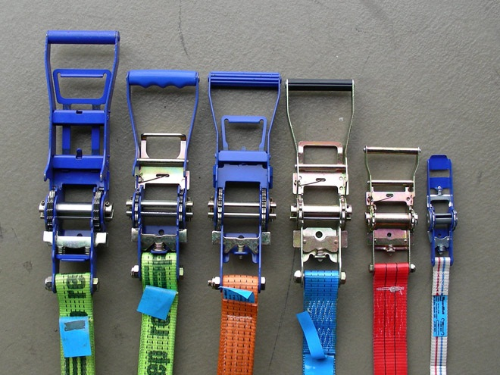
Lashing equipment
Webbing assemblies
Chain
Wire rope
Nets or covers with lashings
Ropes
Blocking boards
Notes:
The choice of the best means of securing a load to a vehicle will depend on the type and composition of the load to be carried. Operators should equip the vehicle with the securing equipment appropriate for the types of load usually carried. If general loads are carried, various types of securing equipment should be available.

Slide 32
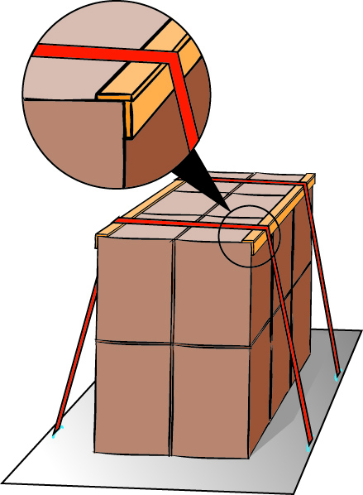
Supporting equipment
Friction mats
Wood runner
Shrink film and stretch film
Steel or plastic band straps
Edge beams protector (aluminium, plastic, wood)
Protective spacers
Tag washers
Notes:
There are different type of base material that can be used to increase securing between paltform and the load such as:
Friction mats
Wood runner
Shrink fil,
Band straps
Edge bewm
Protective spacers and
Tag washers

Slide 33
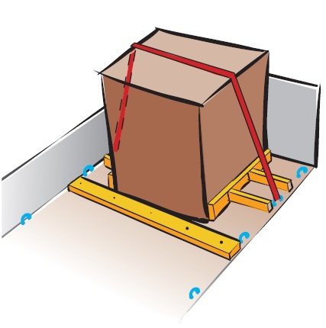
Lashing method
Notes:
A lashing is a restraint device such as webbing, chain or wire rope that either ties load together or keeps load in contact with the load platform or any blocking
device.
If the load is only bottom blocked, lashing might be required to prevent tipping!

Slide 34
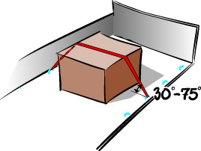
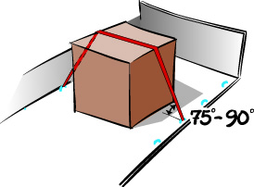
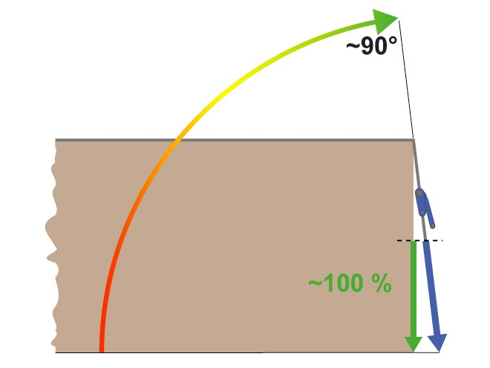
Top-over lashing
THE LARGER THE ANGLE THE BETTER IT IS!
BELOW 30° LIMITED EFFECT!
Notes:
Top-over lashing is a method of securing where lashings are positioned over the top of the goods in order to prevent the load section from tipping or sliding.
If there is no side blocking at the bottom, for example top-over lashing can be used to press the load section towards the platform bed.
THE LARGER THE ANGLE THE BETTER IT IS! BELOW 30° LIMITED EFFECT!

Slide 35
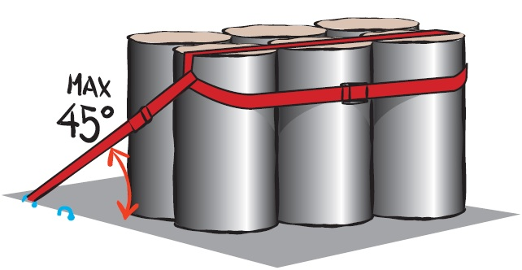
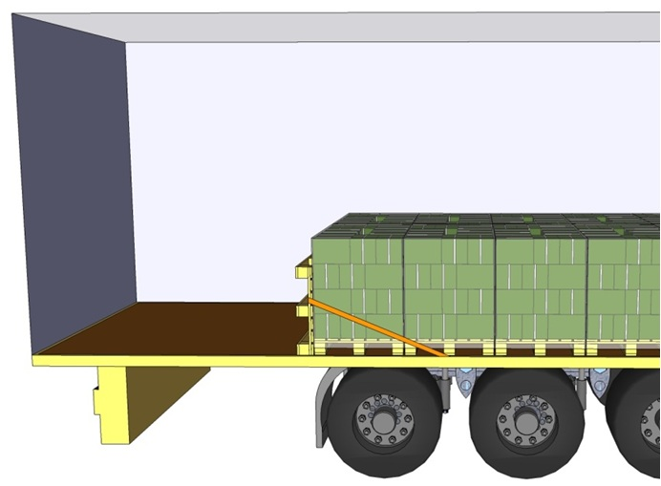
Spring lashing
Notes:
Spring lashing can be used to prevent tipping and/or sliding forwards or backwards.
The angle to the load surface is measured in the longitudinal direction, and it is recommended that the angle is not more than 45º.

Slide 36
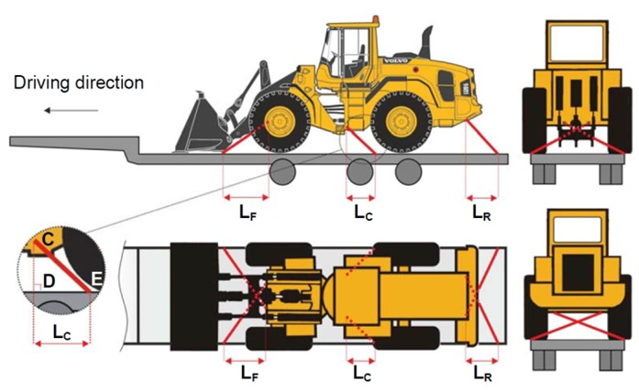
Direct lashing
Notes:
If the load is equipped with lashing eyes compatible with the strength of the lashing, it is possible to lash directly between the lashing eyes and the lashing points on the vehicle.

Slide 37
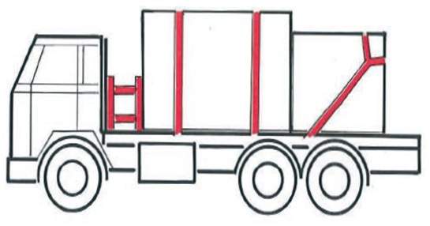
Combination of load securing methods
Notes:
To prevent sliding in longitudinal and transversal direction an arrangement with combined spring lashing, top-over or loop lashing and blocking as show in examples and designed in accordance with the standard/Quick Lashing Guide could be used.

Slide 38

Training in loading and load securing
All persons should receive instruction, information and training on safe loading and securing practices
Notes:
Personnel engaged in loading and securing should be trained and skilled to do this work and understand the relevant terminology. All persons should receive detailed training concerning specific requirements for the transport, loading and securing of load.

Slide 39
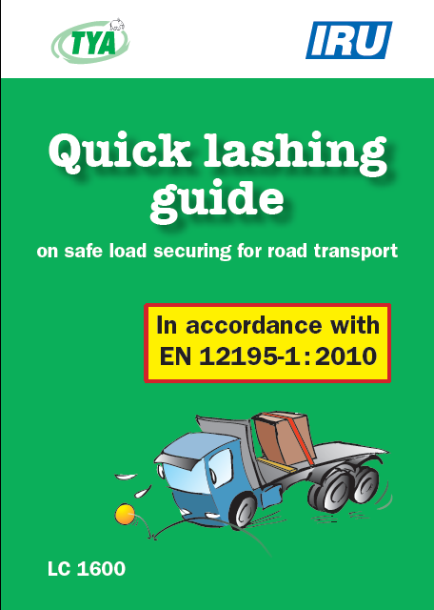
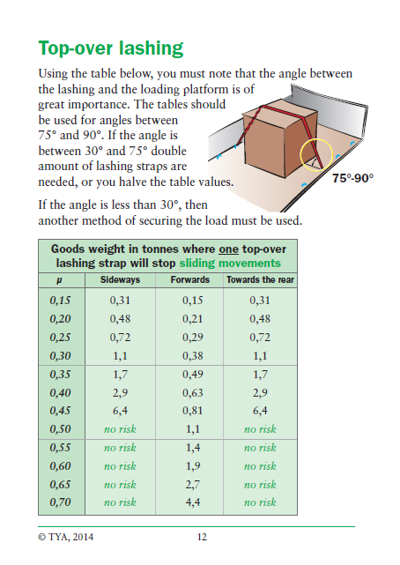
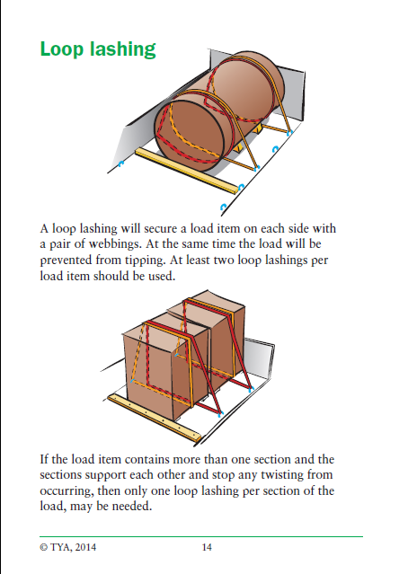
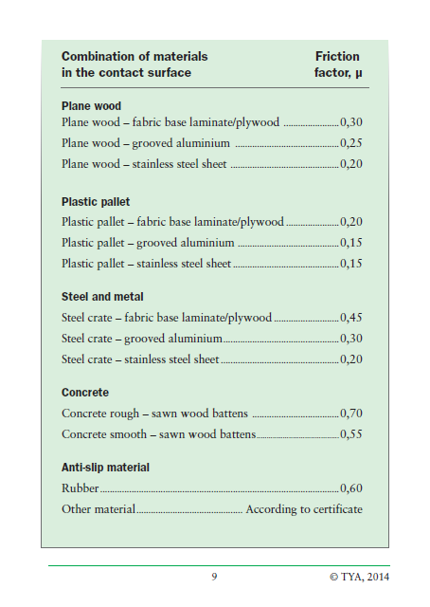

Quick Lashing Guide
Notes:
The IRU International guidelines provide several examples of good practices related to load securing when transporting automobiles, construction equipment and logs.
Valuable advice is given in “the quick lashing guide”, including the number of lashing straps or load securing devices needed based on the type of method, material, friction, weight, etc...

Slide 40
IRU partners
Authority
HSA, Ireland
Companies
TYA, Sweden
MariTerm, Sweden
Notes:
Thank you to the IRU Secretariat General, all IRU CIT Members, all key stakeholders and TYA, MariTerm AB, Health and Safety Authority for their involvement and contribution to this publication which increase knowledge internationally and gives practical advice on safe load securing for road transport.

