Slide 1
Sustainable Mobility and Access to Destinations
Yves Mannaerts
IRU Vice President
European Tourism Forum
Naples, 30-31 October 2014

Slide 2
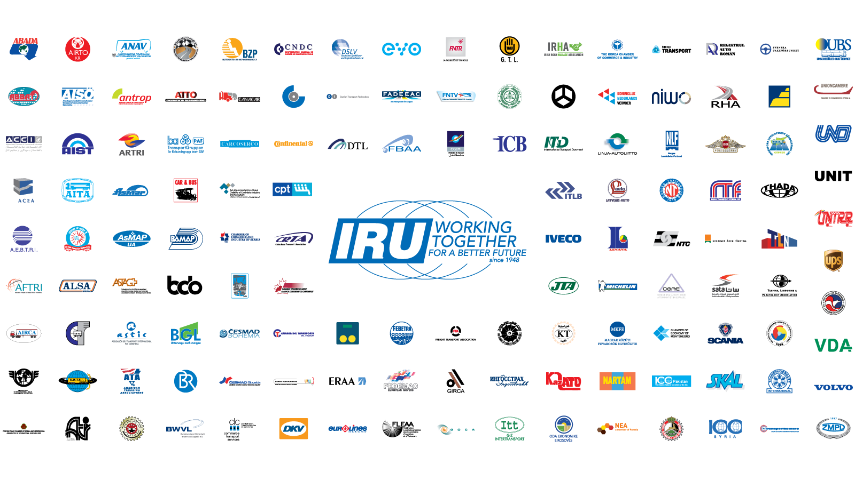
This is the IRU

Slide 3
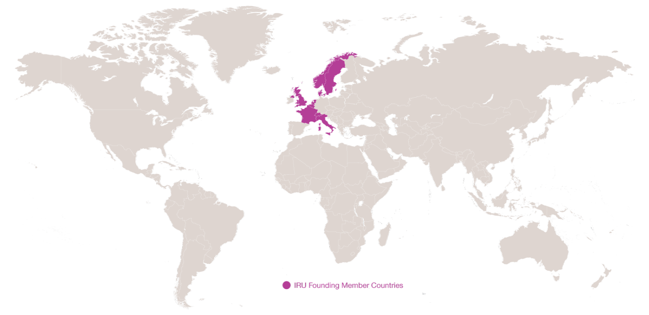
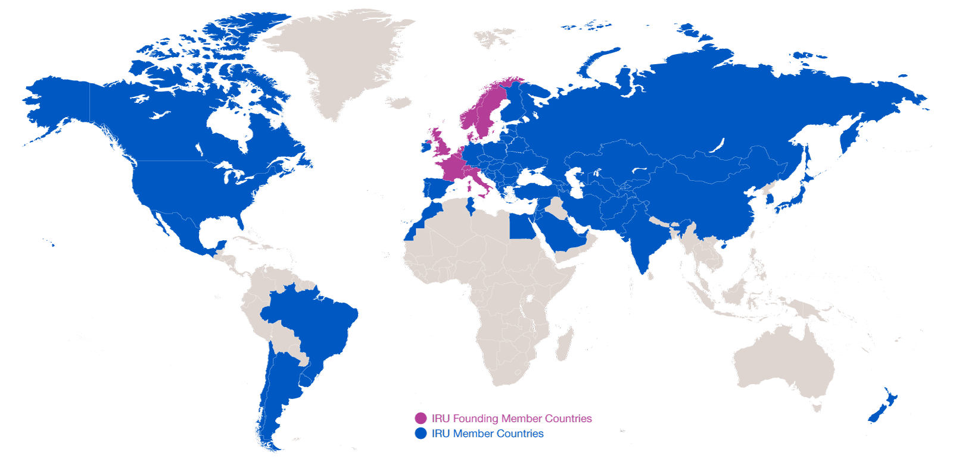
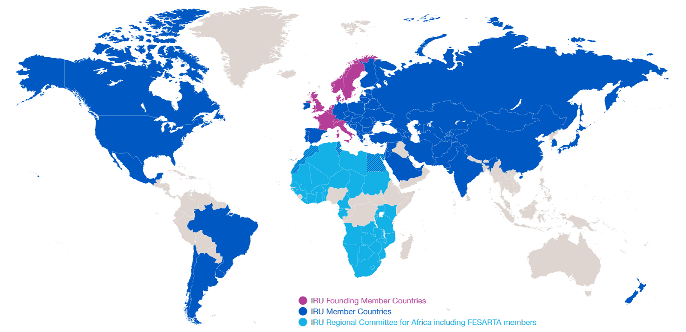
Evolution of IRU Membership
2014: 170 Members in 75 countries
2014: 170 Members in 75 countries
1948: eight founder countries
…and CRIPA: 27 Members + FESARTA in 38 countries

Slide 4

EU Public-Private Smart Move High Level Group
  First serious step to recognise and unlock the potential of group tourism by coach
  Main objective: doubling the use of collective passenger transport by bus and coach, including coach tourism, in the EU by 2025

Slide 5
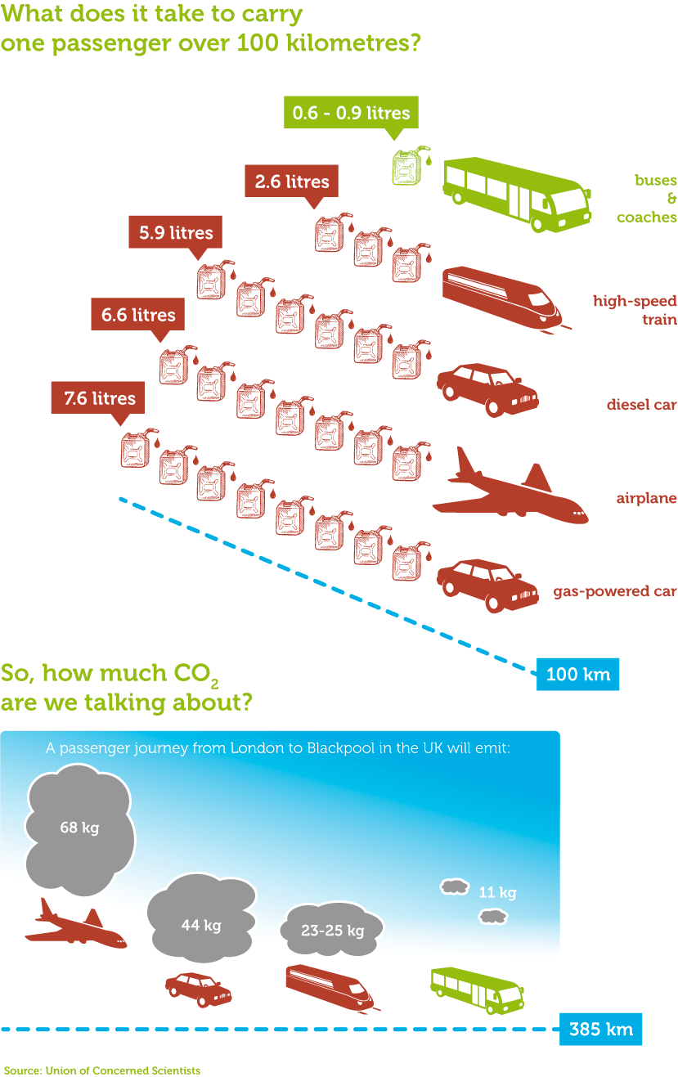

Coaches are …
… the environmental champions

Slide 6
Global Evolution - Commercial Vehicle Toxic Emmissions
- 88%
- 95%
- 97%
- 98%
Source: IRU based on EU Commission 2008, US Environmental Protection Agency 2010, Japan Ministry of the Environment 2005

Slide 7
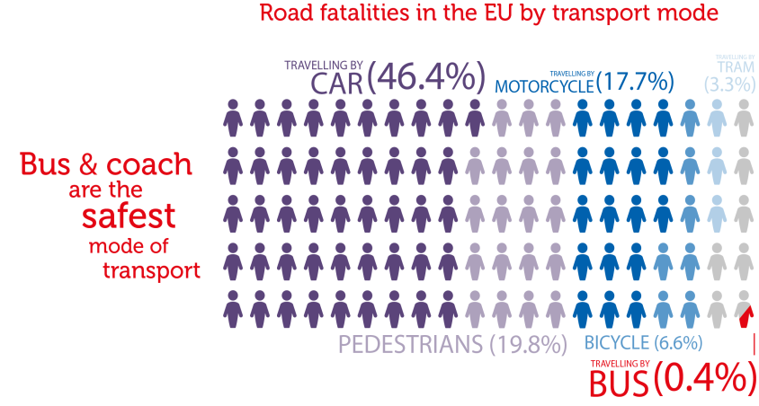



Coaches are …
…the EU road safety champions
... coach?

Slide 8

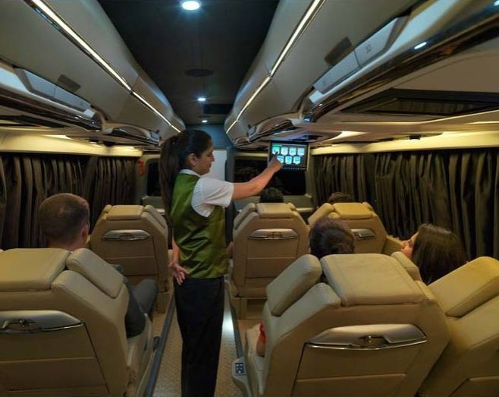

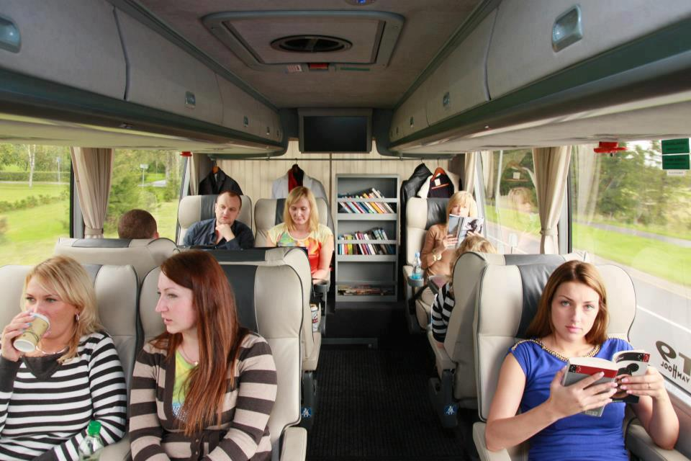
Guess what?
Which airline does this belong to?
What railway does this belong to?

Slide 9
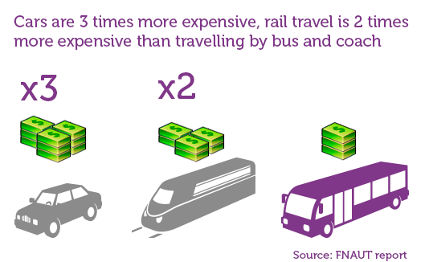

Coaches offer the most cost-effective way…
… of reducing mobility costs

Slide 10
Group tourism by coach
Yet, despite that a number of barriers exist for group tourism by coach, including at local level (LEZ, access restrictions, charges),
the European Commission should, therefore, develop and propose a harmonised EU framework, to be adhered to by cities in the EU, when devising the introduction of LEZs or other similar restrictions.

Slide 11
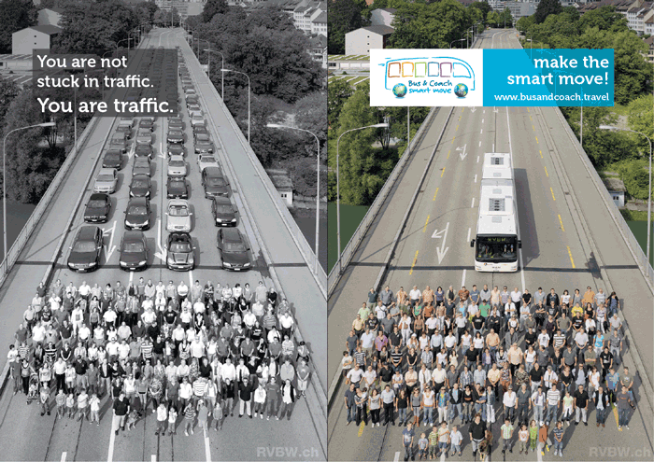
Transport Infrastructure – industry proposals
Create an EU group tourism by coach charter
  Coherent strategy for integrating high-quality group tourism with other interests
  Promote the use of bus only lines by tourist coaches
  Instructions and signs for coach drivers
  Safe, secure and accessible intermodal coach terminals
  Safe and secure amenities for drivers and passengers
  Group tourism marketing plans by cities in partnership with industry

Slide 12
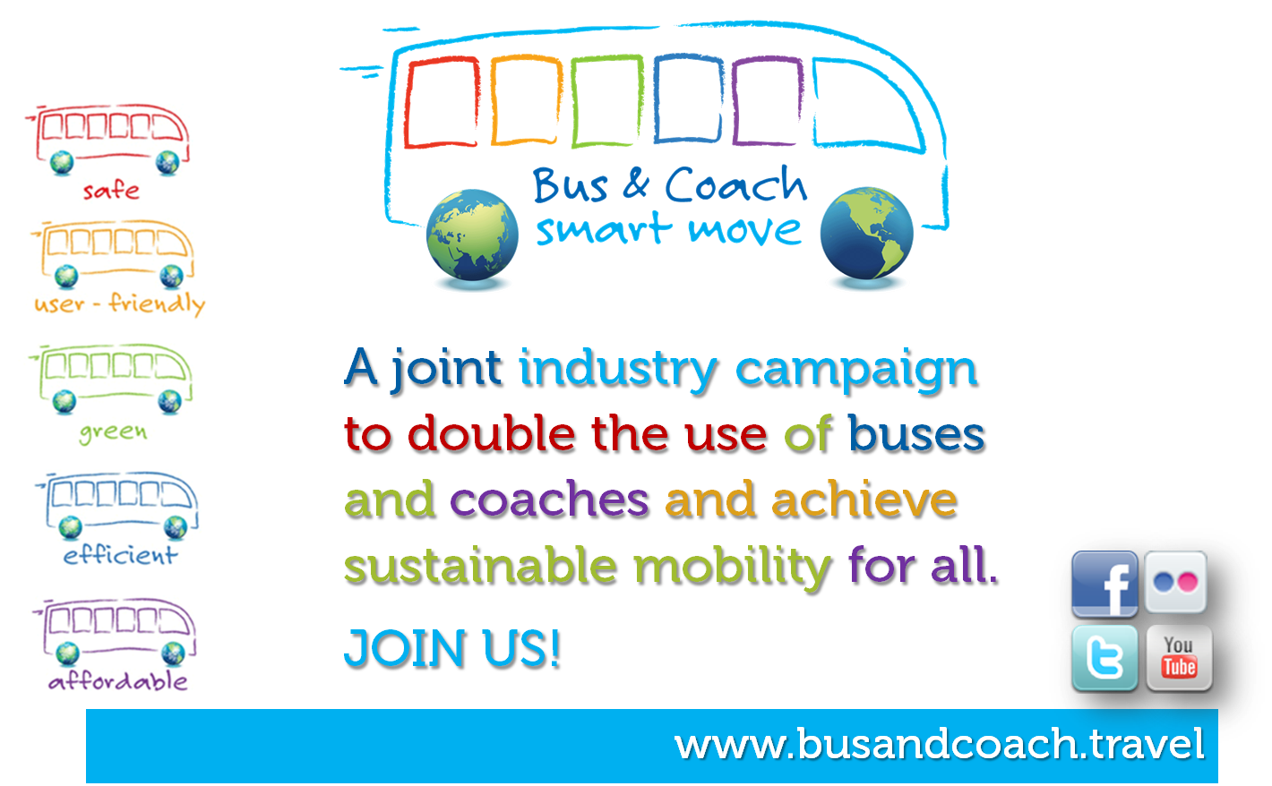
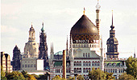





IRU Smart Move Awards

Slide 13
Actions advocated by industry
  COACH OF THE FUTURE: Develop innovative ideas on safe, green, accessible and customer-friendly coaches of the future
  ONE-STOP SHOP: Create a multilingual European single window on access restrictions and LEZs in European cities
  SUSTAINABLE URBAN MOBILITY PLANS: Collective transport to be prioritised, including visiting coaches
  INCENTIVES: Introduction of a reduced VAT for all collective land transport modes, including tourist coaches
  LEGISLATION: To fit the specific needs of the coach industry (driving and rest time rules, passenger rights)
  ADMINISTRATIVE FORMALITES: Control documents of the future; abolition of outdated ones

