Slide 1
Transport Facilitation The role of key UN Conventions UNESCAP Committee on Transport
Bangkok, 15-17 October
Jens Hügel, Head – Sustainable Development

Slide 2
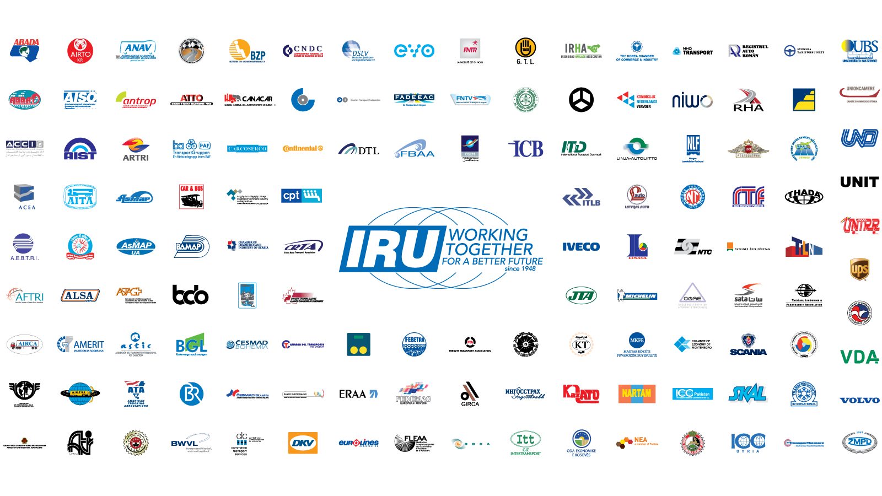
This is the IRU

Slide 3
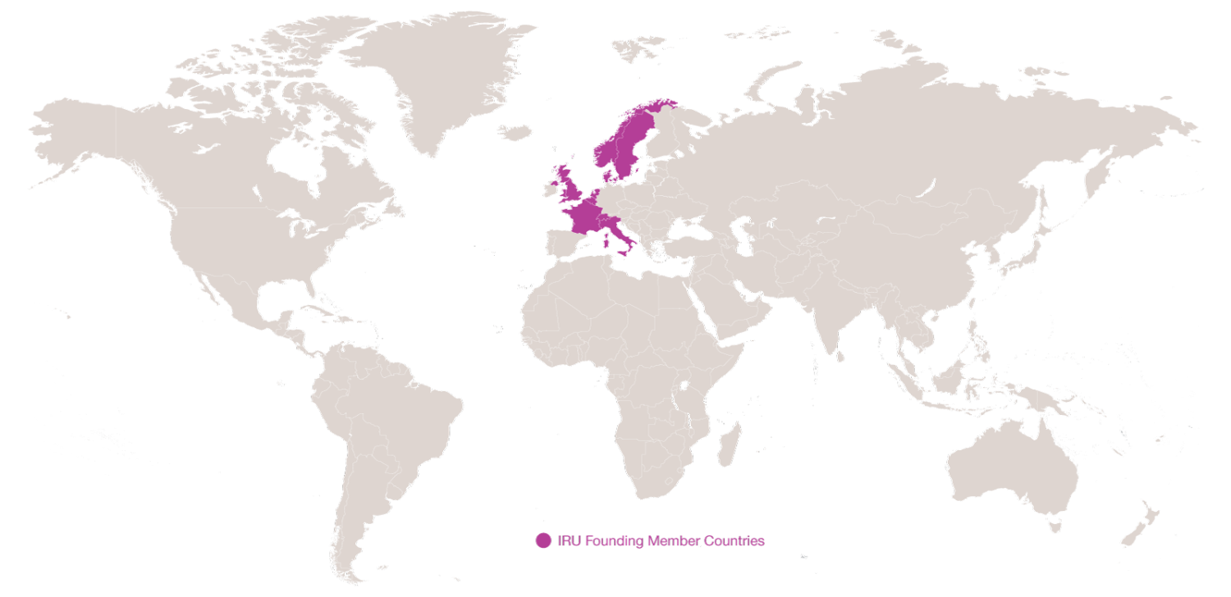
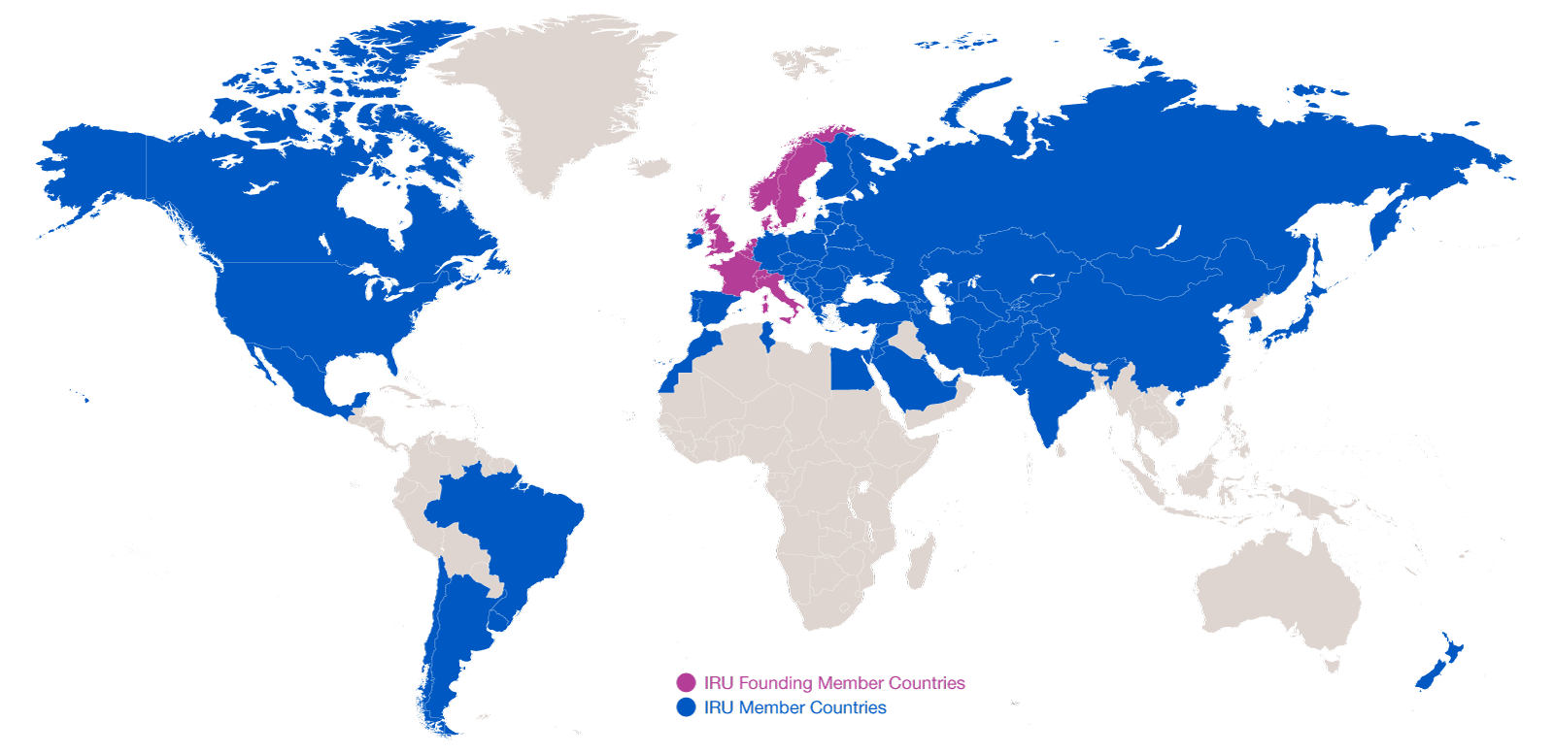
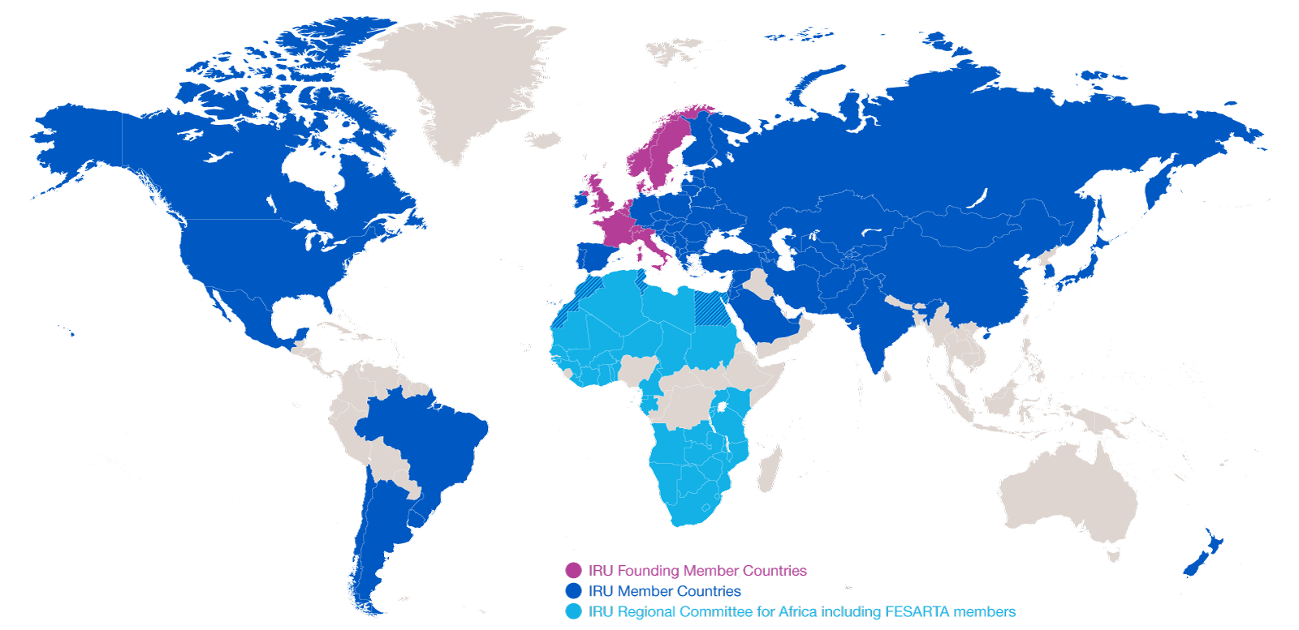
Evolution of IRU Membership
2014: 170 Members in 75 countries
2014: 170 Members in 75 countries
1948: eight founder countries
…and CRIPA: 27 Members + FESARTA in 38 countries

Slide 4






IRU Secretariat General
1948 – IRU founded in Geneva
1973 – IRU Permanent Delegation to the European Union in Brussels
1998 – IRU Permanent Delegation to Eurasia in Moscow
2005 – IRU Permanent Delegation to the Middle East and Region in Istanbul
2012 – IRU Secretariat for Africa in Geneva
2013 – IRU Permanent Delegation to the United Nations in New-York

Slide 5
What is Globalisation?
What does it take to have a cup of coffee in a café?
The combined efforts of 29 companies in 18 countries
Road Transport has become a vital production tool!
Source: IRU

Slide 6
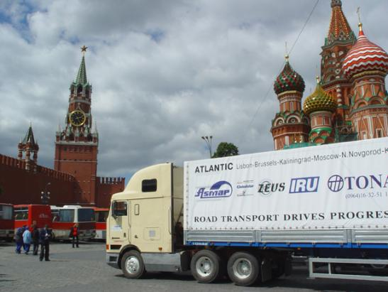
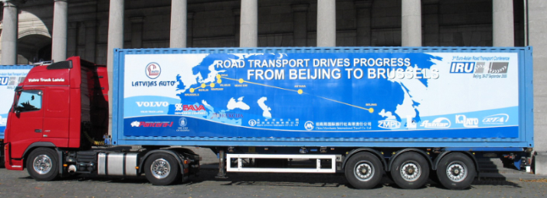
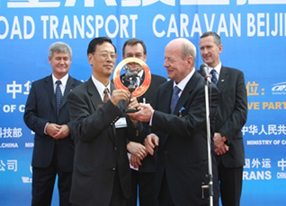
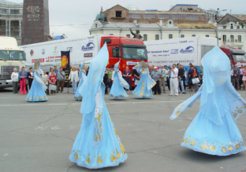
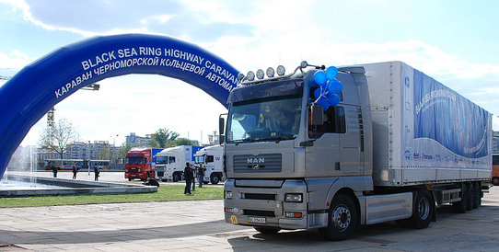
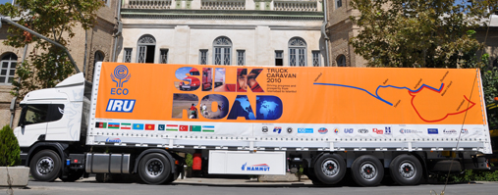
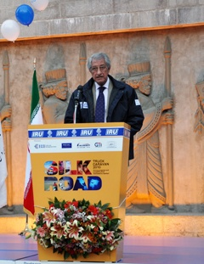
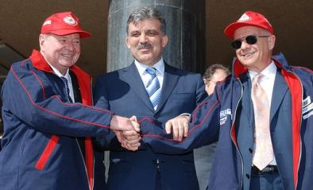
IRU Caravans: No country is landlocked to road transport!
2004: The Lisbon-Vladivostok Caravan
2005: The Beijing-Berlin-Brussels Caravan
2007: Black Sea Highway Caravan
2010: IRU-ECO Silk Road Truck Caravan

Slide 7

IRU Caravans demonstrated that adequate roads exist, but that there is little traffic!!

Slide 8
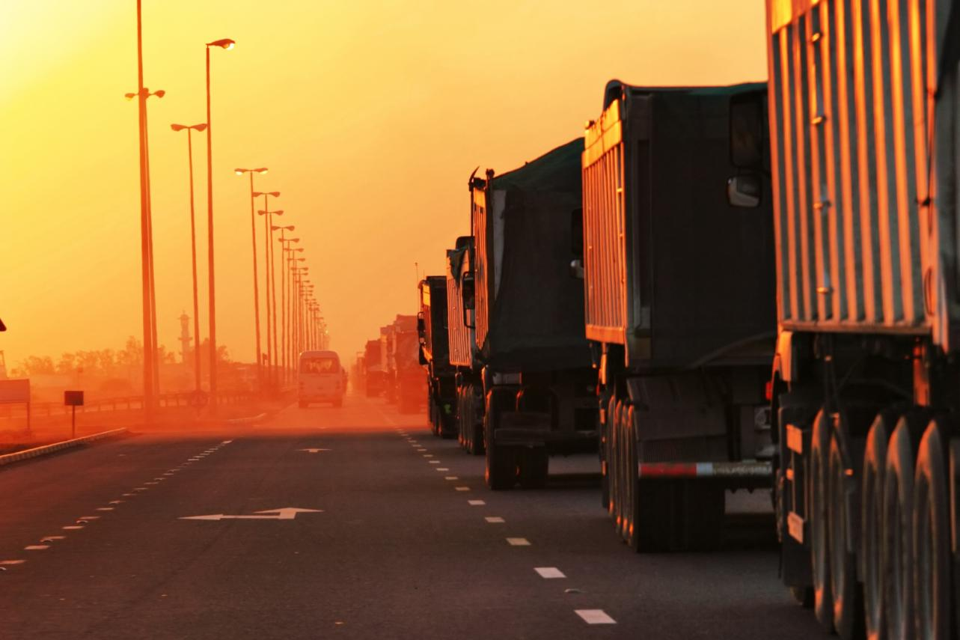
…until the trucks reached border crossings!!

Slide 9




IRU New Eurasian Land Transport Initiative (NELTI)
From September 2008 to date
Monitoring of over 200,000 border crossings
57% of transport time lost at border crossings!
38% of transport costs due to unofficial levies

Slide 10
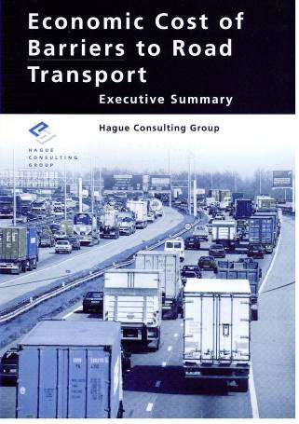
Any penalty on road transport is an even greater penalty on the economy as a whole!
* Includes lost opportunities
Source: Hague Consulting Group

Slide 11
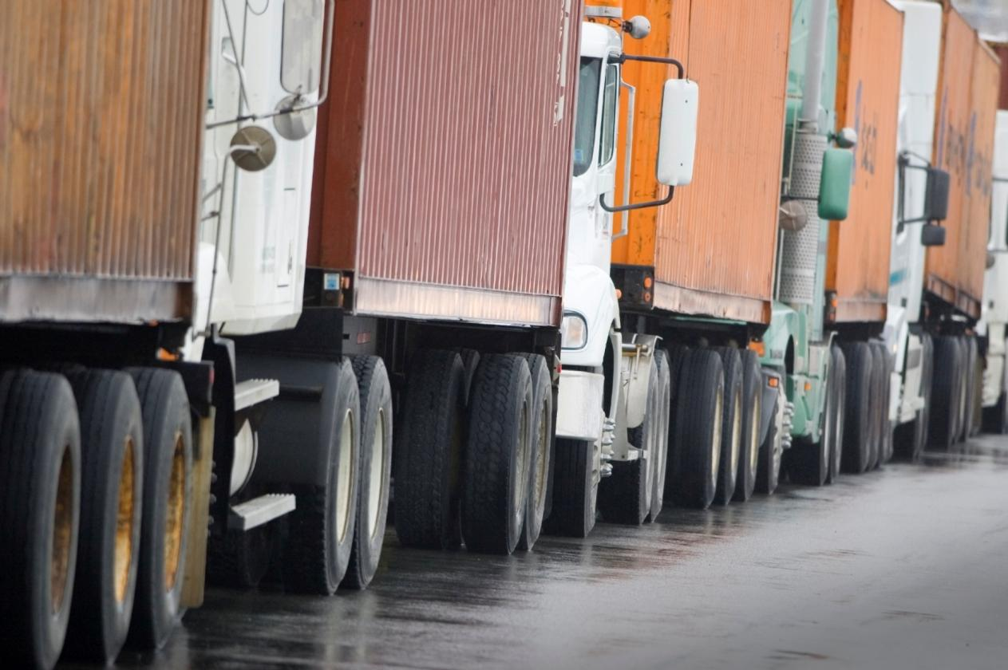
How can we change this view and let road transport drive trade, progress and prosperity?

Slide 12
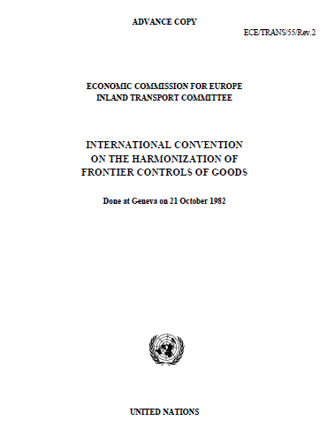
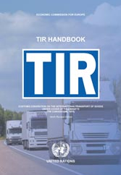
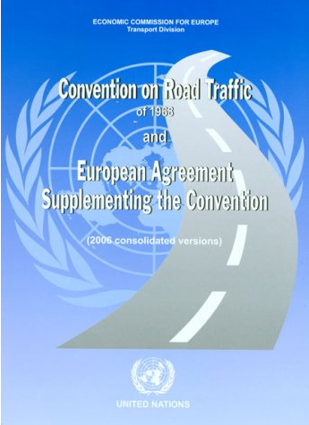
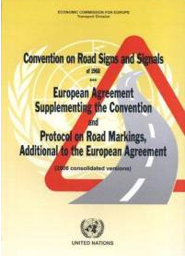
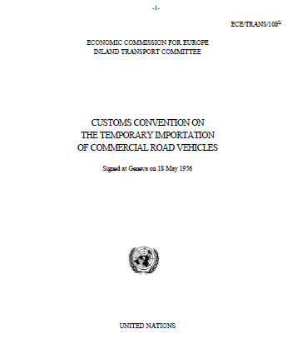
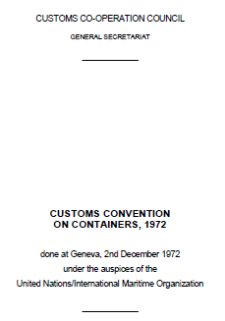
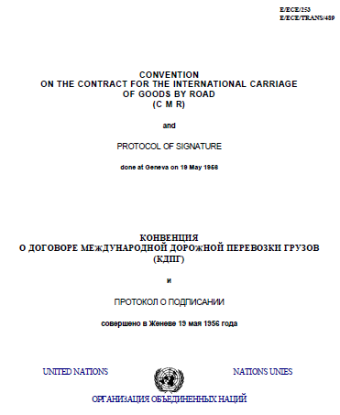
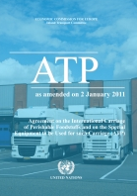
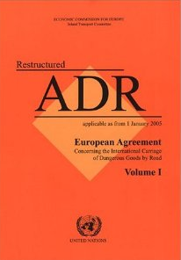
Implement key UN Transport Facilitation Instruments

Slide 13
Securing and facilitating trade and international road transport
Transports
Internationaux Routiers
Managed by the IRU since 1949

Slide 14
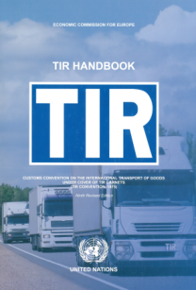

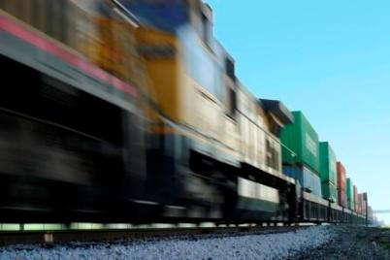
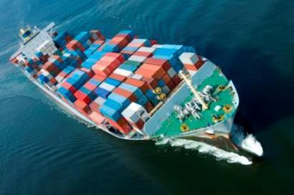
What is the TIR System?
A tried and tested, affordable facilitation instrument for international transport and trade
Multilateral
Intermodal (road-rail, road-maritime, road-air)
Global

Slide 15
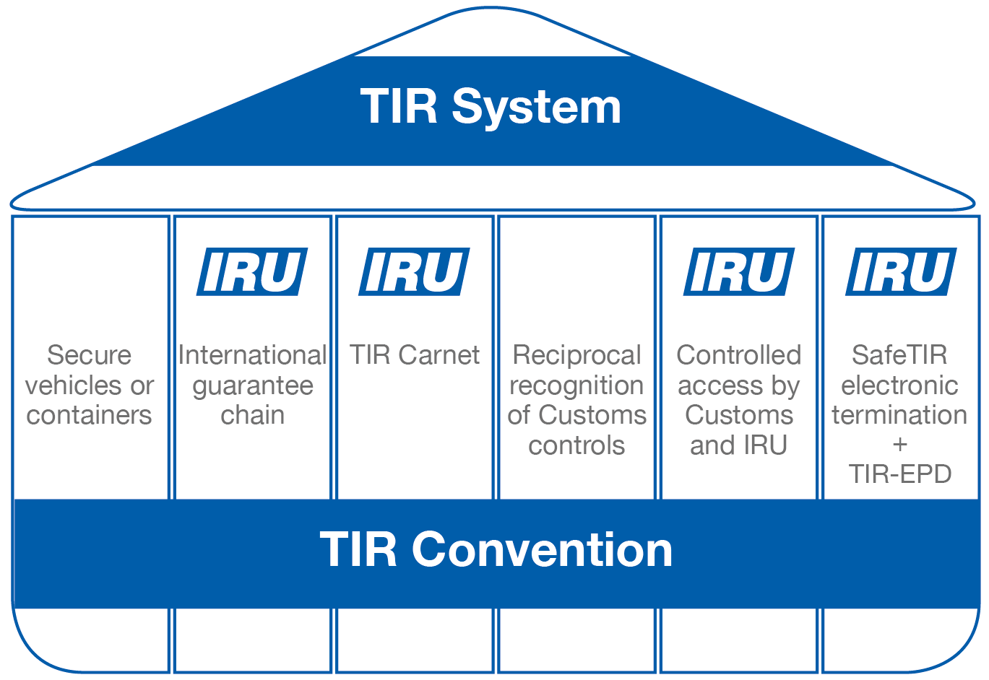
The six pillars of the TIR System

Slide 16
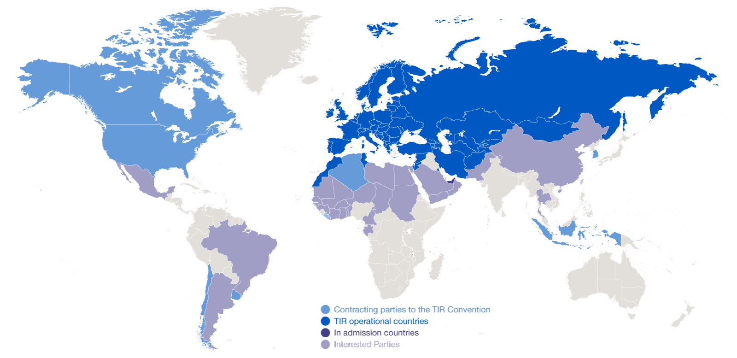
Geographical scope of the TIR Convention

Slide 17
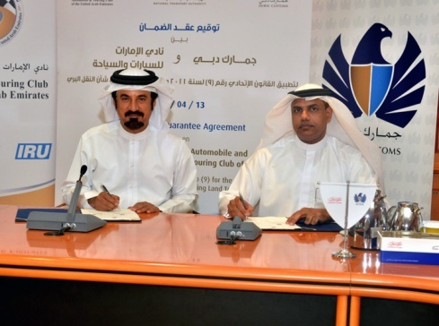
TIR Expansion : latest developments
April 2014 – UAE Customs sign guarantee agreement
April 2014 – Pakistan officially confirms forthcoming accession to TIR
Interest in TIR also expressed by Argentina, Brazil, Mexico, Iraq, KSA and various African countries

Slide 18
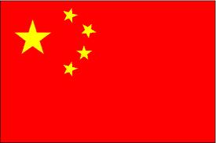

August 2013 – China informs of its intention to accede to the TIR Convention

Slide 19
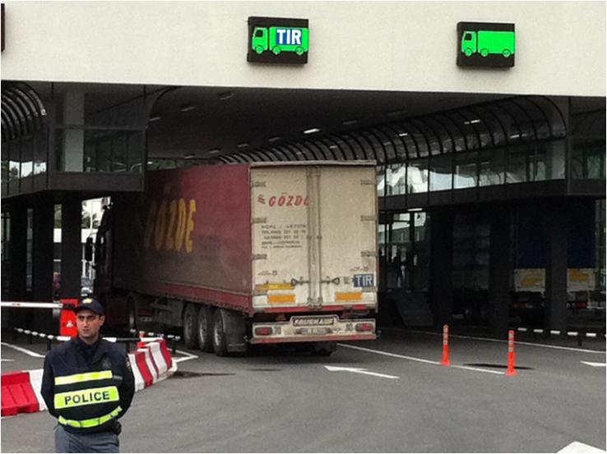

We want to see this…

Slide 20
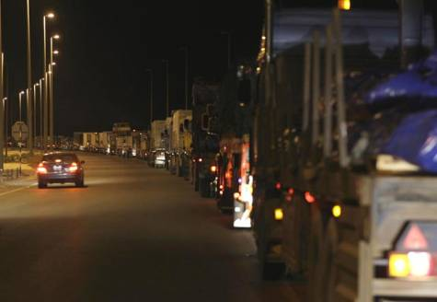
….instead of this...

Slide 21
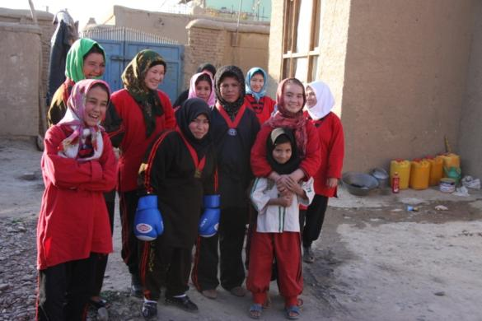
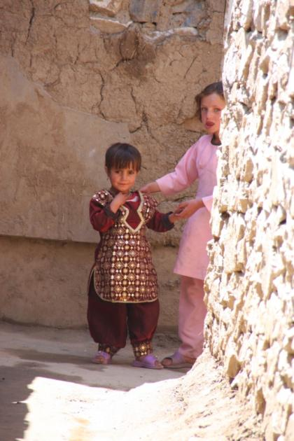
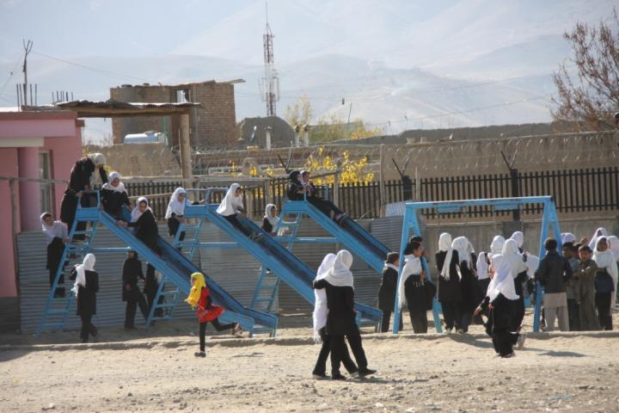
…in order to bring them hope!

