Slide 1
UNECE legal instruments and the private sector
New York, 5 June 2014
Igor Runov
Under Secretary General
Head of IRU Permanent Delegation to the UN

Slide 2

This is the IRU

Slide 3

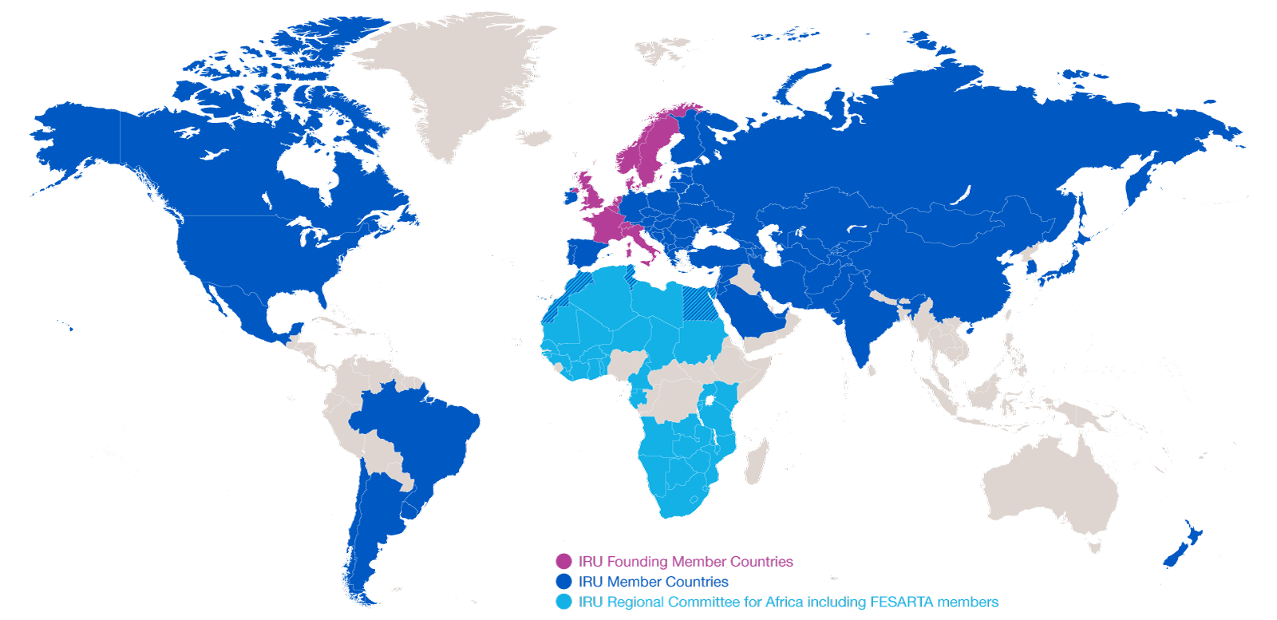
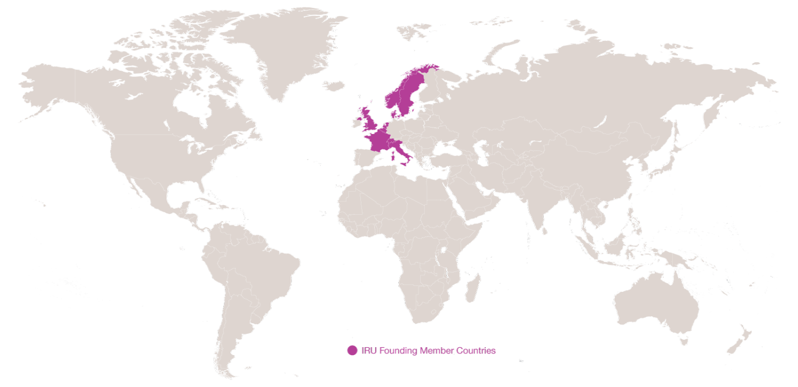
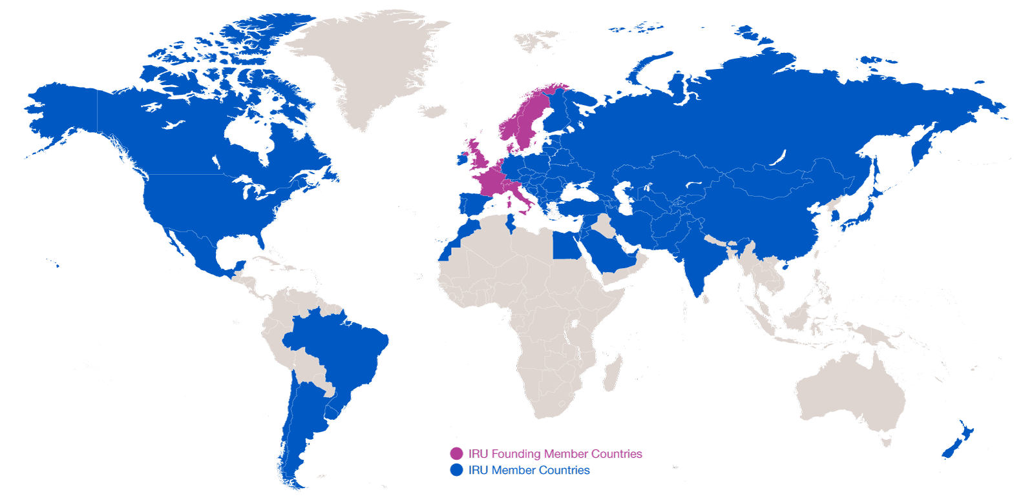
Evolution of IRU Membership
1948: eight founder countries
2014: 170 Members in 75 countries
…and CRIPA: 27 Members + FESARTA in 38 countries

Slide 4
IRU Partner Organisations
Global partners
UN, UNCTAD, UNDP, UNEP, UNMAS, UN-OHRLLS, UNWTO, UNGC, ILO, IMO, ITF, WCO, WHO, WTO
International Financial Institutions
Asian Development Bank (ADB), African Development Bank (AFDB), Islamic Development Bank (IDB), World Bank
Regional partners
AU, AULT, BSEC, CAREC, CEMAC, CIS, CTC, Customs Union, ECO, EEC, EU Institutions, EurAsEC, FESARTA, GUAM, ICDT, LAS, OAS, OSCE, SCO, TRACECA, UNECA, UNECE, UNECLAC, UNESCAP, UNESCWA, UfM

Slide 5
4 priority areas
Trade facilitation and sustainable supply chains
Infrastructure development
Needs of countries in special situations
Safety and security

Slide 6
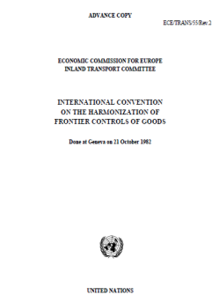
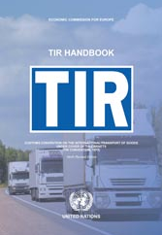
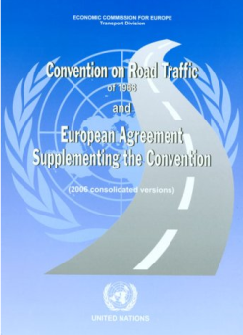
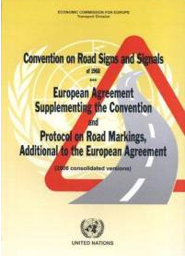
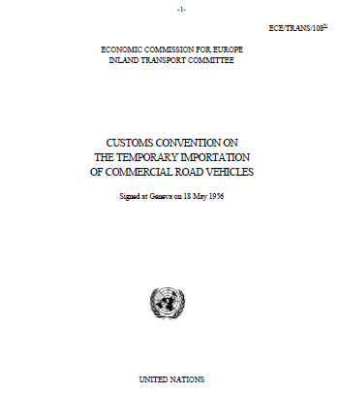
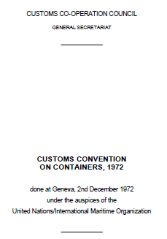
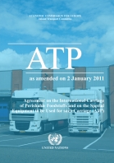
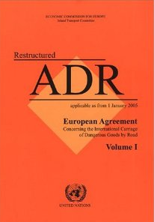
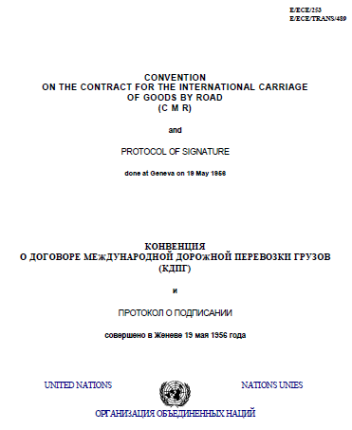
Implement key UN facilitation instruments to allow road transport to drive trade and achieve the SDGs!

Slide 7

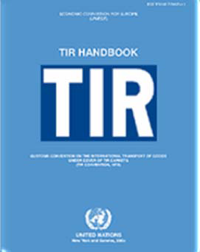
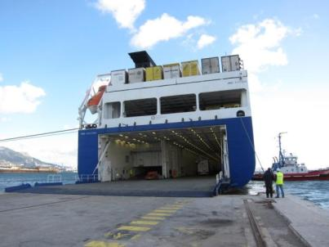
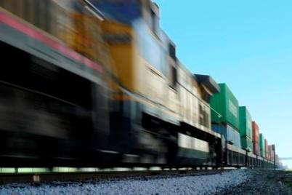
Multimodal TIR
TIR Convention of 1975 includes multimodality
Goods transport across one or more frontiers provided
some portion is made by road
Other modes of transport can be used for non-road leg
Today increasing number of multimodal TIR transports
  RO/RO transports through ferry services
  (Black Sea, Caspian Sea, Baltic States,
  Mediterranean, Persian Gulf)
  Block trains (ECO region)

Slide 8
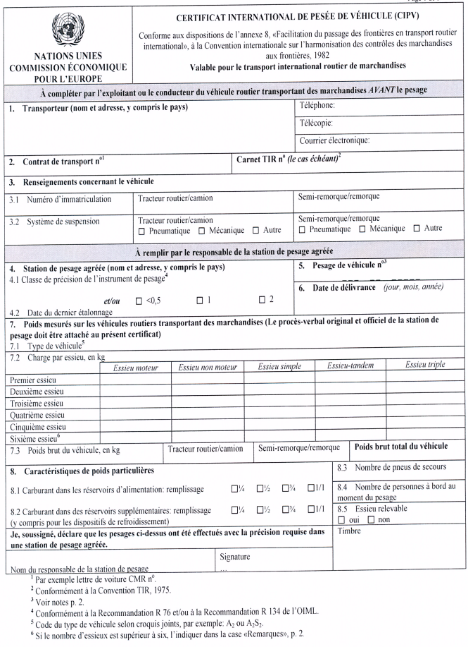
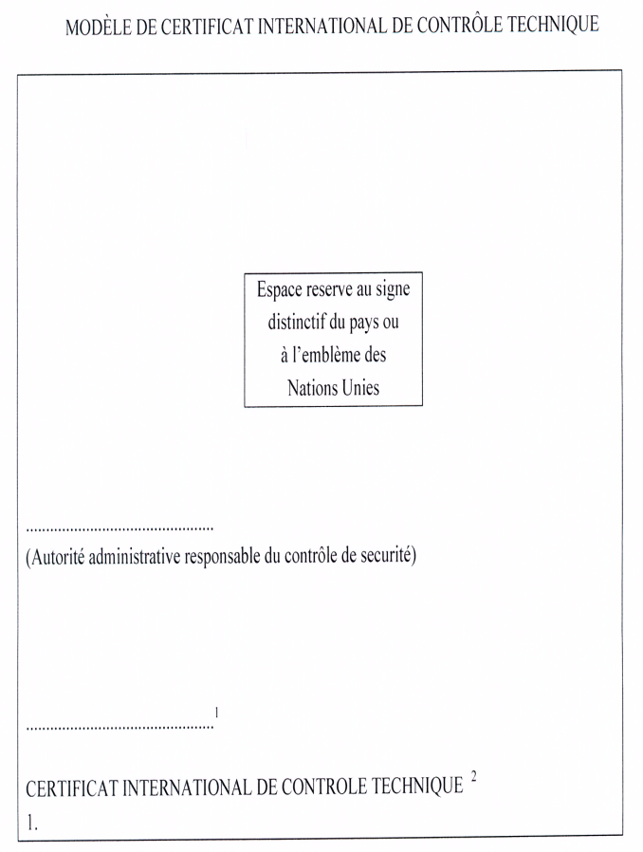
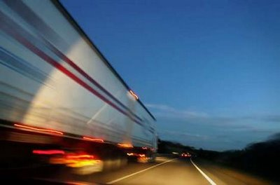
1982 Harmonization Convention
To facilitate cross border transport of goods through nationally coordinated, internationally harmonized, shorter, reduced formalities and controls of goods at borders
Benefits:
Reduction of border delays,
Reduction of transport costs
Reduction of trade transaction costs
Reduction of border operating costs for State budget
More efficient investments in border facilities

Slide 9

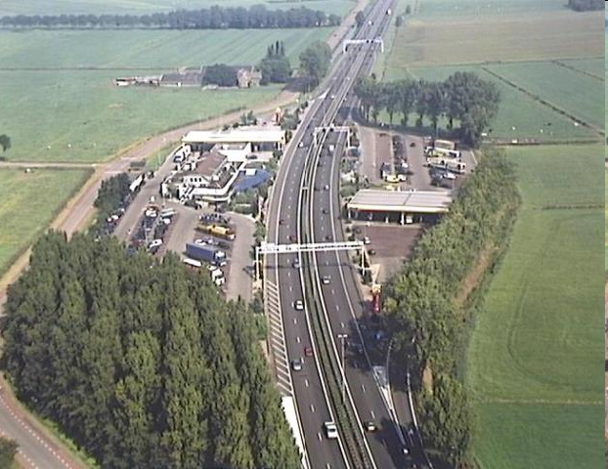
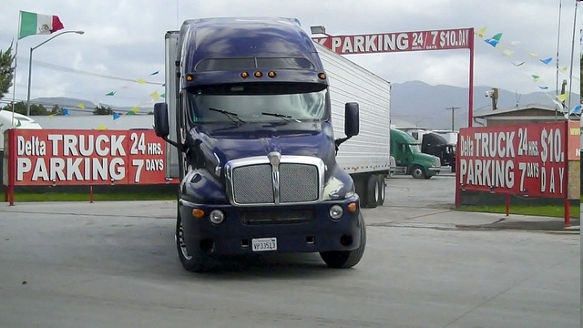
Hard and soft infrastructure

Slide 10

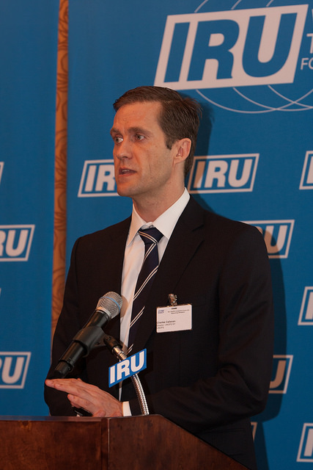
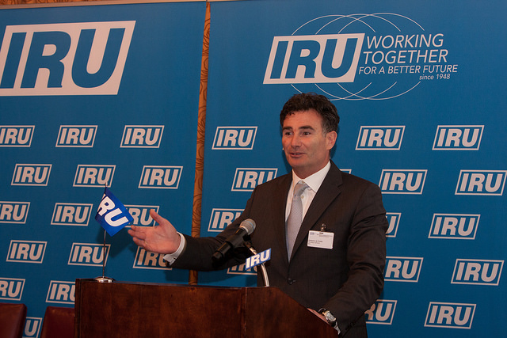
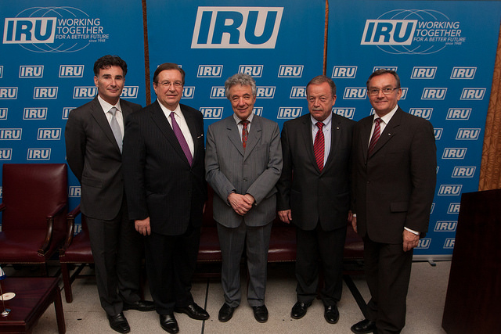
IRU/UNOPS Investment Forum, 28 April

Slide 11
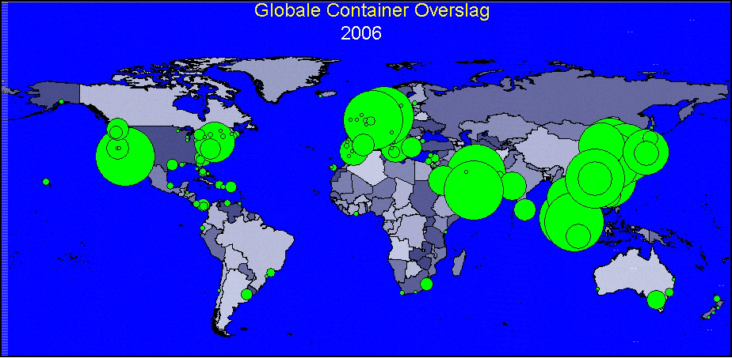
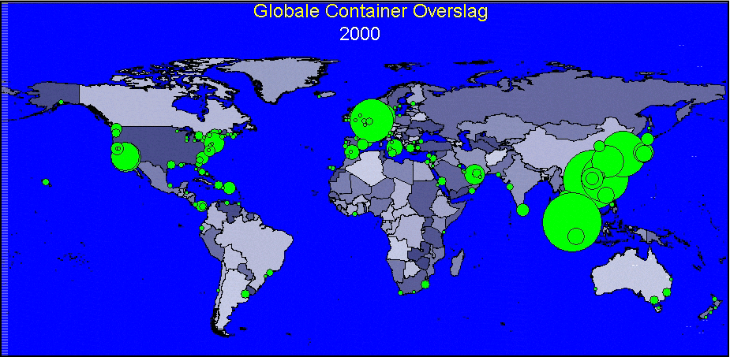
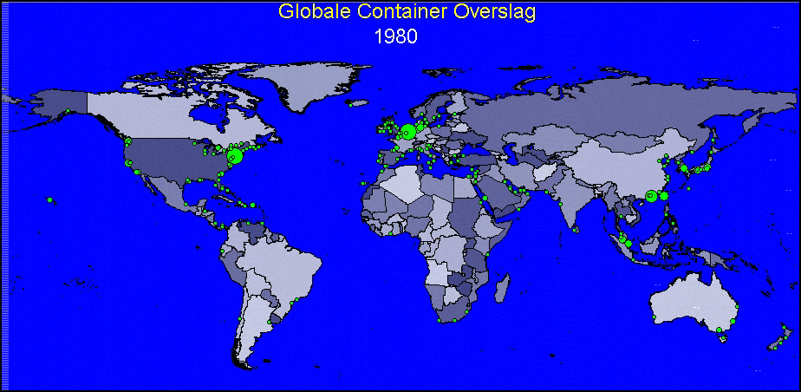
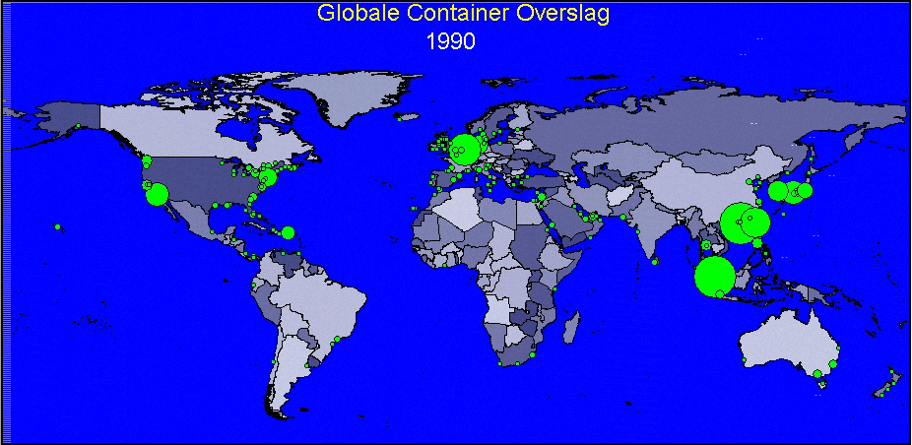
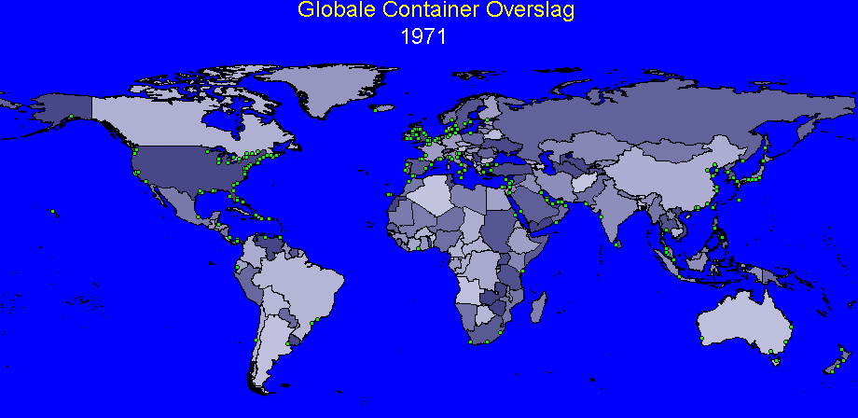
Evolution of sea containers in ports
2010

Slide 12
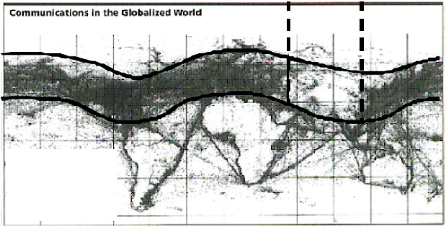
Daily telecommunications activities
Telecommunications gap corresponds to the regions that have not been interconnected to global trade
Source: Centre for Strategic International Studies (CSIS), Washington, DC
Notes:
This desertification of trade and prosperity in the exact same regions can also be seen by the density of the daily telecommunication activities. Every red arrow points to the same regions which are deprived of the benefits of globalisation.
The IRU objective and dream has always been to interconnect with door-to door road transport every business to every major world market to drive prosperity not only in a handful of ports, but in all countries in all regions. It must recognised that no country is landlocked to road transport.

Slide 13
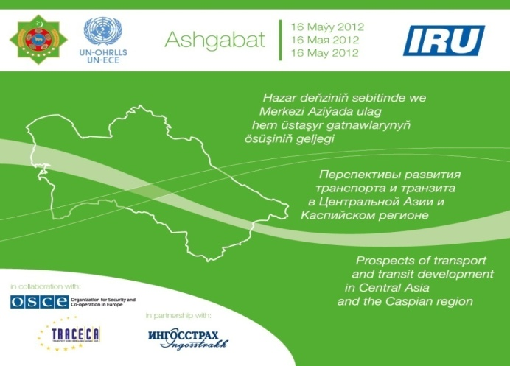
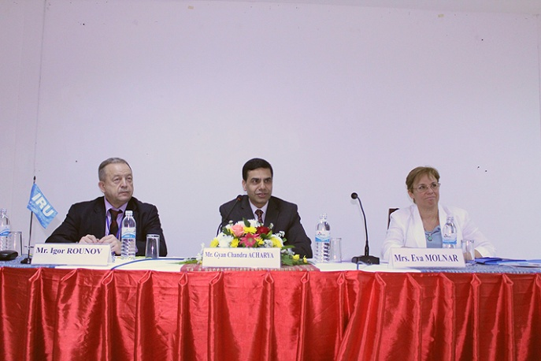
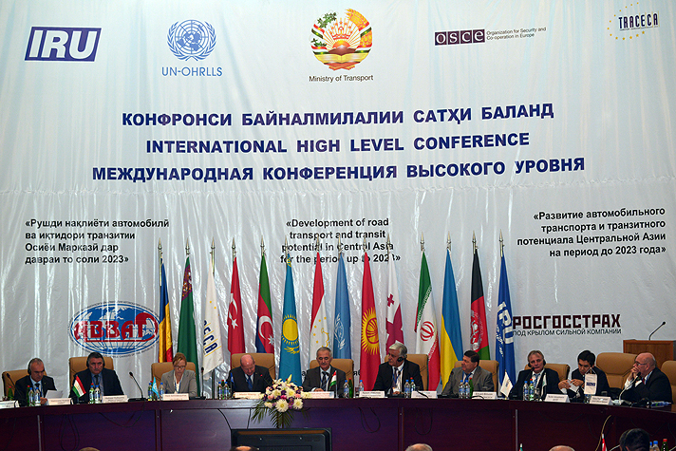
Almaty Programme of Action (APoA)
International Ashgabat Conference
(16 May 2012)
Road transport event during Vientiane Regional Meeting
International Dushanbe Conference
(18 September 2013)
Notes:
13

Slide 14
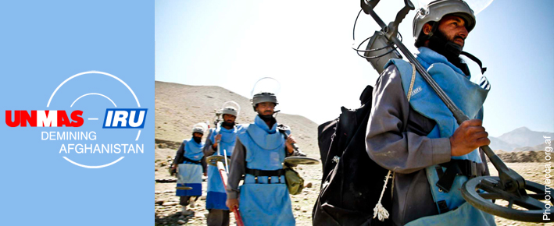
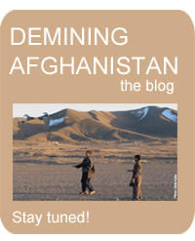
IRU-UNMAS: Demining Afghanistan – an innovative public-private partnership
The blog:
http://demining-afghanistan.org/
UN Decade of Action for Road Safety
- UN Mine Action Service and IRU team up to improve road safety in Afghanistan by removing landmines around roads
- Moving Afghanistan from aid to trade by securing road networks linking Kabul to its Central Asian neighbours
- Clear area of 15 sq km, impact daily lives of 21 communities, direct benefit for over 3,000 families, indirect beneficiaries = 7 million people

Slide 15
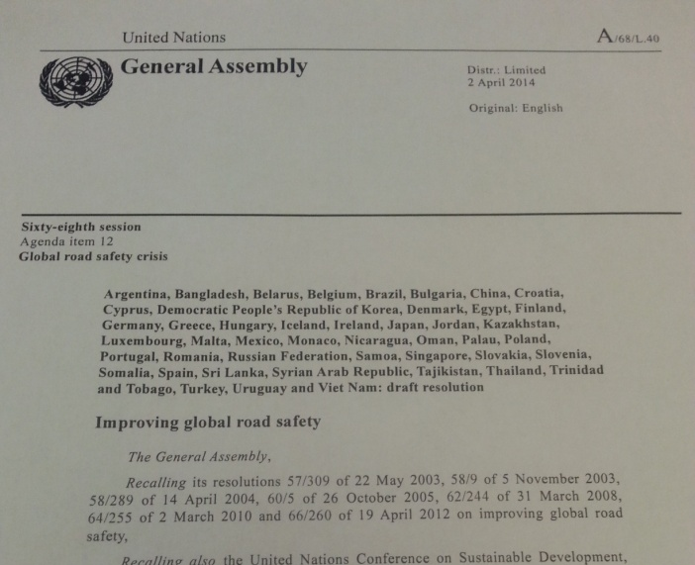

Safety & Security
UN Resolution “Improving global road safety” A/68/L.40
“Acknowledging a number of other important international efforts on road safety, including the development by the International Road Transport Union of harmonized and internationally recognized standards for vocational training of road transport professionals.”
Road Safety Initiative (targeted at distracted driving):
- Initiative by the Turkmen Government (national programme)
- Inclusion in the text of the UN Resolution

