Slide 1
UPDATE ON TIR IN RUSSIA
Moscow, 28 May 2014
Umberto de Pretto, Secretary General

Slide 2
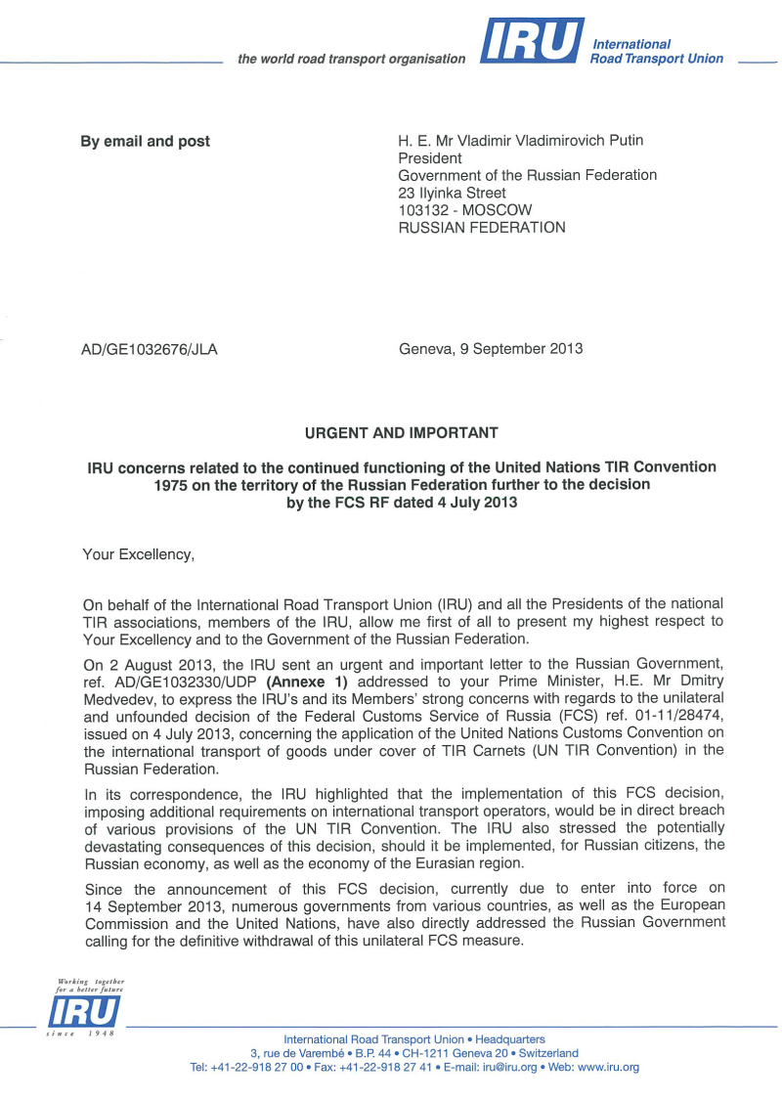
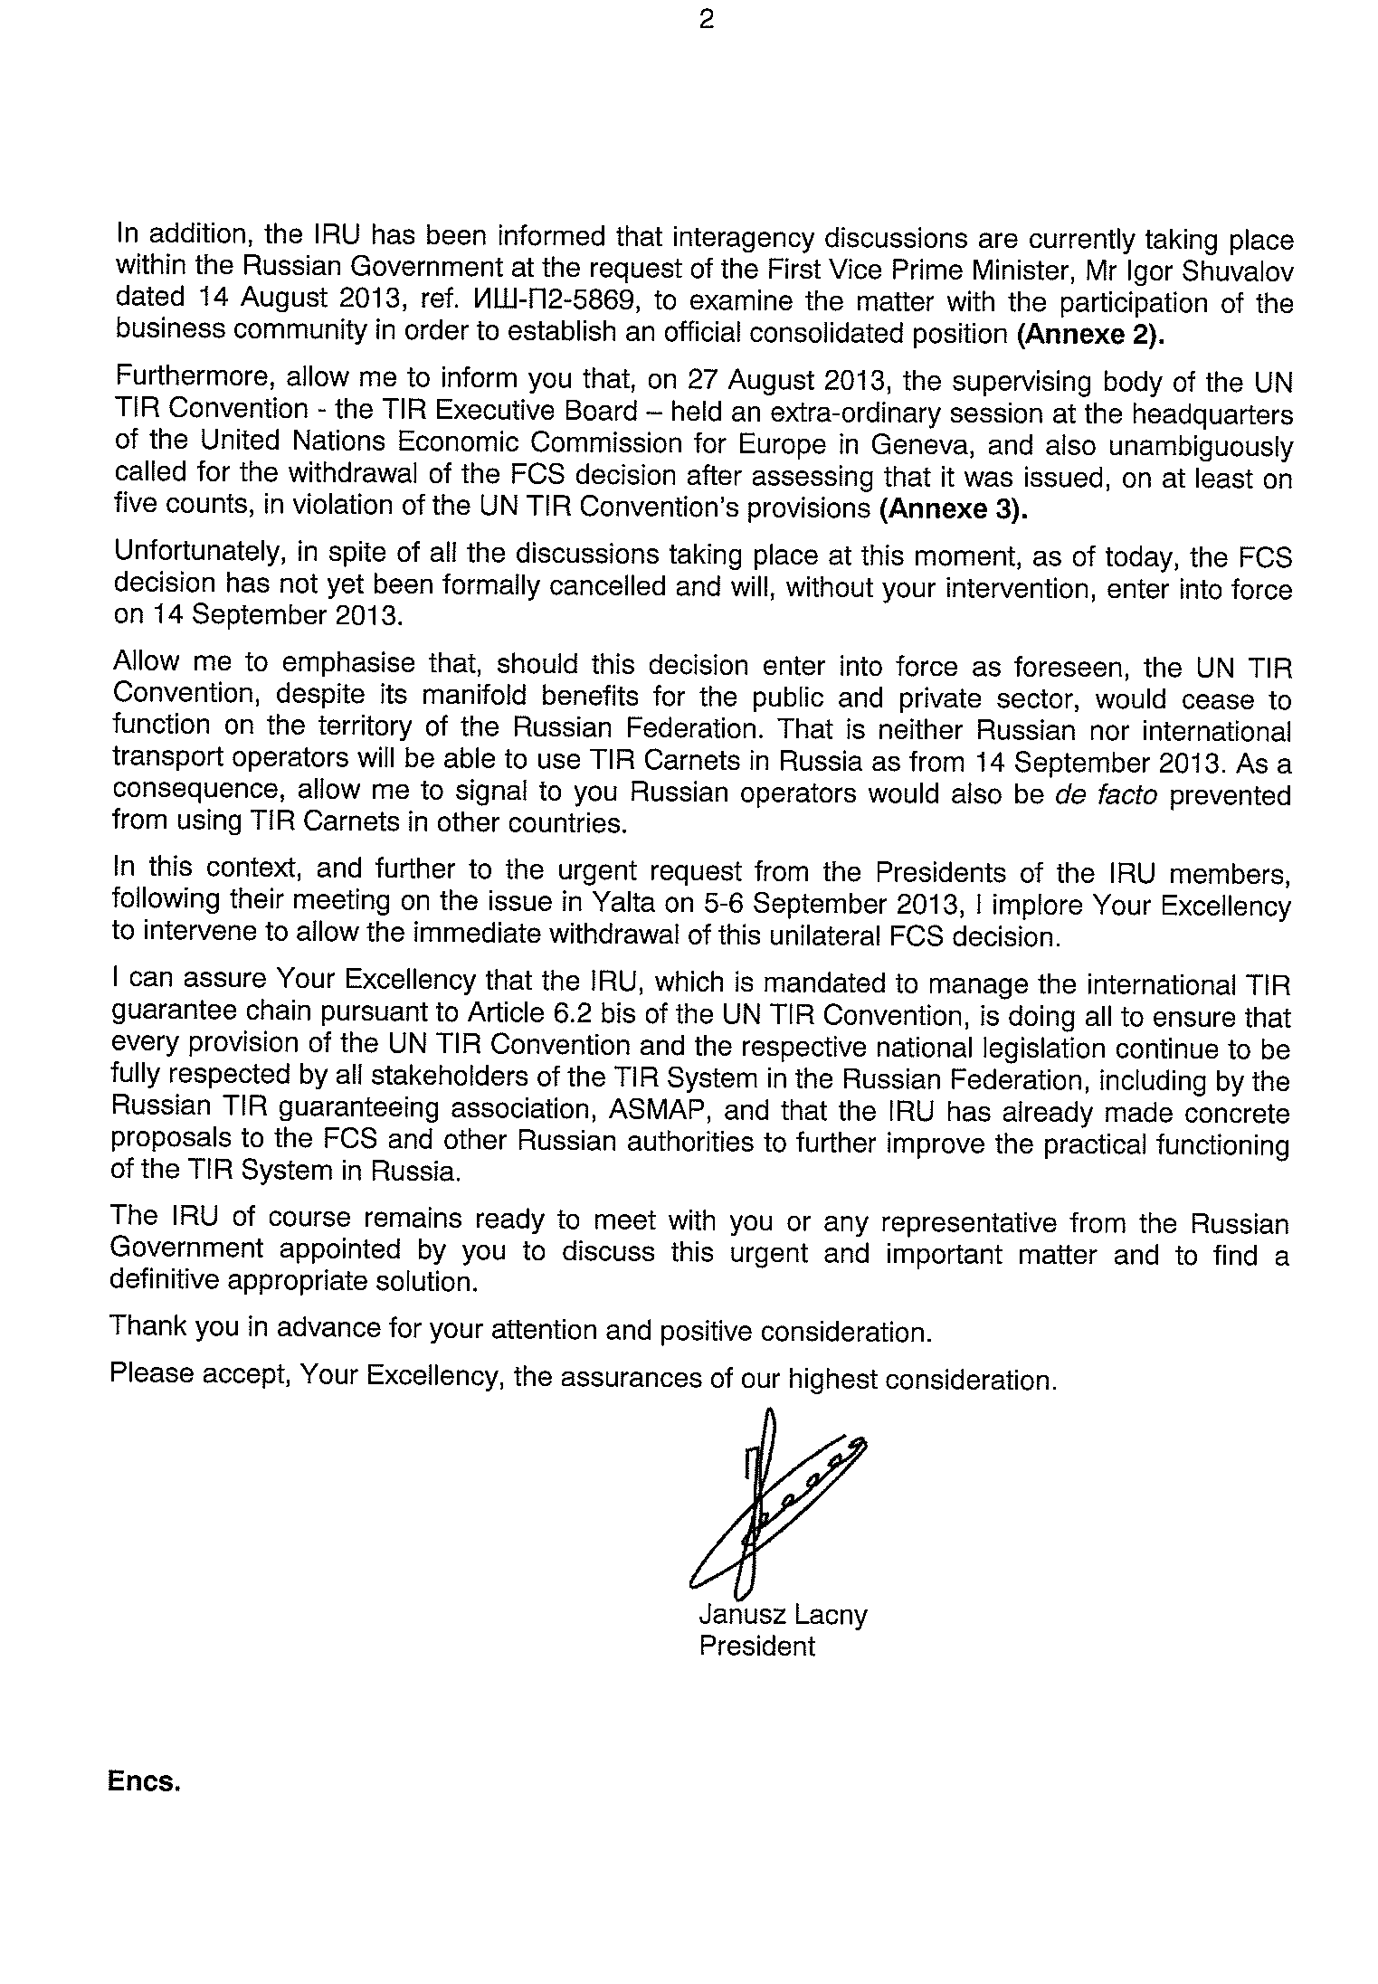
From the outset, IRU called on Russian Government to reinstate TIR

Slide 3
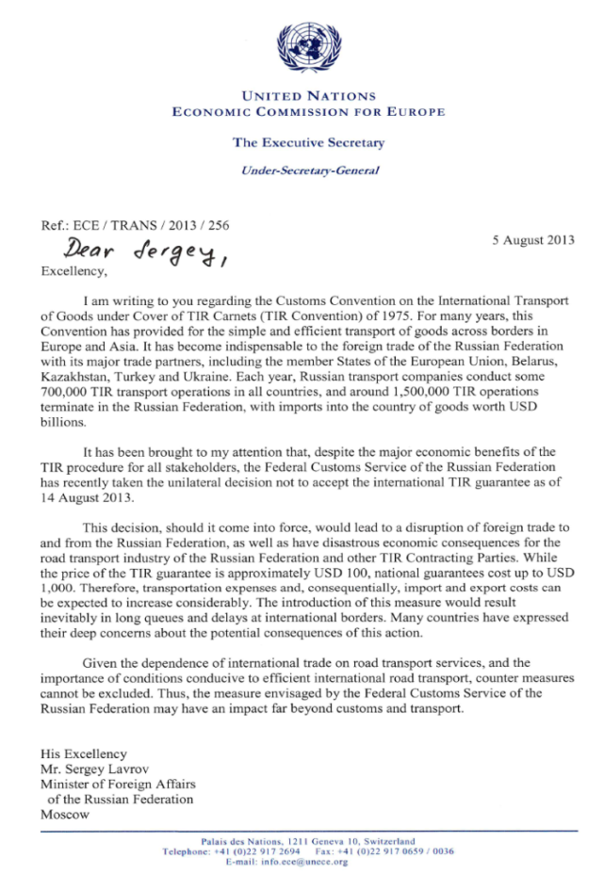
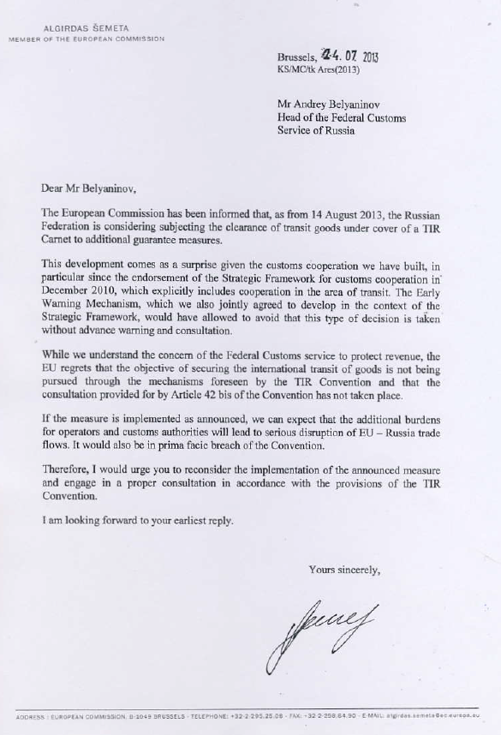
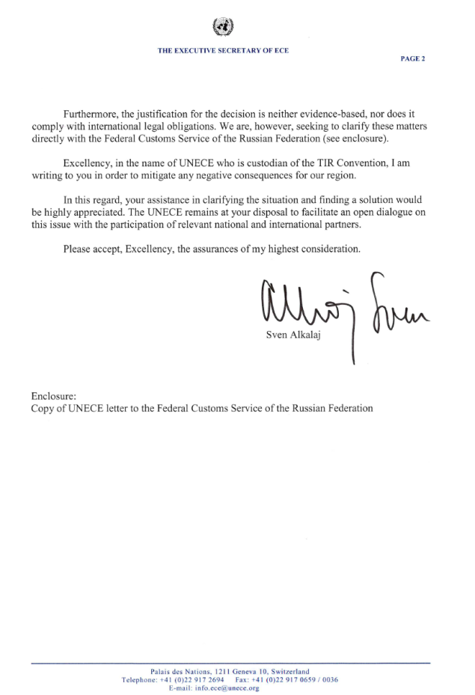
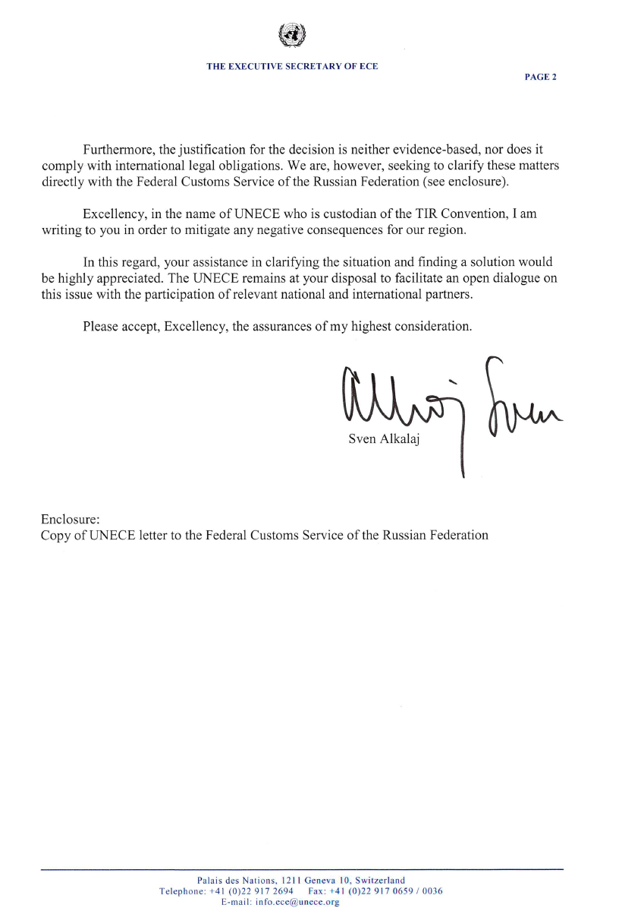
Unprecedented high-level UN and EU support for TIR

Slide 4


November 2013: IRU responded to all possible concerns but FCS was not ready to accept a solution at the time

Slide 5
Outcome of governmental meeting
At the meeting on 26 November 2013 led by Russian Deputy Prime Minister, Mr Shuvalov, it was decided that:
  The guarantee agreement with ASMAP would be prolonged until 1 July 2014
  The TIR Convention would be reauthorised in Russia as from 1 December 2013
  A tender for a new TIR guarantee contract in Russia would be prepared by the FCS RF, the Ministry of Transport and the Ministry of Economy, for finalisation in May 2014

Slide 6
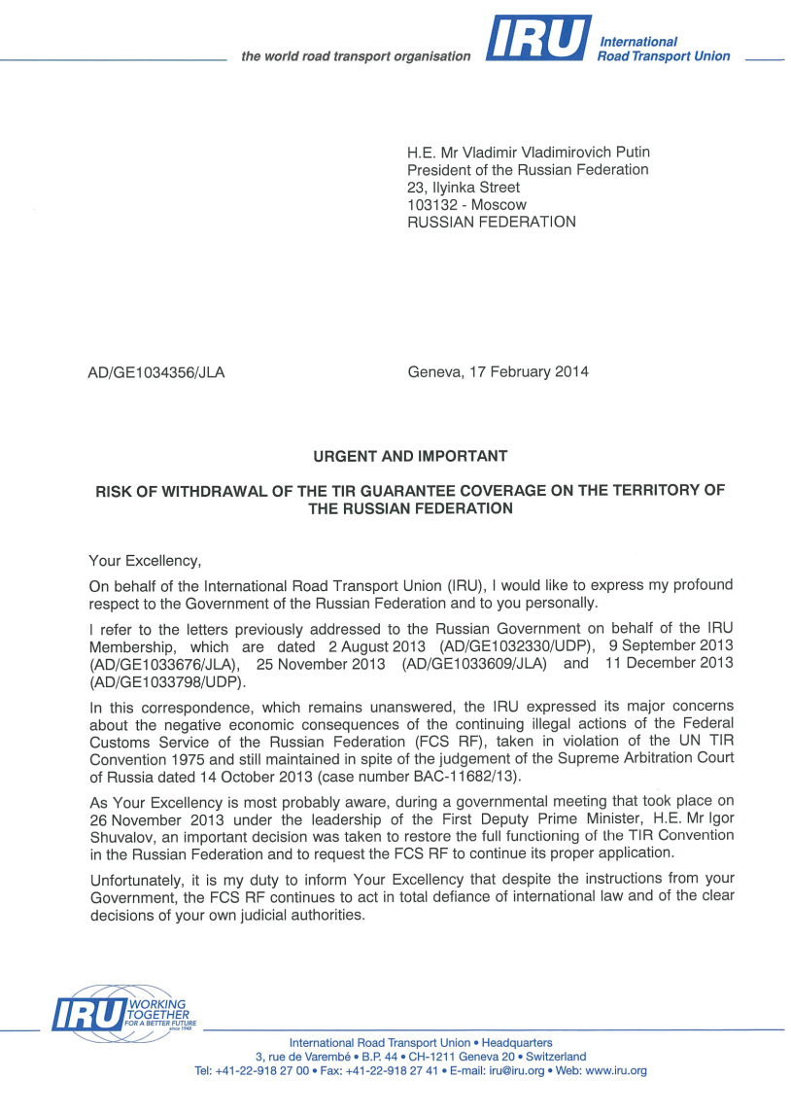
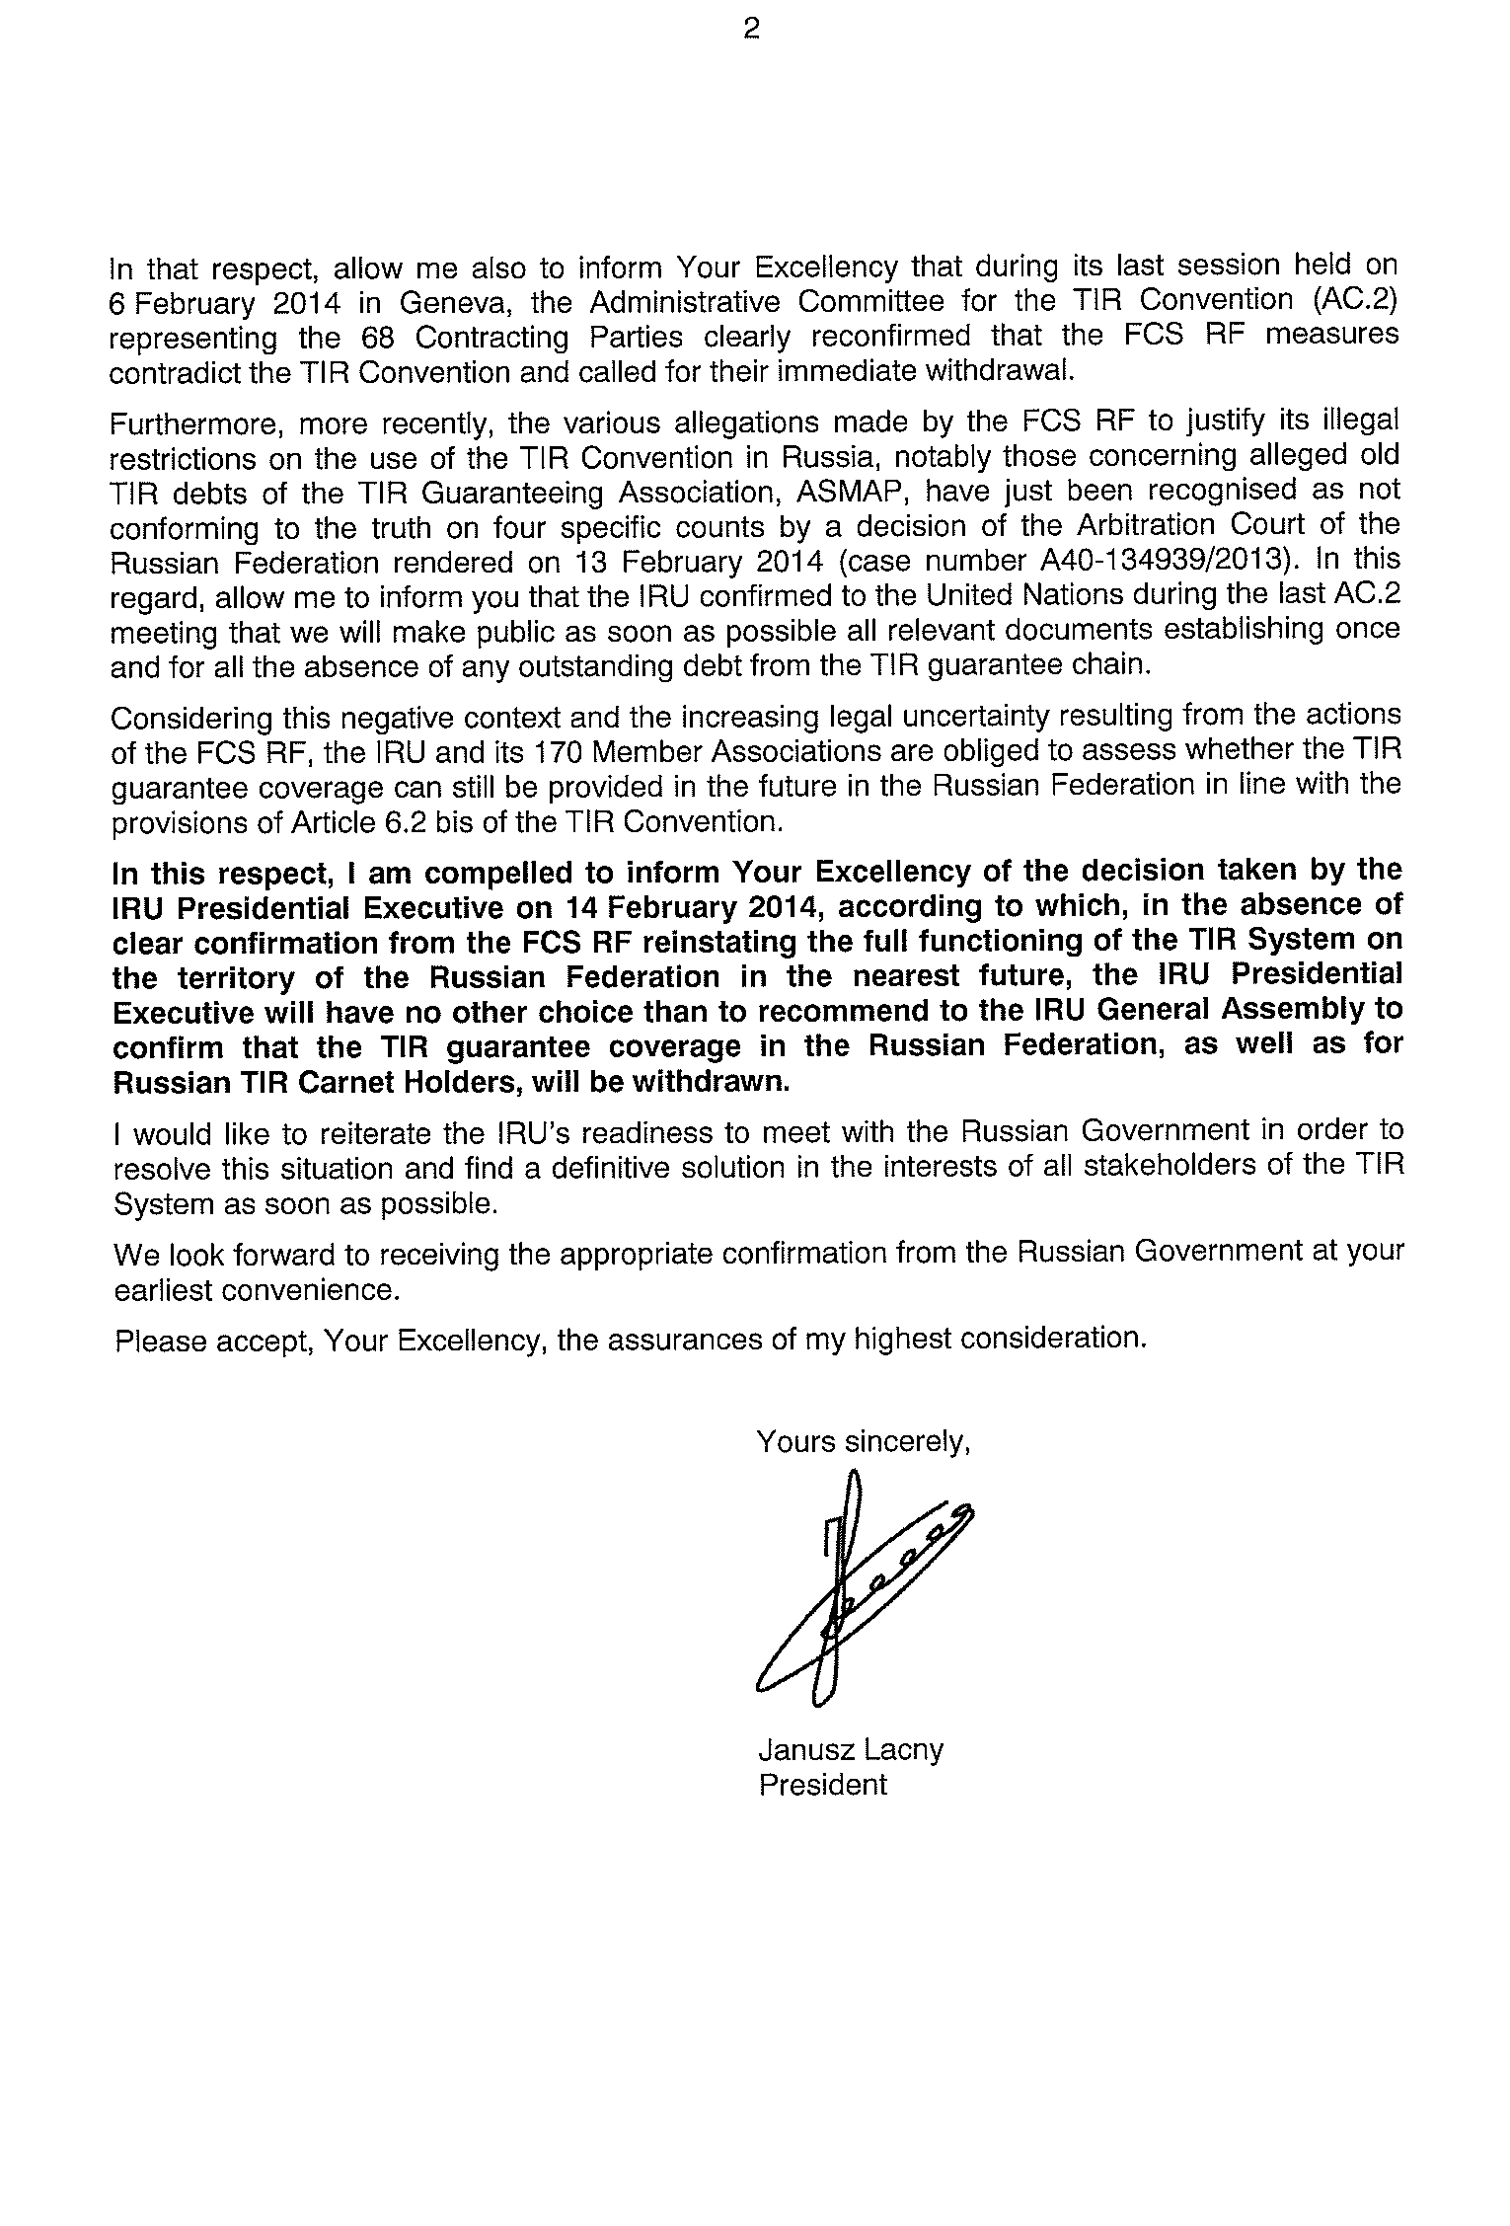
14 February 2014 - IRU Presidential Execuitve decision to address President Putin again

Slide 7
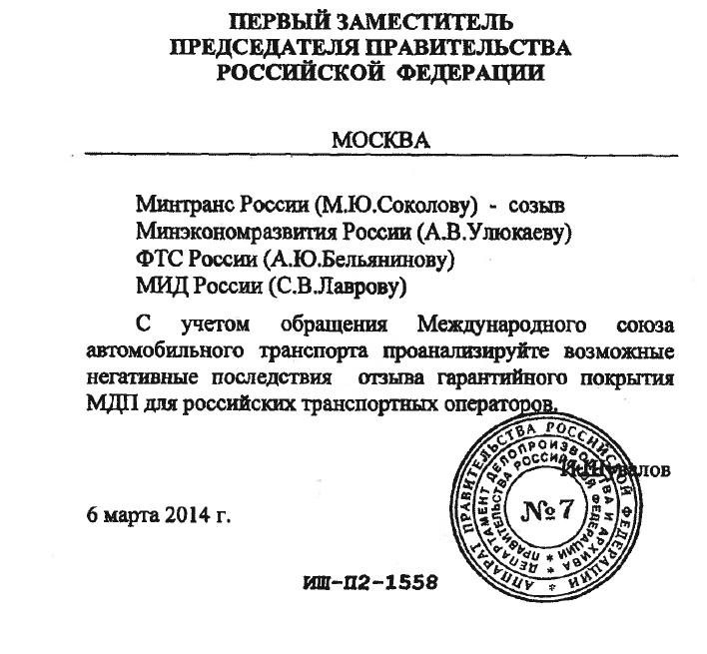
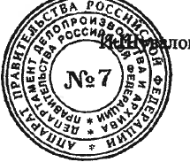
6 March 2014 - Russian Government starts to deal with TIR issue
FIRST DEPUTY PRIME-MINISTER OF RUSSIAN FEDERATION
To: Ministry of Russia
Ministry of Economic Development
FCS of Russia
Ministry for Foreign Affairs
Further to request of the International Road Transport Union, please analyse the possible negative consequences of withdrawal of TIR guarantee coverage for Russian transport operators.
6 March 2014 I. Shuvalov

Slide 8
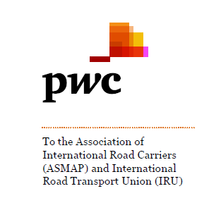
28 March 2014 - Audit of ASMAP confirms full compliance with Annex 9 of the TIR Convention
General Conclusions
PwC concluded that the procedures and organisation put in place by ASMAP are compliant with the current provisions of the TIR Convention as well as rules and regulations of the IRU which has been mandated by the article 6.2 of the TIR Convention to be responsible for the smooth organisation of the TIR Guarantee System. ASMAP is also compliant with its obligations vis-à-vis the Federal Customs Service of the Russian Federation according to the currently applicable Guarantee Agreement.

Slide 9
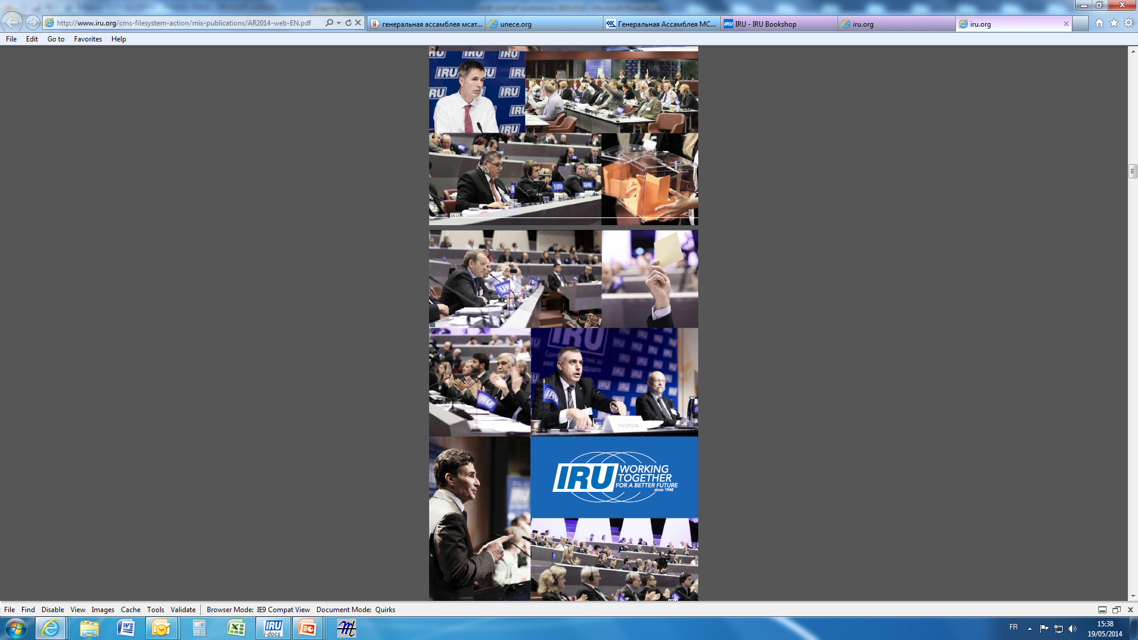
4 April 2014 - IRU General Assembly
The General Assembly gave the IRU Presidential Executive the authority to decide at any time to withdraw the TIR guarantee coverage in Russia, should this become necessary.

Slide 10
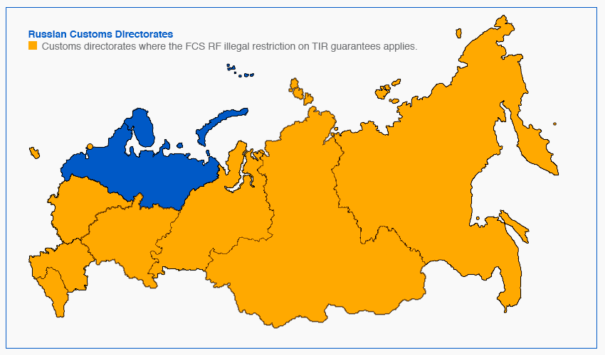
Current situation
  TIR Carnets are currently accepted only in Vyborg (Brusnichnoe and Svetogorsk), Karelia and Murmansk on Russian border and at Belarus and Kazakh borders
  Currently, 51 % decrease in TIR terminations in Russia
  Average decrease in issuance by associations is 29%, and 34% by ASMAP

Slide 11


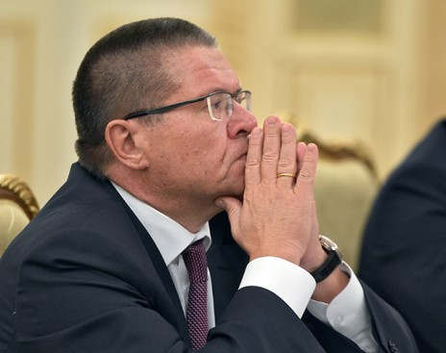
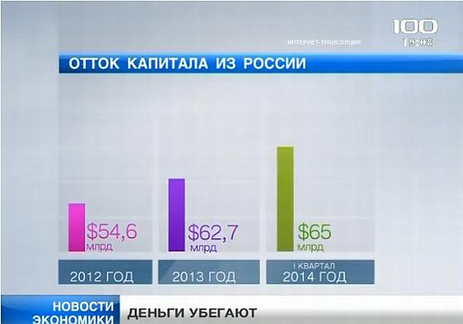
Russian economy is declining

Slide 12
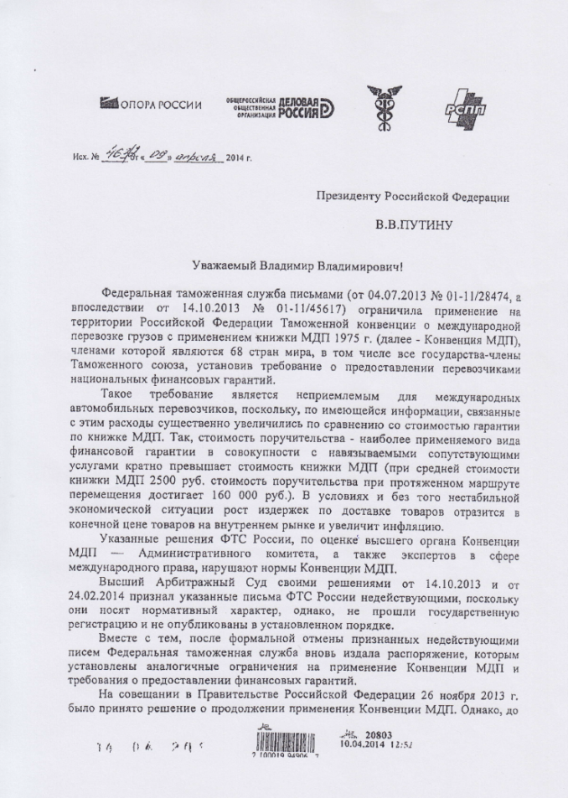
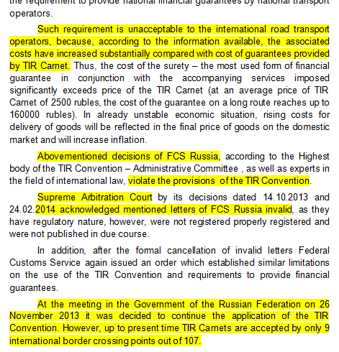
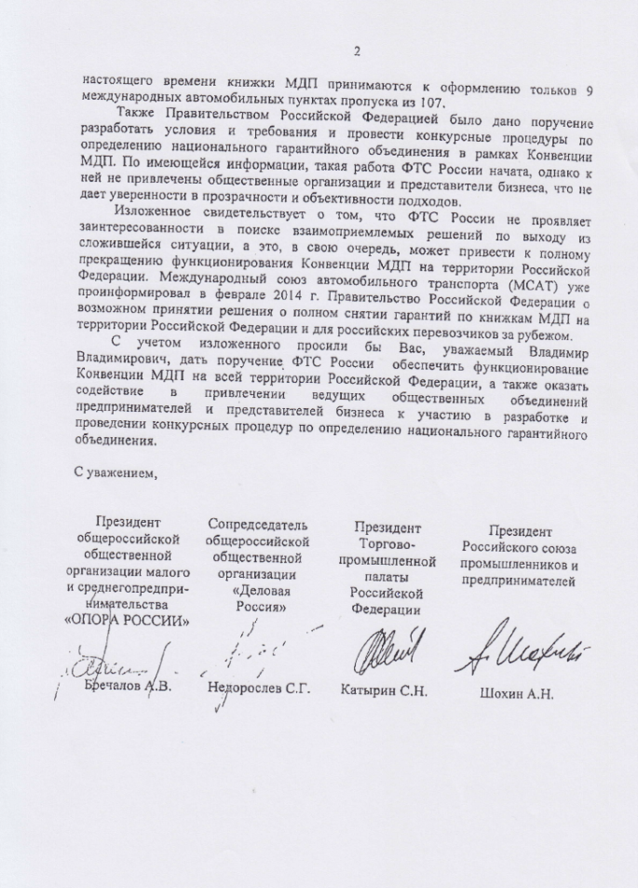
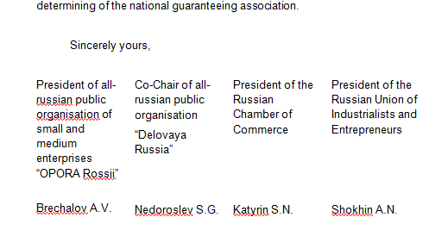
25 April 2014 - Russian business leaders call on President Putin to re-authorise TIR

Slide 13
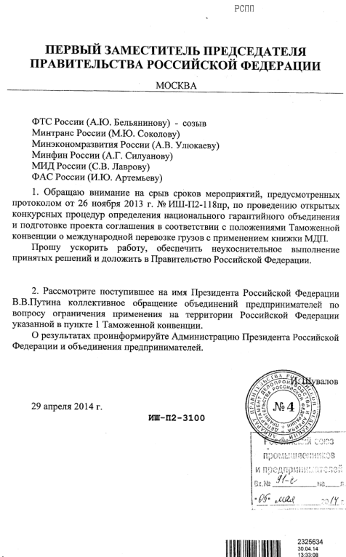
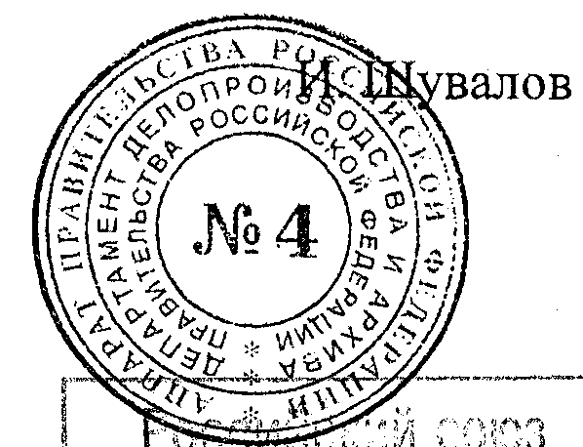
29 April 2014 - Russian Government asks FCS and all Ministries to speed up work on tender procedure
FIRST DEPUTY PRIME-MINISTER OF RUSSIAN FEDERATION
FCS of Russia
Ministry of Transport of Russia
Ministry of Economic Development of Russia
Ministry of Finance of Russia
Ministry of Foreign Affairs of Russia
Federal Antimonopoly Service of Russia
I draw your attention to the missed deadlines foreseen by the Protocol of November 26, 2013 No. ИШ-П2-118пр to carry out the tender procedure to determine national guaranteeing association and to prepare the draft TIR agreement in accordance with provisions of the TIR Convention.
You are requested to accelerate work, ensure strict implementation of the decisions and to report to the Government of the Russian Federation.
29 April 2014 I. Shuvalov

Slide 14
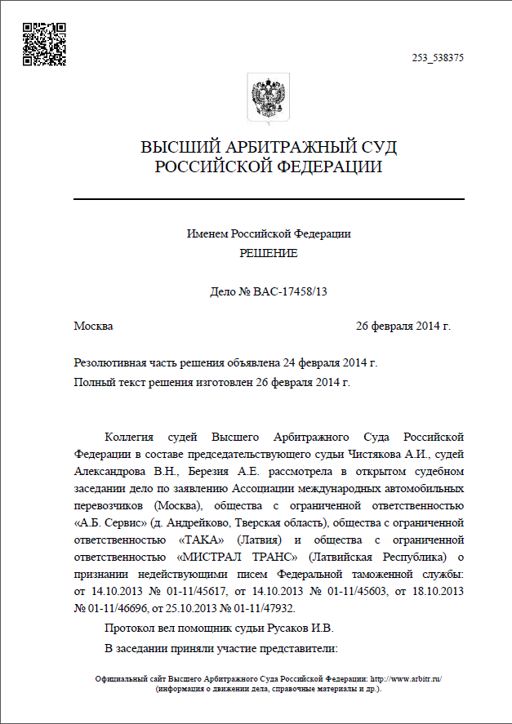
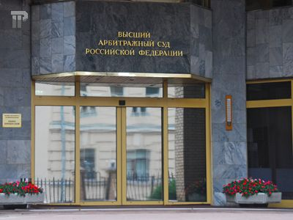
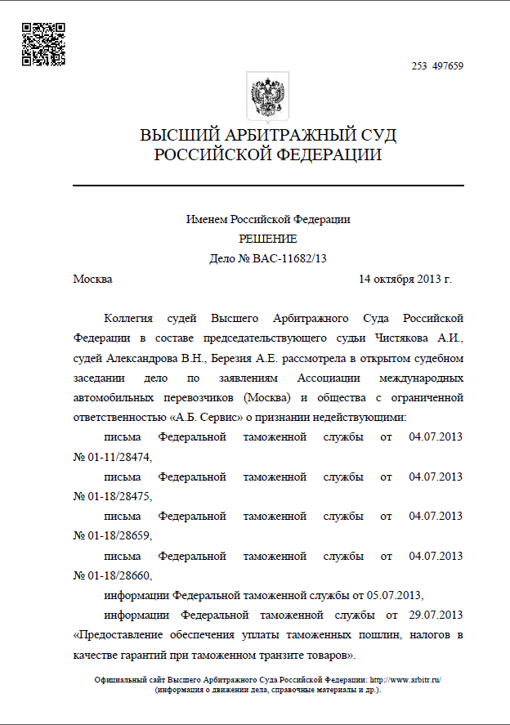
26 May 2014 – 3d decision of the Supreme court against FCS measures

Slide 15
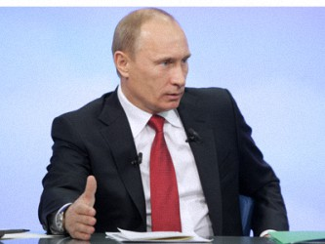
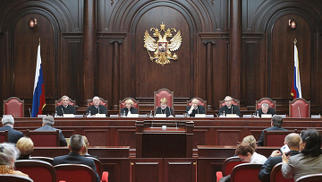
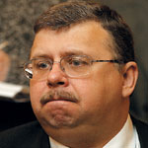
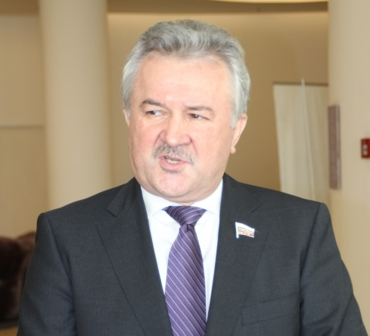
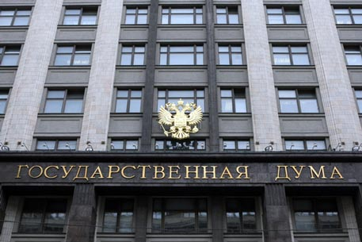
ASMAP actions to resolve situation

Slide 16


What’s next …?
TIR UN bodies sessions 10 – 13 June 2014
ECE/TRANS/WP.30/AC.2/118:
“ <…> The AC.2 is invited to discuss the situation in the Russian Federation in as far as it negatively affects the functioning of the international TIR system and provide guidance on how to pursue the international TIR system after 1 July 2014”.
IRU Presidential Executive on 12 June 2014
will review the latest developments and assess if the IRU is still in a position to guarantee TIR in Russia and for Russian hauliers
All stakeholders must continue efforts to obtain confirmation
from the FCS RF ASAP about reopening all borders for TIR !

Slide 17
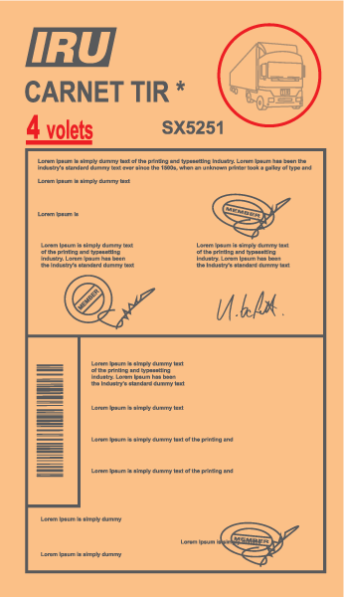
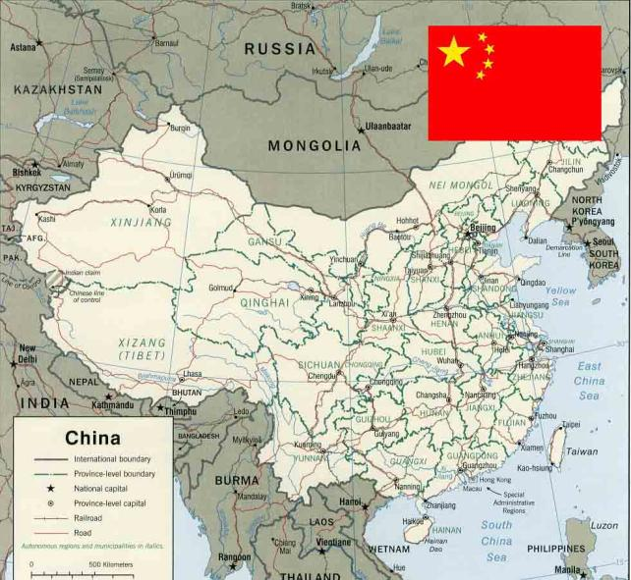

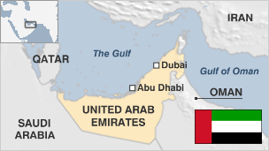
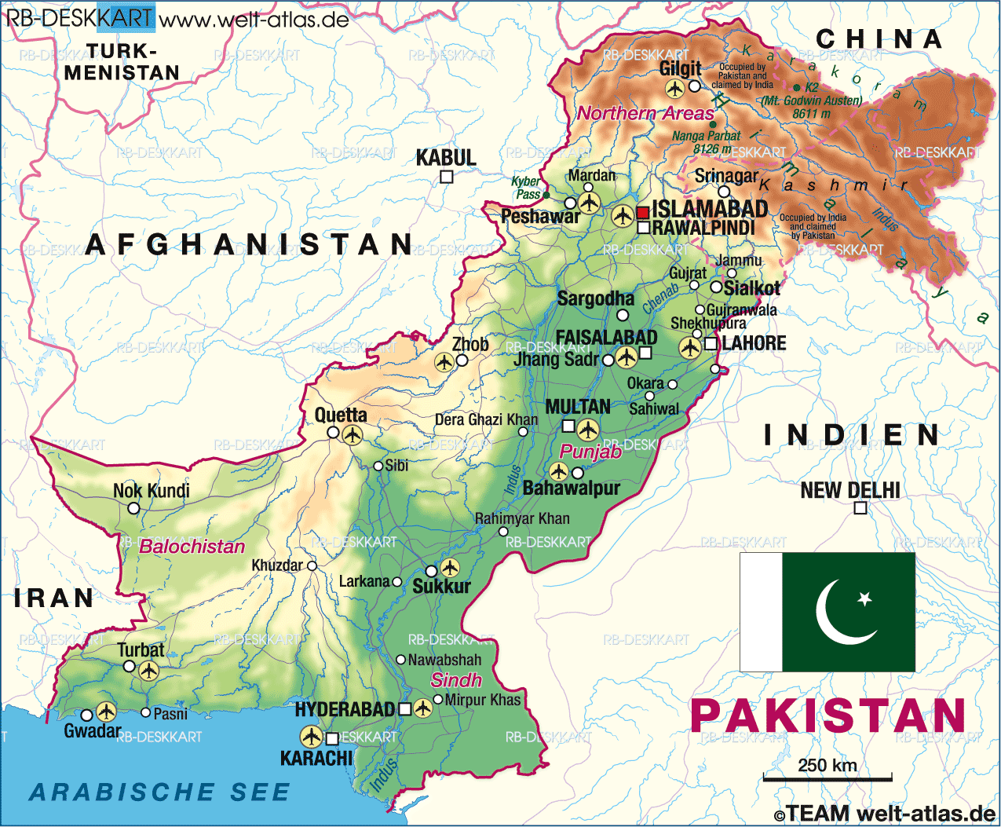

On a global level, TIR is expanding and providing new opportunities for traders

