Slide 1
The challenges for vehicle connectivity for politics and users
CLEPA 2014
Michael Nielsen
General Delegate, IRU Permanent Delegation to the EU

Slide 2
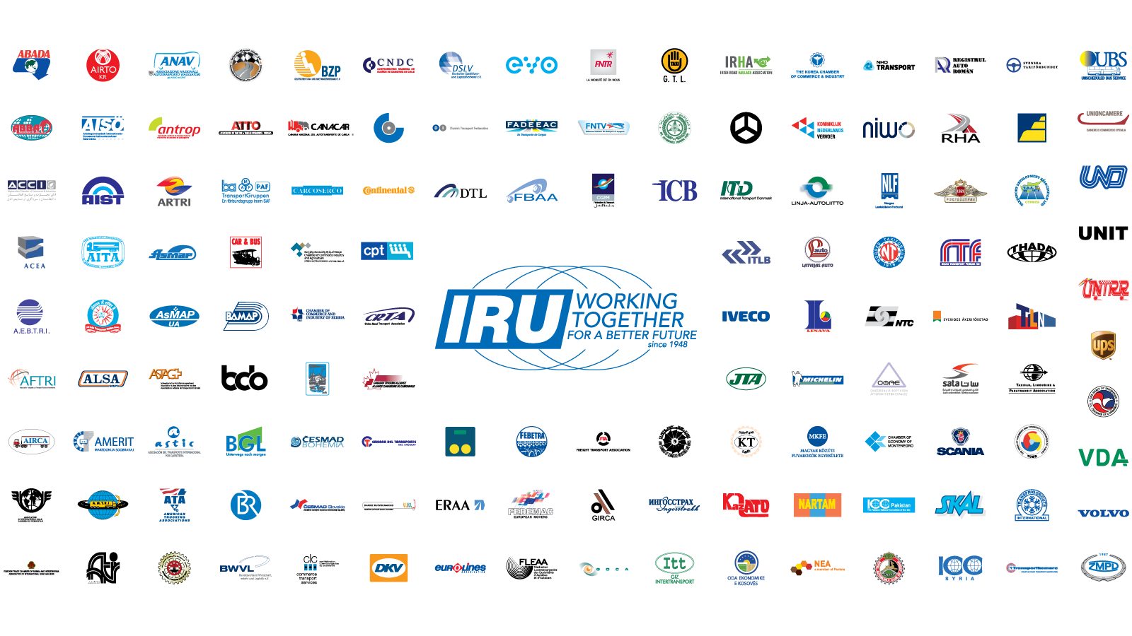
This is the IRU

Slide 3
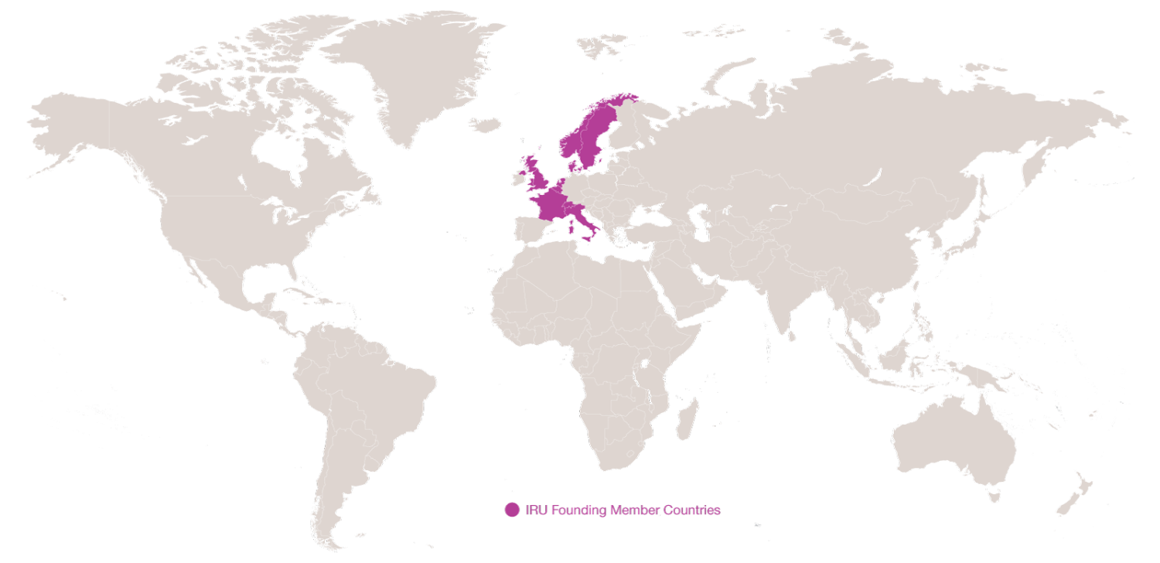
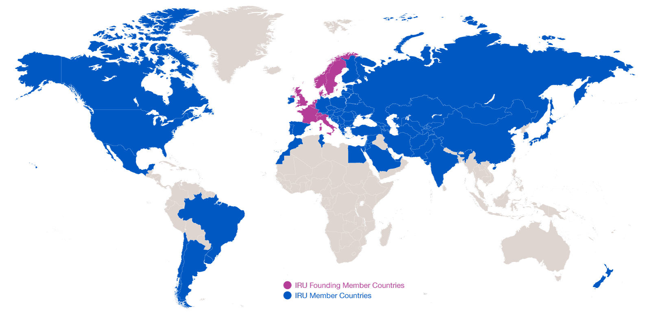
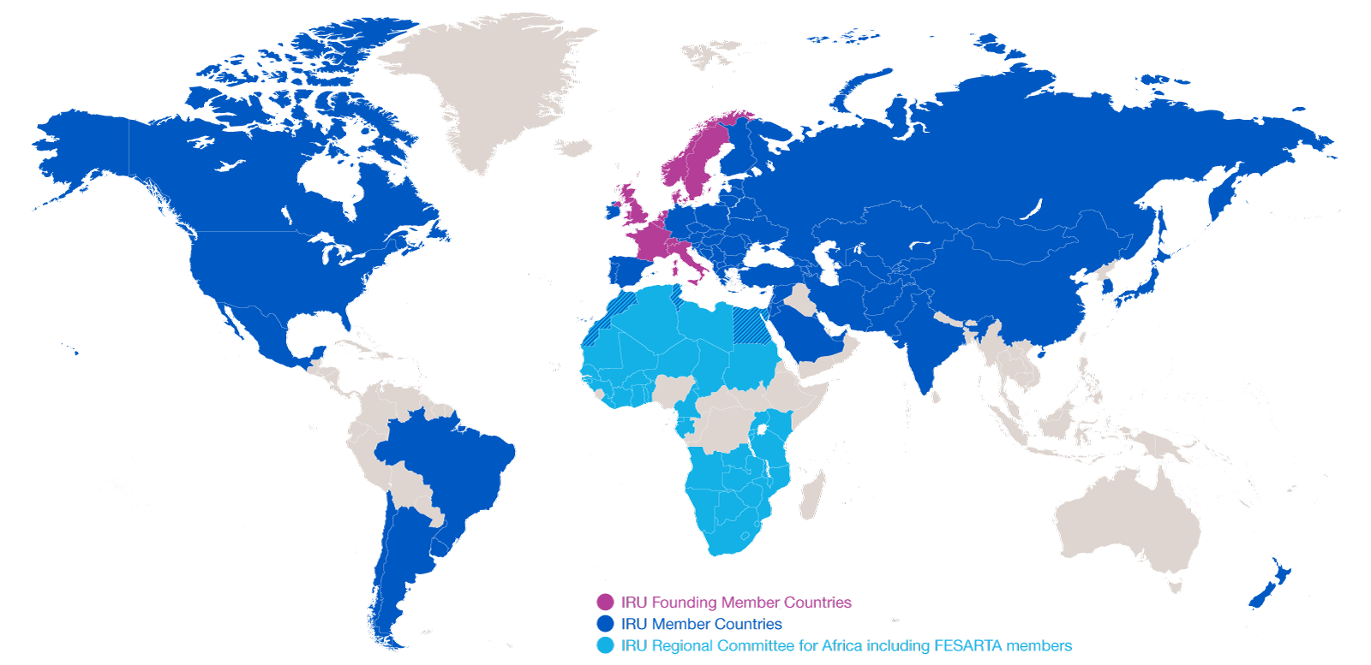
Evolution of IRU Membership
2014: 170 Members in 75 countries
2014: 170 Members in 75 countries
1948: eight founder countries
…and CRIPA: 27 Members + FESARTA in 38 countries

Slide 4
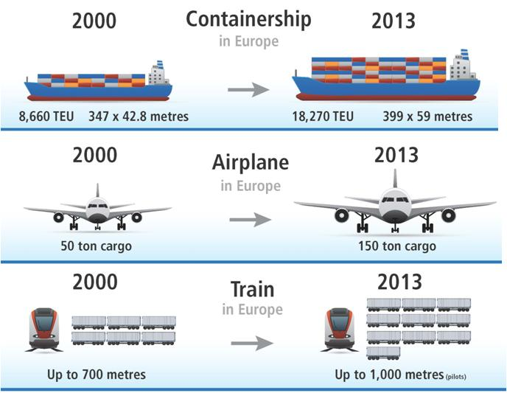

More simple efficiency innovation in transport than deployment of ITS also supported!

Slide 5
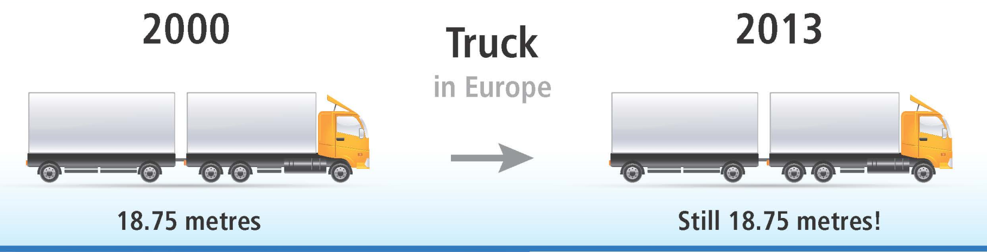
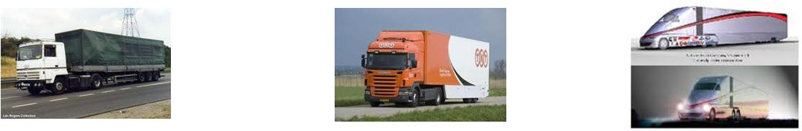
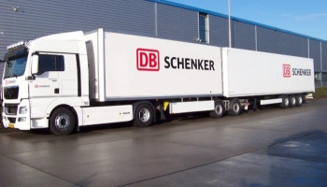
But not generally for road transport...
Should have followed this normal development path

Slide 6
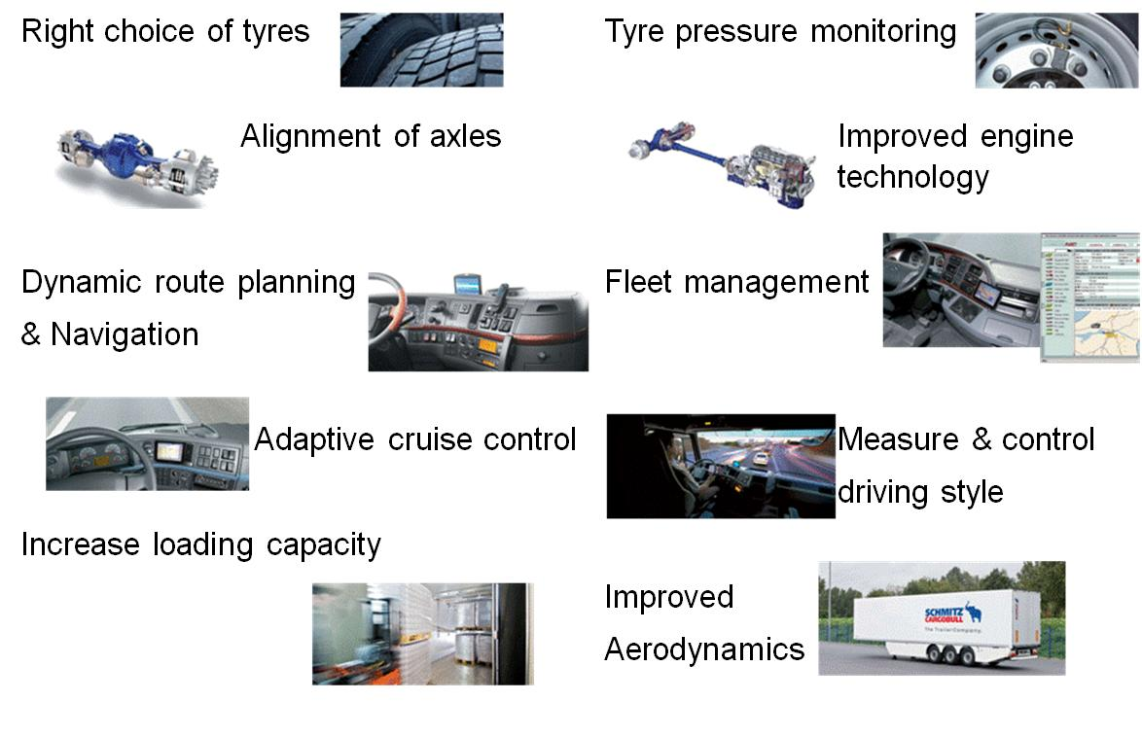
Lots of immediate innovations to benefit from

Slide 7
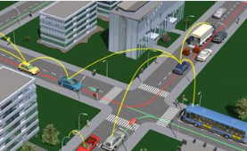
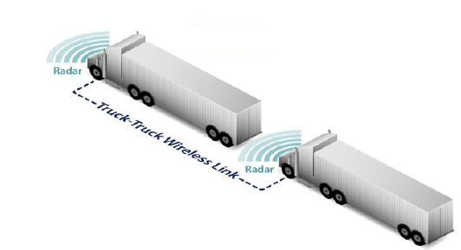
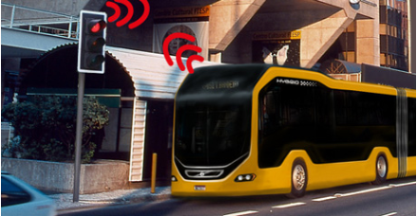
Fleet operators and ITS
Strongly in favour of road transport innovative solutions, as long as they:
provides safety, environmental and economic benefits
responds to real needs of the market
are standardised, harmonised and interoperable
must be used, if possible, on a voluntary basis;

Slide 8
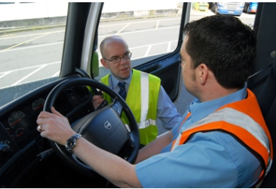
What we recommend
Any coordinated action on ITS applications should:
focus on deployment of proven solutions
include a solid business case
include incentives in the business plan
incorporate the necessary training
ensure freedom of choice
link to transport documents
ensure confidentiality of commercial data

Slide 9
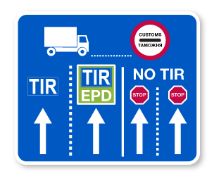
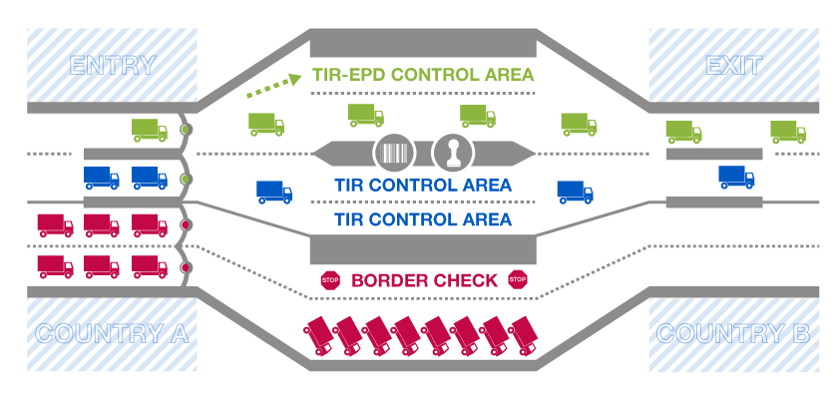
Extending possibilities of existing systems
Reduce border waiting times, facilitate trade, increase risk management efficiency, improve customs controls, secure trade and transport!

Slide 10

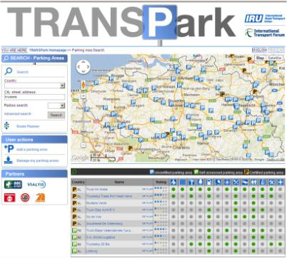
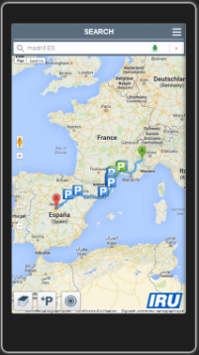


Use new technology
Provides information on secure CV parking
Locate 4,000+ parking areas in 40+ countries
Search by country, within a 200km radius or along planned routes
Check security and comfort levels available in parking areas
Add parking information and submit feedback
Check in at parking areas to benefit from the driver community
And many more useful services!

Slide 11
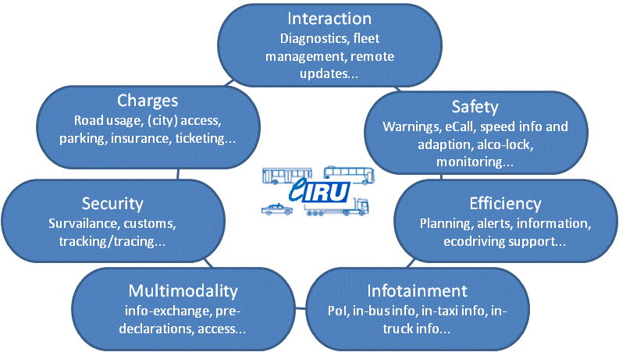
The future is ”Connected”

Slide 12
Main barriers hindering wider uptake
Cost of on-board units, communication and technologies
Equipment and communication suppliers cannot expect that fleet operators will pay excessive costs
Low penetration of equipped infrastructure for V2I
Integration into existing fleet management systems
Access to services
Lack of interoperability
Willingness to invest depends on wide spread service availability

Slide 13
Summary
The future brings new opportunities using ITS – but we also need to better use the existing ones!
Innovations hold a promise of being widely accepted by fleet operators
Where needed, involve fleet operators from the early stages of any innovative development and deployment

