Slide 1
Driving seniors’ and out of season tourism
Practical problems and solutions to bring seniors on board
The view from inside and outside: the customers’ and business’ perspectives
Anssi Manninen, Bussi-Manninen Oy, Finland

Slide 2
The view from inside and outside
Why seniors participate in coach tours?
Easiness attracts
Destination matters
Service and safety are required
Changing needs and expectations
Image of the coach tours

Slide 3
Easiness attracts
All the parts of the tour are planned by professionals
Only one reservation and you’ll get all the services you need
The point of departure is usually easier to reach than airport or train station
You’ll get usually closer to the destination by coach than by your own car or by public transport
Luggage follows you with no extra effort

Slide 4
Destination matters
The destination is the most important factor (destination, date, price, tour operator etc.) when choosing the coach tour for 80 % of the passengers

Slide 5
Service and safety are required
For the coach tour participant the good service quality is the most important thing in every part of the coach tour (transportation, accommodation, restaurants, destinations)
Safety is not only some technical equipment or quality of the coach but also the feeling that someone is taking care of you and helps you when you need help or before you even know you need any help (driver, guide/tour leader, staff at the hotels & restaurants etc.)

Slide 6
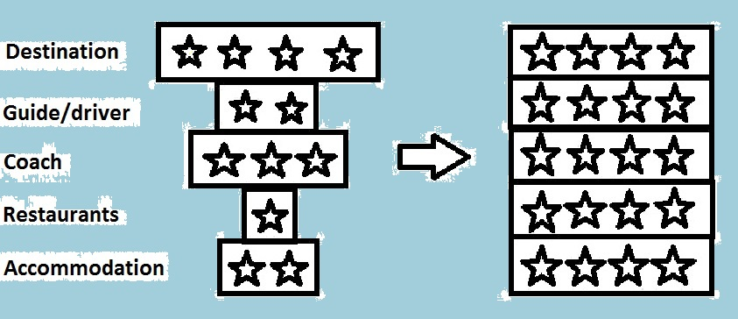
Needs and expectations are changing
Seniors are not homogeneous group, individualism is increasing
More health, wealth, travel experience
Destination defines the coach tour package:

Slide 7
Image of the coach tours

Slide 8
Image of the coach tours
Old-fashioned
For people who doesn’t have courage to travel alone
Slow
Inflexible
Easy way to travel
For people who want to see and experience many places during one tour and just to enjoy travelling
You’ll get to many places that individual tourists won’t get

Slide 9

Coach tours?

Slide 10
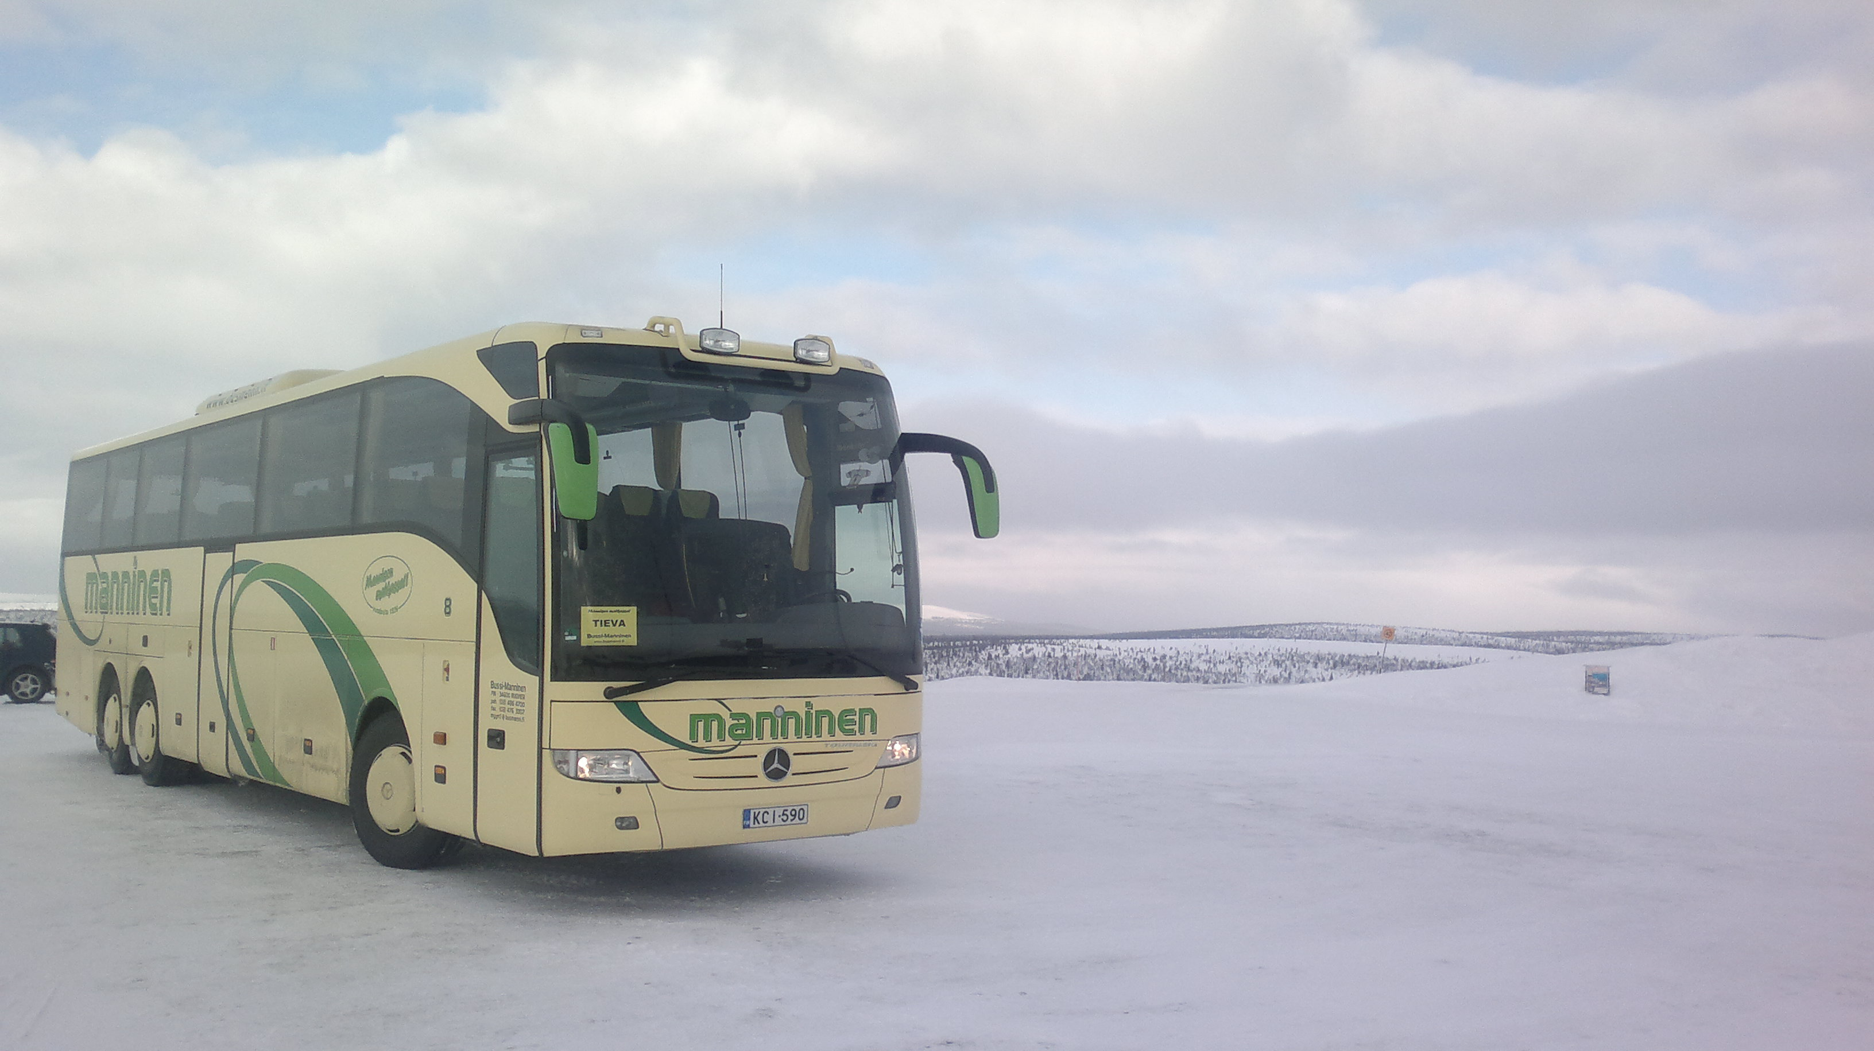
Thank You!
anssi.manninen@busmanni.fi
Tel. +358 500 559 859

