Slide 1

North American Motorcoach Travel:
A Green & Safe Alternative
5th European Bus & Coach Forum
International Road Union
Kortrijk Xpo, Belgium
October 2007

Slide 2

ABA’s Role in the Motorcoach Industry
Founded in 1926
Over 3,700 members currently
800 bus companies, 200 tour operators, 2,700 travel members (destinations, destination marketing organizations, hotels, restaurants, attractions)
Chief lobbyist and advocate to Congress and federal regulators on motorcoach issues
Providing essential research and leadership on environmental effects, economic impacts and safety guidelines for the industry
Bus Industry Safety Council
ABA Foundation

Slide 3
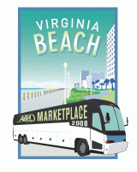
ABA: A Synergy Point for Motorcoaches & Destinations
ABA Marketplace 2008 - The #1 venue for destinations and motorcoaches to book business
3,300 attendees, 2,200 companies represented, 350 bus companies present
ABA affinity programs for members to realize cost savings in their operations
Guidelines for safe operating
City-based economic impact studies:
New York (NY), Washington (DC), Lancaster (PA)
Chicago (IL), Cleveland (OH), Nashville (TN)
Pittsburgh (PA), Pigeon Forge (TN)
Publication listings of popular and motorcoach friendly destinations

Slide 4
Defining the North American Motorcoach Industry
A proud history of safe and efficient service dating back to 1914
Provides a variety of transportation services.
A vast assortment of small businesses.
75 % have fewer than 10 buses
Approximately 3,600 motorcoach companies with 39,000 vehicles
An environmental and congestion mitigation solution

Slide 5
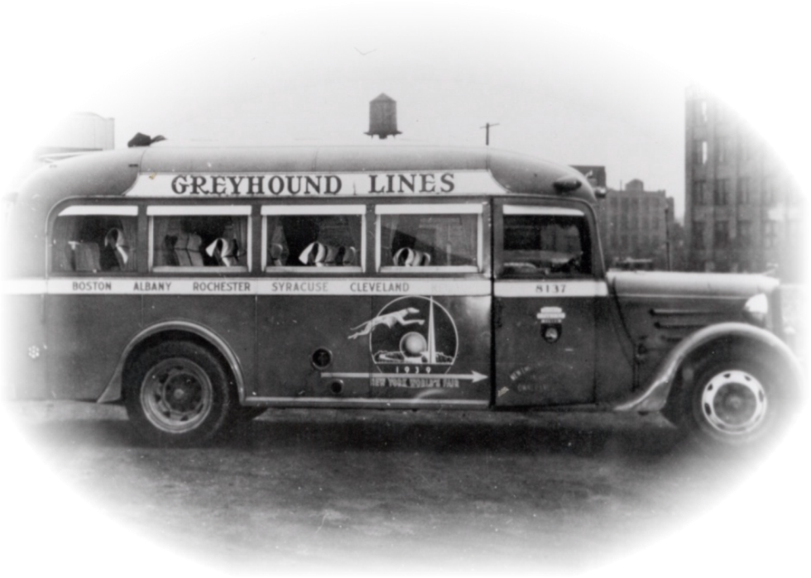

Slide 6
An Overview of Private Motorcoach Services
(by percentage of companies)
Contract Commuter – 7%
Scheduled Service – 19%
Airport Shuttle – 21%
Sightseeing – 29%
Tours – 59%
Charters – 96%

Slide 7

Motorcoach Industry Trends
Historical Growth
Access to New Products
Ease of Market Entry
New Services
Tour Oriented
City to City Opportunities
Trip customization
Intermodal capacity

Slide 8
The Industry in Motion
North America’s most efficient people mover!
More than 631 million US/Canada passengers in 2005
Surpasses passenger train’s annual load (25.4 million) every 2 weeks
Serving more than 4,100 US communities in scheduled service everyday, and potentially every community through other motorcoach services

Slide 9

The Economic Impact of Motorcoach Tourism
One overnight visit is worth
$5,000-$13,000 to a destination!
Including meals, lodging, shopping, local taxes, fuel, fees, rentals, events
The motorcoach industry directly
supports over 1 million U.S. tourism jobs
2,000 new motorcoaches are manufactured
each year, amounting to nearly $1 billion in
economic activity through the purchase of new
coaches
Motorcoach travel and tourist demand
generates more than $44 billion annually in
economic transactions

Slide 10
Proposed Congestion Mitigation Alternatives
Variable “Peak” Pricing
High Occupancy Vehicle/Toll Lanes
Cordon Pricing
London
Stockholm
Express Toll Lanes
Fuel Tax Increases
Special Highway User Fees

Slide 11
Developing Answers to the US Congestion Problem
New Federal Laws
Highway Reauthorization Legislation in 2009
Will authorize new highway funding mechanisms
Will provide new infrastructure development strategy
Will enact a congestion mitigation alternative to reduce highway usage by single passenger cars
New State Laws
Will introduce as needed to implement federal mandates and direction
State fuel taxes
State user fees and permits

Slide 12
Motorcoaches: The Green Solution
A single motorcoach can replace as many as 55 passenger cars on the highways
Motorcoaches emit less carbon dioxide than commuter rail (3x less), transit buses (5x less), and single occupancy cars (6x less)
Motorcoaches achieve 184 passenger miles per gallon as compared to commuter rail (86 passenger MPG), domestic air (42 passenger MPG), transit buses (32 passenger MPG), and cars (28 passenger MPG)

Slide 13
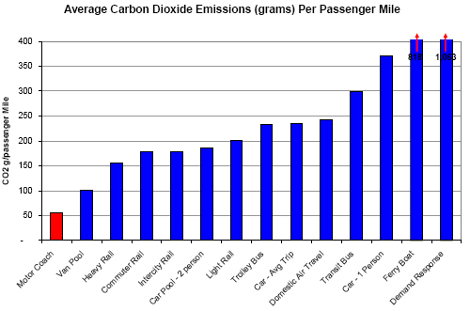

Slide 14
A Focus on Safety
Buses contributed to 0.5 of one percent of all fatal accidents on US highways in 2005

Slide 15
A Focus on Safety
Over the past 10 years, private motorcoaches have averaged about 13 passenger fatalities each year, the lowest of any transportation mode

Slide 16
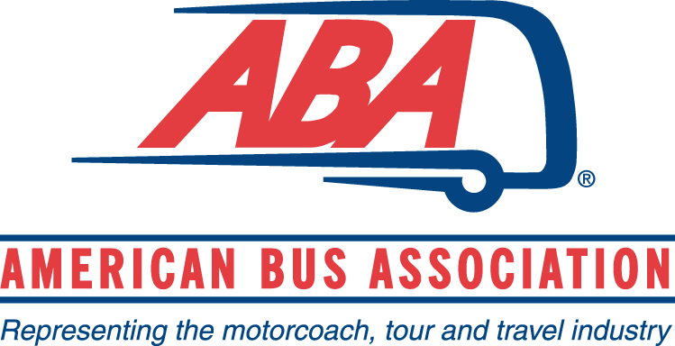

Thanks For Traveling!
Peter Pantuso
President & CEO
American Bus Association
700 13th Street NW, Suite 575
Washington, DC 20005
(800) 283-2877
abainfo@buses.org
www.buses.org

