Slide 1
The City of Chester:
A Tourism & Coach Friendly Policy
That Pays Off
Colin Potts
Destination Focus
International Coach Destination of the Year 2007
(International Road Transport Union)
UK Coach City of the Year 2007
(Coach Tourism Awards)
UK Coach Friendly City
(Confederation of
Passenger Transport)
Notes:
Good morning. My name is Colin Potts and I run a company called Destination Focus that helps destinations get more value from visitors.
Before that I was Head of Tourism in Chester and was delighted to come to Bus World to receive the IRU City Trophy in 2007. As you can see Chester won several awards that year for its coach policy but we certainly regarded this one as the most prestigious.
It is wonderful to be back here two years later to talk to you again.

Slide 2
My Presentation
Understanding Chester
Issues
Policy & Action
Results
Notes:
My presentation focuses on the four key areas shown here:

Slide 3
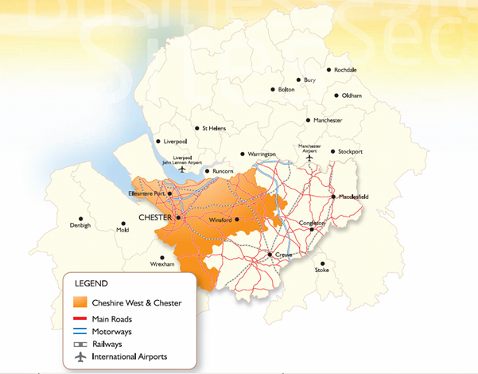
Chester
Historic city of 90,000 people
Notes:
First I should explain a little about the city for those of you who have not yet visited us
Chester is one of England’s best preserved historic cities and has a population of 90,000.
It has great natural advantages for the coach trade:
There is lots to see but it is easy to walk around
There are plenty of hotels
It is close to many other interesting places
It has great motorway access
It is halfway up Britain … on the left!

Slide 4
Tourism in Chester: A Top 5 UK Historic City
Visitors
2.1 million overnight stays
7.4 million day visits
Expenditure
£500 million
Jobs
7,300
Accommodations
3,500 bedrooms
Chester Zoo
#1 in UK
Notes:
As you can see it is a very successful tourism city …

Slide 5
Tourism Issues Facing Chester
Increasing reliance on visitors
Competition
Need for new investment
Spreading the load
Attracting young people
Sustainability
Notes:
But in common with most other historic cities it also faces a number of important issues it must face if it is to stay successful:
An increasing reliance on the leisure visitor economy as manufacturing jobs end and there are reductions in jobs in service industries such as finance.
Competition not only from traditional destinations but also from emerging post-industrial cities.
Competition for shoppers from out of town malls and for leisure spend from various forms of home entertainment.
The need to create new reasons for people to visit the city.
The need to spread visitors out so that their benefit is brought not just to the city centre, and not just in the middle of the day, and not just in Summer.
The realisation that most visitors to historic cities are over 50 years old and that they need to be able to attract younger people.
And of course the recognition of the need for transport to be as sustainable as possible both to and within our cities – to help protect the global environment and to protect the precious heritage of our beautiful historic city.
Chester realised that it needed to have a complete plan for the management and development of the city as a place to live, work, study and invest as well as a place to visit. However the visitor economy would continue to be at the heart of its success and being a place people could easily visit by coach and by train would be important in this.
The coach policy that was recognised by the IRU was started more than 10 years ago although it has evolved over time.It is a policy based on providing an excellent service to visitors and coach operators at each stage of the visitor journey from the point when they first decide they want to come to Chester, through each part of their visit, to the memories they are left with.
The development and implementation of the policy has been helped by many organisations but in particular the UK Confederation of Public Transport, the Coach Drivers’ Club of Great Britain, the Coach Tourism Council and the English Historic Towns Forum.

Slide 6
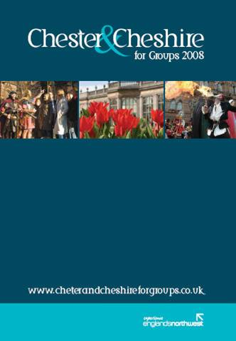
Chester for Groups
brochure
Notes:
Our Groups guide supports our website and makes sure that tour operators have all the information they need to plan a visit.

Slide 7
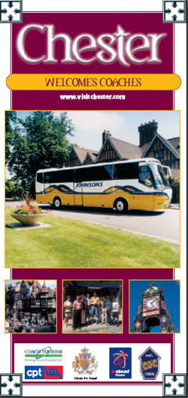
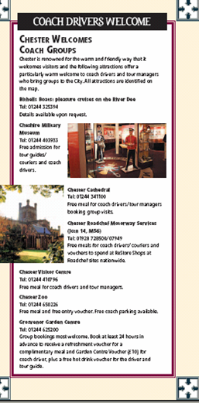
Coach Operators
leaflet
Notes:
And we also produce information designed just for coach operators and drivers.

Slide 8
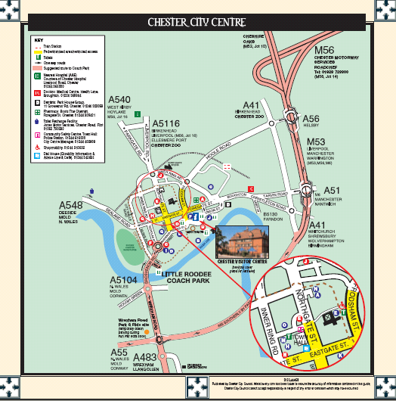
Coach Operators
leaflet
Notes:
This extract shows the main routes into the city, the drop-off and pick-up points in the city centre and the city’s main coach park.
It also shows the Chester Visitor Centre, a building we adapted with coaches in mind. It has a drop-off point outside and includes a 60 seat café and fully accessible toilets as well as tourist information and a shop.

Slide 9
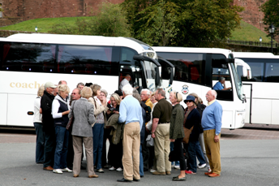
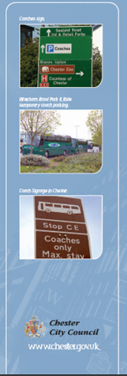
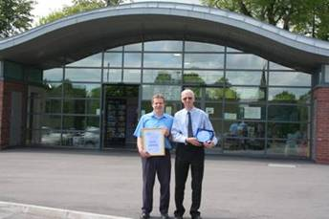
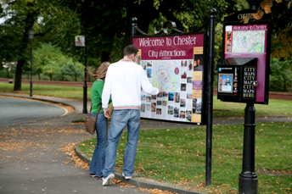
Making it easy
Notes:
Chester Council showed a major commitment to coach travel by building a new coach arrivals facility in the Coach Park. This environmentally friendly building (it has a grass covered roof) contains an information centre, café, toilets and space for drivers to rest.

Slide 10
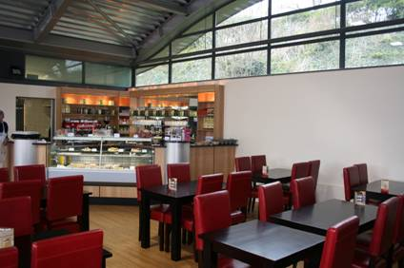
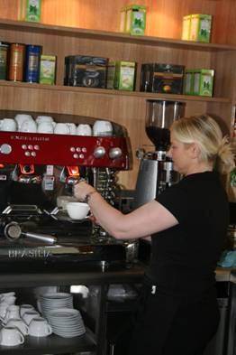
Café at coach park
Notes:
Although the Council paid for the building the café is privately run.

Slide 11
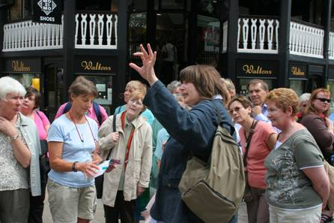
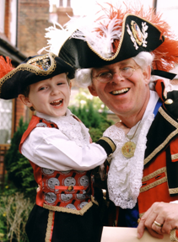
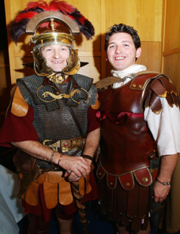
Guided
Tours
Notes:
One of the most visible demonstrations of Chester’s services for groups is our Guided Tours Service.
Our qualified guides speak many languages including Japanese, Russian and Mandarin.
We offer themed tours as well as general ones.
Here you can see some of our Roman soldier guides who also sometimes stage gladiator combat in our Roman amphitheatre.
We also offer tours from other historic periods, ghost tours and even greetings from the World’s top husband and wife town crier team!
We offer a group tours booking service to match groups with guides that will best meet their needs.

Slide 12
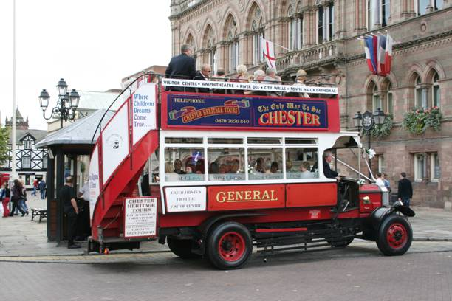
Chester Heritage Bus Tour
Notes:
We encourage guided tours by bus in and around the city …

Slide 13
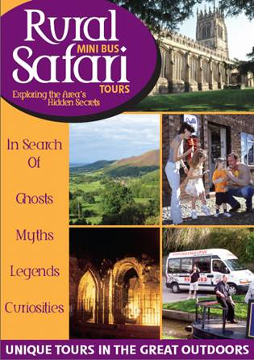
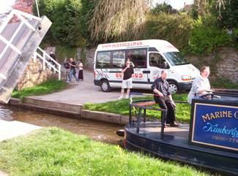
Rural Safari Mini Bus Tours
Notes:
And beyond the city. It is important to Chester’s business that the city is seen as a touring base as well as an attraction in its own right so we recommend themed excursions to Wales and many other areas nearby ... And secured start-up funding to help this company become established.

Slide 14
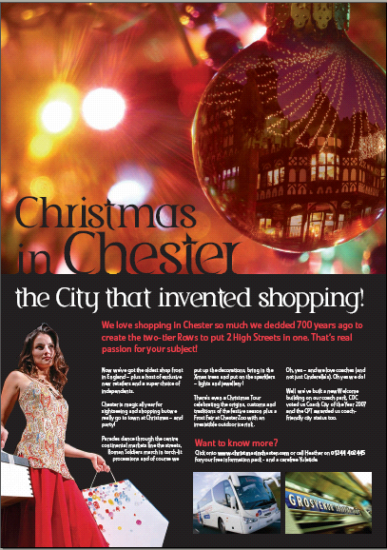
Event led promotion
Notes:
And we stage events and promotions to attract visitors throughout the year; keeping coach operators in mind at all times, particularly by giving them plenty of advance notice of when events are taking place.

Slide 15
Results
Awards are great but also:
Tourism performance ahead
of national trends
New investment in hotels, restaurants and shopping
New investment in Zoo &
Cathedral
New visitor zones
planned
Notes:
It is hard to assess the specific contribution of Chester’s coach policy to the city’s success (although the awards from the coach trade are certainly nice) but certainly we are succeeding in addressing many of the issues I mentioned earlier so the wider policy, which includes our action to support coach travel, is paying off.
Hotel leisure occupancy in 2009 is ahead of 2008 despite the recession.
And despite the addition of 500 new bedrooms in branded hotels in the city centre.
Although we do have more empty shops than last year vacancies are the lowest in North West England and we have seen many important stores opening in the city for the first time.
Our two major attractions, Chester Cathedral and Chester Zoo, have both announced massive development plans.
New developments aimed at visitors are emerging in places on the edge of the city centre that were previously little used – one is right next to the coach park – which may not be a coincidence.
Chester is cautiously confident about its future although it knows that it will have to do better every year to maintain its position as a place where people choose to spend their free time. Looking after the bus and coach trade will be a key part of how this is achieved.

Slide 16
Thank You
Colin Potts
Destination Focus

