Slide 1



Low emmission zones in Germany

Slide 2
Limits set by the EU in Directive 1999/30/EC
on air quality limit values
Average daily limit value of particulate matter (PM₁₀):
50 µg/m3 allowing 35 excesses per year
The EU Member States are obliged to take „necessary actions“ in order to meet the required limit values.
No specific measure are regulated by law (therefore no obligation to set up “low emmission zones").
Notes:
Default from Brussels to the aerial keeping pure
Basis is the air quality guideline of the EU from 1990.
Concerning the charge by particulate matter (PM10) a day average value of 50 µg/m3 is prescribed with 35 excesses per year.
The guideline prescribes „necessary measures“ to the member states, however, leaves them freedom with the conversion.
Hence, an environmental zone in cities is not prescribed.
From this default followed the „rag rug of Germany

Slide 3
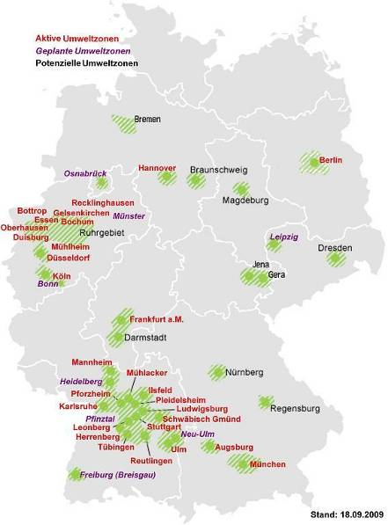
"Rag rug" Germany
→ No uniform regulations in Germany!
→ Every town decides on their own about setting up a low emmission zone
Quelle: www.umwelt-plakette.de
Notes:
The German economy does not close mind to environmental-exculpatory measures.
- A well-balanced total concept which also considers questions of the urban development and the economic development is necessary for it however always.
- Measures must be appropriate for cause and relative.
- Companies need dependable and legally binding basic conditions – political declarations of intent are not sufficient for investment decisions.

Slide 4
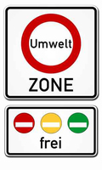
What is standardized
Germany-wide?
Emmissions-control windowscreen stickers to enter low emmission zones (EURO 2, EURO 3, EURO 4)
Stickers are mandatory for all cars driven in these zones –
also for foreign vehicles!
How to obtain these stickers?
By presenting the registration certificate to the local
licensing administration, other competent bodies or online
→ Further Information: http://www.umwelt-plakette.de)
Notes:
* Effectiveness is checked in 2010 – then environmental zone is lifted perhaps enlarged /
** Coaches till 2010 excluded
*** The valid NO2 value becomes an effect control in 2009, not achieved only entrance from III euros

Slide 5

In 2010: 40 low emmission zones in Germany
 | Stadt | 2008 | 2009 |  |  | 2010 |  | 2011 |  | 2012
1 | AUGSBURG
2 | BERLIN |  |  |  |  | Ausnahme für Reisebusse mit gelber Plakette!
3 | BREMEN |  | Reisebusse |  |  | bis Ende 2011 ausgenommen!
4 | BOCHUM
5 | BOTTROP
6 | DORTMUND
7 | DRESDEN
8 | DUISBURG
9 | DÜSSELDORF
10 | ESSEN
11 | FRANKFURT/M
12 | FREIBURG/BREISGAU
13 | GELSENKIRCHEN
14 | HANNOVER | Busse bis | Dezember 2011 |  |  | Ausgenommen! |  | !
15 | HEIDELBERG
16 | HEILBRONN
17 | HERRENBERG
18 | ILSFELD
19 | KARLSRUHE
20 | KÖLN
 | Stadt | 2008 | 2009 |  | 2010 |  | 2011 | 2012
21 | LEONBERG
22 | LUDWIGSBURG
23 | MANNHEIM
24 | MÜHLACKER
25 | MÜHLHEIM
26 | MÜNCHEN
27 | MÜNSTER
28 | NEU-ULM
29 | OBERHAUSEN
30 | OSNABRÜCK
31 | PFINZTAL
32 | PFORZHEIM
33 | PLEIDELSHEIM
34 | RECKLINGHAUSEN
35 | REUTLINGEN
36 | SCHW. GMÜND
37 | STUTTGART
38 | TÜBINGEN
39 | ULM
40 | WUPPERTAL
Notes:
* Effectiveness is checked in 2010 – then environmental zone is lifted perhaps enlarged /
** Coaches till 2010 excluded
*** The valid NO2 value becomes an effect control in 2009, not achieved only entrance from III euros
Criticism
The measures of the national energy politics place on different cost-laden measures to reach climate-political aims.
Besides, balance between cheapness, care security and environment protection gets often lost. The result are cost-ineffective solutions in the climate protection politics.
In the end, there in spite of single, right measures is not enough a lasting and above all in the long term financeable energy-political and environmental total concept.

Slide 6
Situation in Germany
Only 16% of the German Coaches
meet Euro 4, 5 & EEV standard
Special exceptions rules for coaches?
Refitting with particle filters: approx.: 10,000 to 15,000 Euros
Problem: Nitrogen oxide (NOx)
In addition from 2010 higher limit values for nitrogen oxide (NOx) will apply!

Slide 7
Criticism of the low emmission zone
Setting up low emmission zone exceeds the European guidelines from Brussels
Actions taken under the air quality guideline must meet the criteria of “polluter-pays principle" as well as the “proportionality".
-> the low emmission zone violates both principles
Berlin: stricter time frame than other German towns in implementing the so-called 2nd step
No recognition of special authorisations of other German towns with low emmission zones
Notes:
Criticism of the environmental zone
The default from Brussels intends no introduction of an environmental zone with so strict restrictions.
Besides, the environmental zone contradicts the principles of the cause's justice and the commensurability.
She is not appropriate for cause because there is no scientific voucher about the fact that Feinstaubeintragungen are caused above all by the transport. Street blockages and bans on driving remain without relevant effects for the environment. A study of ADAC has shown that up to 70 percent of the particulate matter from southeast (Poland, Czechia, but also Brandenburg) is blown in the town.
She is not relative because she causes considerable encroachments for the companies with high fees for exceptions and bans on driving
Moreover, the uncommensurability of the Berlin regulation appears in the fact that other German towns have introduced less strict timings in connection with the environmental zone
Additional charges: Special authorisations from other towns are not recognised.

Slide 8
Requirement and activities
Postponement of the „2nd step“
Supported by IRU and European coach associations

Slide 9
Estimated extra-costs of low emmission zone shown for the Berlin-Brandenburg economy
Up to now:
more than 6,000 special permissions with fees up to 1,000 EUR (application fee + bureaucracy charges)
For comparison: Hannover (20-120 EUR) and Cologne (5-75 EUR)
From 2010:
Bans on driving for vehicles with red and yellow stickers
Need to substitute or refit up to 75,000 commercial vehicles
1 billion EUR till 2010 for refitting and new investments

Slide 10
Problem: Nitrogen oxide (NOx)
From 2010 on the Directive 2001/81/EC obliges the EU Member States to meet additional limit values for nitrogen oxide (NOx) or take suitable action to reach those set limit values
Directive 2001/81/EC is part of the air quality package
Implemented in national law in Germany in the so-called 33. BImSchV – therefore it`s up to the German government to create an action plan giving possiblities to meet the aforementioned limit values
Notes:
Problem: from 2010 are valid stricter NOx values

Slide 11
Future challenges
Enhancement of an energy and environmental friendly politic which takes into account cost efficiency and competition and supports market-based solutions.
Deciding environmental matters and in particular the low emmission zone must take into account the local industry and involve the respective associations.
Need for the development of a sustainable concept regarding energy and environmental matters.
Notes:
Conclusions:
Energy politics and environmental politics must be based clearly on the most cost-effective solutions.
The Berlin environmental politics is urged to trade itself in constant dialogue with the economy and to carry out if necessary aim corrections like in the case of the environmental zone. She must place on market-based instruments and promote selfliabilities of the industry instead of ordinal-juridical compulsion
Disproportionate hurdles may not be put for ideological reasons to the economy.
What is absent, is an energy-political and environmental total concept which names connections and aim conflicts between three sighting cheapness, care security and environment protection clearly. The politics must make clear and communicate which measures which expenses cause.

Slide 12
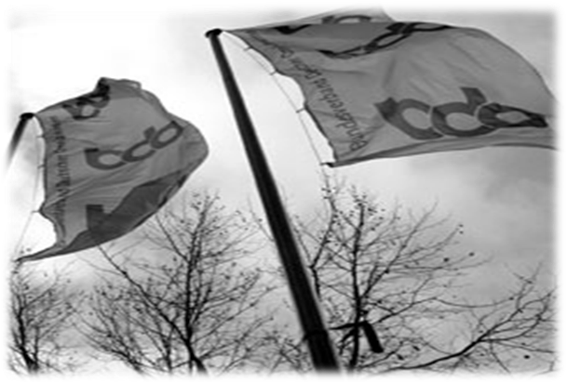
Thank you!

