Slide 1
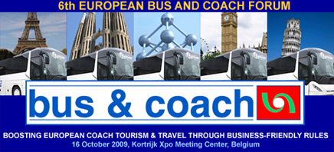
UITP position on the draft regulation on passenger rights for bus/coach Ulrich Weber, UITP-EuroTeam
European Bus and Coach Forum Kortrijk
16 October 2009

Slide 2
Overview
High quality local/regional public transport: integrated multimodal networks
The current COM proposals and local/regional public transport
A possible solution: The UITP Passenger Charter
Notes:
Greening Transport Communication summarising the whole package and setting out what new initiatives the Commission will take in this field until the end of 2009.
2. Greening Transport Inventory, describing the EU action already taken to green transport and on which this package builds.
3. Strategy to Internalise the External Costs of Transport
4. Proposal for a Directive on road tolls for lorries, enabling Member States to reduce environmental damage and congestion through more efficient and greener road tolls for lorries. Revenue from the tolls would be used to reduce environmental impacts and cut congestion
5. Communication on rail noise, setting out how to reduce the perceived noise from existing rail freight trains by 50% and the measures the Commission and other stakeholders will need to take in the future to achieve this.

Slide 3
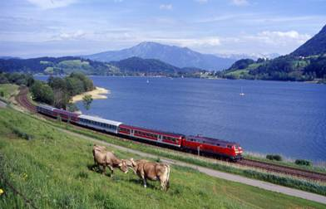
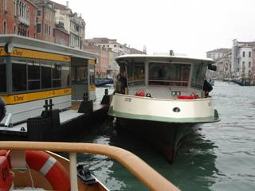

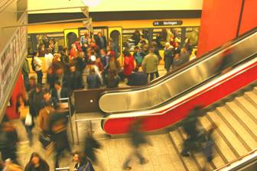
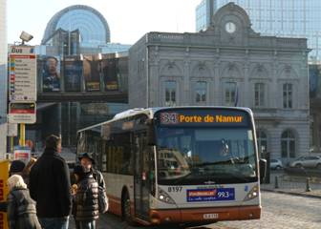
High quality public transport through multimodal integrated networks
Regional/suburban trains, tram/metro, bus, ferry/boats
Integrated tickets, integrated information
Quality management
Notes:
Greening Transport Communication summarising the whole package and setting out what new initiatives the Commission will take in this field until the end of 2009.
2. Greening Transport Inventory, describing the EU action already taken to green transport and on which this package builds.
3. Strategy to Internalise the External Costs of Transport
4. Proposal for a Directive on road tolls for lorries, enabling Member States to reduce environmental damage and congestion through more efficient and greener road tolls for lorries. Revenue from the tolls would be used to reduce environmental impacts and cut congestion
5. Communication on rail noise, setting out how to reduce the perceived noise from existing rail freight trains by 50% and the measures the Commission and other stakeholders will need to take in the future to achieve this.

Slide 4
COM proposal on bus/coach transport – main problems for local/regional PT
Modal approach of COM does not take into account integrated public transport networks
In general: proposal is focused on long distance transport and does not take into account specific characteristics of local/regional PT
Rather short distances, many stops, often high numbers of passengers, many period-ticket holders, no booking of seats, no separate loading of luggage, etc.
It should be under the responsibility of competent local/regional authorities (regulation 1370/2009) to define and finance quality and passenger rights in local/regional transport
Notes:
Greening Transport Communication summarising the whole package and setting out what new initiatives the Commission will take in this field until the end of 2009.
2. Greening Transport Inventory, describing the EU action already taken to green transport and on which this package builds.
3. Strategy to Internalise the External Costs of Transport
4. Proposal for a Directive on road tolls for lorries, enabling Member States to reduce environmental damage and congestion through more efficient and greener road tolls for lorries. Revenue from the tolls would be used to reduce environmental impacts and cut congestion
5. Communication on rail noise, setting out how to reduce the perceived noise from existing rail freight trains by 50% and the measures the Commission and other stakeholders will need to take in the future to achieve this.

Slide 5
COM(2008)817 passenger rights bus/coach - Joint transport industry proposals-
Joint IRU, ECTAA, ETOA and UITP proposals (joint press release 4 May 2009):
To exclude urban, suburban and regional bus transport from the scope of the regulation
To find appropriate solutions for passenger rights based on a serious impact assessment and a sound balance between interests of passengers and operators
Notes:
Greening Transport Communication summarising the whole package and setting out what new initiatives the Commission will take in this field until the end of 2009.
2. Greening Transport Inventory, describing the EU action already taken to green transport and on which this package builds.
3. Strategy to Internalise the External Costs of Transport
4. Proposal for a Directive on road tolls for lorries, enabling Member States to reduce environmental damage and congestion through more efficient and greener road tolls for lorries. Revenue from the tolls would be used to reduce environmental impacts and cut congestion
5. Communication on rail noise, setting out how to reduce the perceived noise from existing rail freight trains by 50% and the measures the Commission and other stakeholders will need to take in the future to achieve this.

Slide 6
COM(2008)817 passenger rights bus/coach - Current discussions in the Council -
UITP has made further detailed text proposals to the current discussions in Council (Council working paper from 3 September)
In order to take better into account characteristics of local/regional bus transport and
In case of possible result on article 2.2 (scope):
„Member States may exempt urban, suburban and regional bus services from the scope of this regulation“
Notes:
Greening Transport Communication summarising the whole package and setting out what new initiatives the Commission will take in this field until the end of 2009.
2. Greening Transport Inventory, describing the EU action already taken to green transport and on which this package builds.
3. Strategy to Internalise the External Costs of Transport
4. Proposal for a Directive on road tolls for lorries, enabling Member States to reduce environmental damage and congestion through more efficient and greener road tolls for lorries. Revenue from the tolls would be used to reduce environmental impacts and cut congestion
5. Communication on rail noise, setting out how to reduce the perceived noise from existing rail freight trains by 50% and the measures the Commission and other stakeholders will need to take in the future to achieve this.

Slide 7
COM(2008)816 passenger rights waterborne transport - Political Agreement Council from 9 October -
UITP welcomes the political agreement
Scope has been redefined: most waterborne public transport services in urban areas and on short distances will be excluded
Ships with not more than 36 passengers or with not more of three crew members or passenger services over distance < 500 m
Council should now find a similar solution for bus dossier and leave the definition of passenger rights under national/regional/local responsibility
Notes:
Greening Transport Communication summarising the whole package and setting out what new initiatives the Commission will take in this field until the end of 2009.
2. Greening Transport Inventory, describing the EU action already taken to green transport and on which this package builds.
3. Strategy to Internalise the External Costs of Transport
4. Proposal for a Directive on road tolls for lorries, enabling Member States to reduce environmental damage and congestion through more efficient and greener road tolls for lorries. Revenue from the tolls would be used to reduce environmental impacts and cut congestion
5. Communication on rail noise, setting out how to reduce the perceived noise from existing rail freight trains by 50% and the measures the Commission and other stakeholders will need to take in the future to achieve this.

Slide 8
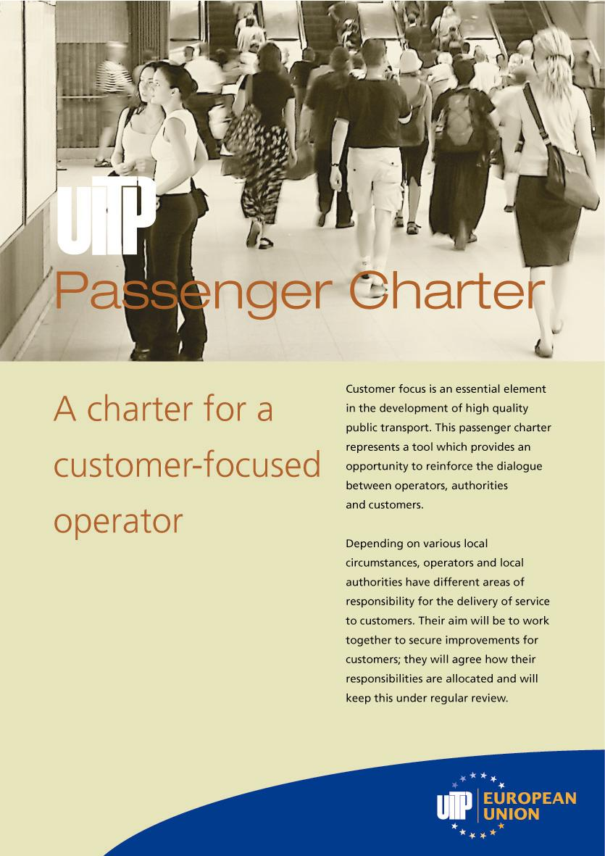
A possible solution: The UITP Passenger Charter
For multimodal public transport networks
Developed in 2006
Recommended to all UITP members
Rights and obligations
UITP is willing to further elaborate this initiative in the context of the activities of the Action Plan on Urban Mobility
Notes:
Greening Transport Communication summarising the whole package and setting out what new initiatives the Commission will take in this field until the end of 2009.
2. Greening Transport Inventory, describing the EU action already taken to green transport and on which this package builds.
3. Strategy to Internalise the External Costs of Transport
4. Proposal for a Directive on road tolls for lorries, enabling Member States to reduce environmental damage and congestion through more efficient and greener road tolls for lorries. Revenue from the tolls would be used to reduce environmental impacts and cut congestion
5. Communication on rail noise, setting out how to reduce the perceived noise from existing rail freight trains by 50% and the measures the Commission and other stakeholders will need to take in the future to achieve this.

Slide 9
The UITP Passenger Charter - Content -
Safety/Security
Customer information
Reliability/punctuality
Cleanliness
Journey comfort
Accessibility
Customer comments and complaints
Customer obligations
Notes:
Greening Transport Communication summarising the whole package and setting out what new initiatives the Commission will take in this field until the end of 2009.
2. Greening Transport Inventory, describing the EU action already taken to green transport and on which this package builds.
3. Strategy to Internalise the External Costs of Transport
4. Proposal for a Directive on road tolls for lorries, enabling Member States to reduce environmental damage and congestion through more efficient and greener road tolls for lorries. Revenue from the tolls would be used to reduce environmental impacts and cut congestion
5. Communication on rail noise, setting out how to reduce the perceived noise from existing rail freight trains by 50% and the measures the Commission and other stakeholders will need to take in the future to achieve this.

Slide 10
Thank you for your attention!
Contact: ulrich.weber@uitp.org
Notes:
Greening Transport Communication summarising the whole package and setting out what new initiatives the Commission will take in this field until the end of 2009.
2. Greening Transport Inventory, describing the EU action already taken to green transport and on which this package builds.
3. Strategy to Internalise the External Costs of Transport
4. Proposal for a Directive on road tolls for lorries, enabling Member States to reduce environmental damage and congestion through more efficient and greener road tolls for lorries. Revenue from the tolls would be used to reduce environmental impacts and cut congestion
5. Communication on rail noise, setting out how to reduce the perceived noise from existing rail freight trains by 50% and the measures the Commission and other stakeholders will need to take in the future to achieve this.

