Slide 1
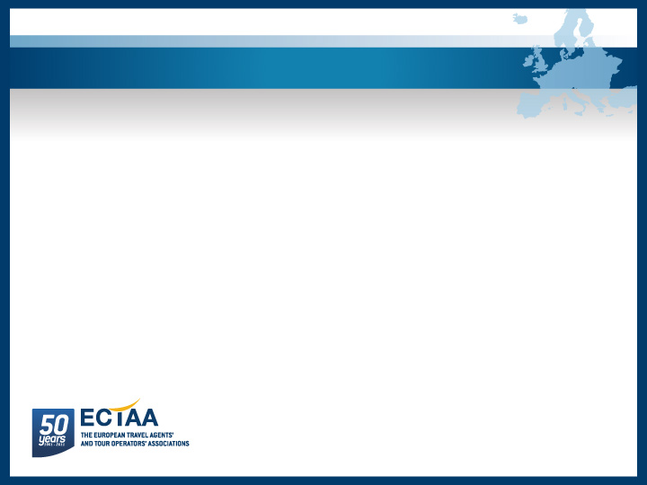
Successful cooperation between modes coach/train/air/shipping (integrated services): the travel agent’s perspective
7th European Bus and Coach Forum, 20 October 2011
1

Slide 2
7th European Bus and Coach Forum, 20 October 2011
Intermodality is key for travel and tourism:
Enhances efficiency on the side of the transport operators
Improves ease of travelling for travellers
Minimises impact on the environment
2

Slide 3
7th European Bus and Coach Forum, 20 October 2011
From travel agents and tour operators’ perspective it is very important:
Offer a seamless travel experience to customers: door-to-door
Offer a greater choice: routes, prices, carbon footprint, etc.
3

Slide 4
7th European Bus and Coach Forum, 20 October 2011
Travel agents / tour operators need:
Access to fares and route information
Reservation and issuance of tickets – (GDSs or other reservation system)
Settlement
Multi-modal journey planning – bus often integrated in national MMJP
Long-term vision: multi-modal reservation and ticketing
4

Slide 5
7th European Bus and Coach Forum, 20 October 2011
Many good initiatives:
Air – rail
Air – cruise
Rail – bus
Air – bus
BUT: They remain initiatives – no political, legal and technical framework in place yet
5

Slide 6
7th European Bus and Coach Forum, 20 October 2011
EU political framework – One of the goals of the White Paper on Transport 2011:
By 2020, establish the framework for a European multimodal transport information, management and payment system
→ Support of travel agents & tour operators
6

Slide 7
7th European Bus and Coach Forum, 20 October 2011
However, many challenges & barriers:
Lack of support of intermodality
(multi-stakeholders & competitors)
Data collection and sharing
(reliability of data, ownership of data, cost of data, real-time data, etc.)
Standardisation of data and processes
(air standardised, rail only now under way - TAP TSI)
Commercial: Revenue-sharing
7

Slide 8
7th European Bus and Coach Forum, 20 October 2011
The potential of multimodal travel has not yet been fully exploited, but:
Political will to set framework conditions
Successful cooperation examples are in place
8

Slide 9
7th European Bus and Coach Forum, 20 October 2011
Thank you for your attention!
9

