Slide 1
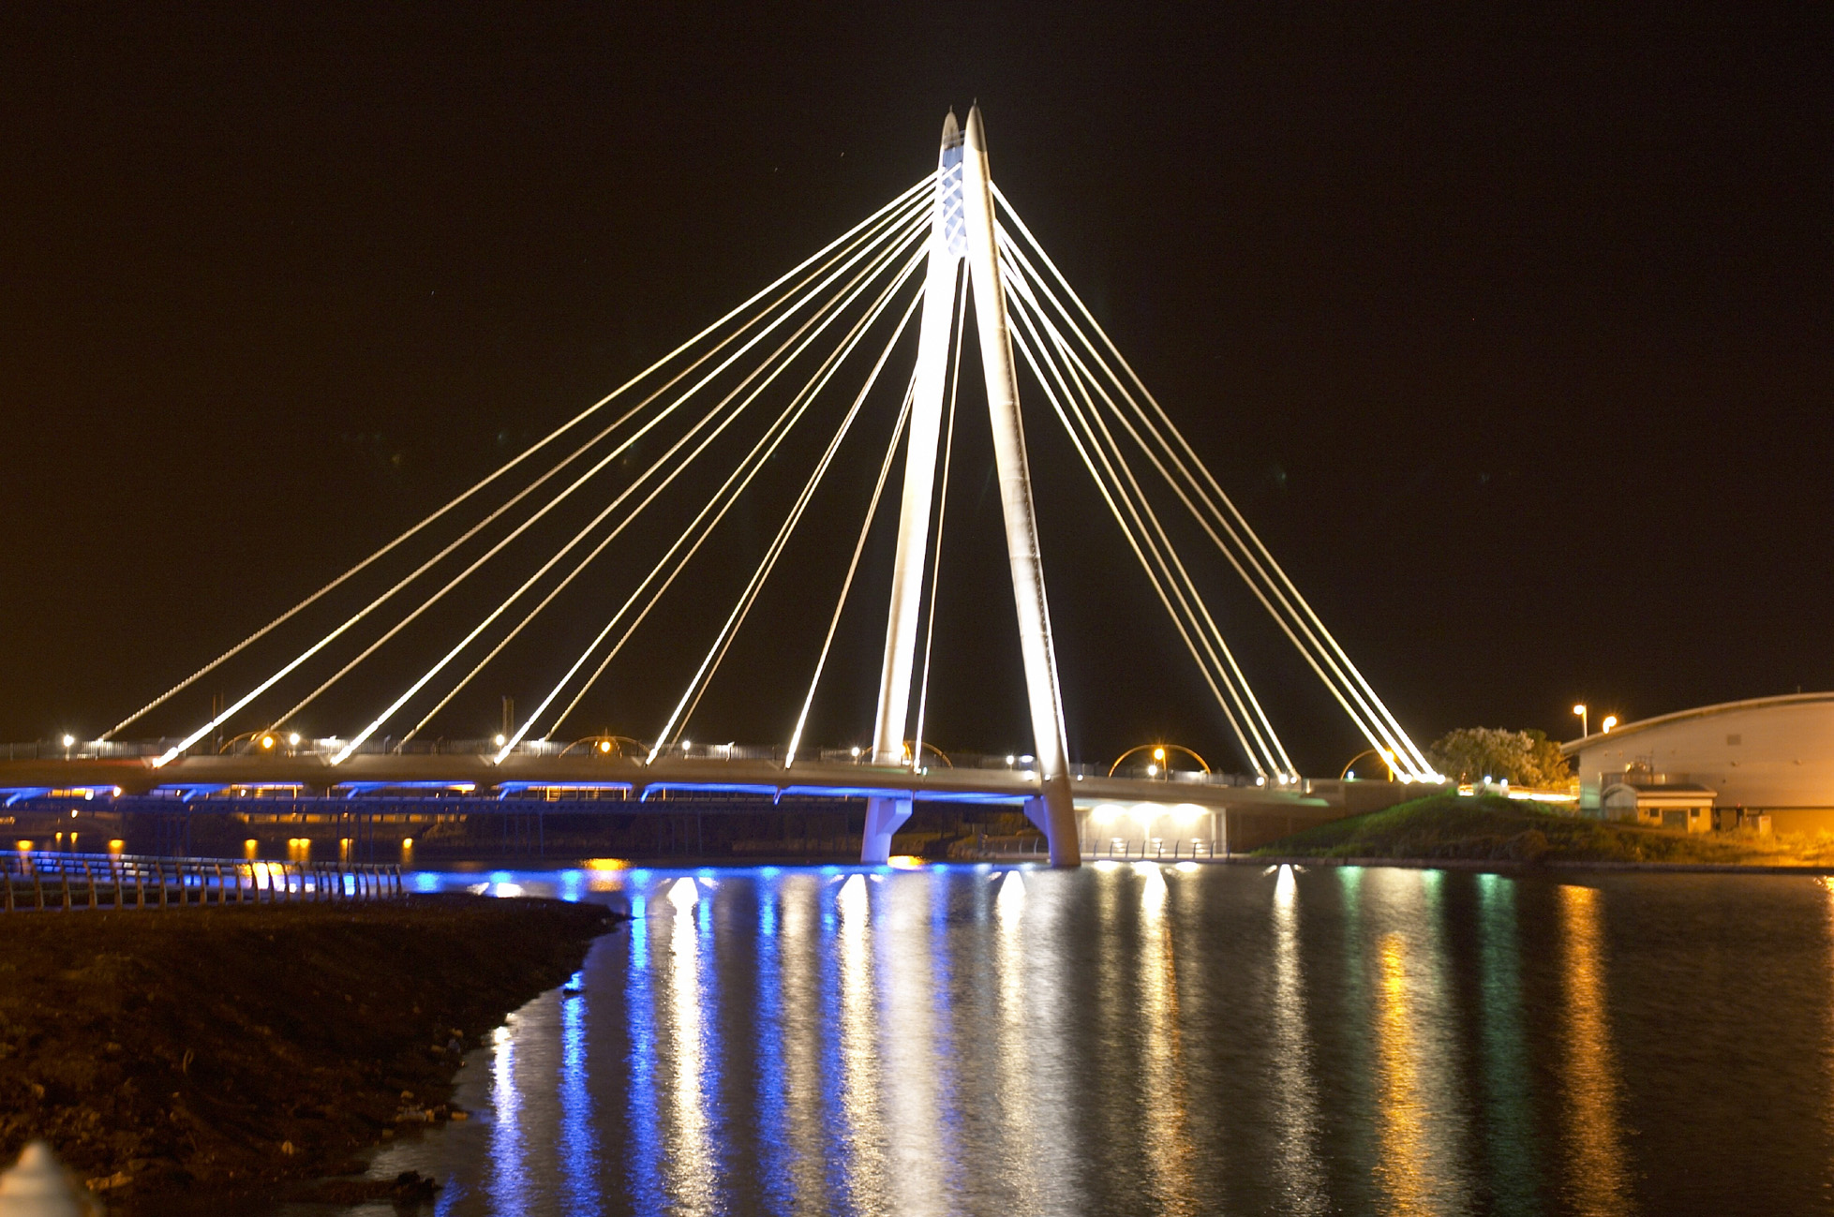

Southport - England’s Classic Resort

Slide 2
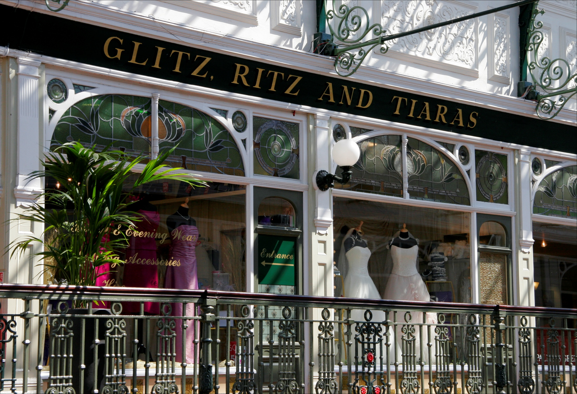
Southport - England’s Classic Resort
Why ‘Classic Resort’?
What is a ‘Classic Resort’?
What has been achieved so far?
What about the future?

Slide 3
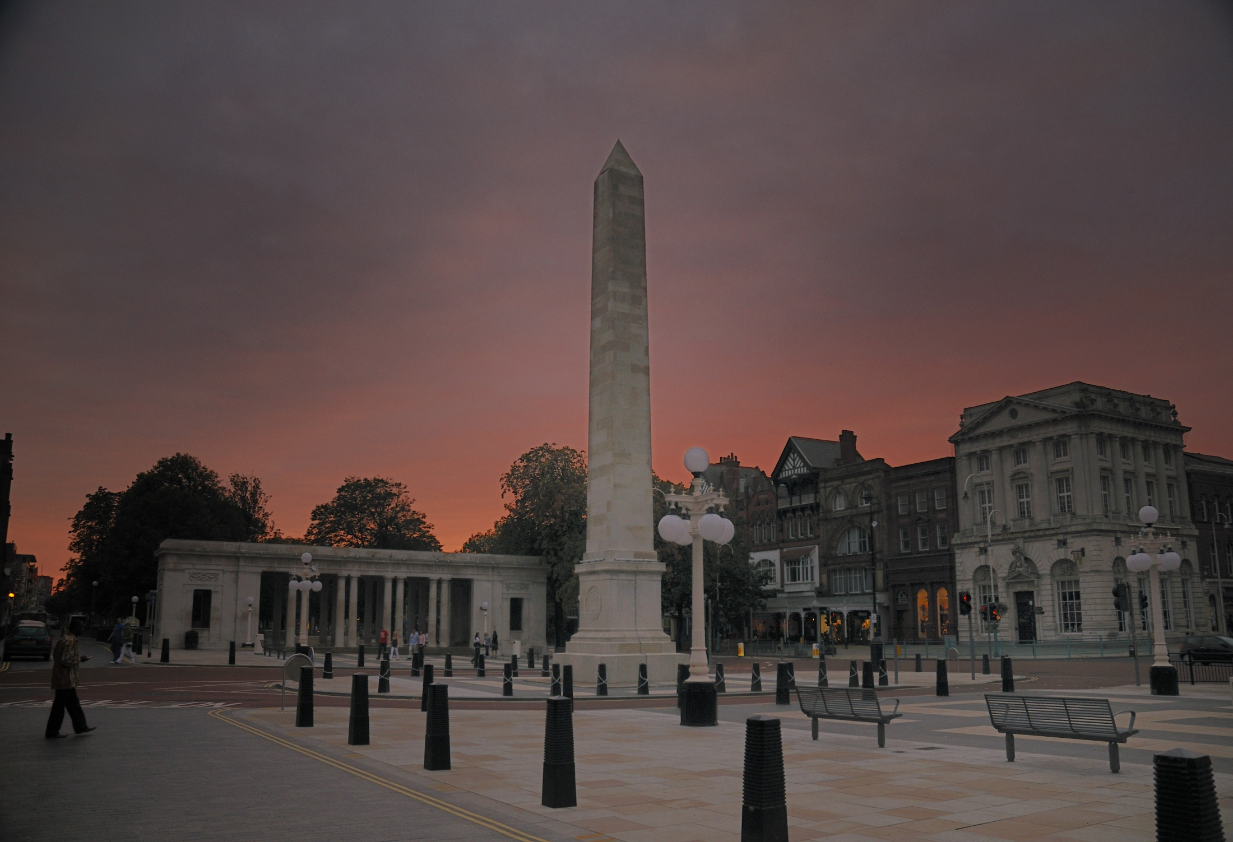
Why ‘Classic Resort’?
Need to respond to changing times!
Rising customer expectations
Holidays taken abroad
Growth in short breaks
Shopping as leisure pastime
Renaissance of Liverpool and Manchester
Cash rich – time poor
Increasingly competitive business tourism market

Slide 4
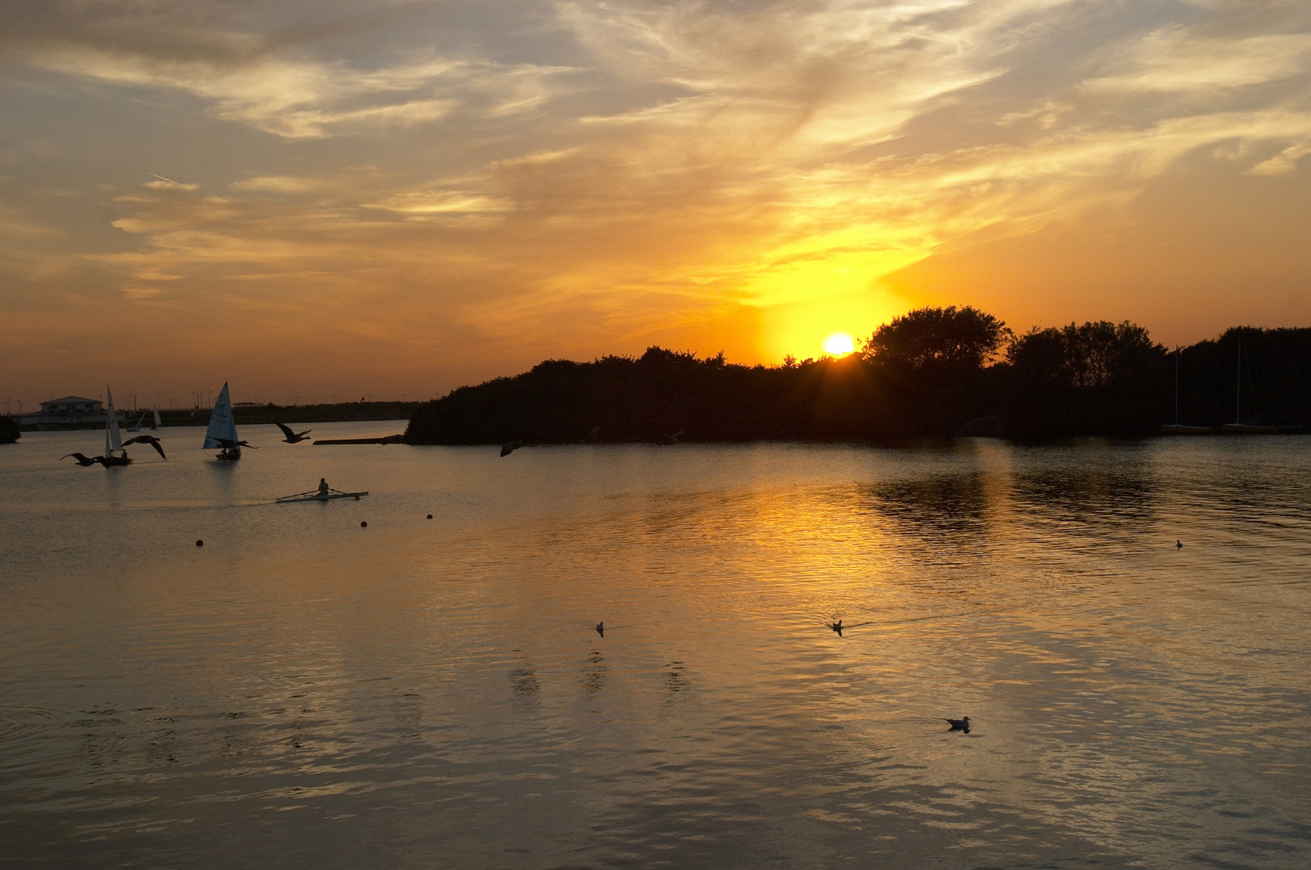
What is a ‘Classic Resort’?
Attractive for its sense of quiet sophistication and its preservation, in a modern way, of the spirit of the traditional seaside resort

Slide 5
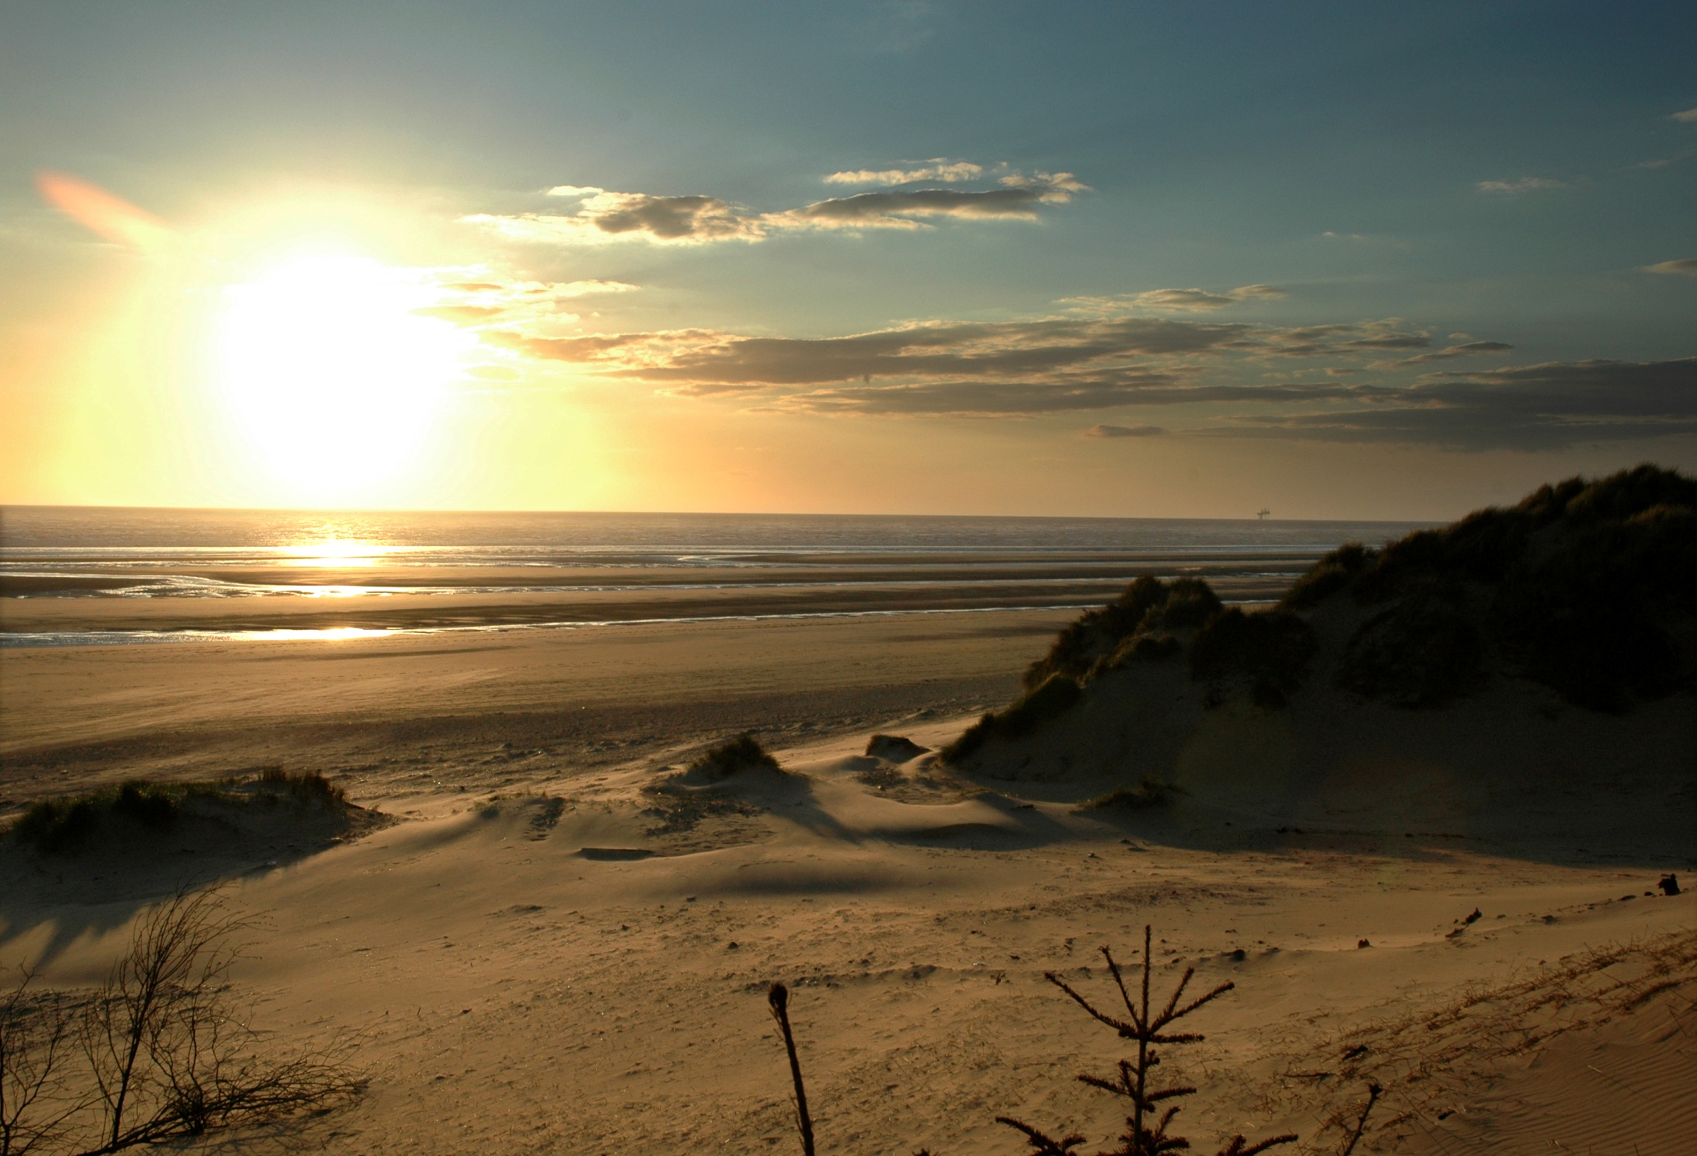
What is a ‘Classic Resort’?
Exemplary respect for architectural and environmental heritage
Pristine built and natural environment
Quality shopping
Quality accommodation
Quality food and beverage
Vibrant and varied cultural programme

Slide 6
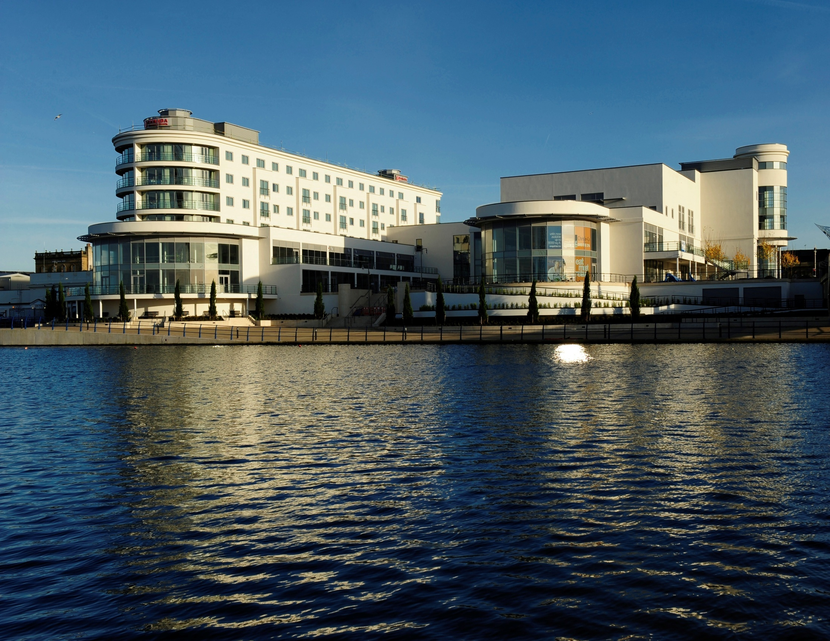
The Story So Far……..
Over £200 million investment over last decade
The Vincent Hotel,Ramada Plaza Hotel,
Formby Hall Golf Resort & Spa
Southport Theatre & Convention Centre
Chapel Street pedestrianisation
Lord Street Gardens / War Memorial
Pier refurbished plus new tram
Promenade - sea defence wall
Ocean Plaza leisure & retail centre
Marine Way Bridge
Eco Centre
Dunes Splash World

Slide 7

……. The Future
The Atkinson
Southport Market
Marine Park Development
Lord Street Retail Quarter
Kings Gardens

Slide 8
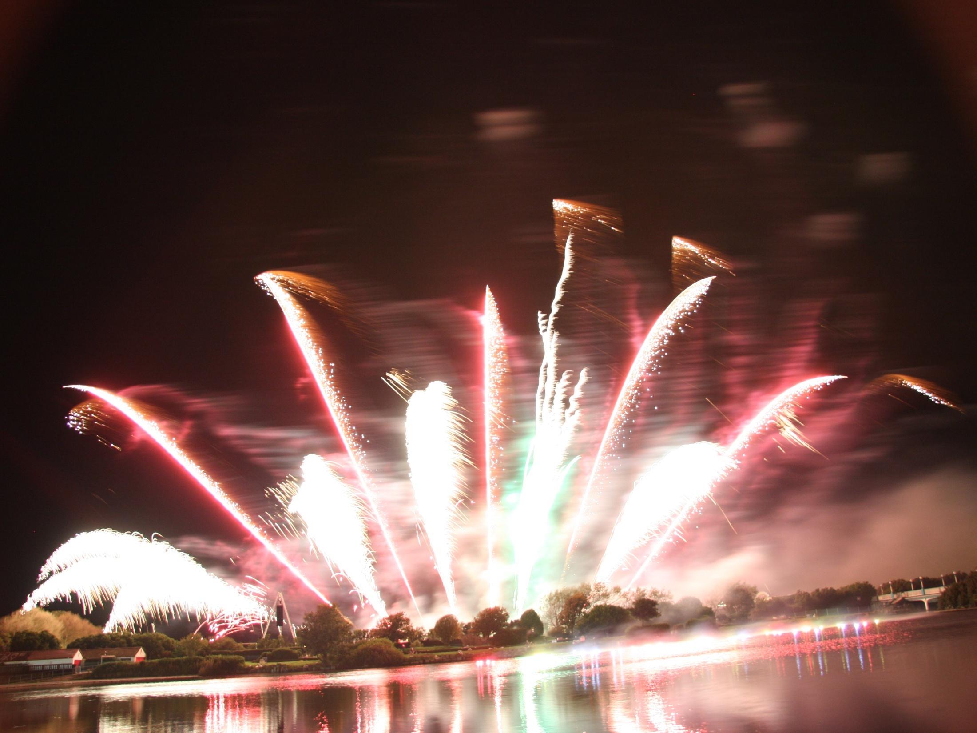

Any Questions?

Slide 9
Target Markets / Products
Leisure Short Breaks / Daytrips
Events
Shopping / Dining
Coast & Countryside
Conferences
Golf
Group travel

Slide 10
Group Travel
Who we Work With
Coach / Bus Operators
Group Travel Organisers
Types of Visit
Day Trips
Short Breaks Based in the Region
Short breaks Based in Southport

Slide 11
What we Offer
Coach Drop-off Points
Secure Coach Parking
Driver Facilities
Driver Passport Incentive Scheme
Group Discounts to Events and Attractions
Meet & Greet Service
Discount Voucher books for Passengers
Dedicated Travel Trade Officer

Slide 12
Marketing & Promotion
Trade Shows (Best of Britain & Ireland, Great Days Out, Group Leisure Travel Trade Show, Operator Events)
Travel Trade Newsletter
PR
Advertising
Sales (event tickets, attraction admissions etc.)
Website
Print (including Travel Trade Guide)

Slide 13
Industry Recognition
CPT Coach Friendly Status
UK Coach Awards ‘Most Coach Friendly Local Authority’ (Winner 2009 & 2010)
UK Coach Tourism Awards ‘Town or City of the Year’ (Winner 2009, Finalist 2010 & 2011)
CPT North West Annual Dinner Dance held in Southport 2010, 2011 and confirmed for 2012
Coach Hosts won ‘Team of the Year’ for 2010 at Southport Ambassador Awards in March
Winner of IRU Trophy 2011

Slide 14
Where are we now?

Slide 15
Financial Impact
In 2010 we welcomed 5,252 coaches
On average each brought 40 passengers
That’s 210,080 visitors
Average day spend - £31
Total Economic Impact for Southport of circa £6,612,480

