Slide 1
TRANSPORT LIBERALISATION TENDENCY
MARch 2016

Slide 2
STRATEGY & DEVELOPMENT > Grégory CARMONA
IRU - BRUXELLES - MARch 2016

Slide 3
REUNIR PRESENTATION
// REUNIR
Reunir is an organization, composed by local private transports companies.
Reunir bring to the organization members, technical and “corporate” support like quality, environment policies, safety, crisis communication, insurance, suppliers, tenders, etc …
Reunir is not a group, but a organization who permit family companies to be more competitive and offer services like a group.
// KEY FIGURES
Turnover – 500 M€
Companies – 127 Companies composed Reunir
Fleet - 7500 vehicles
Human Resources – 9000 employees
IRU - BRUXELLES - MARch 2016

Slide 4
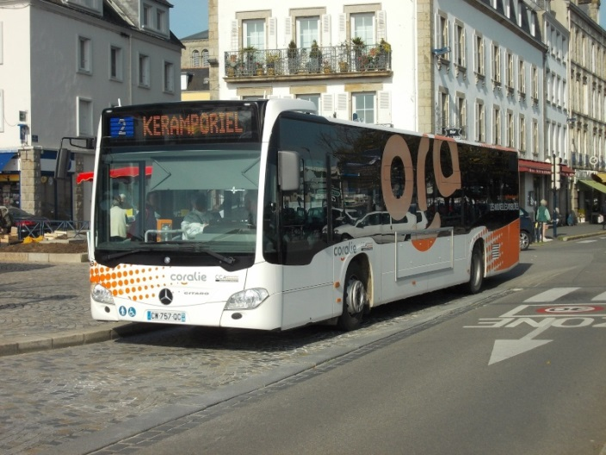
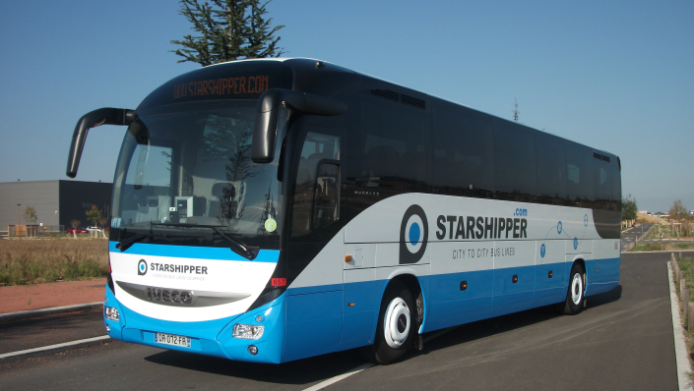
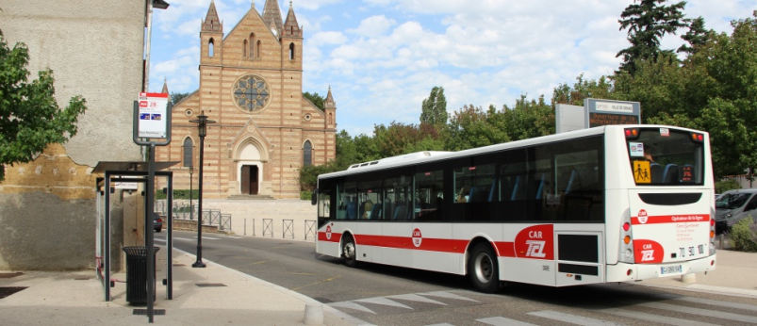
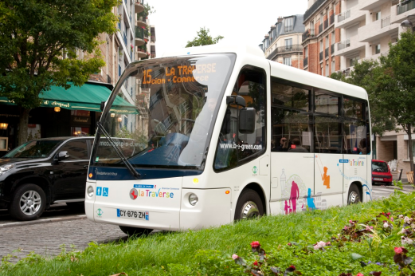
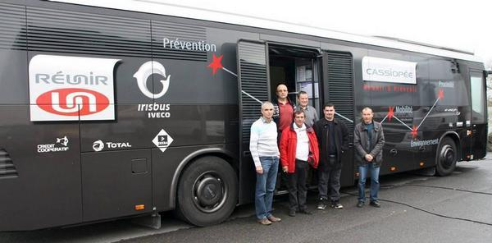
REUNIR PRESENTATION
// TRANSPORTS SYSTEMS OPERATIONS
> Interurban buses
> Urban and suburban buses
> School buses
> Participation in national routes buses (Starshipper)
> Bus stations operations
> Taxi
> Transport on Demand
> Free bicycle services
IRU - BRUXELLES - MARch 2016

Slide 5
BUS NATIONAL ROUTES
// MARKET MODEL
> No Market (no authorized – France before 2009)
> Regulated Market (Administrative contracts – Spain)
> Authorization free market (Administrative authorization – Portugal – Colombia)
> Free Market (Open access market – Germany – France 2015) - With restrictions
// FRENCH MARCKET OPORTUNITIES
> Before 2009 – Railway monopoly – No interurban alternative (bus)
> Since 2009 – Railway monopoly – Interurban bus transport only with internationals routes
> Since 2015 – Railway monopoly – Open access (with restrictions)
> 5 + 2 Players in the market - Starshipper (local companies with Reunir) – Megabus – Flixbus – Isiline (Transdev) – Ouibus (French Railways) + Eurolines (Transdev) – Alsa (Spain – National Express)
IRU - BRUXELLES - MARch 2016

Slide 6
BUS NATIONAL ROUTES
// NEW SITUATION OF THE MARKET
> 5 players with national routes and some “international” players (Eurolines – Alsa)
> More than 100km routes, open access
> Less than 100km routes, regulated open access (Arafer Opinión)
// OPPORTUNITIES
> A new market for bus operators (estimated in 5M passengers in 2020, 3 / 4 M in 2016)
// RISK
> Commercial risk
// INOVATIONS
> New “business” model for bus operators.
> Necessity of technologies for the fleet management, sell tickets, real time information, very independent operation in a large area but necessity of total control and coordination of the network operation (Safety, information, operation optimization).
IRU - BRUXELLES - MARch 2016

Slide 7
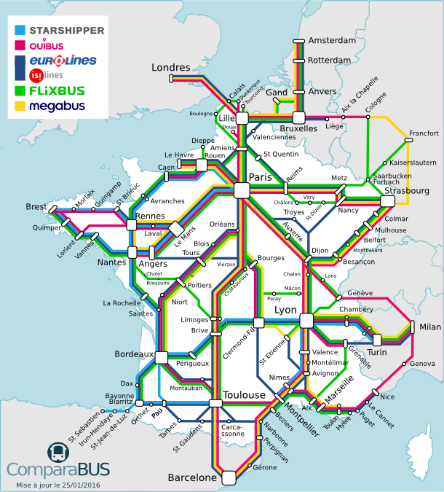
FRENCH BUS NATIONAL ROUTES MAP
IRU - BRUXELLES - MARch 2016

Slide 8
WEAKNESS
// FRENCH RAILWAY MONOPOLY
> French railways are still operating train with total monopoly on national routes.
// FRENCH RAILWAY INFORMATION
> French railways have all the actual information about French railway mobility, knowledge of origins and destinations, bus operators have not access to detailed information's.
// BUS STATIONS
> French Market have a low number of bus stations and not offer the necessary visibility for the service, much time using railways stations, P+R or simple bus stops.
// NEW MARKET AND RAILWAY CULTURE
> In this moment, it´s a very “young” market, French people have a strong railways culture and normally use rail before bus, the bus is positioned as a “low cost” service.
> Normally, French people look first for railway service and web, for exemple SNCF voyage website (subsidiary) had 80M tickets sales in 2014 (first sale transport website in France).
// MARKET POTENTIAL
> 5 Millions passengers in 2020 – Today 29M in Spain (44 M inhabitant)
IRU - BRUXELLES - March 2016

Slide 9
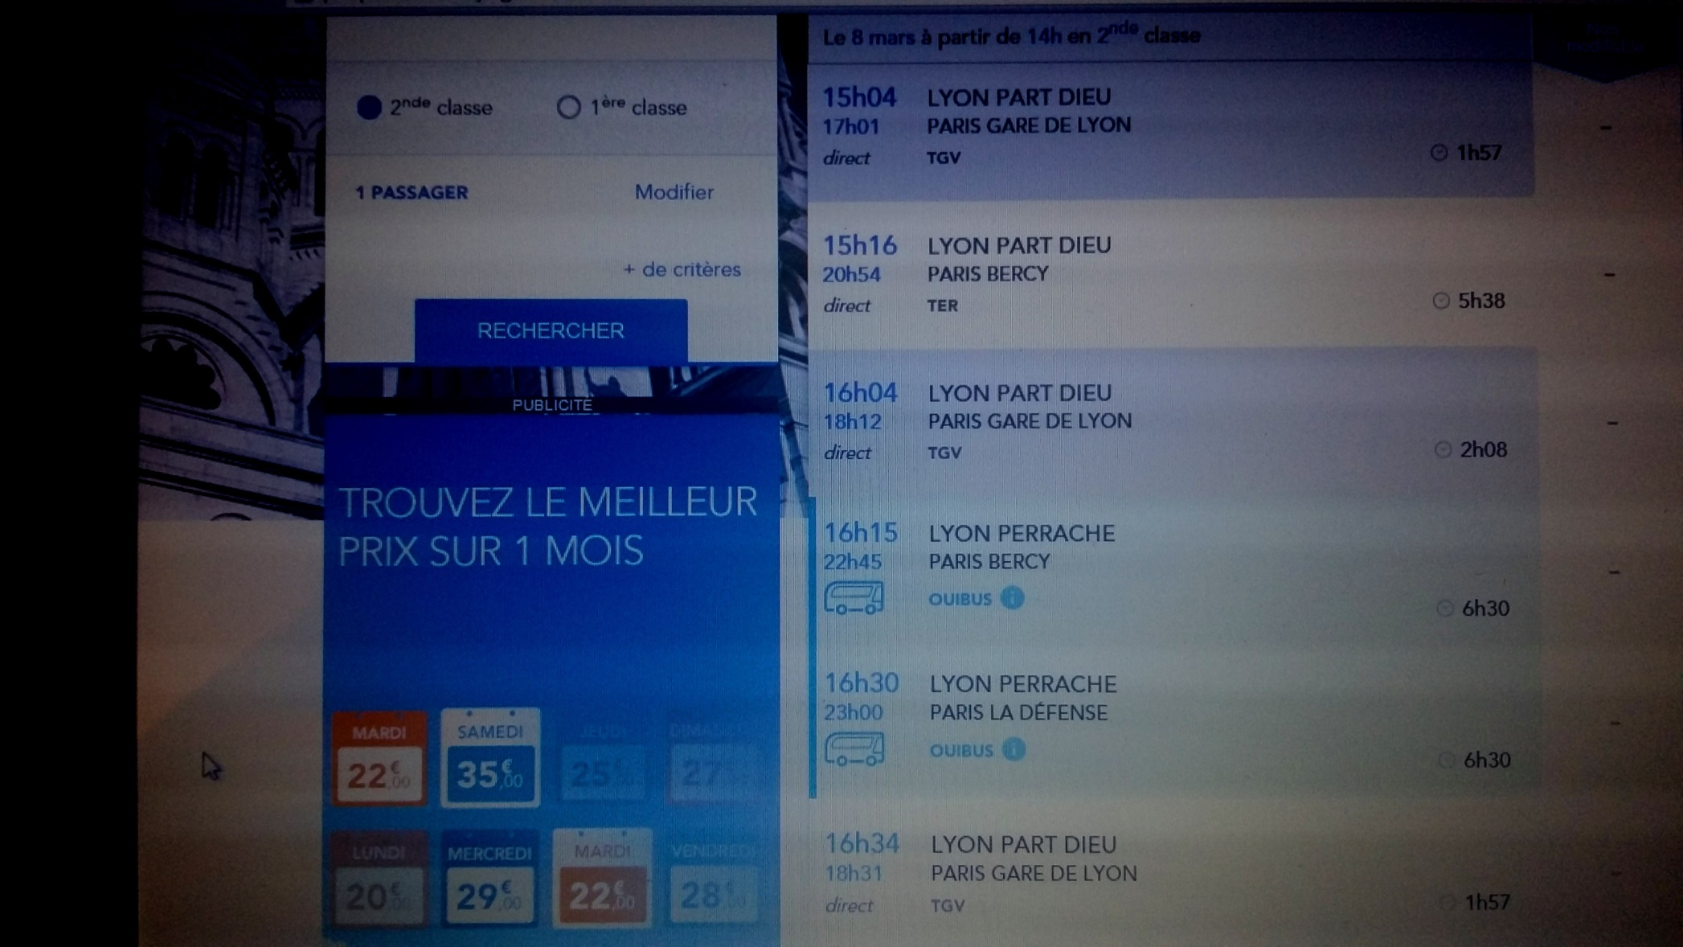
WEAKNESS
IRU - BRUXELLES - March 2016

Slide 10
SPANISH MARKET VS FRENCH MARKET
// SPANISH LONG DISTANCE MARKET
> With more than 60 years of long route bus concession contract, Spain have a consolidated national routes system organized in 90 administrative concession, coordinated by Development Ministry and attributed by tenders process. The ministry fix prices (for minimum services), minimum level of quality and number of services.
// NO PUBLIC OPERATORS
> In Spain, railways had a subsidiary operating national routes, this company was privatized in 1999 (integrated in Alsa group). Now, all players of the market are private company and development ministry receive information of passengers numbers in every contract. With theses information, the development ministry can offer “equitative” tenders process for all operators.
// BUS STATIONS
> Spain have more than 360 bus stations or equivalent. In all contracts operators have the obligation to use bus stations. The bus station are municipal, private or concession. Theses infrastructures offer an equitative access for all operators (municipal / concession) with the same price and conditions for all operators.
// NATIONAL WEBSITE
> The Spanish ministry of development is planning a website with all national route.
// NATIONAL IDENTIFICATION
> All national routes buses have a specific “Logo”
IRU - BRUXELLES - MARch 2016

Slide 11
CONCLUSION ABOUT FRENCH OPEN MARKET
// FRENCH MARKET CHALENGES
Offer infrastructures with true bus stations
Offer the same rule for all companies (like air transport market)
Offer the same information about market
In short : Offer equitable opportunities for all the players of the market
// AND SPAIN MARKET 60 YEARS AFTER?
The tenders process are still in progress in Spain, we can observe little local companies obtaining concessional contract with the development ministry. Company, who traditionally operate local or school bus transport, are now operating national route and win tenders process.
When we talk about liberalization, what do we want ? New monopolies or an open and diversified market … in this moment, France could be in 3 o 4 years similar to o monopoly with only a little number of players and no opportunities for little or medium size company (or subcontracting).
In a concessional regulated market like Spain, there are traditional large groups operating and little player with opportunity to operate.
// COULD BE SPANISH MARKET ORGANISATION THE FUTURE OF FRENCH ONE?
IRU - BRUXELLES - MARch 2016

Slide 12
MANY THANK´S FOR YOUR ATENTION
FOR ANY QUESTION, CONTACT US!
sed@reunir.org

