Slide 1

U.S. Bus and Motorcoach Market and Regulatory Issues October 17, 2013 Kortrijk, Belgium
Presented by:
Victor S. Parra
President and CEO

Slide 2

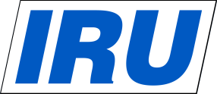
Overview of UMA
Founded in 1971 to represent the interests of the tour and charter motorcoach operators.
Support open and competitive markets.
Opposed economic regulation.
Support a safer operating environment, but oppose “safety” regulations that impose disproportionate economic hardship.
Support regulatory enforcement that improves safety performance and directly correlates with reducing crashes, injuries, and property damage.
“Science must drive policy, and not the reverse!”

Slide 3
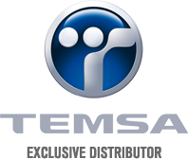

Overview of UMA (con’t)
Today, members include nearly 900 motorcoach operator companies and 200 manufacturers and suppliers including companies such as:

Slide 4
US Motorcoach Market -- Profile
- Seniors: 5- 10 % declining
Students: 45 - 50% increasing
Corporate/Convention: 20% flat
Contract Services (military, contract services, government, non-profits, etc.): 5-10% declining
Social Events (weddings, parties): 10% growing
Private/Public Partnerships: 5%.. great potential!

Slide 5
US Motorcoach Industry
All indicators suggest business is steadily improving:
55% of bus operators reported increased sales 2012, up from 45% in 2011*
32% plan to hire more full time employees in 2013; up 25% in 2012*
35% plan to purchase new coaches in 2013, up from 24% in 2012*
Coach sales increased 6.8%in 2012 **
Groups booking motorcoach travel increased 4.2% ***
* Source: UMA Industry Assessment Survey
** Source: National Bus Trader magazine
*** Source: BusRates.com through September 2013

Slide 6
Motorcoach Industry Legislative and Regulatory Issues from Map-21
Proposal: 3-point seat belts… effective 3 years from final publication date???
Electric On-Board Recorders (EOBRs) – proposal due this month???
New entrant requirements – testing knowledge of laws before granting operating authority
New Hours of Service – Under consideration

Slide 7
Motorcoach Industry Legislative and Regulatory Issues (con’t)
Possible increase in liability insurance requirement: currently $5 million, possibly increase to $15-20 million!
Considering testing roof strength, fire prevention devices, window glazing and roll over prevention
Private/Public Partnerships – Greater use of privately-owned motorcoaches

Slide 8
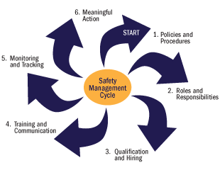
Safety Management Cycle
The Safety Management Cycle is the signature tool behind the Federal Motor Carrier Safety Administration’s investigative process.

Slide 9
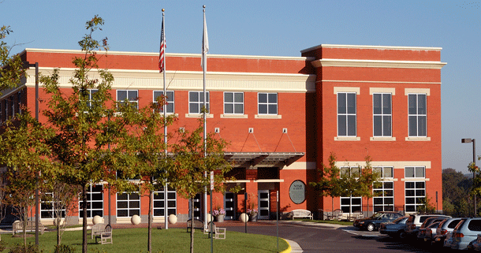

Upcoming UMA Events
^{10th} Annual
Safety
Management
Seminar
December 4-5, 2013
NTSB Training Academy
Dulles, VA

Slide 10
THANK YOU!
What it takes to drive your business!
www.uma.org

