Slide 1
Implementing New Mobility Schemes: Impact on Business, Operations and Regulation
Mobility-as-a-Service
03.05.2017, Brussels
Josef Schneider // EUROPEAN PASSENGERS‘ FEDERATION // www.epf.eu

Slide 2
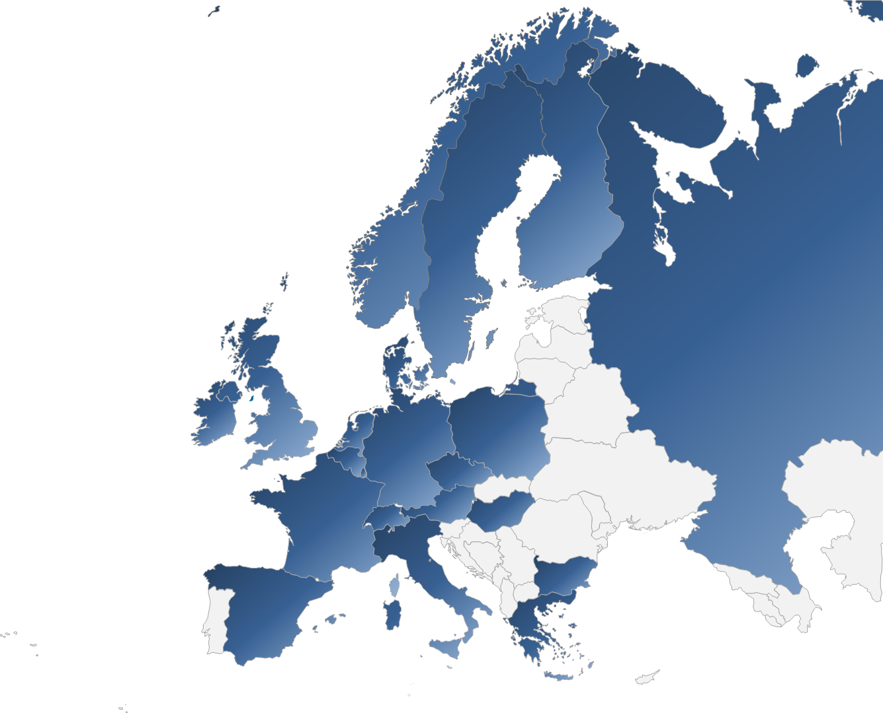
EPF MAP May 2017
38 member organisations
21 countries

Slide 3
WHAT IS THE EUROPEAN PASSENGERS’ FEDERATION?
founded 2002
the European umbrella organisation of national and regional passengers’ organisations
financed by its member organisations
representing passengers’ views at the European level
dealing with all modes of public transport such as local transport, railways, buses, aviation and maritime transport

Slide 4

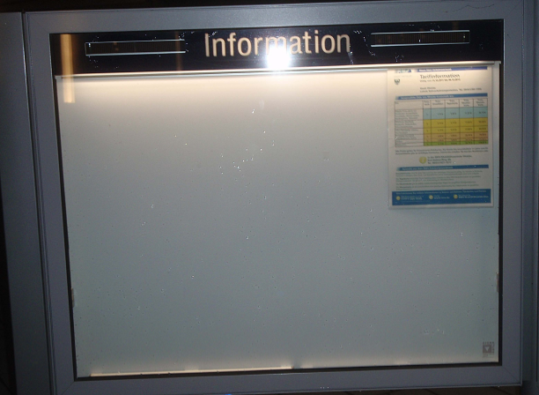
Passengers needs Information before the journey
qualified
complete
understandable
useful
free of barriers
consistent
reliable

Slide 5
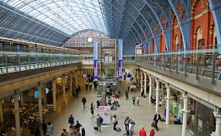
Passengers needs Ticketing
give a full choice of possible offers
best price
quality of service
flexibility
first choice: one through ticket door to door
second choice: all tickets for the whole journey. All tickets together as one single contract
as an absolutely minimum: full information about the whole journey

Slide 6
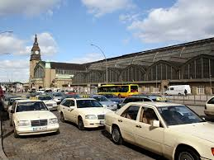
PLAN B - IF THINGS GO WRONG
Need for real-time information, clear and audible announcements.
on an international journey, use of more than one language.
Helpful and visible staff, aware of passenger rights, using initiative.
Assistance to reach the destination.
Investment in the necessary hardware, software and training.

Slide 7
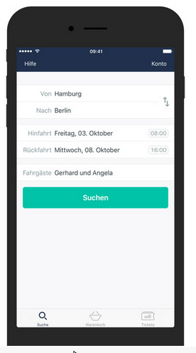
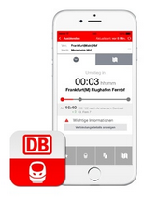
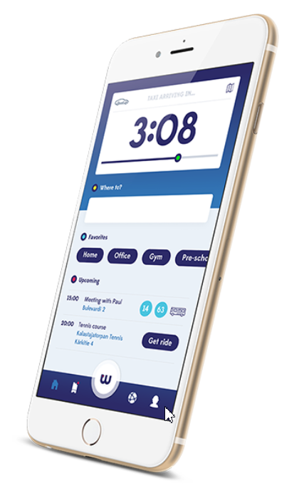
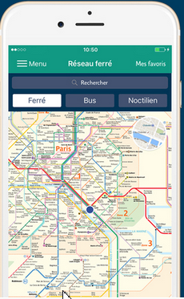
suggestions
there is a strong need for open data
not everything needs to be open source but passenger related data should be freely accessible:
Timetables
Real time information
Delay data
transport composition and occupation
wayfinding
Promote initiatives to develop products for passengers

Slide 8

Thank you for your attention!

