Slide 1



Slide 2
About Samtrafiken
Samtrafiken is a partnership and development company for passenger transport services by shared resources. We enable the emergence of combined mobility services by providing technical and business expertise that co-ordinates and facilitates the availability of the producers' service range.

Slide 3
About Samtrafiken
Founded in 1993
Main objectives
  Collaboration
  Distrubute all of Swedens PTA’s and PTO’s Traffic Data to enable combined journeys
Our aim is to be the best collaboration arena for Public Transport in Sweden

Slide 4
Vision
” We enable the emergence of simple, sustainable and profitable Combined Mobility Services”

Slide 5
WHAT?
Notes:
What do we do at Samtrafiken right now that’s interesting to talk about today?

Slide 6
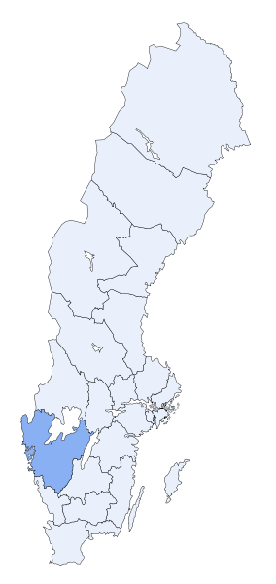
Swedish Mobility Program (SMP)
Establishing a national integration platform
The aim is to enable and promote combined mobility services on a large scale, and third party sales in general by making PTA and PTO services available via a national access point and ensure a common regulatory framework
Starting point is PTA services in Gothenburg area (Västtrafik) 2017/2018. Stockholm and Malmö etc. 2018/2019
We want to see new combined mobility services and sales channels emerge in Sweden
We search for a technical supplier/partner for an integration platform and selling partners. Starting now…

Slide 7
Redefining ”public transport”
Public transport = Passenger transport services by shared resources.

Slide 8
































Notes:
…in a broader sense than before. Now we invite actors in the broader sense of Public Transport. We’ve widened the circle.

Slide 9
HOW?

Slide 10
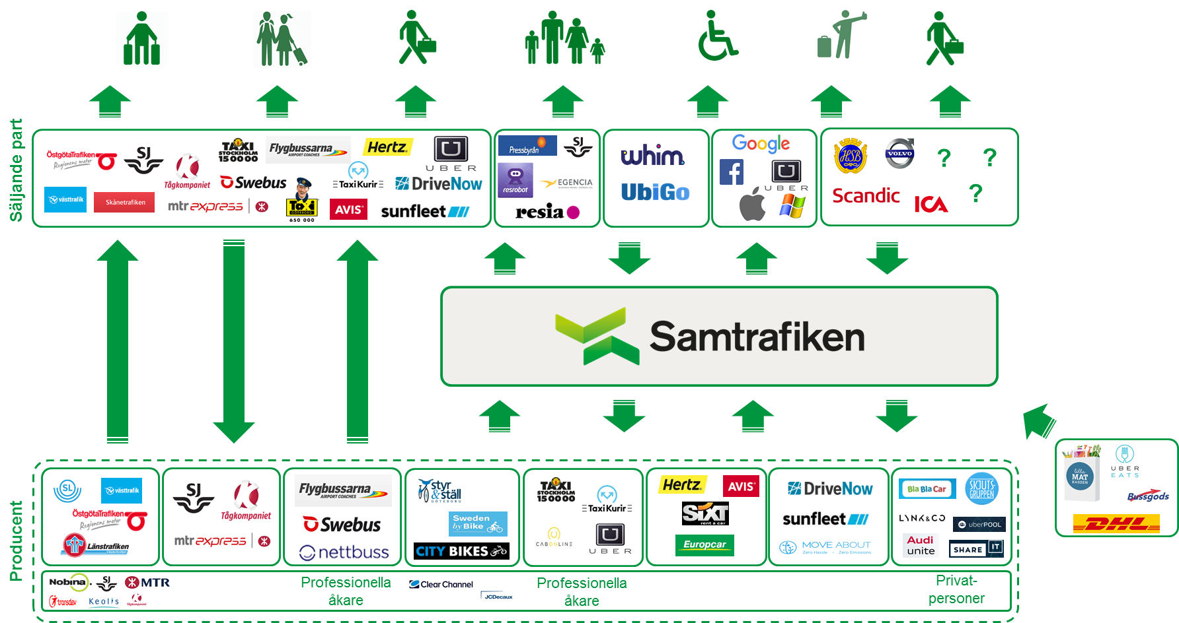
Samtrafiken’s position
Technical facilitator/ coordinator
National access point/ integration platform
Co-ordinate a joint business agreement

Slide 11
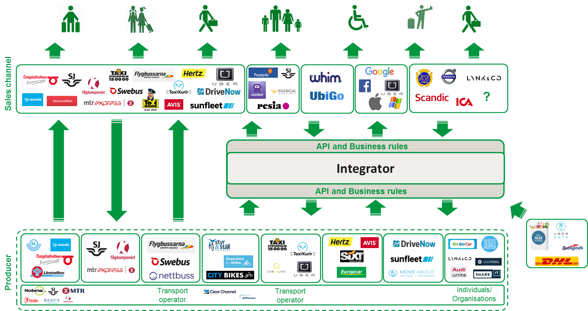
Conclusion principles
No monopoly
It is free to sign contracts / build integrations bilateral
Selling party must have control whose services they wish to sell
The producer must have control whish services are sold and by whom
The technical solution will only be found in the parts it adds a value
The technical solution must be able to communicate with other integrators/platforms

Slide 12
jens.tangefjordbrodin@samtrafiken.se
Notes:
Please don’t hesitate to contact me in the breaks. Will be here all day.

