Slide 1
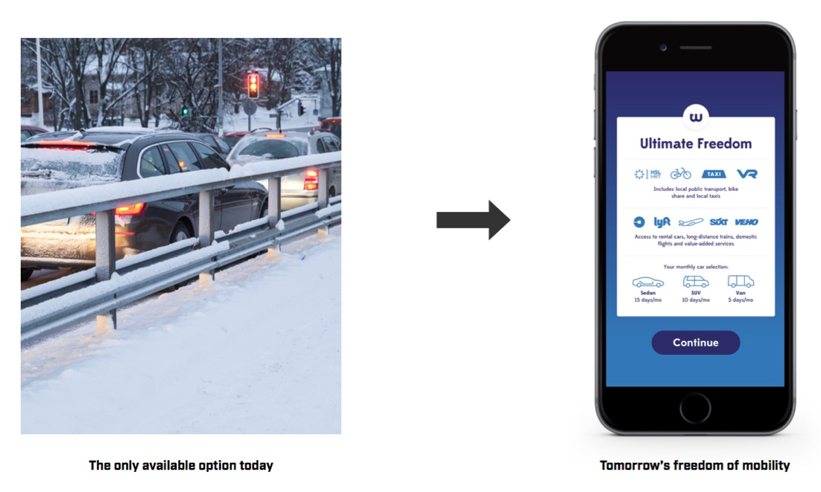

Competitive advantage – Freedom of Mobility
Our service promise is total freedom of mobility.

Slide 2
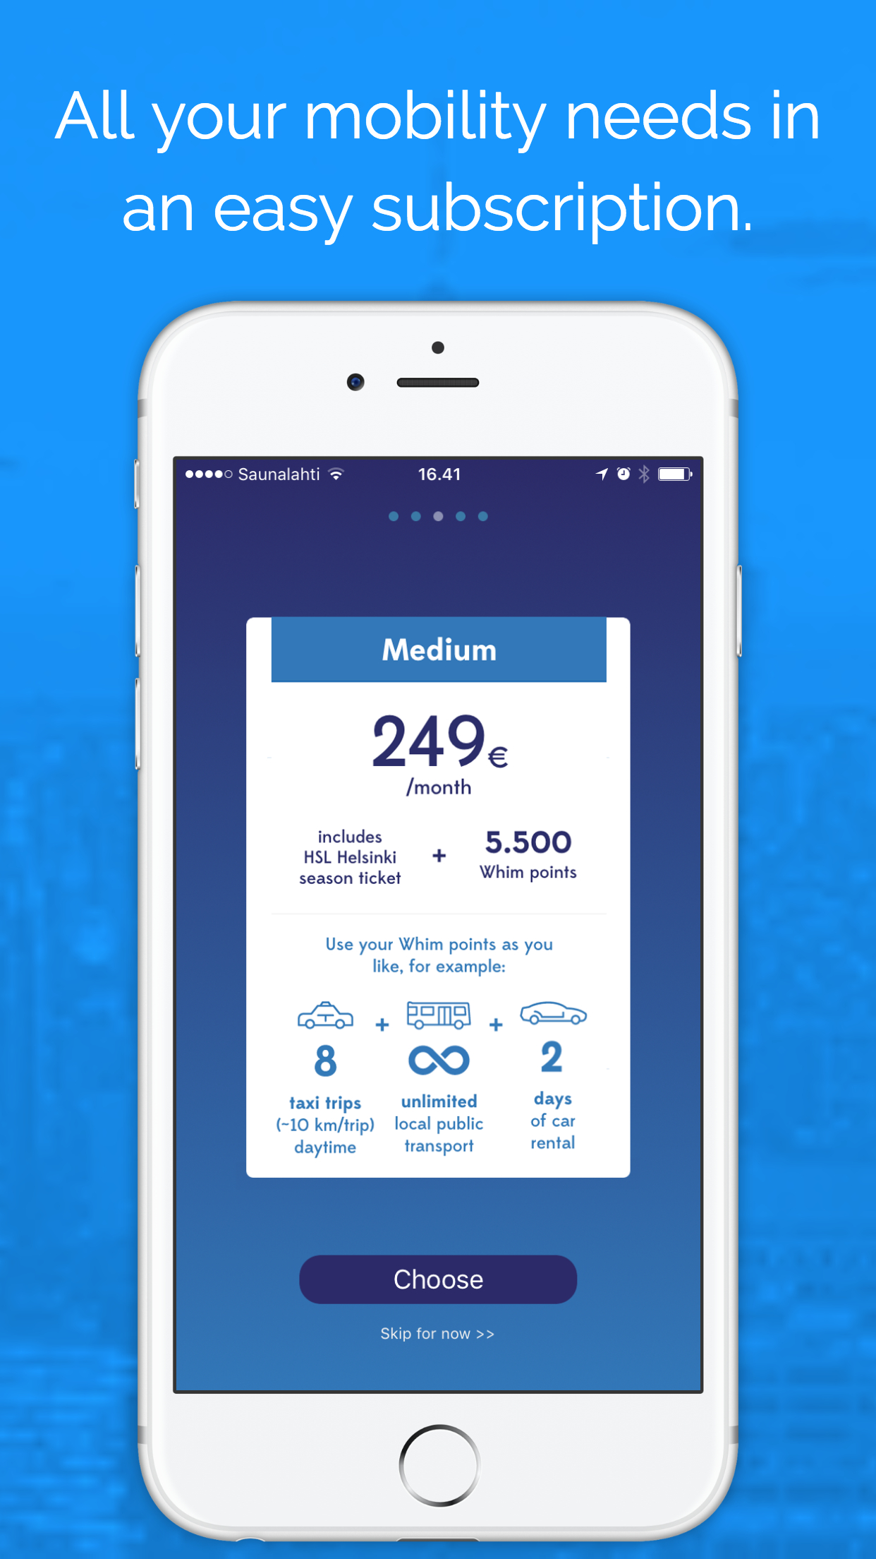
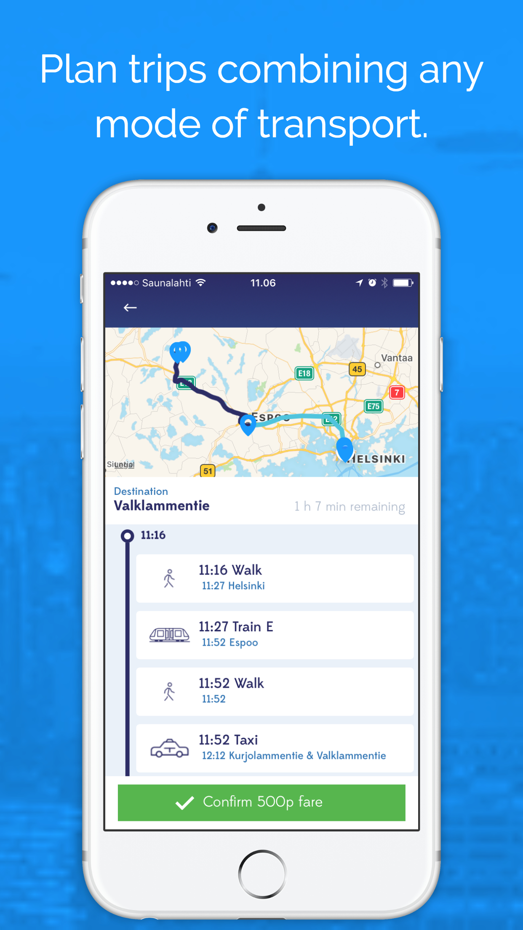

Monthly subscription for all transportation

Slide 3
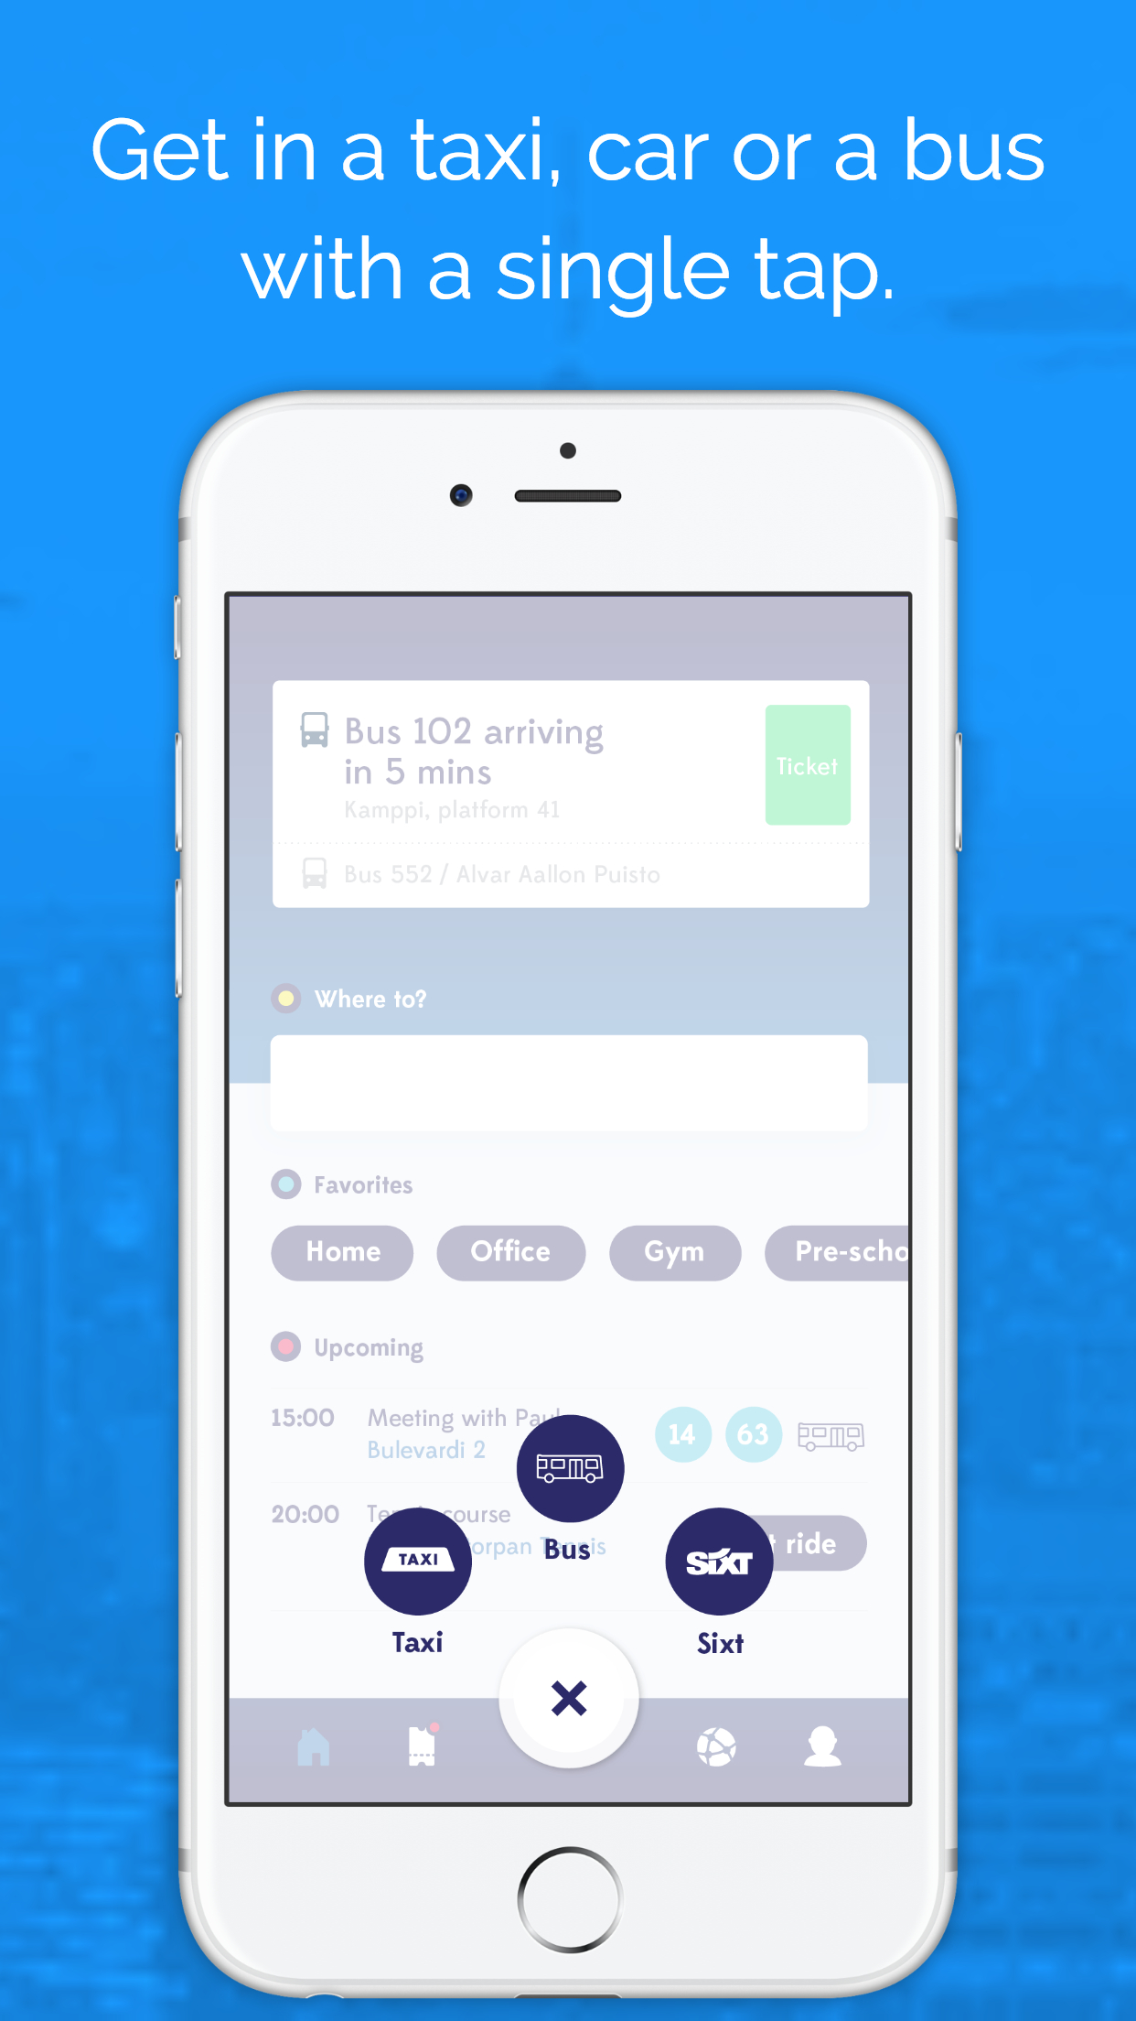
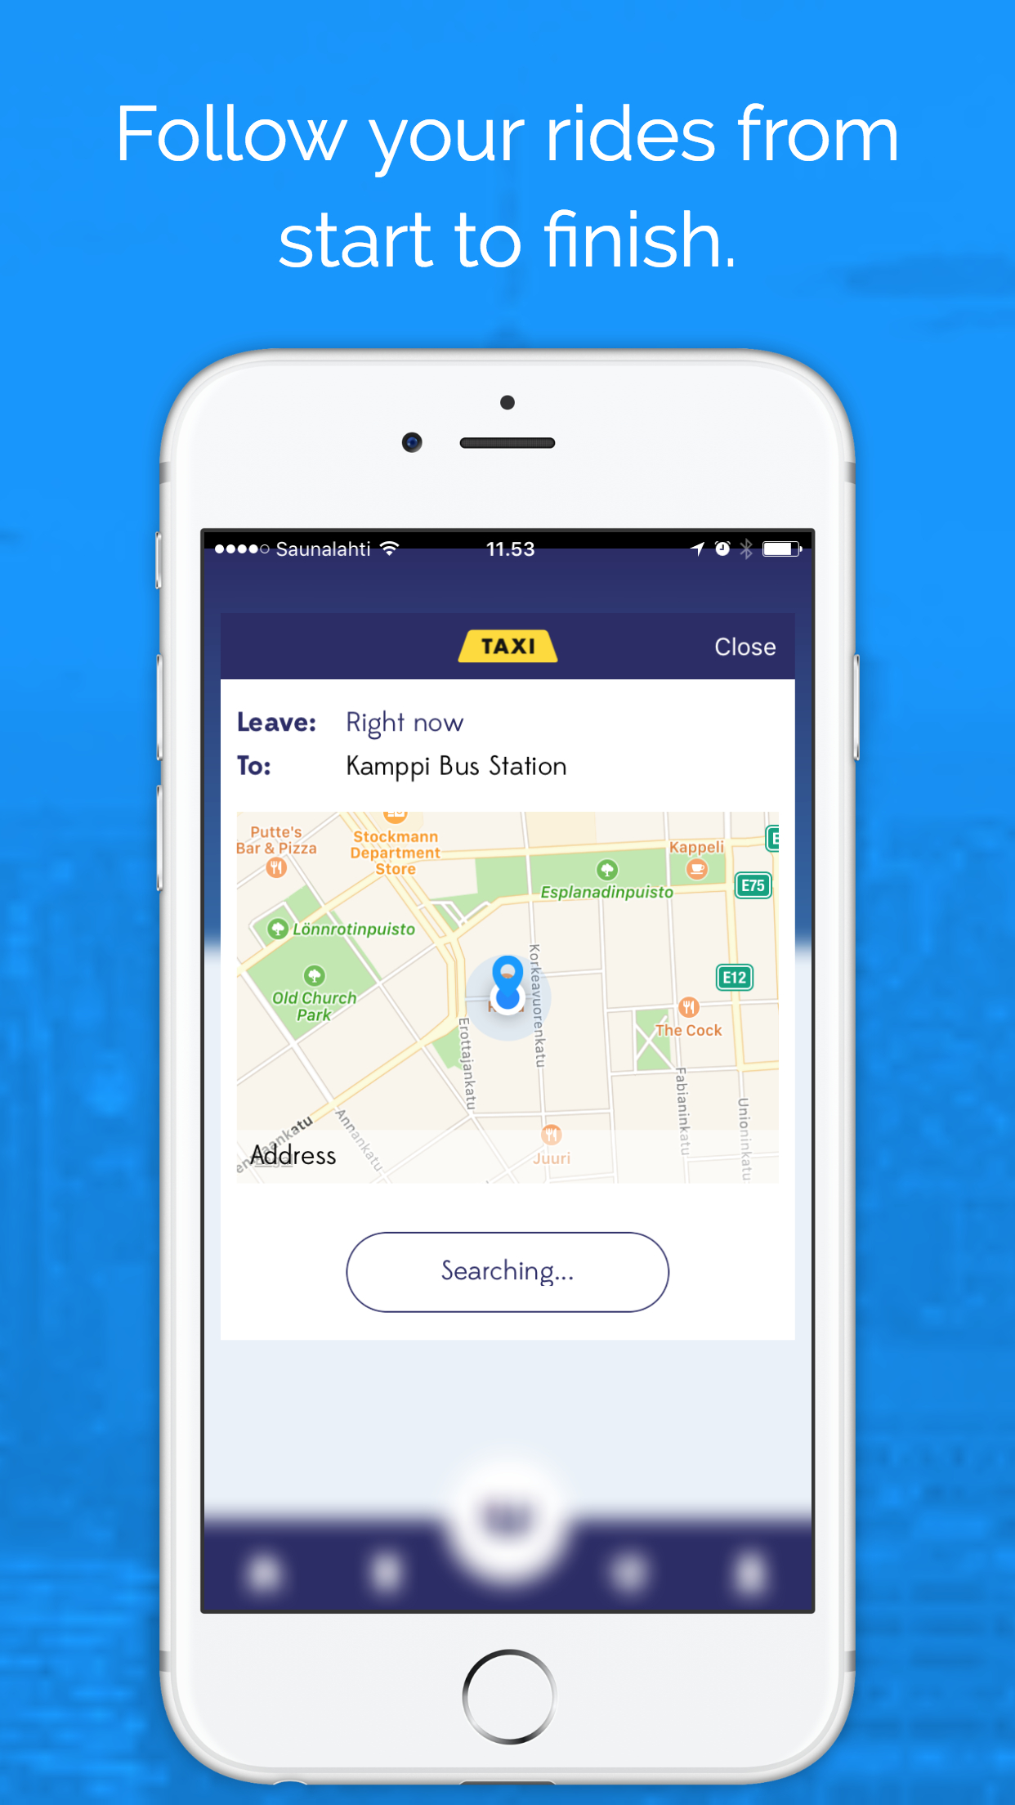
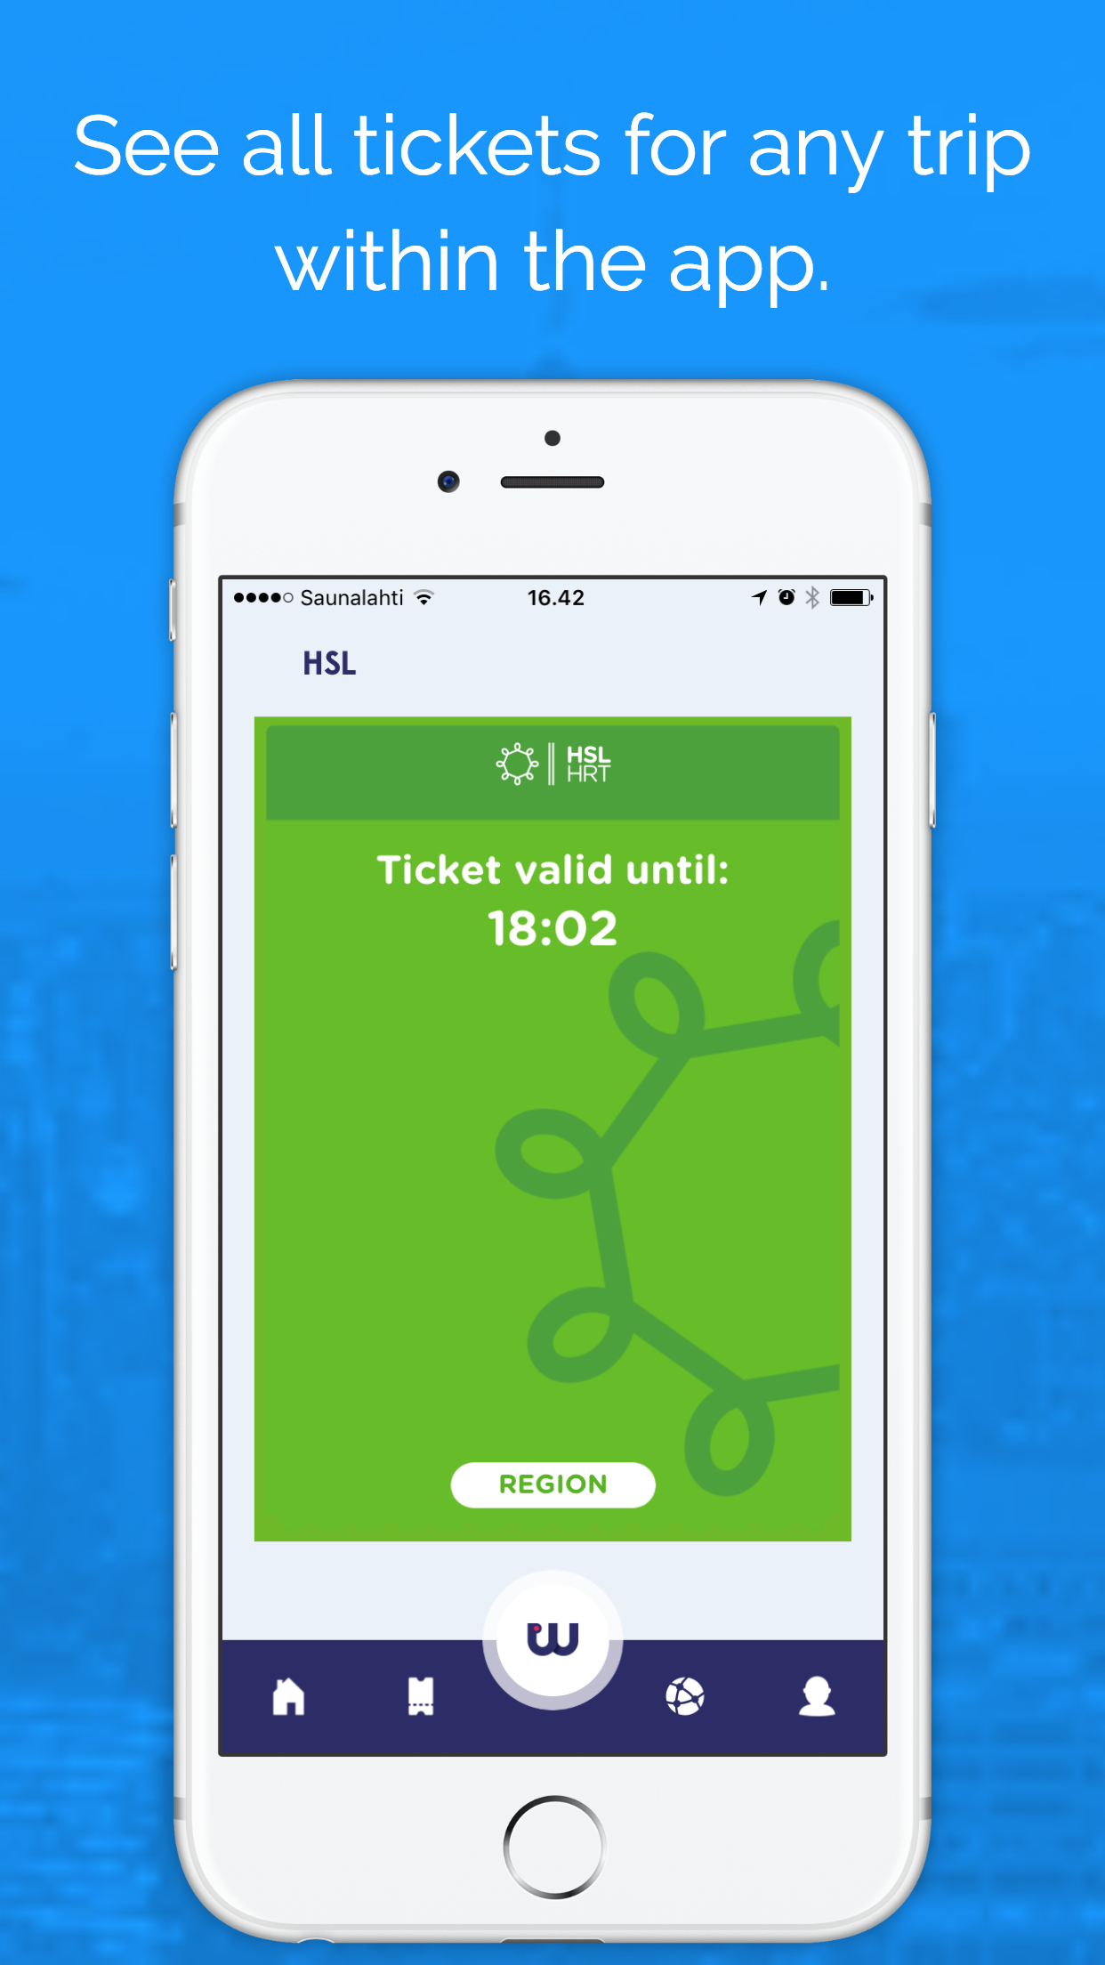
Much more than a trip planner

Slide 4
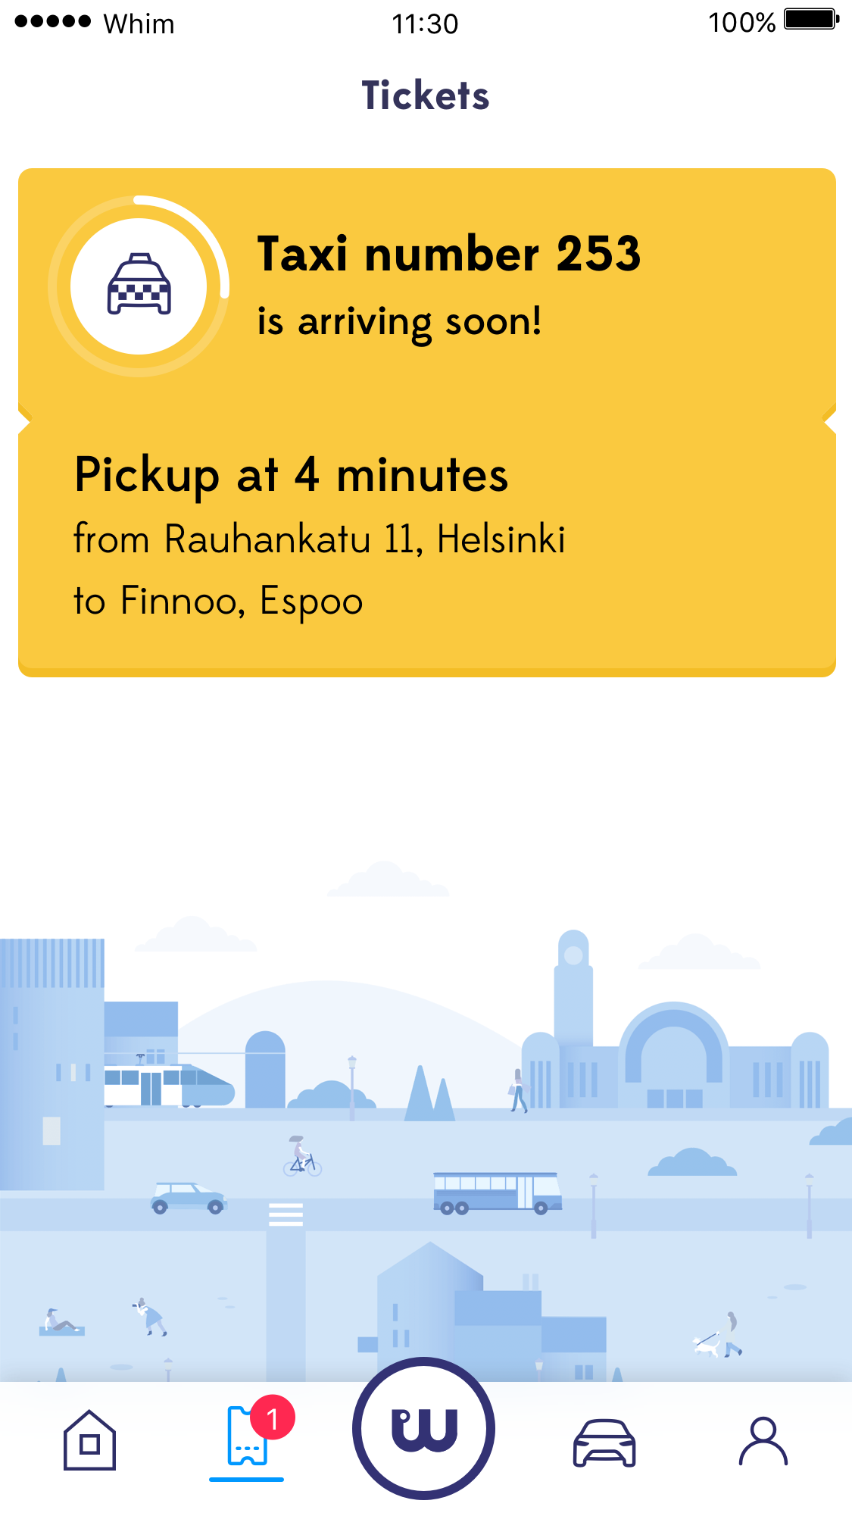
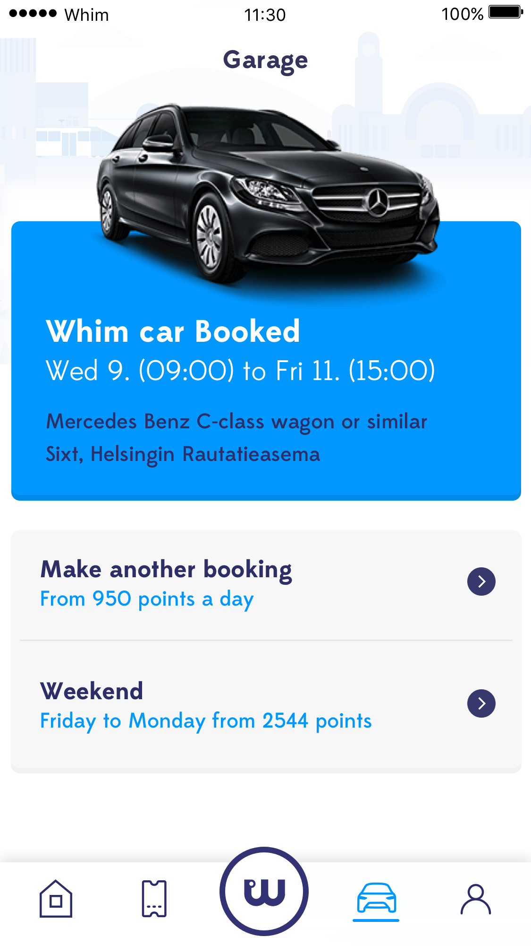
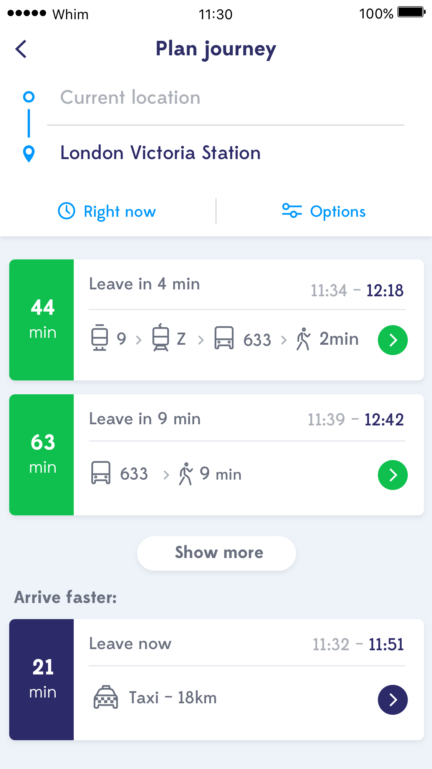
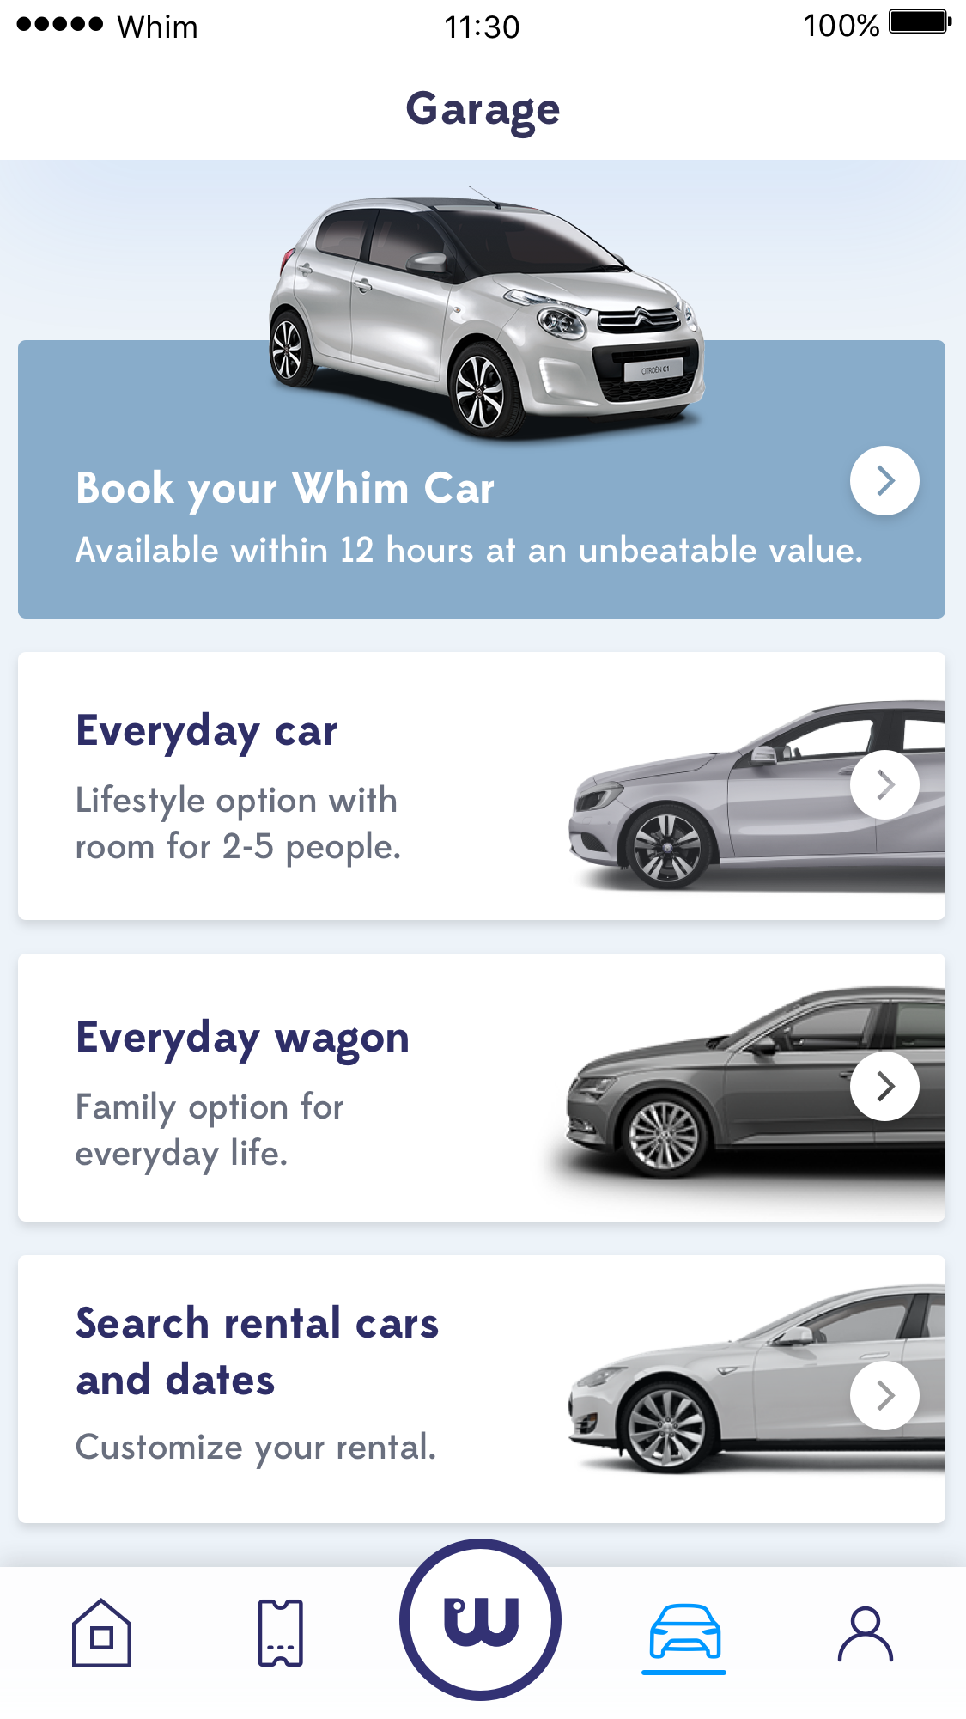
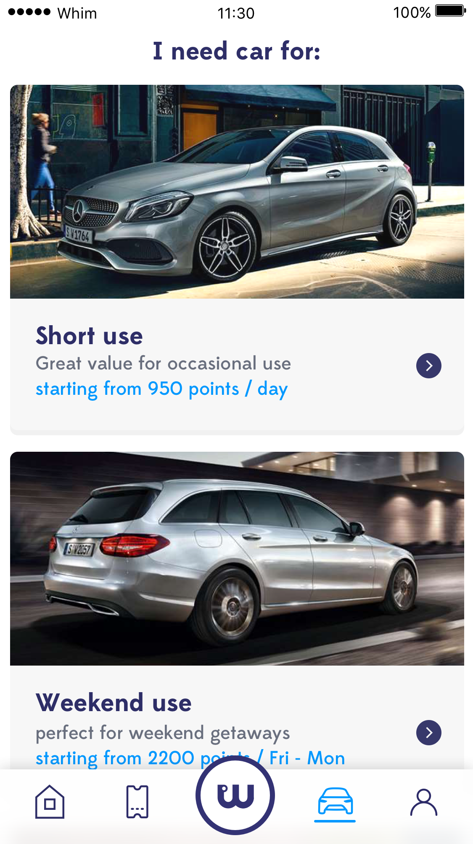
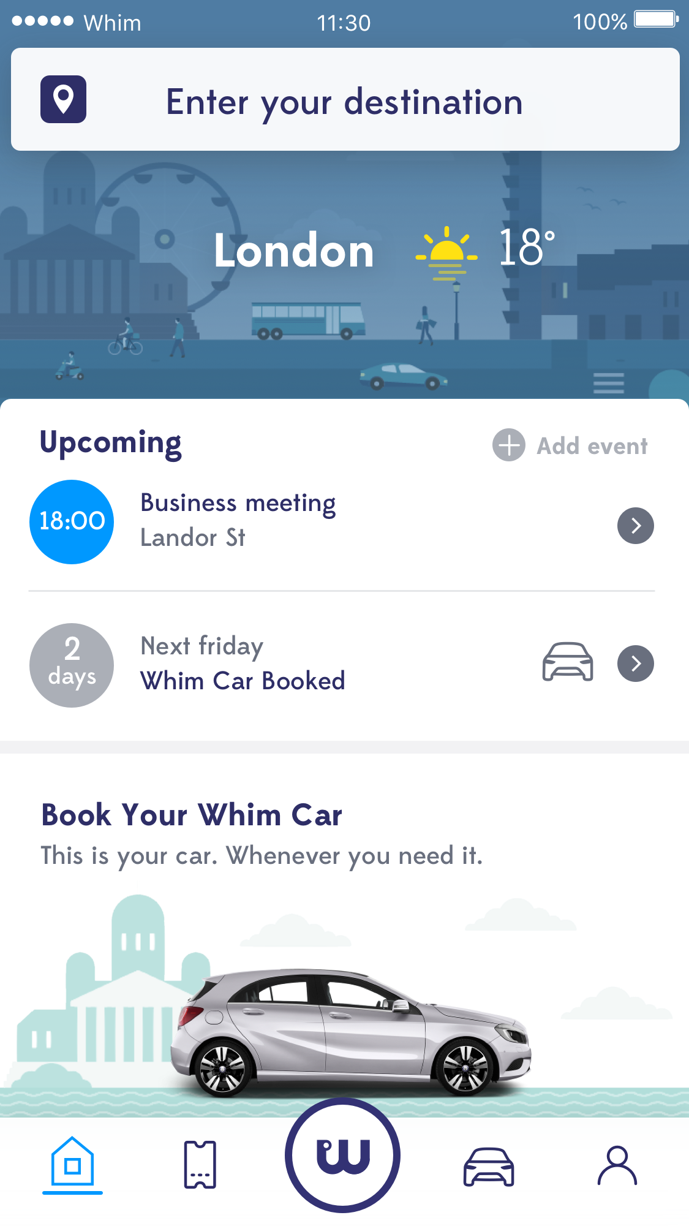

Slide 5
Results from Helsinki

Slide 6
Trips made with Whim in Helsinki before and after Whim*
PT in total
74% of trips
*walking&cycling excluded from the result data, data based on surveys done among Whim users

Slide 7
Spending on transportation services per month*
*”Before” based on a survey executed among Whim users

Slide 8
User Quotes
“I have used Whim now for 2 weeks. This is exactly the kind of service I need. Taxis have arrived and Bus tickets have worked”
“I like the playfulness in the UI”
“Taxi and Bus trips have been executed nicely”
“Whim can find my location and optimize my routes”
“The taxi view is pleasant for the eye”
“I have had great experiences with having taxi drives with Whim!”
“I feel the best solution for my transport is to leave private cars out, Whim seems to be the best solution”
“As a positive test result: I used Sixt-rental cars through Whim and the whole chain from renting the car to returning the car worked perfect”
“Perfect ride with taxi to the Länsisatama port with Whim”
“Taxis seems to be now better informed of how to handle me as whim customer :)“
“One taxi even greeted me with a welcome and my full name :)”

Slide 9

What does a MaaS operator need?
Step 1: Contracts between transportation providers and MaaS operators to buy transportation from at least:
Public transport (urban, intercity)
Taxi or taxi-like service
Access to car (car share, car rental etc.)
Step 2: API’s allowing 3rd party service providers including
Information about transportation services (timetables, routing, locations, disturbances etc.)
Background payment, hailing, ticketing, validation.
To learn more about technical integrations for MaaS, go to: www.maas-api.org
From cities there is no need financing, just co-operation and active enabling.

Slide 10
Common interchange definitions help drive MaaS business forward, by enabling consumer choice
Mobility Data Interchange
Whim Apps
Routing
Traffic Operator
Traffic Operator
Traffic Operator
Transport Operator
Whim backend
APIs – Booking, Ticketing, Roaming
Other Provider
Weather
Payment
APIGW
Identity
Commercial Agreements
Rule Engine
Customer Portal
Ticketing Definitions
Trust Model

Slide 11

Cities and governments to own the market vision

Slide 12

SEE WHIM LIVE NOW www.whimapp.com
www.maas.global
SAMPO HIETANEN
CEO and Founder, MaaS Global Ltd
sampo.hietanen@maas.global
+358 40 565 7688

