Slide 1


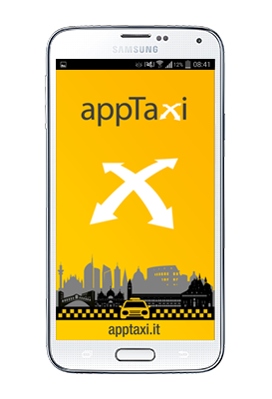
appTaxi on MaaS
3 May 2017
Brussels
Bologna, first Taxi Mobility as a Service (MaaS)
pilot in Italy

Slide 2

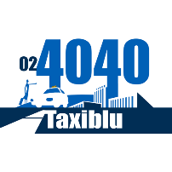


















About appTaxi
We are a business network that include the major Italian taxi companies, now we have 19 associated members.
The consortium was born with the aim to create a new mobility model in Italy.
We develop and promote:
- Technological integration
- Commercial and technological partnerships
- Mobility solutions on the territory
We started by taking over the homonym mobile application appTaxi, born in April 2012, and developing interconnections between different taxi technological realities to increase the coverage, today we connect with 4 different providers of taxi technology.
We have also invested and relaunched appTaxi, integrating innovative services and important collaborations.
With appTaxi, the user can pay the taxi in many ways (such as using bitcoin), and accumulate loyalty points for each taxi ride.
On 2016, we released the first API interface to connect all our associated taxi company to new external services of mobility.
Presentation: Bologna first MaaS pilot with taxi API in Italy - Brussels 3 May 2017

Slide 3
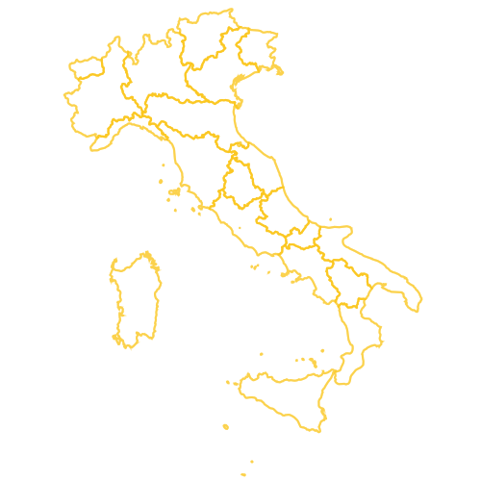




Our Cities & Our Figures
19 Associated
Taxi Companies
Arezzo Bologna Cagliari Castelli Romani Firenze Lignano Milano Modena Monza Padova Palermo Roma Rovigo Siena Torino Treviso Venezia Verona Vicenza
19
Cities Covered
Car & Boat
4898
Regular Taxis
5798
Certified Drivers
239
Employees Call Center
Presentation: Bologna first MaaS pilot with taxi API in Italy - Brussels 3 May 2017

Slide 4



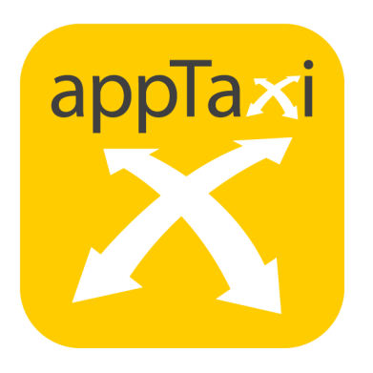
Bologna - first MaaS pilot with taxi API
Through IRU, appTaxi has identified the first partner to develop a project of mobility as a service in Italy that also includes taxis.
myCicero® is a mobile application that has been operating for some years in the multimodal mobility, is widely used in Emilia Romagna and allows the user to schedule and pay the journey from point A to B using different transport systems.
appTaxi, with its partner COTABO, has an extensive fleet at Bologna useful to conduct an intensive test.
Presentation: Bologna first MaaS pilot with taxi API in Italy - Brussels 3 May 2017

Slide 5
The scenarios available to user
(few tester users)
1
Taxi Request realtime booking, calendar booking
2
Taxi Request and Taxi payment
booking and payment through mycicero
3
Payment of taxi taken "on the street"
payment through mycicero
Presentation: Bologna first MaaS pilot with taxi API in Italy - Brussels 3 May 2017

Slide 6
API Technical issues encountered
1
Data Model and Technology Define a data model that allows quick exchange information.
Use an open technology, widespread, safe and scalable.
(REST interface on an HTTP service with OAuth 2.0 user and server authentication)
2
Trusted User Data
Addresses: Derive the positions from declaration of user or from GPS device just switched on? Is the cartography used the same that appTaxi uses or are there different?
Phone: Is the user cell phone number from the third-part application certified? The user mobile number is essential for a taxi ride.
3
Privacy & Brand
Do users know that their data is provided to us, and to our taxi drivers, to carry out the service?
Do users know that the service will be provided by us with our quality and through our investments?
4
Different Requirement The first version of the API that we released, complicates the user experience of the partner application. Simplification is requested.
Presentation: Bologna first MaaS pilot with taxi API in Italy - Brussels 3 May 2017

Slide 7
Conclusion
Our API is not standard and often other developer ask us to modify it or adapt it to their needs before used, this increase costs and time of development.
Taxi service integration requires specific interfaces and adaptation since taxi ride use cases are different from other transport modes cases
MaaS can be the right solution, design data model, scalable, that integrates all the information needed for mobility delivering only the needed at the right time.
Presentation: Bologna first MaaS pilot with taxi API in Italy - Brussels 3 May 2017

Slide 8
Thank You
Speaker:
Alexander Stefan
CTO appTaxi
apptaxi.com Milan, Italy
mycicero is a trademark of:
PluService srl Senigallia, Italy
Presentation: Bologna first MaaS pilot with taxi API in Italy - Brussels 3 May 2017
All trademarks are the property of their respective owners

