Slide 1


Joint Workshop
Mobility-as-a-Service
Implementing New Mobility Schemes:
Impact on Business, Operations & Regulation
May 3, 2017, Brussels
Andreas Hoedl

Slide 2

Our service/our company:
Taxi Dispatcher
Fleet of Cars: About 2000 cars
Availability: 24/7/365 a year
Region: Vienna & Linz
Fast: More than 90% of our customers gain a taxi within 5 min, via Callcenter & App

Slide 3


Offered services in MaaS Field
Taxi
Public transport
Carsharing
Bikesharing
Parking Facilities
Docking Stations
Wayfinder App &
WienMobil App

Slide 4
Wayfinder App &
WienMobil App
Targets of cooperation in MaaS Field:
Optimization of the fleet workload
Reduction of administrative costs
Implementation of individual mobility strategy
To minimize CO2 emission

Slide 5
Advantages/innovation for costumer:
Creating transparency
Increasing efficiency
Reducing barriers
Examples:
Possibility of personalization
One-stop-ticketing
Ticketing via mobile phone possible
Price estimation
Price evaluation regarding different service providers
Information/routing
Wayfinder App &
WienMobil App

Slide 6
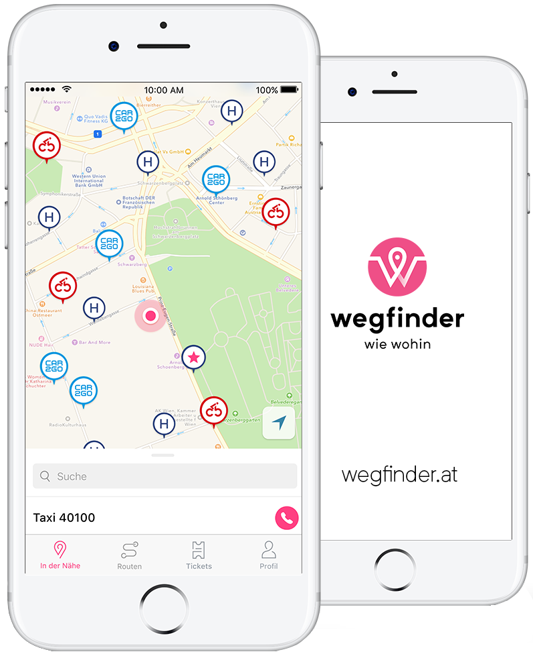
Partner:
Taxi 40100
Taxi 31300
Car2Go
DriveNow
Public Transport (e.g. Wiener Linien, OeBB)
CityBike
NextBike

Slide 7
Legal & Regulatory Challenges in Austria
cab trade vs. livery vehicle
cab trade:
- mandatory tariff-plans for cab trade
- no option to overrun nor to undercut
- no flat pricing
- no consistent method for one-stop ticketing possible
livery vehicle:
- contract of services
- flat price possible
mandatory tariff plan – includes
Basic rate
Time rate
Distance rate
Possible surcharges (e.g. for dispatching)

Slide 8

Thank you for listening!

