Slide 1
Keys to Digitalising the Transport Sector MaaS & Transport Code
Brussels, 3.5.2017
Krista Huhtala-Jenks

Slide 2

Future-Ready Legislation Check-list
What does the end-user want & need?
Who can best cater to those needs?
Whilst ensuring societal needs?
Ѵ Holistic approach to the transport system
Ѵ Enable digitalisation
Ѵ Link MaaS to wider context
Ѵ Allow innovation & automation
Ѵ Policy goals

Slide 3






More Competition - Better services
EASIER MARKET ACCESS, ROOM FOR INNOVATION
less red tape
streamlining across modes & services
technology neutral rules

Slide 4

Behavioural Change
MAAS OPERATORS
TRANSPORT
APIs,
OPEN DATA
AGGREGATORS
BACK OFFICE COMPONENTS
TRANSPORT MODES,
(NEW) SERVICES
INTEGRATES AVAILABLE OPTIONS & PAYMENT
COMPREHENSIVE
”TRAVEL AGENT”
ENABLING ACCESS
Regulation + Technological development

Slide 5


streamlined (de+re) -regulation
open competition, smart incentives
Multiple business models, integration, tools to react
Notes:
As we are the Ministry of Transport and Communications and representing the public sector I must say that we see that first of all the main role of the public sector is to enable development, remove obstacles and support interoperability.
Streamlining legislation, or deregulation, is another one of our government’s key projects. Its goal is to facilitate business operations and citizens’ everyday lives by means of deregulation and the modernisation of regulation. This will support growth, strengthen competitiveness and promote digitalisation.
Creating a growth environment for digital business operations is another of the key projects of the Government Programme.
The creation of innovation and service platforms will be promoted in sectors where the public administration plays a role in terms of the functioning of the markets.
Enterprising, open competition and smart incentives will generate growth, jobs and tax revenue as well as business models suitable for both domestic and international market.
Transport as a service is an example of such a sector. User-based digital services play an important role for the Finnish economy and growth.

Slide 6
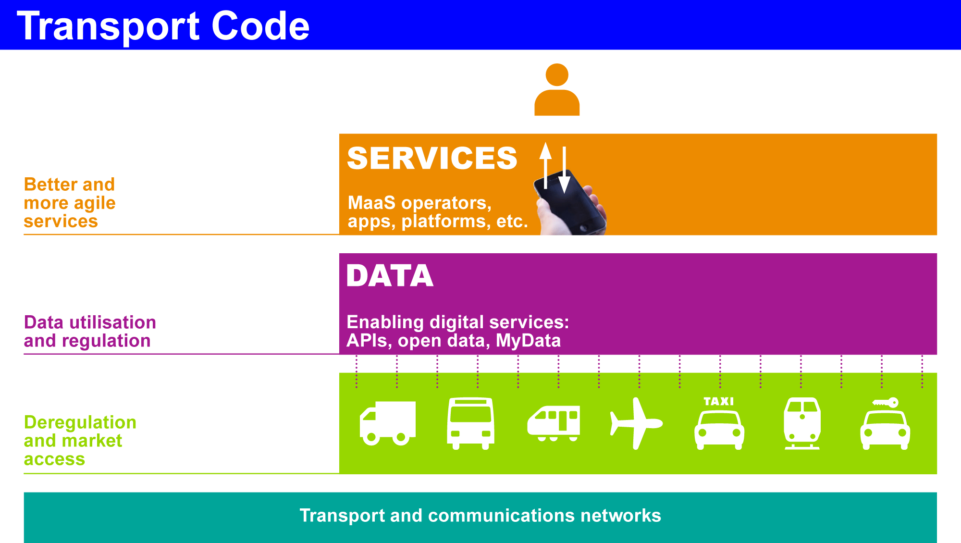
Into force 1 Jan 2018
Into force 1 July 2018

Slide 7




Completing the Multimodal Approach
Phase II

Slide 8
Digitalisation in a Multimodal Framework
Promoting MyData for accessing and sharing personal data
User first
Revised Payment Services Directive (PSD2)
Possible to do the same in the transport sector!
Phase II

