Slide 1
Taxis, the first and last mile of MaaS
3 May 2017
Sonila Metushi, Manager – Mobility of People & Taxis

Slide 2



This is the IRU
Freight Transport
Bus and Coach
Taxis

Slide 3

The most dynamic and most respectable global platform of taxi know-how, service provision, training and private sector advocacy

Slide 4


UpTop – the IRU Global Taxi Network
IRU created UpTop, the IRU Global Taxi Network, to promote legal, reliable, high quality and safe taxi services by making use of the latest smartphone technology for taxis.
UpTop has become the world’s fastest growing taxi network with partners on five continents and 500,000 taxis representing more than 12% of the worldwide taxi market.

Slide 5

Dispatching
Safety
Service Quality
Fares & Payment
No discrimination
Accountability
Lawfulness

Slide 6

Use your local taxi app anytime & anywhere in the world

Slide 7
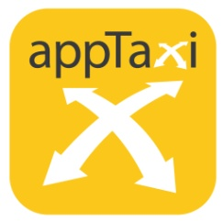






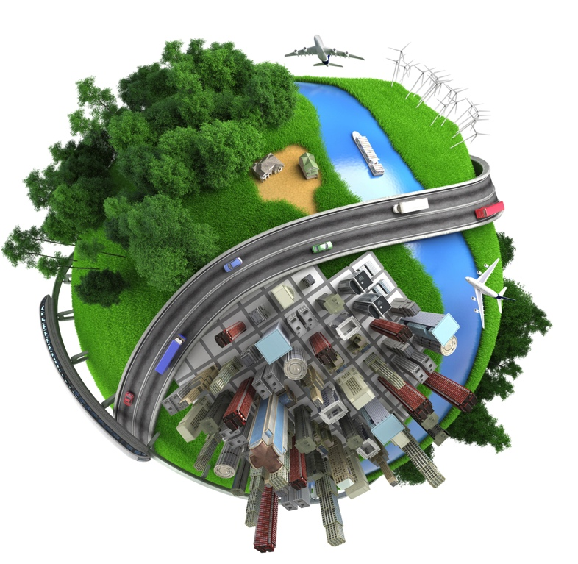









Partners

Slide 8





Taxis, the first and last mile of MaaS

Slide 9



IRU facilitates integration with MaaS
myCICERO
MaaS platform
Italy
UpTop Partner

Slide 10

Taxi of the Future
IRU has initiated an intensive and inclusive broader reflection on new mobility patterns and business models within the
on-going digital revolution, together with partner authorities, regulators, researchers, businesses and indeed all interested stakeholders

Slide 11
For more information:
Sonila Metushi
sonila.metushi@iru.org

