Slide 1
MaaS workshop
Suzanne Hoadley, Polis

Slide 2
Polis & MaaS
Monitoring from a distance – much hype at EU level but not a big issue locally
Local authorities do buy into principles of shared mobility, demand responsive transport and reducing car use/ownership
Main observations:
Technology (data) and taxi/car share driven – public transport largely absent
First/last mile active travel missing – sold as door to door service
Many MaaS objectives and building blocks already being delivered by local authorities

Slide 3
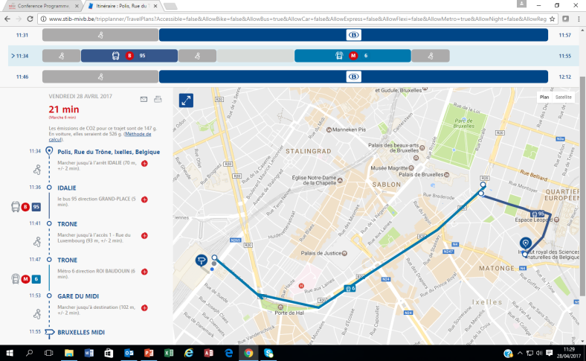
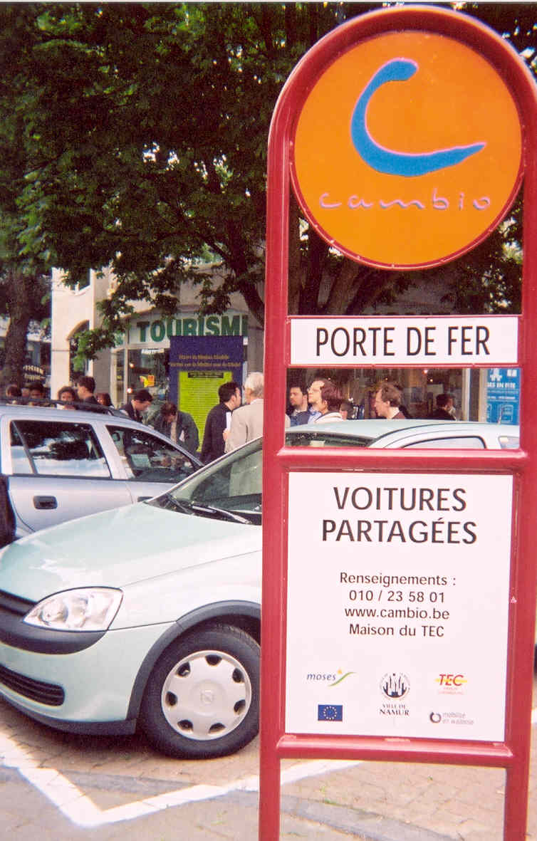
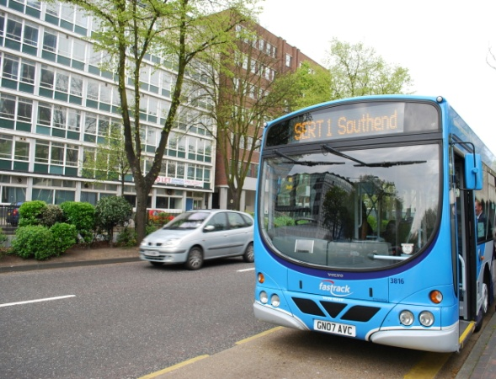
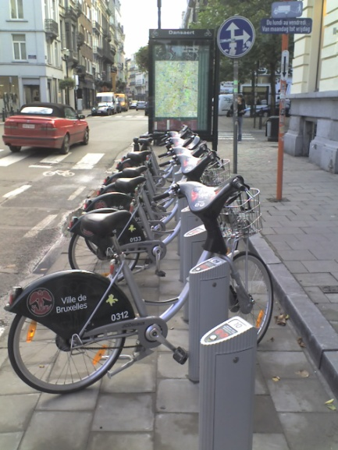


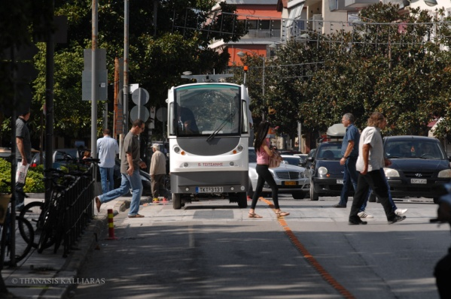
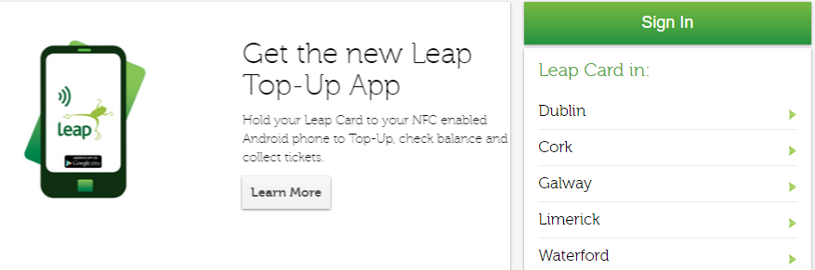
Delivering integrated mobility services is not new to local government

Slide 4
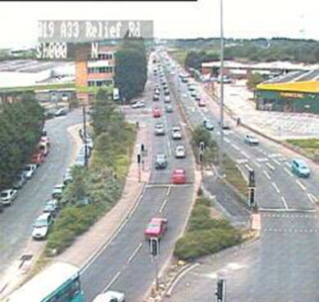
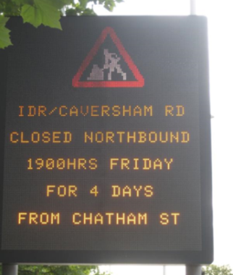
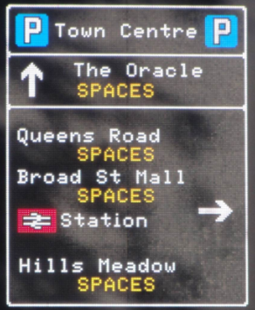

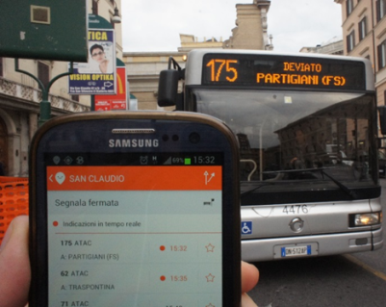


Open data is happening
Growing momentum for opening up transport data
Transparency Outreach
Innovation Economic benefit
Reduce costs Optimal use of network
More and more local authorities are committing to open transport data where technically, legally and financially feasible
Local authority is not always owner of data
Systems not designed for publishing data
Limited resources and skills – local authorities are not data managers

Slide 5
So then, what is MaaS and what is its added value?
MaaS is a brokerage platform not a transport service
What is needed to make MaaS happen?
Transport services
Access to data
Commerical agreements
Users
What can MaaS deliver above and beyond current (integrated) transport information and payment services?
Private transport service providers, eg, taxis, private car-share
Different mobility packages

Slide 6
Some preliminary Polis views on MaaS
Positive where MaaS can support sustainable transport practice:
prevent and reduce car ownership and car trips, increase vehicle occupancy, maintain/increase public transport patronage, promote active travel
Enable improved accessibility and a more efficient service than traditional public transport in specific circumstances, such as where demand is low and dispersed (rural areas)
Concerns that MaaS may lead to:
Greater number of trips that are less sustainable
Higher costs for the user or the transport provider
Disconnect between the user and the transport provider

Slide 7
Key issues and questions
What should be the role of the local authority?
To what extent should travel planning/booking/payment be left to the private sector? Where is the right balance?
Customer-centric principle: deliver better customer experience but not at any cost – collective need takes precedence over individual need
What is the impact of MaaS on travel behaviour?
How to avoid a MaaS monopoly?
What is the business model? Who will pay?
Could MaaS affect way in which transport authorities tender transport services in the future?

Slide 8
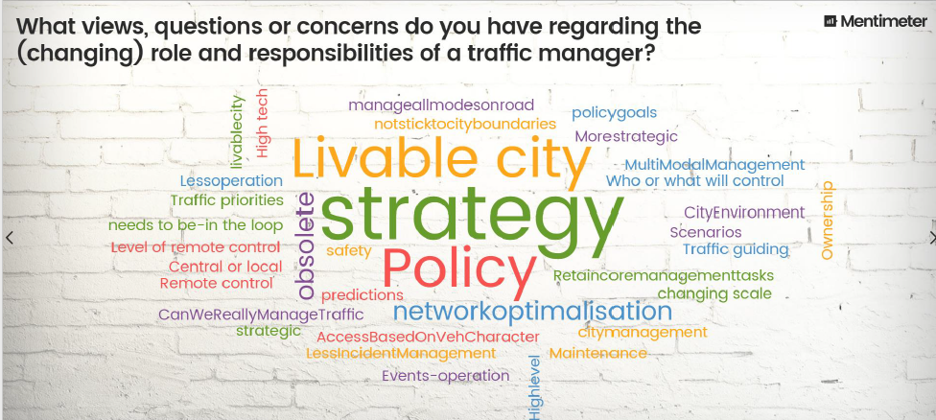
Suzanne Hoadley
shoadley@polisnetwork.eu
www.polisnetwork.eu

