Slide 1
End Users Working Group
Members/Contributors (so far): Maria Kamargianni, UCL, m.kamargianni@ucl.ac.uk
Catherine Kargas, MARCON, ckargas@marcon-net.com
Gabriel Simcic, FIA, gsimcic@fia.com
Jana Sochor, Chalmers University of Technology, jana.sochor@chalmers.se; jana.l.sochor@gmail.com
Sue Zielinski, University of Michigan, susanz@umich.edu

Slide 2
Objective of the End Users WG
“Identify end user-related best practices, gaps, opportunities and actions related to emerging MaaS systems”
Focus areas include: service and design, economics and finance, social inclusion, and environmental sustainability.

Slide 3
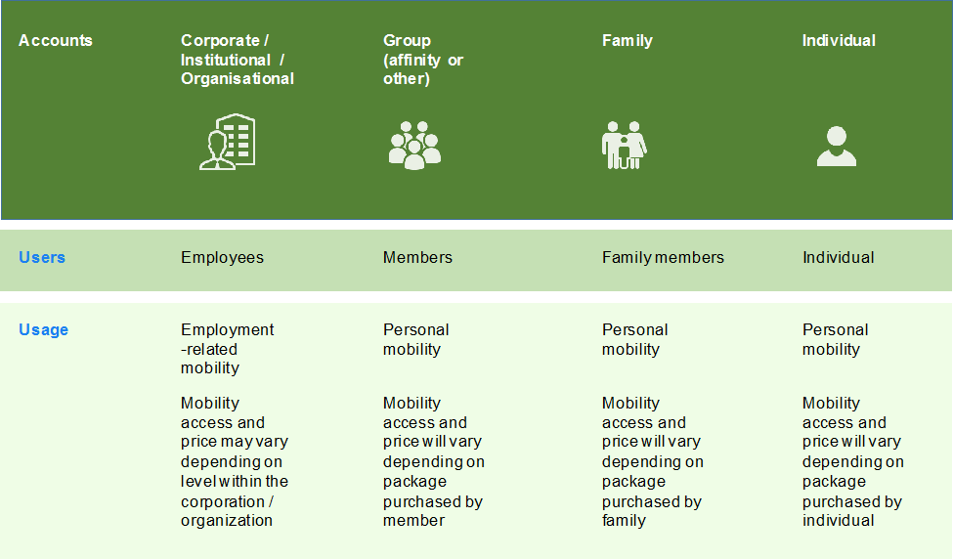
WG Report progress update
Draft WG Report available (projectplace)
End user = an individual person using (traveling with) mobility services
(vs. customers, stakeholders)

Slide 4

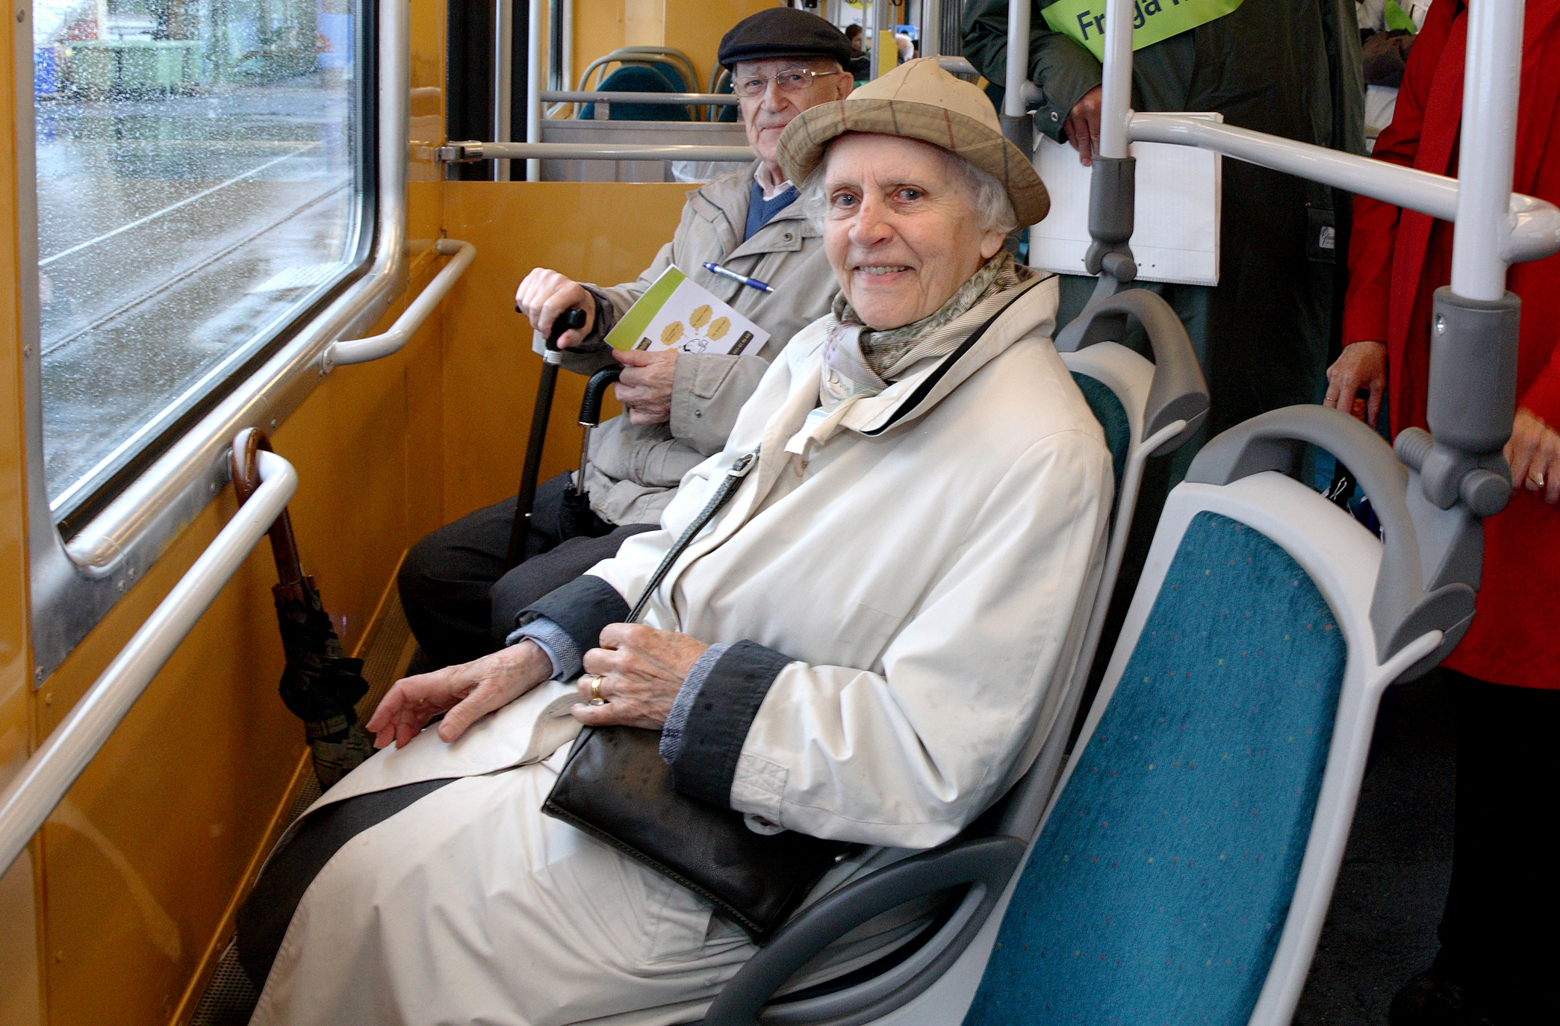

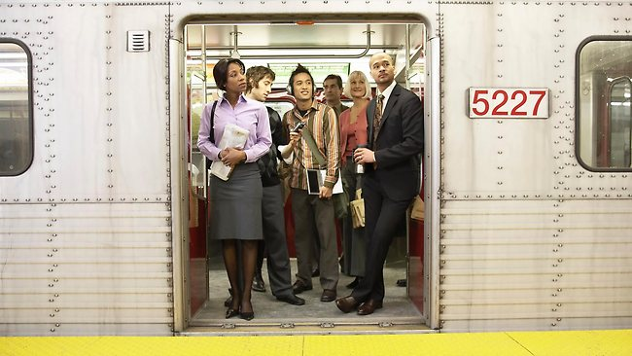
Notes:
MaaS is a user-centric, customer-centric, market-centric proposition within a societally grounded context. This is a fundamental principle and core motivation behind developing and offering MaaS systems. MaaS should be the best value proposition for users, because it helps them meet their basic access needs and solves the ‘pain points’ of journeys (e.g. congestion, disruptions, safety and security risks, and prohibitive or inconsistent costs) In this light, end users are the focus of the ‘Service’ in MaaS, and all other elements are enablers (i.e. technology, policy, business models, land use and physical design, and legislation). In fact, even “mobility” is an enabler, the end goal being “access” or meeting needs and aspirations of the user.

Slide 5

WG Report progress update
Proposed MaaS principles
MaaS is user-centric
Users of public/private transport modes are the same people
MaaS should aim to combine public and private modes
MaaS is a ‘service promise’
MaaS is mode/service/technology agnostic

Slide 6
WG Report progress update
MaaS enablers:
Integrate / connect
Physical space
Remove existing barriers
Ensure usability
“App-like” and “On-demand”
Simple communications and interactions
Not just Tech but also “Human touch”
“Social Feedback”
Innovative business models and financing mechanisms
Use perks and rewards, including “gamification”.
Enhance and capitalise on end users’ assets – enable the end user to also be a provider / earner
Social inclusion and accessibility in MaaS
Mobilise policy / governmental incentives for end users (vs providers)

Slide 7
A ‘Bill of Rights’
Data protection (consent, privacy, ownership, compliance)
Convenience and quality (service promise, assistance, mobility roaming)
Accessibility (non-discrimination)
Cost and financial aspects (no lock-in, monitoring and informing users about cost, value for money)
Environmental (inform users about footprint)

Slide 8
Links with Other WGs
WG1 (single market): Ensure “Mobility roaming”
WG3 (legal and incentives): data protection principles in the “Bill of Rights”; address implications for insurance and liability; favour end-user incentives
WG4 (technical): enable “seamlessness”; ensure “cyber security”.

Slide 9
Next Steps?
Gather input from (non end user) WG MaaS Alliance members as well as MaaS stakeholders
Update as new MaaS projects and services take place
Move “Bill of Rights” further: endorsement of cities / MaaS operators?

Slide 10
Share your thoughts with us
Julie Castermans, ERTICO, j.castermans@mail.ertico.com
Maria Kamargianni, UCL, m.kamargianni@ucl.ac.uk
Catherine Kargas, MARCON, ckargas@marcon-net.com
Gabriel Simcic, FIA, gsimcic@fia.com
Jana Sochor, Chalmers University of Technology, jana.sochor@chalmers.se
Sue Zielinski, University of Michigan, susanz@umich.edu

Slide 11
Let’s Keep it going!

