Slide 1


Trade & Transport Facilitation by Digitalization

Slide 2
Content
1
Paperless Customs Clearance
2
CTOP Initiative
3
TIR-EPD

Slide 3
CHINA CUSTOMS
1
Paperless Customs Clearance

Slide 4
Paperless Customs Clearance
97.4% paperless
2017
over 90% paperless
2015
a pilot reform of export classification clearance in
15 major customs districts
2009-2012
the concept of "paperless customs clearance"
was raised
2001-2002

Slide 5
CHINA CUSTOMS
2
CTOP Initiative

Slide 6
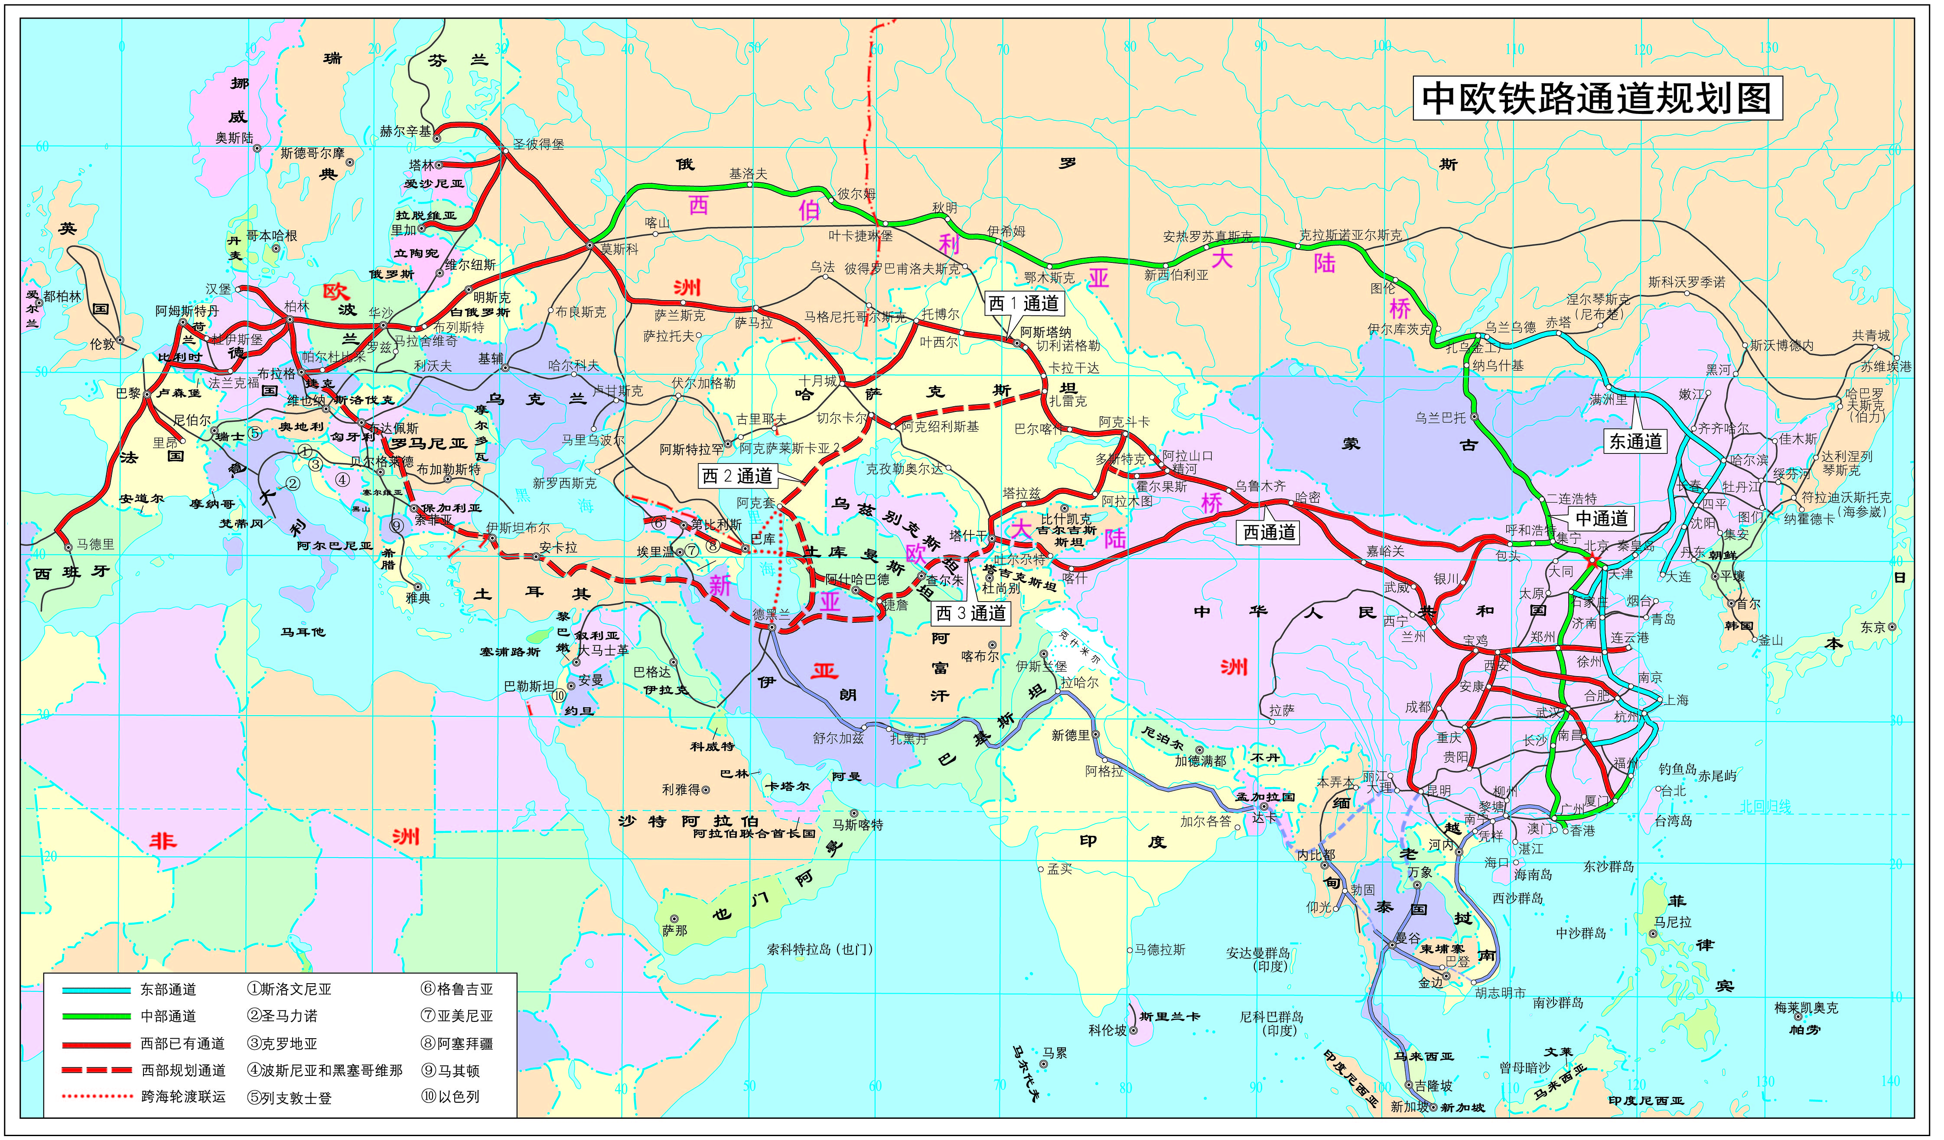
CR-Express Network

Slide 7










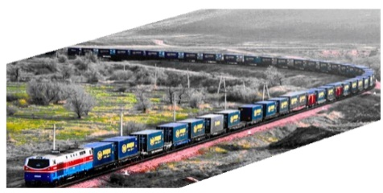



global navigation satellite system
Customs office of departure
seal the lock
waybill
Scanner image
International mail
inspection documents
Hand-held Security and Smart Lock Reader
Data Exchange Platform
unseal the lock
All Customs En route
hand-held reader

Slide 8
CHINA CUSTOMS
3
TIR-EPD

Slide 9
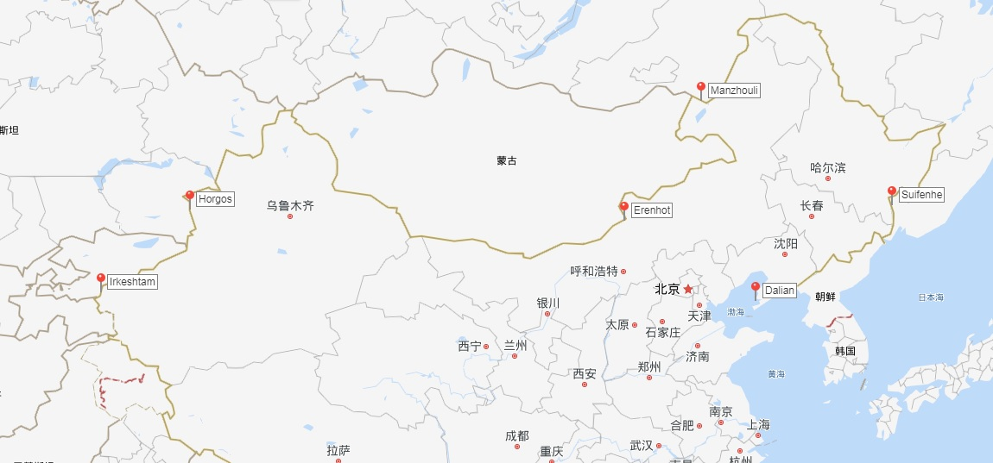
TIR Crossing Points in China

Slide 10
TIR-EPD
TIR-EPD
Launched TIR
TIR – EPD Study √
Tech Basis √
IT staff …
coming soon...
Joined TIR
In May 2018
launched the implementation with 6 crossing points available
In 2016 joined the TIR convention;
In 2017 came into force;
GACC completed preparatory work.

Slide 11
Thank You !

