Slide 1
UNECE-IRU
TIR computerization Project
Georgia's progress, Opportunities and Challenges
Tax and Customs Administration
SPS Border Control Agency of Georgia
2017
2016

Slide 2
Progress
May 2017 during TIR digitalization workshop the initiative on eTIR multimodal corridor has been proposed by Georgian customs
June 2017, in the framework of the WCO IT conference Director General of GRS has officially confirmed its readiness to participate in the project.
March 2018, triple MoU between GRS, IRU and GIRCA (National Association) has been signed, serving as legal bases for participation in the project, followed by
May 2018 Main Principals of the TIR digitalization project signed by GRS, focal point appointed
Amendment to the Order “On Approval Instruction for Movement and Clearance of Goods on the Customs Territory of Georgia” will ensure that electronic messages/information fully replace the paper TIR Carnet

Slide 3




INTERNATIONAL COOPERATION AND INFORMATION EXCHANGE
Legal bases
Protocol between the Customs authorities of Georgia and Ukraine on exchange of information of goods and transport means crossing the borders of Georgia and Ukraine
Agreement between Governments of Georgia and Republic of Azerbaijan on administrative assistance in customs matters
Agreement between Ministries of Finance of Georgia and Kazakhstan to organize the exchange of preliminary data about transportation and goods transfer between two countries;
GUAM Initiative on Advance Exchange of Customs Information
(Georgia, Ukraine, Azerbaijan, Moldova)
Notes:
Online data exchange on clearance of customs declarations, both export and import between Georgian and Ukraine customs administration is operational since 2010. Information used by risk management is useful especially for pre-arrival analyses.

Slide 4
TIR statistics for the corridor countries (2017) including customs offices of departure, en-route and destination
Total :15 577
31% of all TIR operations in Georgia

Slide 5
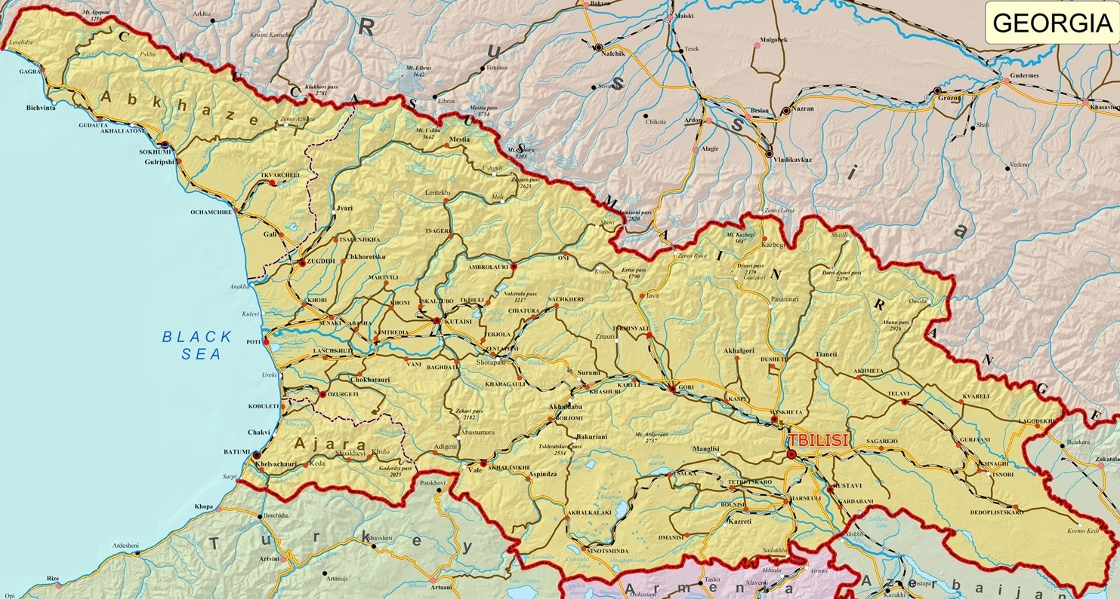
Customs Offices of Exit and Entry that will be
involved in the corridor- 6 Customs Crossing Points
GANTIADI
KAZBEGI
ROKI
KULEVI
SENAKI
AIRPORT KUTAISI
POTI SEA PORT
BATUMI SEA PORT
LAGODEEKHI
BATUMI AIRPORT
AIRPORT TBILISI
SARPI
GARDABANI
Kartsakhi-Railway
MTKVARI
NINOTSMINDA
AKHKERPI
RED BRIDGE
SAMTATSKARO
SADAKHLO
GUGUTI

Slide 6
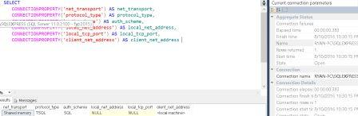

Where we stand
Georgia started working on the messages implementation.
Target date for development all messages before putting into test version: end of Summer 2018
End of September to move from test to production
e

Slide 7
THANK YOU FOR YOUR ATTENTION
Irina Sigua
Advisor Department for International Relations
Georgia Revenue Service

