Slide 1
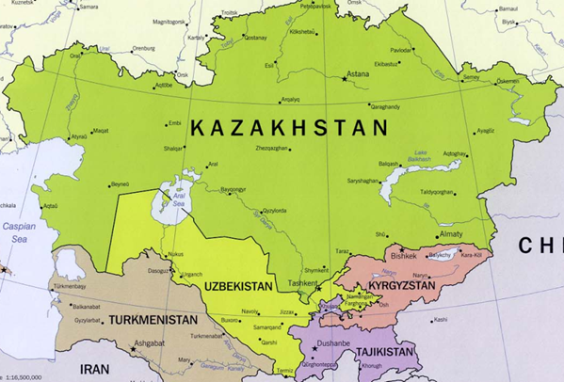
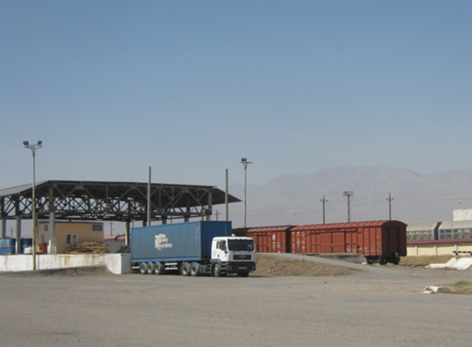
International trade and transport facilitation through digitalization

Slide 2
Digital transformation: GIZ vision worldwide
triggers fundamental changes in the realms of economy, politics and society
revolutionizes the way for the state to communicate with its citizens
must revolve around people, not technology and create added value, not additional work
Notes:
Our cooperation partners as well as other implementing agencies are realigning their work accordingly and already take advantage of these new opportunities.
Digital transformation started in 2015

Slide 3
Regional Program:
Trade Facilitation in Central Asia
4 countries of Central Asia: Kazakhstan, Kyrgyzstan, Tajikistan and Uzbekistan.
Timeframe: January, 2017- December, 2019.
Partners: Ministries of Economy, Customs Administrations

Slide 4
Program objective and intervention areas
Risk Management in customs
Transit & transport
Private sector in regional trade facilitation
Trade-oriented companies in Central Asia benefit from cost-cutting measures for trade facilitation

Slide 5
TFCA measures on digitalization
Area of intervention | Digitalization measures
Risk Management in Customs | Support to modernization of Unified Automated Information System in KG, KZ, TJ and UZ
Transit & transport | TIR-EPD implementation with emphasis on Preliminary Information at Customs for Advance Cargo Information transmission - Jointly with IRU and national associations Open to support customs procedures optimization and automation
Private sector in regional trade facilitation | Regional trade information portal for Central Asian countries Electronic catalogue of national standards for goods in KZ (regional expansion)

Slide 6
Trade Facilitation:
German technical assistance worldwide
German Aid for trade and Agenda 2030
The Global Alliance for Trade Facilitation as the unique public-private partnership dedicated to international trade facilitation
GIZ as the development agency assists developing countries to implement TFA
Other development agents: ADB (CAREC), IFC, USAID, SECO, EU BOMCA

Slide 7
Thank you for your attention!

